Slide 1

MONEY MATTERS:
UL SYSTEM FINANCIAL WELLNESS SERIES
Session #4
Investing for International
Students, Faculty & Staff
July 20, 2022

Slide 2
Brian Bolton
Professor of Finance brian.bolton@louisiana.edu http://business.louisiana.edu/financeispersonal

Slide 3
Owning Your Financial Future
INVESTING GOALS, HABITS & STRATEGIES
Today, June 22
BUDGETING & DEBT MANAGEMENT
Wednesday, July 6
INVESTING FOR RETIREMENT,
EDUCATION & SPECIAL EVENTS
Wednesday, July 13

Slide 4
Owning Your Financial Future
INVESTING for INTERNATIONAL FACULTY,
STUDENTS & PROFESSIONALS
Wednesday, July 20
TAX PLANNING
(for budgeting, investing & retirement)
Wednesday, July 27
CAREER PLANNING: YOUR MONEY & YOUR FUTURE
Wednesday, August 3

Slide 5
Owning Your Financial Future
Structure of each session:
  Open question & answer session
  Brian presents specific guidance and ideas for the session’s topic
  Open question & answer session…about any topics you wish to discuss

Slide 6
Happiness
Long-Term Goals
Short-Term Goals
Financial Needs
Family Needs

Slide 7
Financial Wellness
A goal without a plan is just a dream.
Wealth is largely the result of habit.
The most difficult thing is the decision to act; the rest is mere tenacity.
It takes as much energy to plan as it does to wish.
You cannot escape the responsibility of tomorrow by avoiding it today.

Slide 8
This is exactly how most of us think about other priorities in our lives: family, career, education.
Let’s try to have the same thinking for our financial lives.
A goal without a plan is just a dream.
Wealth is largely the result of habit.
The most difficult thing is the decision to act; the rest is mere tenacity.
It takes as much energy to plan as it does to wish.
You cannot escape the responsibility of tomorrow by avoiding it today.

Slide 9
A Few Opening Morals
You cannot escape the responsibility of tomorrow by avoiding it today.

Slide 10
What Are Your Values, Dreams & Goals?
Education
Career
Family
What Is Your Current Situation?
Education
Career
Family
Financial

Slide 11
Create a Personal Financial Plan for You:
Investing
Budgeting
Debt Management
Taxes
Insurance
Retirement
Education
Family
Business Planning
Philanthropy
Estate Planning

Slide 12
What Are Your Values, Dreams & Goals?
Education
Career
Family
What Is Your Current Situation?
Education
Career
Family
Financial
Create a Personal Financial Plan for You:
Investing
Budgeting
Debt Management
Taxes
Insurance
Retirement
Education
Family
Business Planning
Philanthropy
Estate Planning

Slide 13
What Are Your Values, Dreams & Goals?
Education
Career
Family
What Is Your Current Situation?
Education
Career
Family
Financial
For many international students, faculty & staff,
each of these may be highly uncertain.
Both your goals and your current situation may be influenced and controlled by situations or decisions that seem far out of your control.

Slide 14
A Few Opening Morals
HAVE A PLAN!
And then have a few back-up plans.
CONTROL WHAT YOU CAN CONTROL.
And then adjust as circumstances change.
FOR STUDENTS…COMPLETE YOU DEGREE.
Your education has to be your top priority.
Find mentors – faculty or students – who have been through what you’re going through.

Slide 15
A Few Opening Morals
SAVINGS
INVESTING
WEALTH
(and freedom, options & opportunities)

Slide 16
From an International Perspective…
SAVINGS
INVESTING
It might sound rudimentary, but managing your budget and actively saving is one thing you can control.
If uncertainty is the enemy, having control over your income and expenses can give you more short-term control over your situation.
YES, you can invest in the U.S.
You may or may not want to, until you have greater short-term control over your situation, but you generally have all the investment options as a permanent resident of the US would have.
OPPORTUNITY
(and freedom, options & wealth)

Slide 17
From an International Perspective…
Budgeting is critical.
Always watch exchange rates.
Income taxes….if you earn income in the U.S., including investment income, you have to pay income tax in the U.S. (or at least file).
If permanent residency is a goal, you have to constantly comply with residency and reporting requirements...to avoid losing the options for permanent residency in the future.

Slide 18
Income & Expense Management
Create a budget on how you will spend your money each month
  Fixed expenses (rent, tuition, books, utilities, food, insurance, car payments, phone bill)
  Discretionary expenses (clothing, entertainment, travel, emergencies)
  Unexpected expenses (medical bills, taxes)
Learn to live within your means (avoid going into debt to maintain your lifestyle). Unpaid debt will follow you everywhere you go.
You have limited opportunities to increase your income, which makes controlling your expenses even more important.

Slide 19
Preparing & Investing for YOUR Future
Prepare and invest in your future - Optional Practical Training, OPT!
If you’re about to graduate, plan to save $410 USD for your OPT application fees.
  OPT is an off-campus employment benefit for F-1 students that have completed their education at an American university.
  Employment has to be related to field of study: https://internationalaffairs.louisiana.edu/current-students/working-usa/optional-practical-training-opt (for UL Lafayette students)

Slide 20
Income Taxes in the U.S.
Filing for income tax:
It’s important to be aware that, as a nonresident student in the US, you’re legally required to file a tax return if you received US income during 2020.
And even if you didn’t work or receive income in the US, you’re still obliged to file a Form 8843 with the IRS.
University of Louisiana at Lafayette has arranged discounted access to Sprintax Tax Preparation for its students. Sprintax guides students through the tax preparation process, arrange the necessary documents and check if you’re due a tax refund.
Sprintax was used by over 225,000 international students and scholars last year, and the average Federal refund received by eligible students was over $1,126.

Slide 21
Income Taxes in the U.S. (Cont.)
Check to see if your University offers discounted income tax preparation assistance. UL Lafayette has a partnership with Sprintax, which is relatively user-friendly for international students and employees.
Register and follow the simple instructions
Complete the online questionnaire
Enter your unique discount code in the box on the ‘Review your order’ page (21ULL100F5 for 2021, to be updated for 2022)
Sprintax will prepare your tax return here: https://taxprep.sprintax.com/?utm_ref=louisiana-edu

Slide 22
Other Common Financial
Challenges for International Students
Health insurance while in school
Costs of Living & Standards of Living
Exchange Rates Always Change
Establishing a Financial Presence in the U.S.
Career Planning
Uncertainty…The enemy of all planning

Slide 23
Other Common Financial
Challenges for International Students
Health insurance while in school
Costs of Living & Standards of Living
Exchange Rates Always Change
Establishing a Financial Presence in the U.S.
Career Planning
Uncertainty…The enemy of all planning
You are required to have health insurance while in school. And your university or employer may not provide this insurance. Shop around, plan ahead.
The U.S. hospital bills and insurance practices may be different from what you’re used to. Ask lots of questions. Never pay before you absolutely have to or before you are absolutely sure of what you owe.

Slide 24
Other Common Financial
Challenges for International Students
Health insurance while in school
Costs of Living & Standards of Living
Exchange Rates Always Change
Establishing a Financial Presence in the U.S.
Career Planning
Uncertainty…The enemy of all planning
Rent, food, insurance and other costs of living may be very different in the U.S.
When you prepare your short- and long-term budgets, make sure you are using U.S. costs and not home costs. Ask for help when in doubt.
Always avoid pressure to live a U.S. standard of living. You are here to get a degree – you can worry about your standard of living once you graduate.

Slide 25
Other Common Financial
Challenges for International Students
Health insurance while in school
Costs of Living & Standards of Living
Exchange Rates Always Change
Establishing a Financial Presence in the U.S.
Career Planning
Uncertainty…The enemy of all planning
You may be receiving financial assistance from home. You may have limited income opportunities in the U.S.
If the U.S. Dollar appreciates, that is probably bad news for you.
I would recommend getting more of your money or source of income in U.S. Dollars to act as a hedge. (I would not recommend getting involved with any complex financial securities that pretend to act as a hedge.)

Slide 26
Other Common Financial
Challenges for International Students
Health insurance while in school
Costs of Living & Standards of Living
Exchange Rates Always Change
Establishing a Financial Presence in the U.S.
Career Planning
Uncertainty…The enemy of all planning
Get a bank account – with checking and savings accounts.
Get a credit card – it will help you build your U.S. credit history.
If you plan to borrow in the U.S., you may have to have someone co-sign on your loans.
Set aside $410 for your OPT as you get closer to graduating.

Slide 27
Other Common Financial
Challenges for International Students
Health insurance while in school
Costs of Living & Standards of Living
Exchange Rates Always Change
Establishing a Financial Presence in the U.S.
Career Planning
Uncertainty…The enemy of all planning
Filing for your OPT should be Step #1, if you plan to stay in the U.S. beyond graduation.
Think ahead and plan ahead for lots of future decisions:
Should you get another degree?
Where will you live?
Should you take a good job with uncertain visa options or a mediocre job with the promise of a visa?
Should you go back home?

Slide 28
Other Common Financial
Challenges for International Students
Health insurance while in school
Costs of Living & Standards of Living
Exchange Rates Always Change
Establishing a Financial Presence in the U.S.
Career Planning
Uncertainty…The enemy of all planning
We can never control uncertainty.
But we can create plans with different scenarios that will make uncertainty less of a surprise when it happens.
What if there’s another pandemic?
What if your advisor retires?
What if the U.S. dollar strengthens?
What if you start a family?
What if you win the lottery?

Slide 29
Some More General Tips
Ask for help!
  In many cases, your best source of information will be international faculty, either in your department or elsewhere.
Plan ahead.
  Uncertainty will be a fact of life. Try to avoid major surprises.
Communicate with family, both in the U.S. and at home.
  In many cases, they are (directly or emotionally) going through this experience with you. Let them help. Share your issues with them.
Finish your degree.
  Given the constraints many of you will have, such as with limits on having a job, completing what you came here for should be your #1 priority.

Slide 30
Happiness
Long-Term Goals
Short-Term Goals
Financial Needs
Family Needs

Slide 31

Isn’t this a lot like what you do with your education planning?

Slide 32
You’ve been doing this with your education for years.
You’re about to begin doing this with your career…and you will continue working through this process for the next 30 or 40 years.
Whether it’s education planning or career planning, by now we know that all of our personal decisions with have financial implications.
The more we plan ahead and integrate our decision-making process, the more control we will have over our futures…and the less money will be a source of stress and the more money will be a source of empowerment.
Isn’t this a lot like what you do with your education planning?

Slide 33
Frequently Asked Question #1
Are international students, faculty and staff
legally allowed to invest in the United States?
Answer: YES!
  In general…as there may be country-specific laws that prohibit such.
This includes opening a brokerage account with Robinhood or Fidelity and buying-selling any financial securities, whether in the U.S. or elsewhere.
  You generally need a visa, taxpayer ID or social security number to open any account.

Slide 34
Frequently Asked Question #1
Are international students, faculty and staff
legally allowed to invest in the United States?
You will owe U.S. income taxes on any profits you make (either short-term ordinary income or long-term capital gains taxes).
You want to be careful that your investing or trading activity does not look like a full-time job.
  It must be passive income, income that you earn as part of a hobby or passive and disconnected strategy.
  The rule of thumb is less than 500 hours-per-year means it’s a hobby, but you probably want to err on the lower end of this to be safe.

Slide 35
Frequently Asked Question #2
Can an international student or employee open an Individual Retirement Account (IRA) or a Roth RIA?
Answer: Yes, probably.
The requirement to open an account is to have earned income in the U.S. (and to also have a social security number or taxpayer ID.)
If you have earned income, you are eligible for the same IRA rules and opportunities as any permanent resident is.

Slide 36
Frequently Asked Question #3
Are international students, faculty and staff eligible for a company-sponsored retirement account, such as a pension or 401(k)?
Answer: YES!
  The university’s human resources department will give you the same enrollment options and responsibilities as any other student.
  In some cases, you may be automatically enrolled…which means money will be taken out of your paycheck (pre-tax) and diverted to a retirement account automatically.
    Check to see if this happens and opt-out if you do not want this – it will decrease the size of your paycheck and it may complicate your financial situation in the future.

Slide 37
Frequently Asked Question #4
What happens to my investment and retirement account assets if I end up leaving the U.S.A. at some point in the future?
Answer: Nothing.
The money will stay in your U.S. account and will stay in the assets you chose to invest in until you decide otherwise.
With retirement account assets, you still cannot withdraw them until
you’re 59 ½ years old without paying taxes and a 10% penalty.
When you sell or withdraw any account assets, you may owe U.S. taxes and you will be paid in U.S. dollars, regardless of where you are living.

Slide 38
Frequently Asked Question #5
Okay, I understand that I am legally allowed to generally invest in the U.S. as an international students, faculty or staff.
But I do not know anything about investing. How do I do it?
If you have a company-sponsored retirement account, your company may assign you with an investment advisor who can help you get started.
Working with your own independent financial advisor can help you put together an investment strategy and give you a lot of peace of mind…but this is going to be the most expensive option.
Or, you can just go it alone and management your accounts and your investments yourself. This is going to be the least expensive option – and perhaps the most fun.

Slide 39
WE DO NOT GIVE INVESTMENT ADVICE
But here are some investment issues to think about:
Do you want to pick individual stocks (or other securities) and monitor them regularly?
  This can help you feel more control, more connection and more personal interest in your investments.
  Advantages: Potential for big gains, maybe a personal connection to the companies, you feel more engaged with the process.
  Disadvantages: Potential for big losses, requires more time and energy, transaction costs (trading, taxes) can add up, there are 1000s to choose from, potential loss of sleep and hair.

Slide 40
WE DO NOT GIVE INVESTMENT ADVICE
But here are some investment issues to think about:
Or, would you be content investing in mutual funds and/or market indexes that pool dozens or hundreds of stocks?
  Advantages: Potential for moderate gains, lower risk (through diversification), lower trading and tax costs, you can narrow down the selection pretty quickly, less loss of sleep and hair
  Disadvantages: Lots of singles and doubles but no home runs, no emotional connection to your investments, susceptible to big market downturns (but not necessarily more than individual stocks)

Slide 41
WE DO NOT GIVE INVESTMENT ADVICE
If you want to invest in individual stocks, I cannot help you.
But if you are interested in market indexes, here are some ideas:
  SPY – The S&P 500 index. 500 of the largest U.S. firms, from all industries.
  SPYD – The same as above, with a focus on those companies that pay regular dividends out to investors from their earnings. You will get more income, but possibly lower long-term capital gains.
  IWM – The Russell 2000. 2000 smaller U.S. firms (the 2000 firms after the 1000 largest firms). More volatility, possibly higher returns.
  EFA – Index of non-US firms (Europe, Far East, Australasia). Big firms.
  EEM – Index of non-US, emerging market stocks. Bigger firms in developing countries. More risk than any of the above.
  GBTC – A Bitcoin index. Invest in Bitcoin without mining or owning. Big Risk.

Slide 42
Investing – How Do You Do It?
When you’re just getting started with investing, there are a few approaches you can take:
  Start with a small amount of money – whether that’s $20 or $2,000 – and just go for it. Pick a few investments, track them regularly and be prepared to buy more or sell more should you feel comfortable doing either.

Slide 43
Investing – How Do You Do It?
When you’re just getting started with investing, there are a few approaches you can take:
  Start with a small amount of money – whether that’s $20 or $2,000 – and just go for it. Pick a few investments, track them regularly and be prepared to buy more or sell more should you feel comfortable doing either.
  Determine how much you have to invest.
    Put ½ of that into an index fund or a specific mutual fund. This will provide some security, generally with less or moderate risk.
    Put the other ½ into individual stocks or securities that intrigue you. If you’re interested in the companies, you might be more likely to follow them as investments.
    This half-half approach will help you figure out what kind of investor you are. In 1-2 years, you might gravitate more to either of the approaches that interest you more.

Slide 44
Investing – How Do You Do It?
When you’re just getting started with investing, there are a few approaches you can take:
  Start with a small amount of money – whether that’s $20 or $2,000 – and just go for it. Pick a few investments, track them regularly and be prepared to buy more or sell more should you feel comfortable doing either.
  Determine how much you have to invest.
    Put ½ of that into an index fund or a specific mutual fund. This will provide some security, generally with less or moderate risk.
    Put the other ½ into individual stocks or securities that intrigue you. If you’re interested in the companies, you might be more likely to follow them as investments.
    This half-half approach will help you figure out what kind of investor you are. In 1-2 years, you might gravitate more to either of the approaches that interest you more.
  Talk to a financial advisor. Note that they generally do not (initially) tell you which specific investments to make, but they will work talk through your options with you and help you better understand what you’re getting into.
    They will ask you 2 questions – what are your goals and what is your risk tolerance – and then work with you to find the investments that best align with your answers to these questions.

Slide 45
Investing for Success
If you hire an investment or financial advisor, when you first meet with them they will ask you 2 questions:
  What are your investing goals?
  What is your risk tolerance?

Slide 46
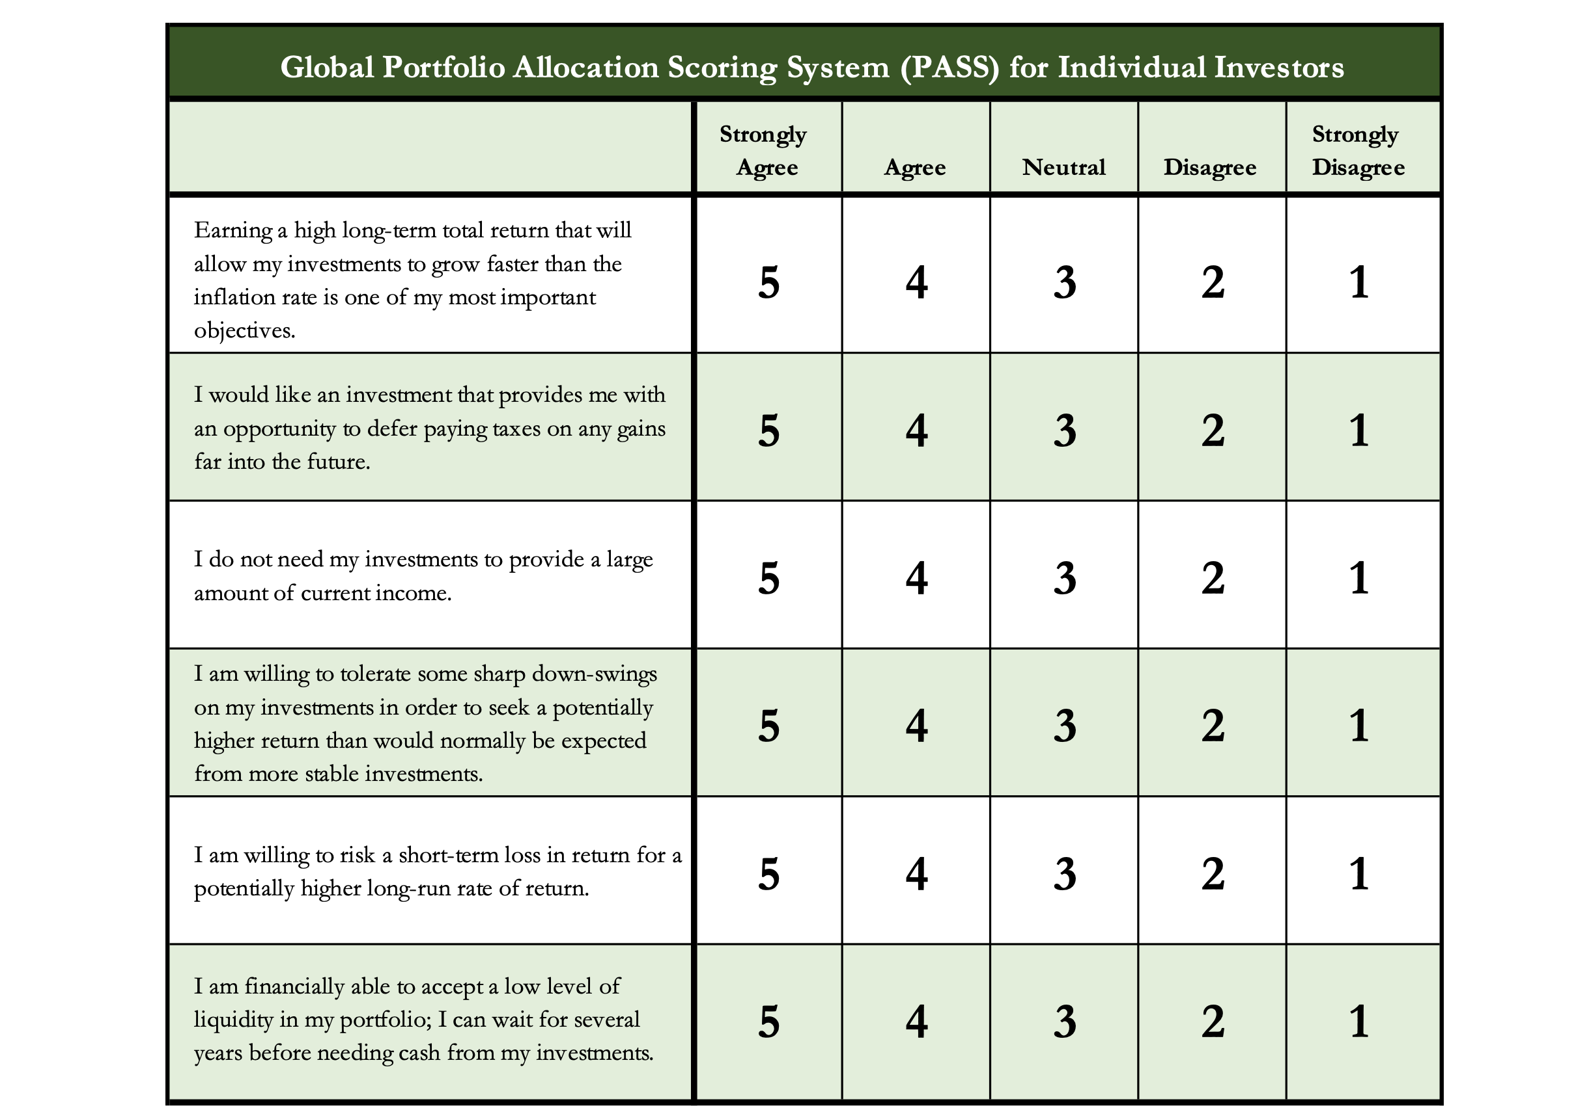
Determining Your Risk Tolerance

Slide 47
Determining Your Risk Tolerance
High Risk Attitude
I want to summer in Paris and winter in Hawaii
Medium-High Risk Attitude
I will work through normal retirement age, but I want my spouse to retire early - and we want to visit Paris & Hawaii
Medium-Low Risk Attitude
I want my children to have a college education
Low Risk Attitude
I want food on the table and a roof over my head

Slide 48
Comparing Different Investments

Slide 49
Comparing Different Investments

Slide 50
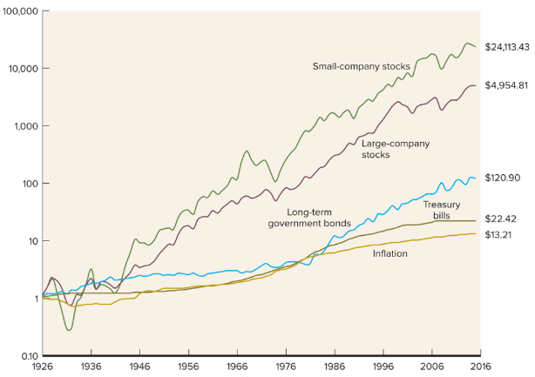
Comparing Different Investments

Slide 51
Comparing Different Investments
Investing $1,000 at different interest rates…
@1% @3% @5% @10%
After 1 year $1,010 $1,030 $1,050 $1,100
After 3 years $1,030 $1,093 $1,158 $1,331
After 5 years $1,051 $1,159 $1,276 $1,611
After 10 years $1,105 $1,344 $1,629 $2,594
After 25 years $1,282 $2,094 $3,386 $10,835

Slide 52
Comparing Different Investments
Investing $1,000 at different interest rates…
@1% @3% @5% @10%
After 1 year $1,010 $1,030 $1,050 $1,100
After 3 years $1,030 $1,093 $1,158 $1,331
After 5 years $1,051 $1,159 $1,276 $1,611
After 10 years $1,105 $1,344 $1,629 $2,594
After 25 years $1,282 $2,094 $3,386 $10,835

Slide 53
Comparing Different Investments
Investing $1,000 at different interest rates…
@1% @3% @5% @10%
After 1 year $1,010 $1,030 $1,050 $1,100
After 3 years $1,030 $1,093 $1,158 $1,331
After 5 years $1,051 $1,159 $1,276 $1,611
After 10 years $1,105 $1,344 $1,629 $2,594
After 25 years $1,282 $2,094 $3,386 $10,835

Slide 54
Comparing Different Investments
Investing $1,000 at different interest rates…
@1% @3% @5% @10%
After 1 year $1,010 $1,030 $1,050 $1,100
After 3 years $1,030 $1,093 $1,158 $1,331
After 5 years $1,051 $1,159 $1,276 $1,611
After 10 years $1,105 $1,344 $1,629 $2,594
After 25 years $1,282 $2,094 $3,386 $10,835

Slide 55
Comparing Different Investments
Investing $1,000 at different interest rates…
@1% @3% @5% @10%
After 1 year $1,010 $1,030 $1,050 $1,100
After 3 years $1,030 $1,093 $1,158 $1,331
After 5 years $1,051 $1,159 $1,276 $1,611
After 10 years $1,105 $1,344 $1,629 $2,594
After 25 years $1,282 $2,094 $3,386 $10,835

Slide 56
Long-Term Investment Planning
YOUR VALUES
YOUR GOALS
FINANCIAL STRATEGIES
INVESTMENT STRATEGIES
Identify Your Risk Tolerance
Identify Your Time Horizons
Select Investments
Monitor & Modify Investments

Slide 58
Don’t wait around for other people to be happy for you.
Any happiness you get,
You’ve got to make yourself.
~ Alice Walker, poet & novelist
A goal without a plan is just a dream.
Wealth is largely the result of habit.
The most difficult thing is the decision to act; the rest is mere tenacity.
It takes as much energy to plan as it does to wish.
You cannot escape the responsibility of tomorrow by avoiding it today.

Slide 59
Owning Your Financial Future
INVESTING GOALS, HABITS & STRATEGIES
Today, June 22
BUDGETING & DEBT MANAGEMENT
Wednesday, July 6
INVESTING FOR RETIREMENT,
EDUCATION & SPECIAL EVENTS
Wednesday, July 13

Slide 60
INVESTING for INTERNATIONAL FACULTY,
STUDENTS & PROFESSIONALS
Wednesday, July 20
TAX PLANNING
(for budgeting, investing & retirement)
Wednesday, July 27
CAREER PLANNING: YOUR MONEY & YOUR FUTURE
Wednesday, August 3

Slide 61
Brian Bolton
Professor of Finance brian.bolton@louisiana.edu http://business.louisiana.edu/financeispersonal

