Slide 1
MONEY MATTERS SESSION #5
FINANCIAL PLANNING FOR INTERNATIONAL STUDENTS
Focusing on financial planning opportunities, challenges and situations that might be unique to international graduate students.
Manage Your Money Today
Maximize Your Money in the Future
January 19, 2022

Slide 2
Owning Your Financial Future: Spring 2022
FINANCIAL PLANNING FOR INTERNATIONAL STUDENTS
Today, January 19
TAX PLANNING
Wednesday, February 9
DEBT & STUDENT LOAN MANAGEMENT
Wednesday, March 9
INVESTING
Wednesday, March 30
CAREER PLANNING & FINANCIAL PLANNING
Wednesday, April 13

Slide 3
Owning Your Financial Future: Spring 2022
FINANCIAL PLANNING FOR INTERNATIONAL STUDENTS
Today, January 19
TAX PLANNING
Wednesday, February 9
DEBT & STUDENT LOAN MANAGEMENT
Wednesday, March 9
INVESTING
Wednesday, March 30
CAREER PLANNING & FINANCIAL PLANNING
Wednesday, April 13

Slide 4
Owning Your Financial Future: Spring 2022
FINANCIAL PLANNING FOR INTERNATIONAL STUDENTS
Today, January 19
TAX PLANNING
Wednesday, February 9
DEBT & STUDENT LOAN MANAGEMENT
Wednesday, March 9
INVESTING
Wednesday, March 30
CAREER PLANNING & FINANCIAL PLANNING
Wednesday, April 13

Slide 5
Owning Your Financial Future: Spring 2022
FINANCIAL PLANNING FOR INTERNATIONAL STUDENTS
Today, January 19
TAX PLANNING
Wednesday, February 9
DEBT & STUDENT LOAN MANAGEMENT
Wednesday, March 9
INVESTING
Wednesday, March 30
CAREER PLANNING & FINANCIAL PLANNING
Wednesday, April 13

Slide 6
Owning Your Financial Future: Spring 2022
FINANCIAL PLANNING FOR INTERNATIONAL STUDENTS
Today, January 19
TAX PLANNING
Wednesday, February 9
DEBT & STUDENT LOAN MANAGEMENT
Wednesday, March 9
INVESTING
Wednesday, March 30
CAREER PLANNING & FINANCIAL PLANNING
Wednesday, April 13

Slide 7
FINANCIAL PLANNING FOR INTERNATIONAL STUDENTS
Today, January 19
YOUR VALUES
YOUR GOALS
Education
Career
Family
FINANCIAL STRATEGIES
Investing
Budgeting
Debt
Insurance
Taxes
Visa
Career Planning

Slide 8
FINANCIAL PLANNING FOR INTERNATIONAL STUDENTS
Today, January 19
YOUR VALUES
YOUR GOALS
Education
Career
Family
FINANCIAL STRATEGIES
Investing
Budgeting
Debt
Insurance
Taxes
Visa
Career Planning

Slide 9
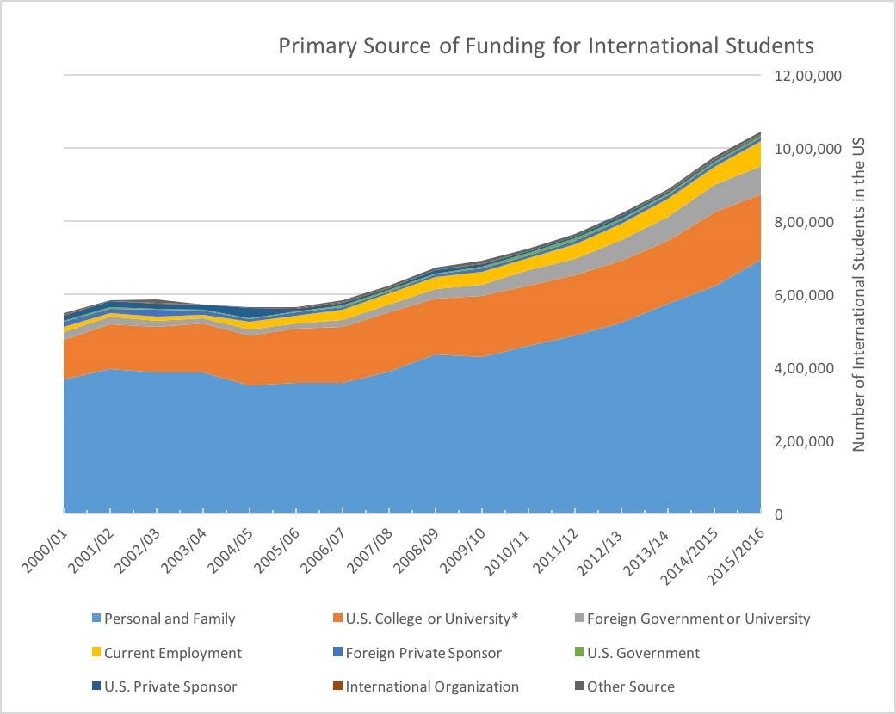
Source: Russell, K. (2018). The Next Financial Calamity Is Coming.

Slide 10
Happiness
Long-Term Goals
Short-Term Goals
Financial Needs
Family Needs

Slide 11
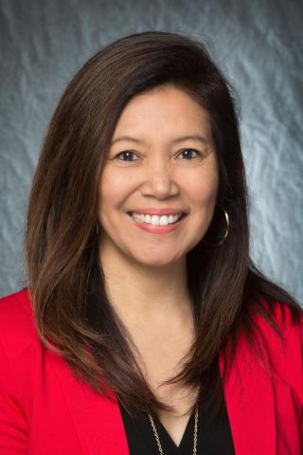
Today’s Expert
Dr. Rose Honegger
Associate Director of Global Engagement
UL Lafayette Office of International Affairs
roseh@louisiana.edu

Slide 12
Today’s Agenda
International Student Perspectives from Dr. Rose Honegger
Overview of common financial issues for international students..…both short-term & long-term
Questions from you

Slide 13
Budgeting
Create a budget on how you will spend your money each month
Fixed expenses (rent, tuition, books, utilities, food, insurance, car payments, phone bill)
Discretionary expenses (clothing, entertainment, travel, emergencies)
Unexpected expenses (medical bills, taxes)
Learn to live within your means (avoid going into debt to maintain your lifestyle). Unpaid debt will follow you everywhere you go.
You have limited opportunities to increase your income, which makes controlling your expenses even more important.

Slide 14
Preparing & Investing for YOUR Future
Prepare and invest in your future. If you’re about to graduate, plan to save $410 USD for your OPT (Optional Practical Training) application fees.
OPT is an off-campus employment benefit for F-1 students that have completed their education at an American university.
Employment has to be related to field of study: https://internationalaffairs.louisiana.edu/current-students/working-usa/optional-practical-training-opt

Slide 15
Income Taxes in the U.S.
Filing for income tax:
It’s important to be aware that, as a nonresident student in the US, you’re legally required to file a tax return if you received US income during 2020.
And even if you didn’t work or receive income in the US, you’re still obliged to file a Form 8843 with the IRS.
University of Louisiana at Lafayette has arranged discounted access to Sprintax Tax Preparation for you. Sprintax will guide you through the tax preparation process, arrange the necessary documents and check if you’re due a tax refund.
Sprintax was used by over 225,000 international students and scholars last year, and the average Federal refund received by eligible students was over $1,126.

Slide 16
Income Taxes in the U.S. (Cont.)
All you need to do is:
Register and follow the simple instructions
Complete the online questionnaire
Enter your unique discount code: 21ULL100F5 in the box on the ‘Review your order’ page
Sprintax will prepare your tax return here: https://taxprep.sprintax.com/?utm_ref=louisiana-edu

Slide 17
Other Common Financial Challenges for International Students
Health insurance while in school
Costs of Living & Standards of Living
Establishing a Financial Presence in the U.S.
Career Planning
Uncertainty…The enemy of all planning

Slide 18
Other Common Financial Challenges for International Students
Health insurance while in school
Costs of Living & Standards of Living
Establishing a Financial Presence in the U.S.
Career Planning
Uncertainty…The enemy of all planning
You are required to have health insurance while in school. And the University does not provide this insurance. Shop around, plan ahead.
The U.S. hospital bills and insurance practices may be different from what you’re used to. Ask lots of questions. Never pay before you absolutely have to or before you are absolutely sure of what you owe.

Slide 19
Other Common Financial Challenges for International Students
Health insurance while in school
Costs of Living & Standards of Living
Establishing a Financial Presence in the U.S.
Career Planning
Uncertainty…The enemy of all planning
Rent, food, insurance and other costs of living may be very different in the U.S.
When you prepare your short- and long-term budgets, make sure you are using U.S. costs and not home costs. Ask for help when in doubt.
Always avoid pressure to live a U.S. standard of living. You are here to get a degree – you can worry about your standard of living once you graduate.

Slide 20
Other Common Financial Challenges for International Students
Health insurance while in school
Costs of Living & Standards of Living
Establishing a Financial Presence in the U.S.
Career Planning
Uncertainty…The enemy of all planning
Get a bank account – with checking and savings accounts.
Get a credit card – it will help you build your U.S. credit history.
If you plan to borrow in the U.S., you may have to have someone co-sign on your loans.
Set aside $410 for your OPT as you get closer to graduating.

Slide 21
Other Common Financial Challenges for International Students
Health insurance while in school
Costs of Living & Standards of Living
Establishing a Financial Presence in the U.S.
Career Planning
Uncertainty…The enemy of all planning
Filing for your OPT should be Step #1, if you plan to stay in the U.S. beyond graduation.
Think ahead and plan ahead for lots of future decisions:
Should you get another degree?
Where will you live?
Should you take a good job with uncertain visa options or a mediocre job with the promise of a visa?
Should you go back home?

Slide 22
Other Common Financial Challenges for International Students
Health insurance while in school
Costs of Living & Standards of Living
Establishing a Financial Presence in the U.S.
Career Planning
Uncertainty…The enemy of all planning
We can never control uncertainty.
But we can create plans with different scenarios that will make uncertainty less of a surprise when it happens.
What if there’s another pandemic?
What if your advisor retires?
What if the U.S. dollar strengthens?
What if you start a family?
What if you win the lottery?

Slide 23
Some General Tips
Ask for help!
In many cases, your best source of information will be international faculty, either in your department or elsewhere
Plan ahead.
Uncertainty will be a fact of life. Try to avoid major surprises.
Communicate with family, both in the U.S. and at home.
In many cases, they are (directly or emotionally) going through this experience with you. Let them help. Share your issues with them.
Finish your degree.
Given the constraints many of you will have, such as with limits on having a job, completing what you came here for should be your #1 priority.

Slide 24
Happiness
Long-Term Goals
Short-Term Goals
Financial Needs
Family Needs

Slide 25
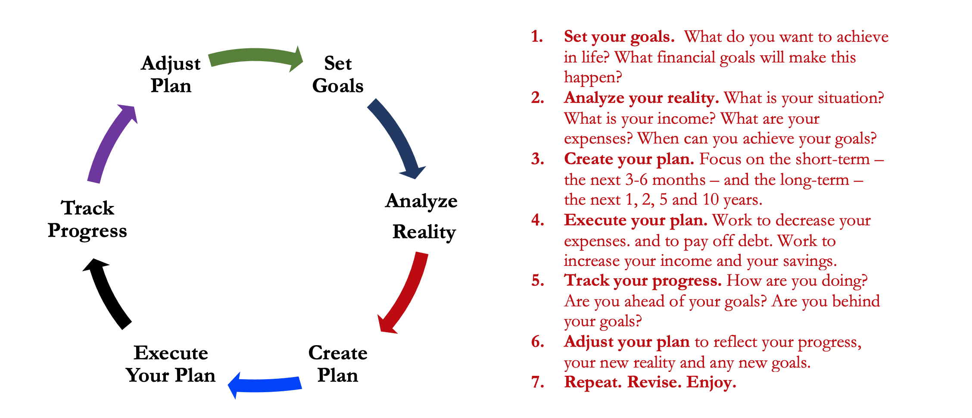
Isn’t this a lot like what you do with your education planning?

Slide 26
You’ve been doing this with your education for years.
You’re about to begin doing this with your career…and you will continue working through this process for the next 30 or 40 years.
Whether it’s education planning or career planning, by now we know that all of our personal decisions with have financial implications.
The more we plan ahead and integrate our decision-making process, the more control we will have over our futures…and the less money will be a source of stress and the more money will be a source of empowerment.
Isn’t this a lot like what you do with your education planning?

Slide 27
Making Debt Management a Part of Your Plan
FINANCIAL STRATEGIES
EDUCATION STRATEGIES
BUDGETING
STRATEGIES
GRAD SCHOOL STRATEGIES
Identify Your Income & Expenses
Identify Your Resources
Identify Your Priorities & Goals
Identify Your Priorities & Goals
Do Your Planning
Do Your Planning
Monitor & Modify Budgeting Activities
Monitor & Modify Your Progress & Plan

Slide 28
Making Debt Management a Part of Your Plan
FINANCIAL STRATEGIES
YOU,
as grad students, are better wired and equipped to make long-term plans – education, career, financial & otherwise – than 99% of humanity.
Be confident. Be intentional.
Be diligent.
Be awesome.
EDUCATION STRATEGIES
BUDGETING
STRATEGIES
GRAD SCHOOL STRATEGIES
Identify Your Income & Expenses
Identify Your Resources
Identify Your Priorities & Goals
Identify Your Priorities & Goals
Do Your Planning
Do Your Planning
Monitor & Modify Budgeting Activities
Monitor & Modify Your Progress & Plan

Slide 29
Owning Your Financial Future: Spring 2022
FINANCIAL PLANNING FOR INTERNATIONAL STUDENTS
Today, January 19
TAX PLANNING
Wednesday, February 9
DEBT & STUDENT LOAN MANAGEMENT
Wednesday, March 9
INVESTING
Wednesday, March 30
CAREER PLANNING & FINANCIAL PLANNING
Wednesday, April 13

Slide 30
Today’s Expert
Dr. Rose Honegger
Associate Director of Global Engagement
UL Lafayette Office of International Affairs
roseh@louisiana.edu

Slide 31
brian.bolton@louisiana.edu

