Slide 1

MONEY MATTERS
SESSION #7 – DEBT MANAGEMENT
Maximizing your income and managing your expenses
to support your personal & professional goals.
Manage Your Money Today
Maximize Your Money in the Future
March 15, 2022

Slide 2
Owning Your Financial Future
YOUR VALUES
YOUR GOALS
Education
Career
Family
FINANCIAL STRATEGIES
Investing
Income & Expense Management
Debt Management
Taxes, Insurance & Other

Slide 3
Owning Your Financial Future: Spring 2022
FINANCIAL PLANNING FOR INTERNATIONAL STUDENTS
Today, January 19
TAX PLANNING
Wednesday, February 9
DEBT & STUDENT LOAN MANAGEMENT
Tuesday, March 15
INVESTING
Wednesday, March 30
CAREER PLANNING & FINANCIAL PLANNING
Wednesday, April 13

Slide 4
Owning Your Financial Future: Spring 2022
FINANCIAL PLANNING FOR INTERNATIONAL STUDENTS
Today, January 19
TAX PLANNING
Wednesday, February 9
DEBT & STUDENT LOAN MANAGEMENT
Tuesday, March 15
INVESTING
Wednesday, March 30
CAREER PLANNING & FINANCIAL PLANNING
Wednesday, April 13

Slide 5
Owning Your Financial Future: Spring 2022
FINANCIAL PLANNING FOR INTERNATIONAL STUDENTS
Today, January 19
TAX PLANNING
Wednesday, February 9
DEBT & STUDENT LOAN MANAGEMENT
Tuesday, March 15
INVESTING
Wednesday, March 30
CAREER PLANNING & FINANCIAL PLANNING
Wednesday, April 13

Slide 6
Owning Your Financial Future
YOUR VALUES
YOUR GOALS
Education
Career
Family
FINANCIAL STRATEGIES
Investing
Income & Expense Management
Debt Management
Taxes, Insurance & Other

Slide 7
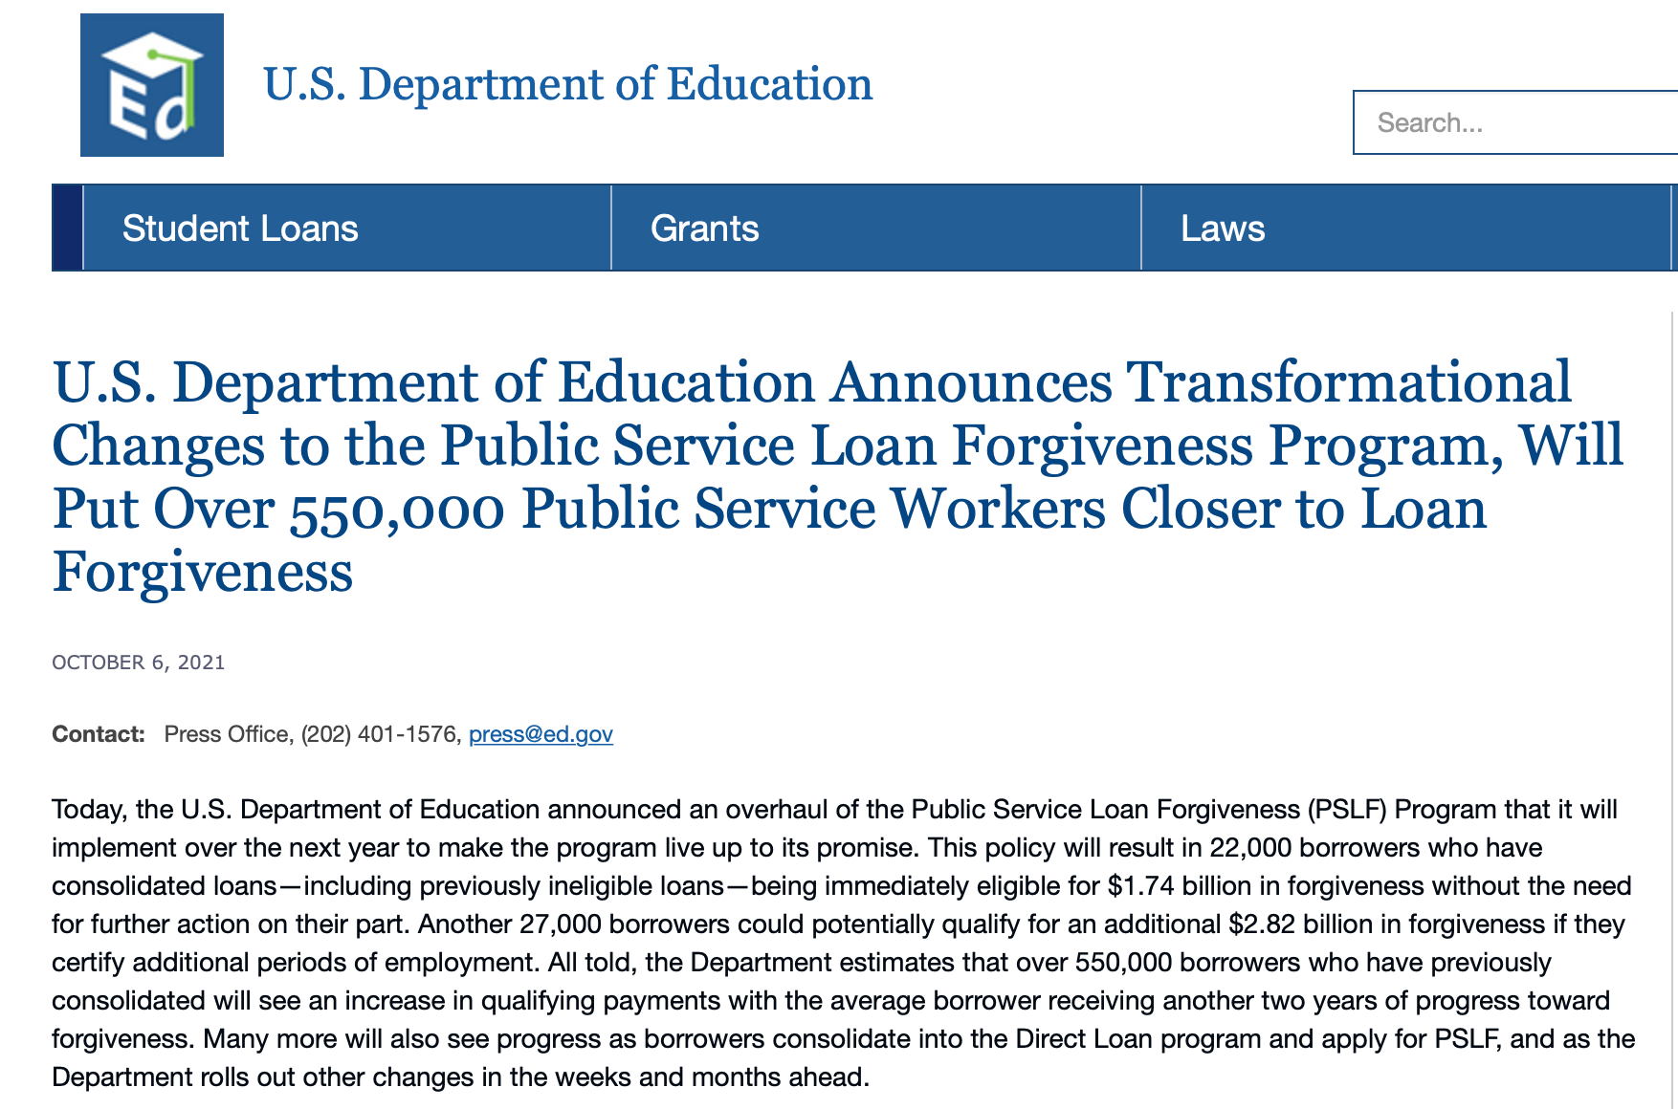
What’s New in Student Loans & Debt

Slide 8
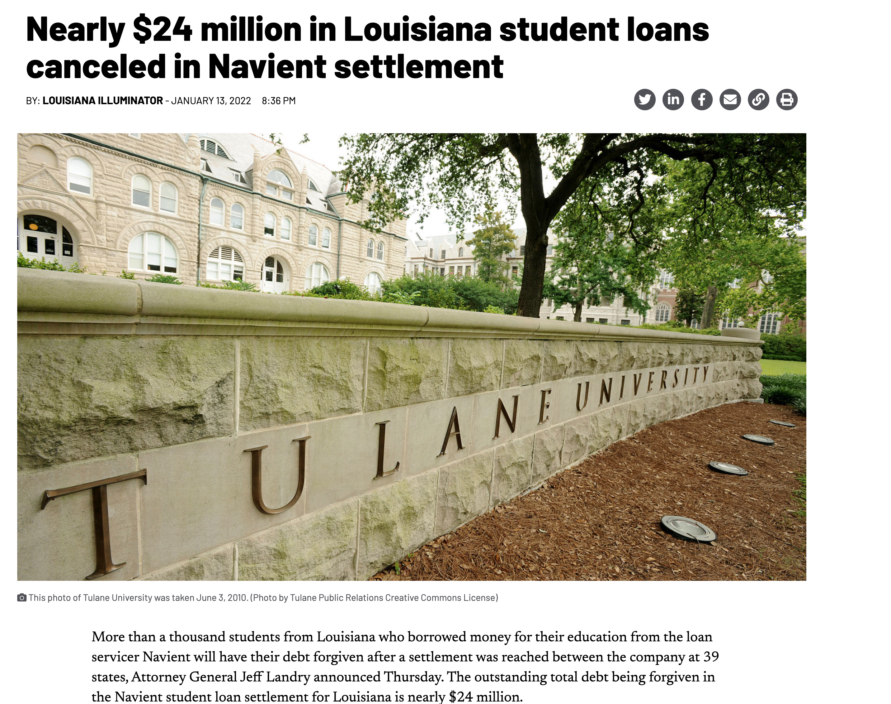
What’s New in Student Loans & Debt

Slide 9
What’s New in Student Loans & Debt
The fine print of this settlement is critical to understand:
It only applied to private loans through Navient, most of which were for for-profit schools.
It only applied to 66,000 borrowers nationwide who were in default.
  If you were current on your payments – despite the admission of deceptive lending practices – you were not eligible for forgiveness.

Slide 10
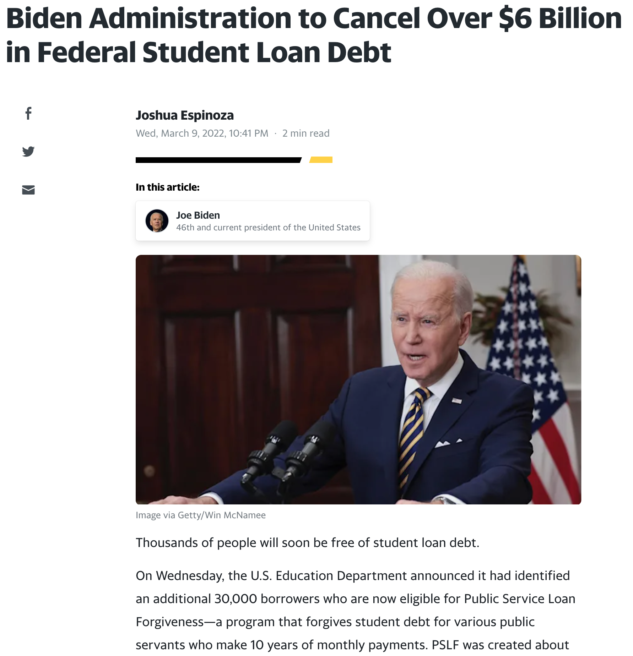
What’s New in Student Loans & Debt
This announcement was last week:
Again, the fine print is critical:
Eligible borrowers include:
  Those with subsidized, federal loans.
  Those who have made 10 years of on-time payments
  Those who have been in certain Public Service jobs for 10 years.
  Those with income below certain thresholds.
This is not a new program.
It is merely the Department of Education actively identifying borrowers who qualify.

Slide 11
What’s New in Student Loans & Debt
Required payments on federal student loans have been on pause since Spring 2020. Payments are scheduled to resume on May 2, 2022.
During this pause, no payments have been required.
During this pause, interest has not been accruing.
For new graduates, remember that you probably get a 6-month grace period after you graduate (or go below ½ time) before (a) interest accrues and (b) you have to make payments.

Slide 12
What’s New in Student Loans & Debt
Required payments on federal student loans have been on pause since Spring 2020. Payments are scheduled to resume on May 2, 2022.
My Advice:
Plan for the worst, hope for the best.
Assume that you will be required to begin making payments (and accruing interest) within 6 months of graduating.
Make a plan now to understand your repayment options.
Make a plan now to understand how you will pay off your debt.

Slide 13
What’s New in Student Loans & Debt
One More Piece of Bad News:
Interest rates have been at historic lows throughout the pandemic.
Interest rates are likely to begin going up soon (like, tomorrow).
This will be in an effort to fight or slow down inflation.
My opinion: Inflation will be around – and unusually high – for at least another year.
  Interest rates are likely to go up 1-2% throughout this year. If this begins to slow down inflation, most of us will not see the slowdown until 2023.
  For most items, once the prices go up, the prices are unlikely to go down.
    Or we will experience shrink-flation…where we pay the same price for less stuff (e.g. a box of cereal going from 20 ounces to 16 ounces).
  The possible exception to this is gasoline and energy – which are influenced by general inflation, but are disproportionately impacted by Russia’s invasion of Ukraine.

Slide 14
What Can You Do Today To Help Your Situation
Contact your credit card companies.
Ask to have your credit limits increased.
By increasing your available or possible debt, your credit score will think you are managing your debt obligations better. And this will improve your credit credit score.

Slide 15
Today’s Agenda
Questions from you
Some strategies for using debt & for managing debt
  Types of debt: Student Loans, Credit Cards, Other
    Good Debt vs. Bad Debt
    Costs & Benefits of different types of debt
  Understanding your Credit Score
  Understanding our Credit System
  Developing habits that will last a lifetime
Questions from you

Slide 16
WHAT IS DEBT
Debt is borrowing from YOUR future.
We borrow because we want something today that we cannot afford today.
We make a promise to pay for that something in the future.
The entity we borrow from wants to make money. They are not our friends.
We have to pay them helping us get what we want today.
  At a minimum, we pay them interest on our debt.
  Depending on the type of debt, we may have to pay them much more (fees, collateral, earnings, control, etc.)

Slide 17
WHAT IS DEBT
Debt is borrowing from YOUR future.
If your debt is keeping you up at night…
If your debt is preventing you from achieving your goals…
If your debt is damaging your relationships…
…Then you may have too much debt.
(we will return to this issue later)

Slide 18
One Truism About DEBT
If you borrow $10,000,
You will have to repay $10,000.
Whatever you borrow, you will have to repay – in full, with interest – 99% of the time. Lenders do not exist to give you money.
One good exception: Student loan forgiveness.
Lots of bad exceptions: Default, bankruptcy, short sale…

Slide 19
Why Are You Here?
Take a few seconds to ask yourself these 2 questions:
Why Are You in Graduate School?
What will you be doing in 5 years?

Slide 20
Why Are You Here?
Why do I think you are here?
I think you are here to think about your financial situation.
I think you are here to begin developing a financial plan.
I think you are here today to gain better control over your income and expenses to help you:
Eliminate some stress associated with being a grad student.
Maximize your goals over the long-term.

Slide 21
Questions From You #1
Ideally how much of your income should you expect to go into paying off various loans (car, house, school, etc.)?
There are 2 ways to address this:
From a lender’s perspective.
From your own, personal perspective.

Slide 22
Questions From You #1
Ideally how much of your income should you expect to go into paying off various loans (car, house, school, etc.)?
The lender’s perspective:
28% of your gross income should go to housing payments (at most)
(including rent, mortgage, taxes, insurance…but not maintenance or utilities)
36% of your gross income should go to all debt payments (at most)
(including housing, credit cards, student loans, auto loans…)

Slide 23
Questions From You #1
Ideally how much of your income should you expect to go into paying off various loans (car, house, school, etc.)?
28% of your gross income should go to housing payments (at most)
(including rent, mortgage, taxes, insurance…but not maintenance or utilities)
36% of your gross income should go to all debt payments (at most)
(including housing, credit cards, student loans, auto loans…)
Be very careful: These ratios are based on payments, not borrowed amounts or loan balances. Lenders may encourage you to extend your loan repayment term, which may lower your monthly or annual payment….but doing this will usually increase the total amount that you have to repay over the life of the loan.

Slide 24
Questions From You #1
Ideally how much of your income should you expect to go into paying off various loans (car, house, school, etc.)?
These ratios are based on payments, not borrowed amounts or loan balances. Lenders may encourage you to extend your loan repayment term, which may lower your monthly or annual payment….but doing this will usually increase the total amount that you have to repay over the life of the loan.
You generally want to repay your debt as soon as possible.
Longer term = More interest paid = More cash out of your pocket
The biggest exception is student loan debt…where rates are generally the lowest, some interest can be tax deductible, and you have maximum flexibility in repayment plans (and, if you are on track for public service forgiveness, you need to make 10 years of payments).

Slide 25
Questions From You #1
Ideally how much of your income should you expect to go into paying off various loans (car, house, school, etc.)?
From a personal perspective, it will all depend on your other goals and investments and your specific situation.
If you buy a home, you will increase your debt.
If you have children, you may increase your debt as you save for their education or incur other expenses.
You can offset this by having a lower auto loan or reducing your student loans.
Always, always, always pay off your credit card balances as soon as you are able.

Slide 26
Questions From You #1
Ideally how much of your income should you expect to go into paying off various loans (car, house, school, etc.)?
From a personal perspective, it will all depend on your other goals and investments and your specific situation.
If your debt payments are over 40% of your income,
make a plan to change this and to get your payments lower.
This will help your credit score, it will help you access more debt in the future, it will free up income to invest in your other goals…and it will help you sleep at night.

Slide 27
Questions From You #2
How does income-based loan payment work?
There are several income-based payment plans, so these responses will be generic.
You choose 1 of 4 repayment plans
You make monthly payments based on your discretionary income.
  The payments range from 10-20% of your income.
You have flexibility if you lose your job or move to a lower paying job.
If you make payments for 20-25 years, your loan will be forgiven.
Income-Contingent Repayment is generally required if you are going to eventually seek public service loan forgiveness (after 10 years of working in public service and making on-time payments).

Slide 28
Questions From You #3
Is it smart to pay off student debt as soon as you are able to?
General Answer: No, not for most people.
I have 30k in savings and 16k in student debt, mostly subsidized and low-interest (2-4%). I've been trying to figure out if it would be smarter to pay off my loans entirely before I leave school and start accruing interest or if it'd be better to save/invest my savings and pay off the debt over time.
If I were you, I would not be in a hurry to repay the $16k of student debt.

Slide 29
Questions From You #3
I have 30k in savings and 16k in student debt, mostly subsidized and low-interest (2-4%). I've been trying to figure out if it would be smarter to pay off my loans entirely before I leave school and start accruing interest or if it'd be better to save/invest my savings and pay off the debt over time.
If I were you, I would not be in a hurry to repay the $16k of student debt.
Yes, you could pay off the debt with your savings.
But is there something else you could be using the savings for?
  Buying a new house?
  Building up a retirement account?
  Setting money aside for kids?
  Do you have other debt to repay?
  Does having the debt cause you stress?

Slide 30
Questions From You #3
I have 30k in savings and 16k in student debt, mostly subsidized and low-interest (2-4%). I've been trying to figure out if it would be smarter to pay off my loans entirely before I leave school and start accruing interest or if it'd be better to save/invest my savings and pay off the debt over time.
Do you have any other debt to repay?
As a general rule, student loan debt should be the last debt you pay off.
Your interest rate is very low - lower than you’ll get on just about any other loan.
You generally have the most flexibility with repayment.
  If you quit or lose your job next year, after paying off your student loan debt, that money is gone and you may now have to borrow at a much higher rate.
  But if that $16k is still in savings, you can use it as necessary next year.

Slide 31
Questions From You #3
I have 30k in savings and 16k in student debt, mostly subsidized and low-interest (2-4%). I've been trying to figure out if it would be smarter to pay off my loans entirely before I leave school and start accruing interest or if it'd be better to save/invest my savings and pay off the debt over time.
What else could you be doing with the $16k of savings?
If you are only going to earn 0.25% on your savings, and you don’t have anything else to do with it, maybe pay off the 2-4% student loans at 2-4%.
The S&P 500 Index has averaged 12.1% annual return over the past 100 years. What if you invest $10,000 into an S&P 500 Fund and use the growth in that to pay off your student loan over time?
  Note – This is just an example, not a recommendation. There is no guarantee of getting this return, certainly not every single year. There are other investments you could make that might
  have less risk and uncertainty (or more risk and uncertainty).

Slide 32
Questions From You #3

Slide 33
Questions From You #3

Slide 34
Questions From You #3

Slide 35
Questions From You #3
I have 30k in savings and 16k in student debt, mostly subsidized and low-interest (2-4%). I've been trying to figure out if it would be smarter to pay off my loans entirely before I leave school and start accruing interest or if it'd be better to save/invest my savings and pay off the debt over time.
Only YOU can decide what best aligns with:
Your short-term and long-term goals.
Your mental health. What helps you sleep better at night.
I finished my MBA in a similar situation. I had about the same debt but less in savings. I paid close to the minimum payments for the first 1-2 years after graduation. Then, as my income became more comfortable and my plans become more clear, I was able to make larger one-time payments.
I ended up paying off the debt 4.5 years after graduation. Even then, it wasn’t a financial decision; it was an “I’m ready to get rid of this and stop having to think about this decision.”

Slide 36
Questions From You #4
I don't have any loans personally, but I'm expecting to marry someone who will and I want to be as prepared as possible.
How might their debt affect my credit score, if any, and how much should be allocated to paying off debt? Should it be a top priority to pay off immediately or should it be set as a 5 to 10 year plan sort of thing so that I can use money to also build my present and future in small increments as well.
Initially….there is no affect on your credit score:
Your existing debt and credit score belong to you.
Your spouse’s existing debt and credit score below to them.
Credit rating firms will NOT re-calculate your score based on your partner’s situation.
That’s the good news….

Slide 37
Questions From You #4
How might their debt affect my credit score, if any, and how much should be allocated to paying off debt? Should it be a top priority to pay off immediately or should it be set as a 5 to 10 year plan sort of thing so that I can use money to also build my present and future in small increments as well.
The concern is if you two apply for a loan together – perhaps on a mortgage or car loan or credit card.
Lenders will see both credit scores and will get to decide what rate to charge – or whether to lend to you at all.
Lenders may choose to use a rate based on the worse credit score, causing you both to make higher payments.

Slide 38
Questions From You #4
How might their debt affect my credit score, if any, and how much should be allocated to paying off debt? Should it be a top priority to pay off immediately or should it be set as a 5 to 10 year plan sort of thing so that I can use money to also build my present and future in small increments as well.
The concern is if you two apply for a loan together – perhaps on a mortgage or car loan or credit card.
A strategy might be to co-sign on a loan, possibly getting better terms because of your credit score, and then to use this to improve your spouse’s credit score and situation.
  Of course, you may not get better terms and you may not even get the loan.
Having joint debt will only affect your individual credit score if you miss payments or default (marital status is not a variable in calculating a credit score).

Slide 39
Questions From You #4
How might their debt affect my credit score, if any, and how much should be allocated to paying off debt? Should it be a top priority to pay off immediately or should it be set as a 5 to 10 year plan sort of thing so that I can use money to also build my present and future in small increments as well.
If the spouse-to-be’s debt it at very high interest rates, then being as aggressive as possible in paying it off could be a very good strategy to increase your net cash flow (by decreasing your interest expenses).
And…of course, it should improve your peace of mind and how you think about your financial futures.
My favorite cliché is “own your financial future.” To me, getting rid of high-interest debt can be the most powerful form of taking ownership of your financial future.

Slide 40
Questions From You #4
How might their debt affect my credit score, if any, and how much should be allocated to paying off debt? Should it be a top priority to pay off immediately or should it be set as a 5 to 10 year plan sort of thing so that I can use money to also build my present and future in small increments as well.
I kind of like the 5-to-10 year plan thinking, if you are comfortable with it.
Paying off all of the spouse’s debt immediately WILL NOT immediately correct their credit score. That takes years, regardless.
  And the best way to improve it is to prove that they can repay their debt…and this only happens by having debt and by making all required payments.
Methodically paying off the spouse’s debt, thoughtfully borrowing together (and making required payments) and strategically building up your own portfolio – or your combined portfolio with your assets – may be the most balanced and beneficial plan.

Slide 41
A Small Reminder
Throughout these sessions, we have encouraged you to communicate with your partners, spouses and families about your financial situations and financial goals.
We know that financial issues are cited as the #1 or #2 reason for divorce in the U.S.
Financial advisors always cite debt management as the primary financial issue that families struggle with.
To you who asked the previous question:
I love that you know this about your spouse-to-be. Communication, trust and openness obviously matter in relationships…and knowing each other’s financial situation allows you to create a plan for sharing your future together.

Slide 42
And Now A Question FOR You
I know a lot about debt consolidation conceptually.
And I think I know many of the financial issues international students face.
Do any of you have any experience with debt consolidation?
Do any of you have any unique debt experiences as international students?

Slide 43
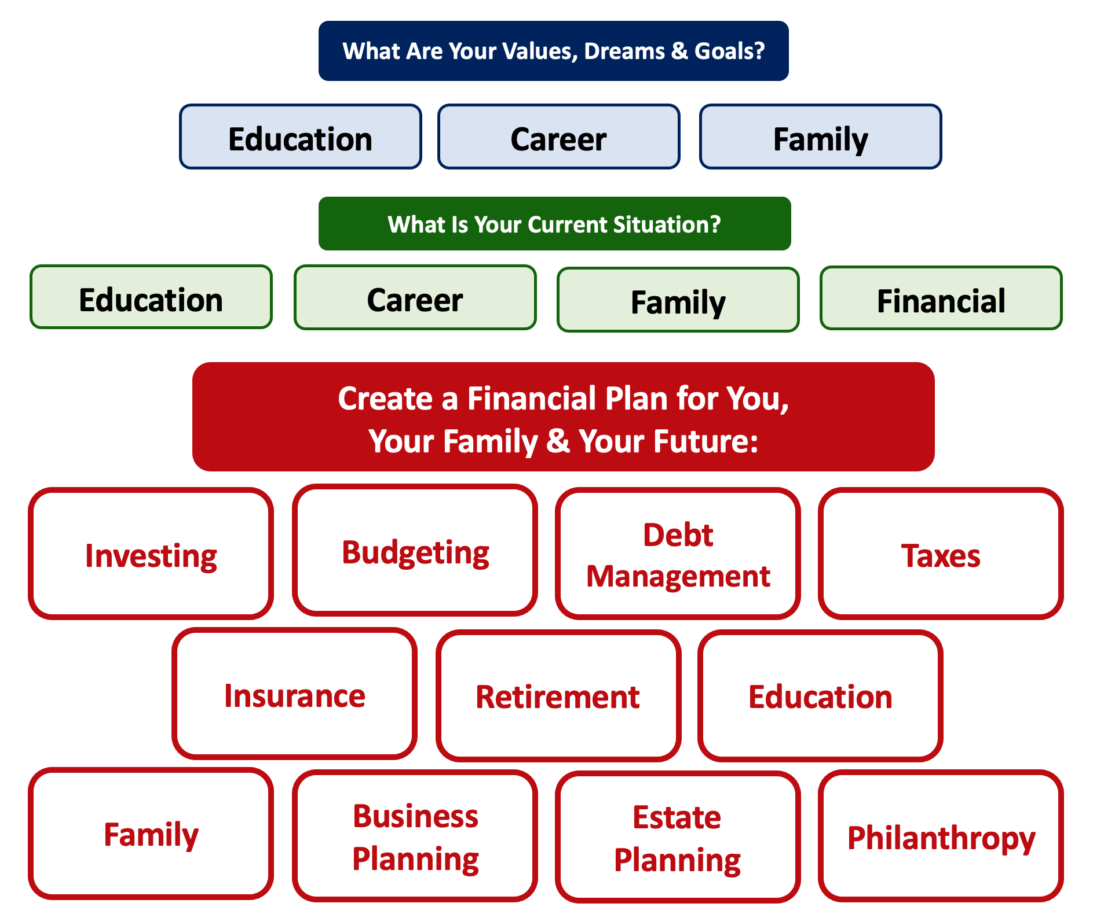

Slide 44
Debt is NOT a bad thing.
Debt can help us achieve our goals, depending on our current situations and what those goals are.
Debt is also called “leverage” – because it gives us the ability do things we might not be able to do otherwise.

Slide 45
Debt is NOT a bad thing.
My one primary piece of advice:
Whenever borrow money – whether it’s $20 for a Friday night pizza on your credit card or a $10,000 student loan – have a plan for paying it back.
Know why you are borrowing and where you will get the money to repay it.

Slide 46
A Little Math: Good Debt vs. Bad Debt

Slide 47
A Little Math: Good Debt vs. Bad Debt
Yes, I’ve simplified this a little. You will be making debt payments on your mortgage over those 3 years, so that would count against your equity growth. But this also means you would repay less in 3 years, which would increase your equity growth. And I have ignored taxes: both the benefits from using a mortgage and any costs due to the gains you may earn on the sale. But the idea here is to show how debt can create – or leverage – opportunities today to create value in the future.

Slide 48
A Little Math: Good Debt vs. Bad Debt
Isn’t this a lot like what you’re doing with your education?
You’re investing today – time, energy, money – in order
to create bigger and better opportunities for your future.
These opportunities may or may not be financial.
These opportunities are what will help you live your values and achieve your goals & dreams.
Yes, you do have to repay the money you borrowed. But if you are borrowing the money to achieve your dreams – dreams that you would not otherwise be able to achieve – then it’s probably a wonderful investment for you.

Slide 49




Good Debt vs. Bad Debt
High cost, both in $$$ and opportunity
Lots of uncertainty
Potential for enormous return
Perfectly aligned with values, goals & dreams
High cost, both in $ and opportunity
Lots of uncertainty
Potential for some return
Usually aligned with values, goals & dreams
Very high cost
Short-term fulfillment
No future return
Unrelated to values, goals & dreams

Slide 50
Good Debt vs. Bad Debt
$100,000 of principal
$45,435 of interest
Repaid over 20 years @ 4% interest

Slide 51
Good Debt vs. Bad Debt
$100,000 of principal
$58,389 of interest
Repaid over 20 years @ 5% interest

Slide 52
Good Debt vs. Bad Debt
$100,000 of principal
$216,030 of interest
Repaid over 20 years @ 15% interest

Slide 53
Good Debt vs. Bad Debt
Is this debt aligned with my values, goals & dreams?
How am I going to repay this debt?

Slide 54
Free Money…for you or for your bank.
Borrowing $100,000
At 15% Interest
Repaying over 20 years.
You Borrow $100,000
You Repay $316,030

Slide 55
Free Money…for you or for your bank.
Borrowing $100,000
At 15% Interest
Repaying over 20 years.
You Borrow $100,000
You Repay $316,030
Investing $50 a month
At 10% interest
For 20 years
You Invest $12,000
You Have $38,285

Slide 56
Good Debt vs. Bad Debt
NOTE:
Using a credit card is not necessarily a bad idea.
Only racking up loads of credit card debt is a bad idea.
I regularly use 3 credit cards.
Here’s how and here’s why…

Slide 57
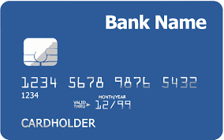
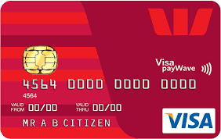
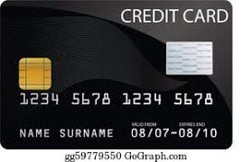
Credits Cards as Tools for Financial Planning
Card #1: Automatic bill payment of recurring monthly expenses (phone, insurance, cable, utilities)
Card #2: Living and discretionary expenses (gas, groceries, coffee, pizza, new shoes)
Card #3: Non-recurring big expenses (vacation, holidays, charity, new refrigerator)
Card #3 frequently has a $0.00 balance

Slide 58
Credits Cards as Tools for Financial Planning
WHY DO I DO THIS?
#1 Mental Budgeting: This helps me mentally be aware of what I’m spending and why I’m spending.
  Instead of just knowing that I’m putting $1,000 on my credit cards in a month, separating the expenses across cards forces me to be aware of what I’m spending money on.
  When I review my statements and budgets at the end of each month, this gives me an easy opportunity to judge myself and to analyze my own behavior.
Card #1: Automatic bill payment of recurring monthly expenses (phone, insurance, cable, utilities)
Card #2: Living and discretionary expenses (gas, groceries, coffee, pizza, new shoes)
Card #3: Non-recurring big expenses (vacation, holidays, charity, new refrigerator)

Slide 59
Credits Cards as Tools for Financial Planning
WHY DO I DO THIS?
#2 FREE MONEY!
  I pay off the full balance of each card each month. If I make a purchase on October 5, the cash does not leave my bank account until December 1.
    It might only be a penny or two, but earning interest during those 57 days feels kind of nice.
  Miles, cash-back and other rewards.
    Choose a card with benefits that you would be paying for anyway. And then cash in the rewards instead of paying cash in the future.
Card #1: Automatic bill payment of recurring monthly expenses (phone, insurance, cable, utilities)
Card #2: Living and discretionary expenses (gas, groceries, coffee, pizza, new shoes)
Card #3: Non-recurring big expenses (vacation, holidays, charity, new refrigerator)

Slide 60
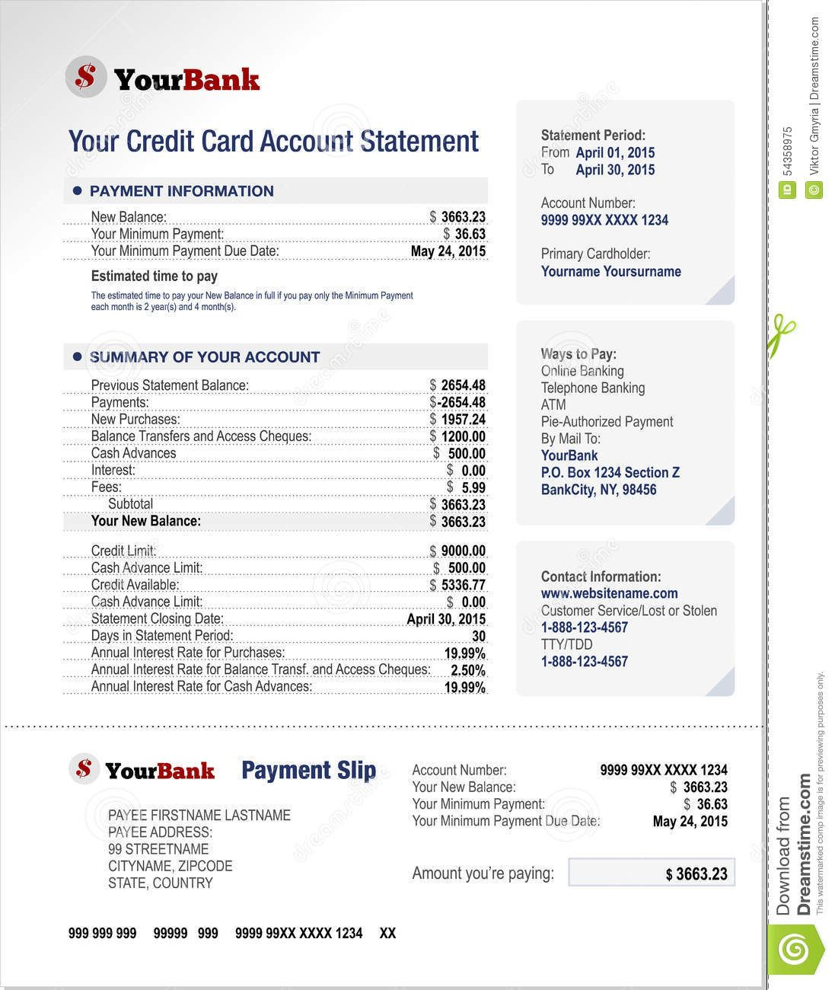
Credits Cards as Tools for Financial Planning
Statement Period: The window of days/purchases that are covered by the statement. We do not begin paying interest on our purchases until after this period.
New Balance: Total amount owed, may include new purchases and previous balance (it is just new purchases here)
Minimum Payment: Pay this or face a hit to your credit score for a late or missed payment.
Payment Due Date: Set your recurring payment to transfer money from your bank account on this date. Take advantage of time and the credit card cycles.
(Note May 24 is 54 days later than the period began)

Slide 61
Credits Cards as Tools for Financial Planning
Previous Statement Balance: The outstanding balance at the beginning of the statement period. We gotta pay this…eventually.
New Purchases: Charges to the card between April 1 and April 30 (depending on when the merchant posted the charge)
Balance Transfer: We moved $1,200 from another card to this card…perhaps to take advantage of a lower interest rate or more flexible repayment options.
Annual Interest on Balance Transfer: It’s only 2.50%. This is probably an introductory offer
to get us to move money to this account.

Slide 62
Credits Cards as Tools for Financial Planning
Previous Statement Balance: The outstanding balance at the beginning of the statement period. We gotta pay this…eventually.
New Purchases: Charges to the card between April 1 and April 30 (depending on when the merchant posted the charge)
Balance Transfer: We moved $1,200 from another card to this card…perhaps to take advantage of a lower interest rate or more flexible repayment options.
Annual Interest on Balance Transfer: Read the fine print. This 2.50% rate will expire and will
probably go up to 19.99% very soon.

Slide 63
Credits Cards as Tools for Financial Planning
Cash Advance: Using a credit card as a debt card. One of the dumbest things we can every do. We pay fees and we owe interest from the second we take the advance (we do not get the grace period with cash).
Interest Rate on Cash Advances: 19.99%. From the second we withdraw the cash. Be very careful.
Credit Limit: We have a limit of $9,000. This is not per period, but total. If our balance was $8,000 last month, we can only spend $1,000 this month. This is a very important number for calculating your credit score.

Slide 64
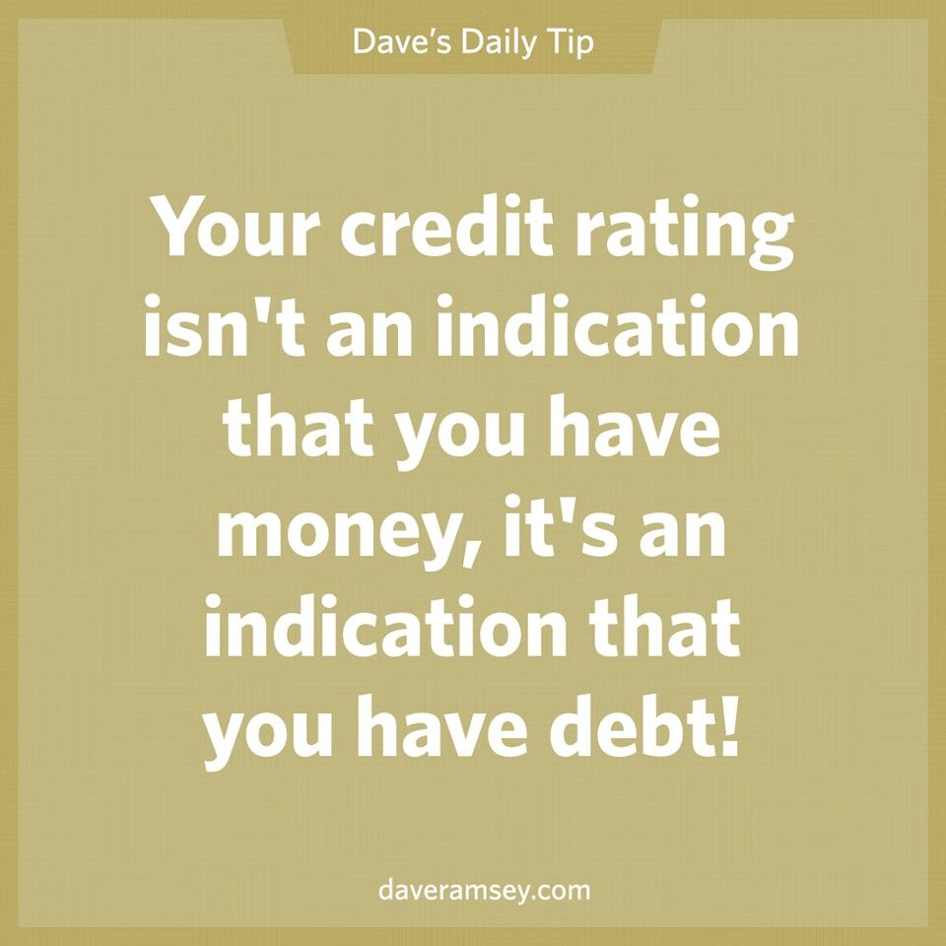
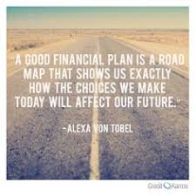
Daily Inspiration

Slide 65
LET’S MAKE THIS PERSONAL…
WHAT IMPACTS YOUR CREDIT RATING AS A CONSUMER?

Slide 66
LET’S MAKE THIS PERSONAL…
WHAT IMPACTS YOUR CREDIT RATING AS A CONSUMER?
35% Payment History – This is perhaps this simplest category, as it looks at how well you repay all borrowed amounts on credit cards, retail accounts, auto loans, utilities and phone bills, other installment loans and other debts. The better you are at repaying, the better your Payment History. Pay your bills on time.

Slide 67
LET’S MAKE THIS PERSONAL…
WHAT IMPACTS YOUR CREDIT RATING AS A CONSUMER?
30% Amounts Owed –The amount you owe is not simply about how much money you owe, but it’s also about how much of your available credit you use. If you have a credit card limit of $5,000 and your balance is $4,000, that’s worse than having a limit of $20,000 and a balance of $10,000. There are many trade-offs within this category and it can be confusing.
Pro-tip if you are using more than 30% of your available balance: Pay it off or down before the end of your reporting cycle and the credit agencies will never know it existed.

Slide 68
LET’S MAKE THIS PERSONAL…
WHAT IMPACTS YOUR CREDIT RATING AS A CONSUMER?
15% Length of Credit History – This is also pretty simple – the longer your history of paying bills and loans, the better off you’ll be. Yes, this does bias against younger borrowers – but if your behavior in the other categories is strong, you should be okay. Be patient – you’ll build your history.

Slide 69
LET’S MAKE THIS PERSONAL…
WHAT IMPACTS YOUR CREDIT RATING AS A CONSUMER?
10% Credit Mix – Perhaps ironically, it can be better to have 5 different accounts that you repay regularly than it is to have just 2 different accounts. The greater the variety of accounts you have, the more opportunity you have to indicate that you are a low credit risk. Of course, if you have 5 accounts and you miss your payments, that will be doubly bad. Pay your bills on time and the Credit Mix will take care of itself.

Slide 70
LET’S MAKE THIS PERSONAL…
WHAT IMPACTS YOUR CREDIT RATING AS A CONSUMER?
10% New Credit – Opening a large number of new accounts in a short period of time may indicate that you are a higher risk. So, is the moral to never open new accounts? No – because then you can never indicate that you are a low risk. Be mindful of opening too many accounts in a short period of time, pay all your bills on time, and the New Credit category will not be a big issue.

Slide 71
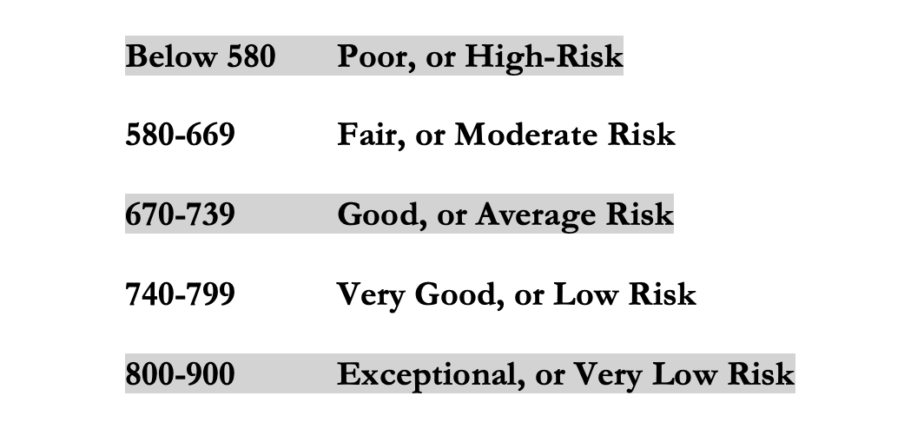
LET’S MAKE THIS PERSONAL…
WHAT IMPACTS YOUR CREDIT RATING AS A CONSUMER?
Your FICO Score will become an actual number: between 250 and 900.
The higher your Score, the lower interest rates you will pay on most loans.
The average FICO Score for Americans is just over 700.
The average in Louisiana is 677, the second lowest in the 50 U.S. states; only Mississippi has a lower average FICO Score.

Slide 72
LET’S MAKE THIS PERSONAL…
WHAT SHOULD YOU BE FOCUSED ON WITH RESPECT TO YOUR CREDIT SCORE?
If your FICO Score is below 600, there are probably 1 or 2 areas where you have significant weaknesses in your history.
Commit to correcting these weaknesses and not creating any new weaknesses.
If your FICO Score is between 600-700, there are probably 1 or 2 areas that can be improved – or where you used to have significant weaknesses.
Keep doing what you’re doing – and commit to not creating any new concerns.
If your FICO Score is over 700, keep doing what you’re doing and time will eventually get you the best score possible.

Slide 73

Review from Sessions on Investing and Budgeting
I utilize 4-5 different accounts on a regular basis, as defined below. This allows me to mentally align my finances with my goals, kind of like how I use 3 credit cards with 3 different purposes each.
Checking & Transaction Account
No risk,
0.0% return,
all cash
Short-to-Medium Term Goals
Some risk,
0-3% return goals,
cash + savings
Long-Term
Goals
Some Risk,
3-7% return goals,
savings + investments
Retirement
Accounts
Lots of risk,
8-12% return goals,
all investments

Slide 74
Review: A Few Rules About INVESTING
Investing lets COMPOUND INTEREST be your friend.
  With compound interest, your interest earns interest.
  Without actively making decisions, your money can grow exponentially.
  Yes, there is risk – the exponential growth rate could be negative.
  Such risk is greatest if you ‘invest’ over very short periods of time.
  Historically, over the past 100+ years, if you invest for 5+ years, you have benefited from positive exponential growth.
  The average return of a common stock over the past 100 years is 10%.
    The word ’average’ is very important here. But, the good news, we can all achieve ‘average’ returns relatively easily (though they may not be 10% in the future)

Slide 75
Review: A Few Rules About INVESTING
Investing lets COMPOUND INTEREST be your friend.
  With compound interest, your interest earns interest.
  Without actively making decisions, your money can grow exponentially.
  Yes, there is risk – the exponential growth rate could be negative.
  Such risk is greatest if you ‘invest’ over very short periods of time.
  Historically, over the past 100+ years, if you invest for 5+ years, you have benefited from positive exponential growth.
  The average return of a common stock over the past 100 years is 10%.
    The word ’average’ is very important here. But, the good news, we can all achieve ‘average’ returns relatively easily (though they may not be 10% in the future)
Not to be too esoteric or philosophical…
But compound interest doesn’t just apply to investing.
Compound interest applies to all aspects of grad school life:
Time Management
Mental Health
Health Management
Writing Skills
Relationships
And…Of course, Money Management

Slide 76
Review: A Few Rules About INVESTING
Investing lets COMPOUND INTEREST be your friend.
  With compound interest, your interest earns interest.
  Without actively making decisions, your money can grow exponentially.
  Yes, there is risk – the exponential growth rate could be negative.
  Such risk is greatest if you ‘invest’ over very short periods of time.
  Historically, over the past 100+ years, if you invest for 5+ years, you have benefited from positive exponential growth.
  The average return of a common stock over the past 100 years is 10%.
    The word ’average’ is very important here. But, the good news, we can all achieve ‘average’ returns relatively easily (though they may not be 10% in the future)
And…if we connect this to Debt Management:
Owing Compound Interest can be your biggest financial foe.
Owing interest on interest on interest can be an anchor on your future and can compromise all of your dreams and goals.

Slide 77
Review: A Few Rules About INVESTING
Investing lets COMPOUND INTEREST be your friend.
  With compound interest, your interest earns interest.
  Without actively making decisions, your money can grow exponentially.
  Yes, there is risk – the exponential growth rate could be negative.
  Such risk is greatest if you ‘invest’ over very short periods of time.
  Historically, over the past 100+ years, if you invest for 5+ years, you have benefited from positive exponential growth.
  The average return of a common stock over the past 100 years is 10%.
    The word ’average’ is very important here. But, the good news, we can all achieve ‘average’ returns relatively easily (though they may not be 10% in the future)
YOU, as grad students, are better wired and equipped to make long-term plans – education, career, financial & otherwise – than 99% of humanity.
Be confident. Be intentional.
Be diligent. Be awesome.

Slide 78
Developing A Budgeting Mindset
Budgeting is more of a mental game than a financial process.
Think of budgeting as part of a long-term financial plan.
Think of budgeting in the same way you think of studying, writing or working in the laboratory.
Recognize your own behavior, habits, priorities and goals. Only you know what is best for you. Choose the budgeting approach that works best for you…and for you only.

Slide 79
Developing A Budgeting Mindset
If you have a spouse, partner, family or others who are affected by your budgeting decisions….
….Talk to them. Make budgeting a team effort.
Research on personal finance shows that couples feel more empowered and develop a closer, stronger relationship when they share financial goals, decisions and strategies with each other.
Your pets may be affected by your budgeting decisions. But you don’t have to communicate with them. They don’t want to be bothered with budgeting decisions. They have other priorities.

Slide 80

Isn’t this a lot like what you do with your education planning?

Slide 81
And as you begin to develop your full financial plan – seeing the trade-offs with Budgeting, Investing and Debt Management – you will begin to see how interconnected all of these aspects are.
Finance is just a matter of managing money across time.
And one thing we know about time is that our plans will change – so the better you have control of your initial financial plan, the more you will be able to adjust when life and time give you new goals.
Isn’t this a lot like what you do with your education planning?

Slide 82
Making Debt Management a Part of Your Plan
FINANCIAL STRATEGIES
EDUCATION STRATEGIES
BUDGETING
STRATEGIES
GRAD SCHOOL STRATEGIES
Identify Your
Income & Expenses
Identify Your Resources
Identify Your
Priorities & Goals
Identify Your
Priorities & Goals
Do Your Planning
Do Your Planning
Monitor & Modify Budgeting Activities
Monitor & Modify Your Progress & Plan

Slide 83
Making Debt Management a Part of Your Plan
FINANCIAL STRATEGIES
YOU,
as grad students, are better wired and equipped to make long-term plans – education, career, financial & otherwise – than 99% of humanity.
Be confident.
Be intentional.
Be diligent.
Be awesome.
EDUCATION STRATEGIES
BUDGETING
STRATEGIES
GRAD SCHOOL STRATEGIES
Identify Your
Income & Expenses
Identify Your Resources
Identify Your
Priorities & Goals
Identify Your
Priorities & Goals
Do Your Planning
Do Your Planning
Monitor & Modify Budgeting Activities
Monitor & Modify Your Progress & Plan

Slide 84
brian.bolton@louisiana.edu

