Slide 1

STUDENT SUPPORT SERVICES
FINANCIAL WELLNESS SERIES 2024
Session #2: Debt & Taxes
Managing Financial Challenges & Obligations
February 28, 2024

Slide 2
Brian Bolton
Professor of Finance brian.bolton@louisiana.edu http://business.louisiana.edu/financeispersonal

Slide 3
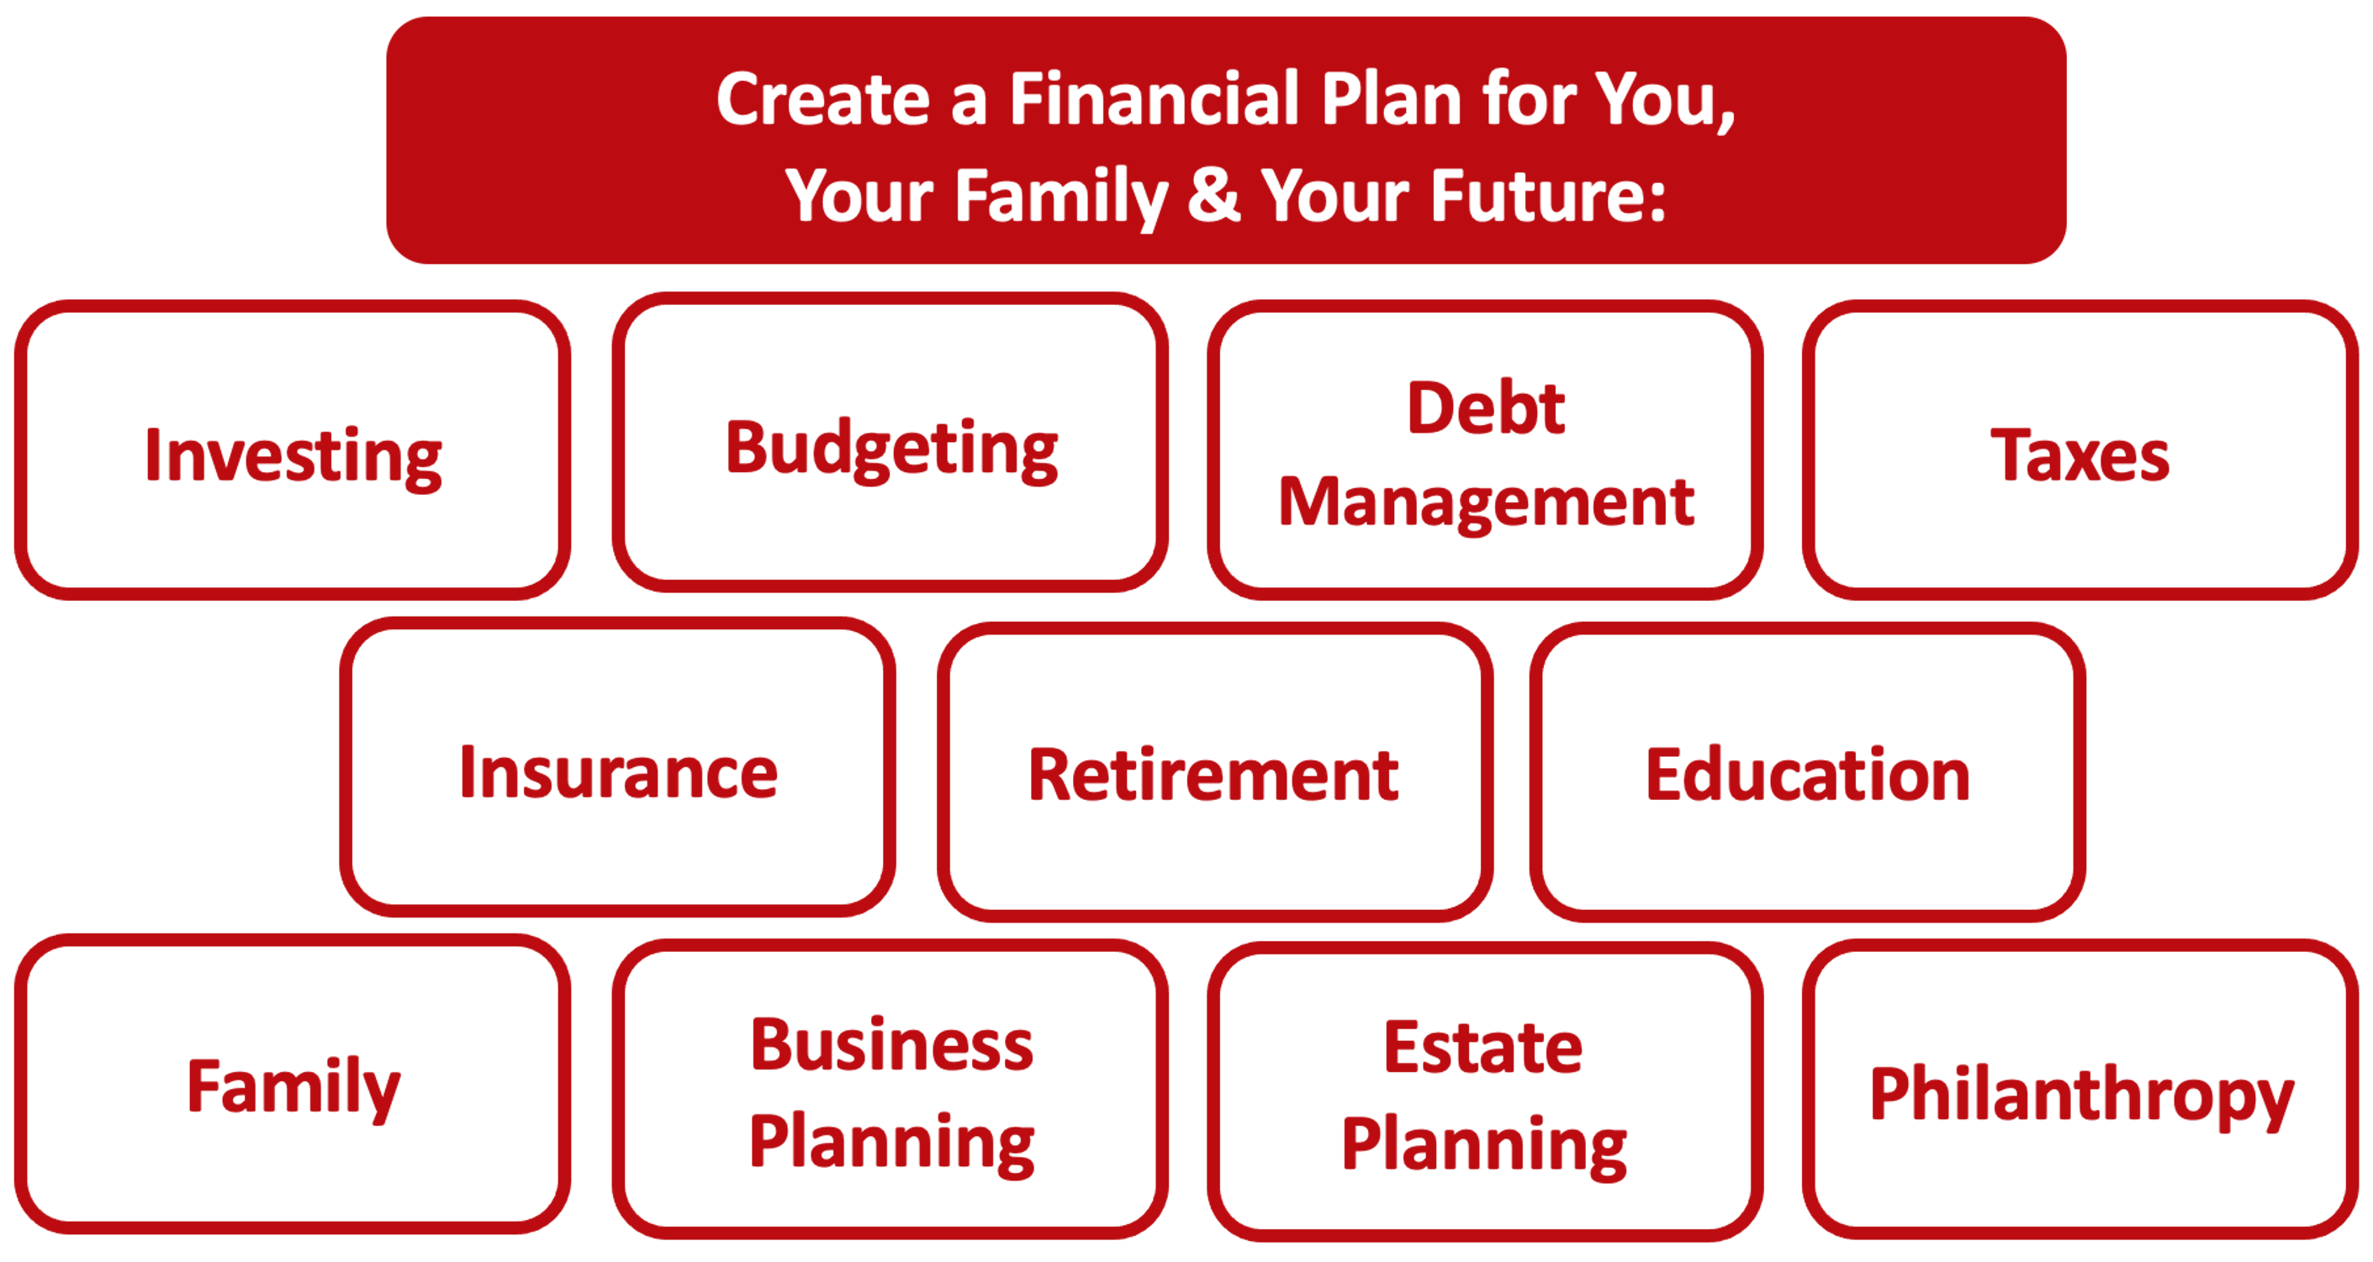

Slide 4
Owning Your Financial Future
YOUR VALUES
YOUR GOALS
Education
Career
Family
FINANCIAL STRATEGIES
Investing
Income & Expense Management
Debt Management
Taxes, Insurance & Other

Slide 5
Owning Your Financial Future
YOUR VALUES
YOUR GOALS
Education
Career
Family
FINANCIAL STRATEGIES
Investing
Income & Expense Management
Debt Management
Taxes, Insurance & Other

Slide 6
Owning Your Financial Future
YOUR VALUES
YOUR GOALS
Education
Career
Family
FINANCIAL STRATEGIES
Investing
Income & Expense Management
Debt Management
Taxes, Insurance & Other

Slide 7
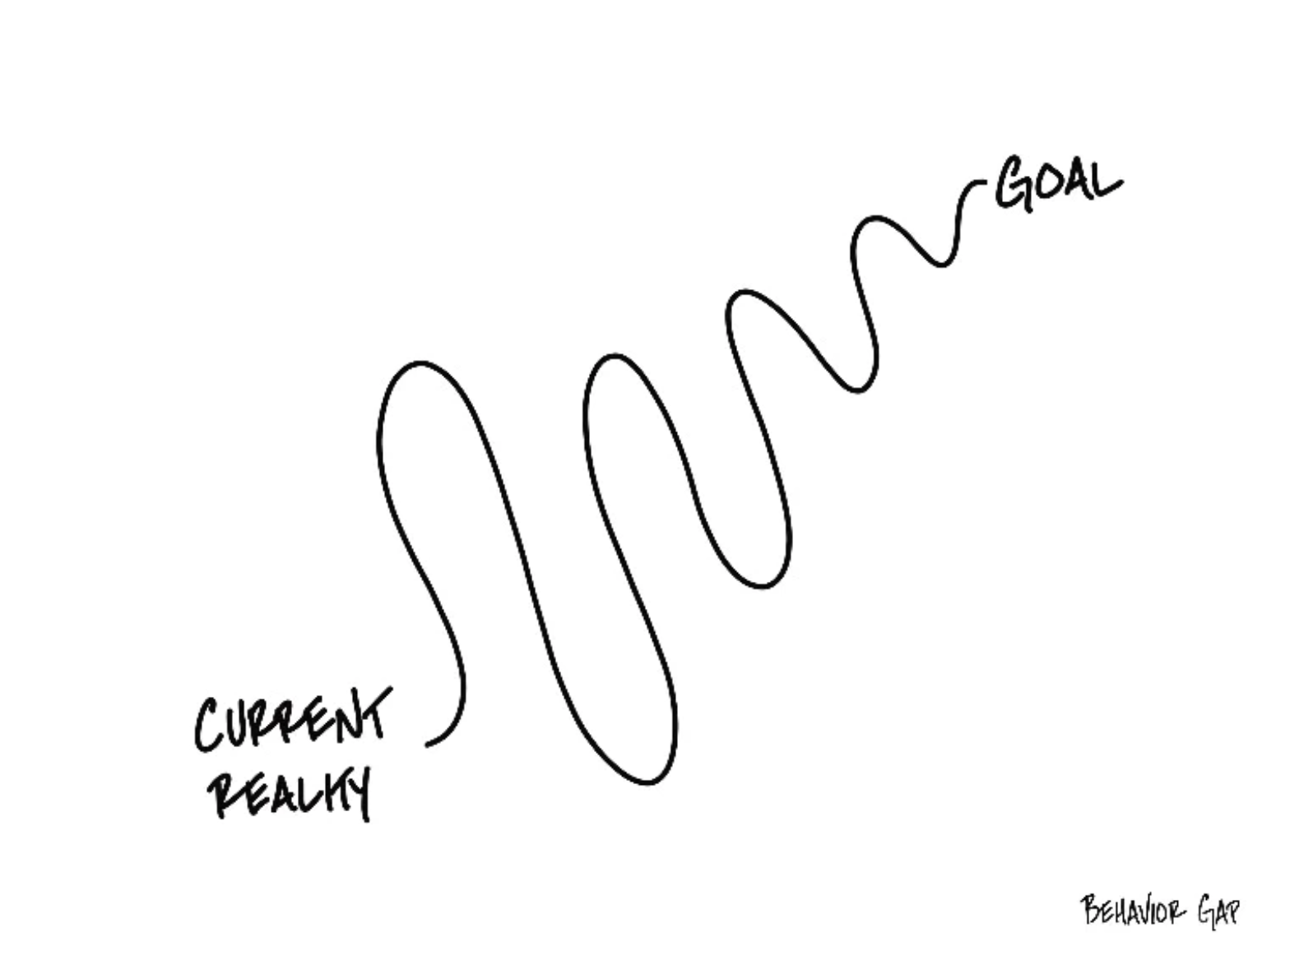

Slide 8
Opening Quiz – Question #1
If you sold cookies out of your apartment during 2022 and made $500 from those sales, you owe taxes on that $500 of income.
TRUE
FALSE

Slide 9
Opening Quiz – Question #1
If you sold cookies out of your apartment during 2022 and made $500 from those sales, you owe taxes on that $500 of income.
TRUE
FALSE
Maybe

Slide 10
Opening Quiz – Question #2
If you sold cookies out of your apartment during 2022 and made $500 from those sales, and spent $200 making those cookies, what do you owe taxes on?
$500
$300
$200
$0

Slide 11
Opening Quiz – Question #2
If you sold cookies out of your apartment during 2022 and made $500 from those sales, and spent $200 making those cookies, what do you owe taxes on?
$500
$300
$200
$0

Slide 12
Opening Quiz – Question #3
If you sold cookies out of your apartment during 2022 and made $500 from those sales, and spent $700 making those cookies, what do you owe taxes on?
$500
$700
$0
You get a refund
for the $200 loss

Slide 13
Opening Quiz – Question #3
If you sold cookies out of your apartment during 2022 and made $500 from those sales, and spent $700 making those cookies, what do you owe taxes on?
$500
$700
$0
You get a refund
for the $200 loss

Slide 14
Opening Quiz – Question #4
If you earned $13,500 of income in 2022, which of the following applies to you:
You owe taxes on the entire $13,500.
It depends on whether someone else claims you as a dependent.
You do not owe any taxes and you do not have to file a tax return.
You do not owe any taxes but you have to file a tax return.

Slide 15
Opening Quiz – Question #4
If you earned $13,500 of income in 2022, which of the following applies to you:
You owe taxes on the entire $13,500.
It depends on whether someone else claims you as a dependent.
You do not owe any taxes and you do not have to file a tax return.
You do not owe any taxes but you have to file a tax return.

Slide 16
Opening Quiz – Question #5
Imagine you put $1,000 into a Roth IRA today.
Imagine this grows to become $25,000 over the next 35 years.
When you withdraw that $25,000 at age 60, what income will be taxed?
NONE
$25,000
$24,000
$1,000

Slide 17
Opening Quiz – Question #5
Imagine you put $1,000 into a Roth IRA today.
Imagine this grows to become $25,000 over the next 35 years.
When you withdraw that $25,000 at age 60, what income will be taxed?
NONE
$25,000
$24,000
$1,000

Slide 18
Opening Quiz – Question #6
If you spend $2,500 (or more) on education expenses that are required for your degree – including tuition, books, supplies, maybe a computer – you might be able to receive a $2,500 credit on your tax return.
TRUE
FALSE

Slide 19
Opening Quiz – Question #6
If you spend $2,500 (or more) on education expenses that are required for your degree – including tuition, books, supplies, maybe a computer – you might be able to receive a $2,500 credit on your tax return.
Check out the American Opportunity Tax Credit (up to $2,500) and the Lifetime Learning Credit (up to $2,000) to see if you are eligible for either credit.
Credits directly reduce the taxes you owe…which is really nice.
TRUE
FALSE

Slide 20
Opening Quiz – Question #7
If you are an international student but do not earn any income during a given year, you do NOT need to file a tax return or any return with the IRS.
TRUE
FALSE

Slide 21
Opening Quiz – Question #7
If you are an international student but do not earn any income during a given year, you do NOT need to file a tax return or any return with the IRS.
If you received any income, you have to file a tax return (Form 1040).
But, if you did not receive any income, you still need to file Form 8843 to tell the IRS that you were in the US but did not earn any income.
TRUE
FALSE

Slide 22
Happiness
Long-Term Goals
Short-Term Goals
Financial Needs
Family Needs

Slide 23
You cannot escape the responsibility
of tomorrow by avoiding it today.

Slide 24
5 Things You Can Do To Reduce Your Taxes
Open an Individual Retirement Account or Roth IRA
  You can defer income tax and avoid capital gains tax altogether
Talk to HR and reduce your tax withholding
  If you get a refund, you are loaning your income to the government
Cluster your income so you make less than $13,850 in a year
  If possible, shift income between years to get the maximum deduction
Scan tax code and identify 3-5 deductions & credits you qualify for
  Child tax credit, education expenses (tuition, books…), student loan interest, charitable deductions, small business or hobby-related expenses
Get rid of your income

Slide 25
4 Frequently Asked Questions – TAXES
Gross Salary & Wages
Less: Medical Expenses
Less: Student Loan Interest paid
Less: Contributions to Retirement Accounts
Adjusted Gross Income
Less: Standard Deduction or Itemized Deduction
Taxable Income
x Tax Rate .
Gross Taxes Owed
Less: Tax Credits .
Taxes Owed
“Above-the-Line” Deductions.
We like these because they reduce “Adjusted Gross Income” and you also get another deduction “below-the-line”
Standard Deduction = $13,850 for 2023
(or $27,700 for married-filing-jointly)
Everyone gets this deduction / subtraction, at least. Some will “itemize” certain deductions to get an even larger subtraction
Credits are wonderful → The reduce the taxes owed, dollar-for-dollar
But not everyone will have credits. They are for specific situations (see previous slide), but do a little homework to see if any apply to you.

Slide 26
Personal Finance is…personal.
It’s about you and not about anyone else.
You have to make it about you and your goals.

Slide 27
Because personal finance is personal, it is virtually impossible for me to give you any specific advice.
However, there is one word of advice that applies to 99% of people working on their finances:
SAVE

Slide 28
INDULGENCE is good.
IMPULSE is bad.

Slide 29
WHAT IS DEBT
Debt is borrowing from YOUR future.
We borrow because we want something today that we cannot afford today.
We make a promise to pay for that something in the future.
The entity we borrow from wants to make money. They are not our friends.
We have to pay them helping us get what we want today.
  At a minimum, we pay them interest on our debt.
  Depending on the type of debt, we may have to pay them much more (fees, collateral, earnings, control, etc.)

Slide 30
WHAT IS DEBT
Debt is borrowing from YOUR future.
If your debt is keeping you up at night…
If your debt is preventing you from achieving your goals…
If your debt is damaging your relationships…
…Then you may have too much debt.
(we will return to this issue later)

Slide 31
One Truism About DEBT
If you borrow $10,000,
You will have to repay $10,000.
Whatever you borrow, you will have to repay – in full, with interest – 99% of the time. Lenders do not exist to give you money.
One good exception: Student loan forgiveness.
Lots of bad exceptions: Default, bankruptcy, short sale…

Slide 32
Frequently Asked Question
Is it smart to pay off student debt as soon as you are able to?
General Answer: No, not for most people.
Student loans – if they are federally subsidized loans – are some of the BEST debt you have.
They generally have low interest rates, flexible repayment plans& the possibility of forgiveness.
HOWEVER, if you have private, unsubsidized student loans, they could be BAD debt that you want to pay off as soon as you are able.

Slide 33
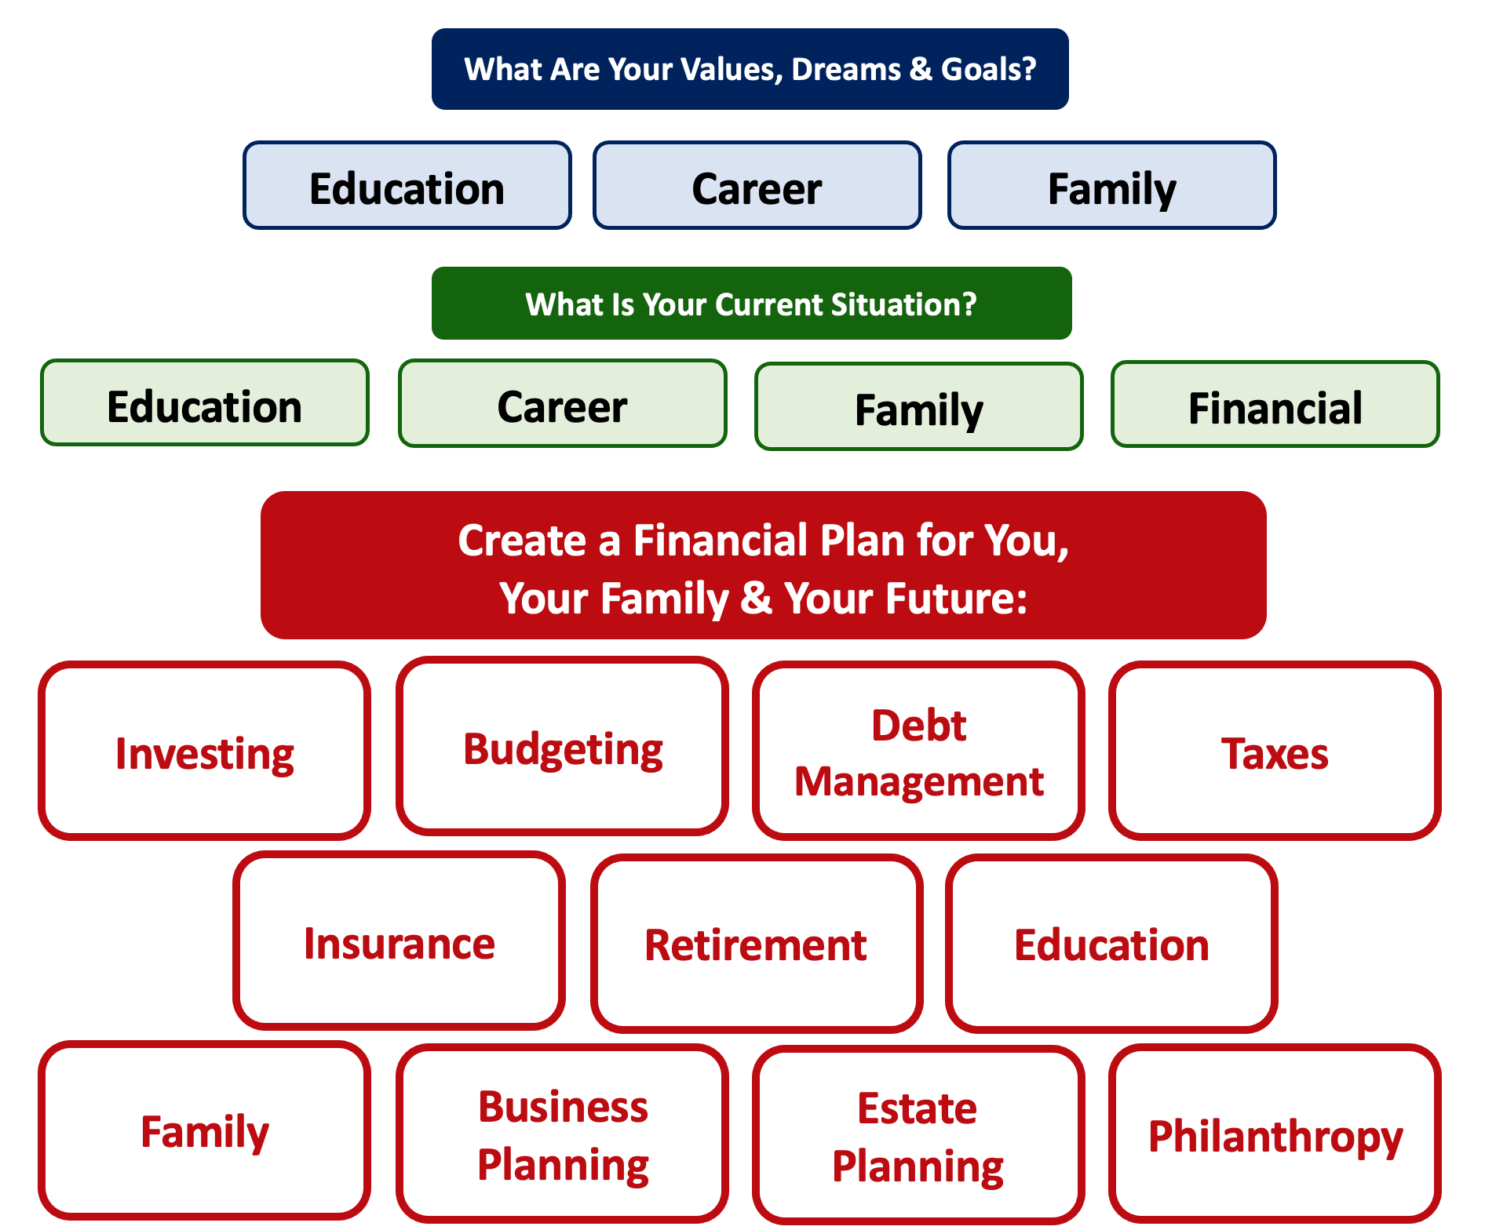
Debt is NOT a bad thing.
Debt can help us achieve our goals, depending on our current situations and what those goals are.
Debt is also called “leverage” – because it gives us the ability do things we might not be able to do otherwise.

Slide 34
Debt is NOT a bad thing.
My one primary piece of advice:
Whenever borrow money – whether it’s $20 for a Friday night pizza on your credit card or a $10,000 student loan – have a plan for paying it back.
Know why you are borrowing and where you will get the money to repay it.

Slide 35
A Little Math: Good Debt vs. Bad Debt

Slide 36
A Little Math: Good Debt vs. Bad Debt
Yes, I’ve simplified this a little. You will be making debt payments on your mortgage over those 3 years, so that would count against your equity growth. But this also means you would repay less in 3 years, which would increase your equity growth. And I have ignored taxes: both the benefits from using a mortgage and any costs due to the gains you may earn on the sale. But the idea here is to show how debt can create – or leverage – opportunities today to create value in the future.

Slide 37
A Little Math: Good Debt vs. Bad Debt
Isn’t this a lot like what you’re doing with your education?
You’re investing today – time, energy, money – in order
to create bigger and better opportunities for your future.
These opportunities may or may not be financial.
These opportunities are what will help you live your values and achieve your goals & dreams.
Yes, you do have to repay the money you borrowed. But if you are borrowing the money to achieve your dreams – dreams that you would not otherwise be able to achieve – then it’s probably a wonderful investment for you.

Slide 38




Good Debt vs. Bad Debt
High cost, both in $$$ and opportunity
Lots of uncertainty
Potential for enormous return
Perfectly aligned with values, goals & dreams
High cost, both in $ and opportunity
Lots of uncertainty
Potential for some return
Usually aligned with values, goals & dreams
Very high cost
Short-term fulfillment
No future return
Unrelated to values, goals & dreams

Slide 39
Good Debt vs. Bad Debt
$100,000 of principal
$45,435 of interest
Repaid over 20 years @ 4% interest

Slide 40
Good Debt vs. Bad Debt
$100,000 of principal
$58,389 of interest
Repaid over 20 years @ 5% interest

Slide 41
Good Debt vs. Bad Debt
$100,000 of principal
$216,030 of interest
Repaid over 20 years @ 15% interest

Slide 42
Good Debt vs. Bad Debt
Is this debt aligned with my values, goals & dreams?
How am I going to repay this debt?

Slide 43
Good Debt vs. Bad Debt
NOTE:
Using a credit card is not necessarily a bad idea.
Only racking up loads of credit card debt is a bad idea.
I regularly use 3 credit cards.
Here’s how and here’s why…

Slide 44
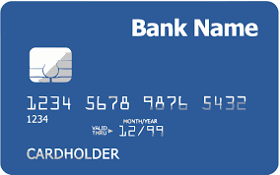
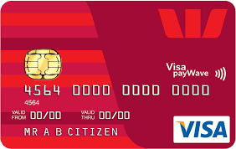
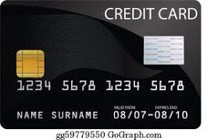
Credits Cards as Tools for Financial Planning
Card #1: Automatic bill payment of recurring monthly expenses (phone, insurance, cable, utilities)
Card #2: Living and discretionary expenses (gas, groceries, coffee, pizza, new shoes)
Card #3: Non-recurring big expenses (vacation, holidays, charity, new refrigerator)
Card #3 frequently has a $0.00 balance

Slide 45
Credits Cards as Tools for Financial Planning
WHY DO I DO THIS?
Mental Budgeting: This helps me mentally be aware of what I’m spending and why I’m spending.
  Instead of just knowing that I’m putting $1,000 on my credit cards in a month, separating the expenses across cards forces me to be aware of what I’m spending money on.
  When I review my statements and budgets at the end of each month, this gives me an easy opportunity to judge myself and to analyze my own behavior.
Card #1: Automatic bill payment of recurring monthly expenses (phone, insurance, cable, utilities)
Card #2: Living and discretionary expenses (gas, groceries, coffee, pizza, new shoes)
Card #3: Non-recurring big expenses (vacation, holidays, charity, new refrigerator)

Slide 46
Credits Cards as Tools for Financial Planning
WHY DO I DO THIS?
FREE MONEY!
  I pay off the full balance of each card each month. If I make a purchase on October 5, the cash does not leave my bank account until December 1.
    It might only be a penny or two, but earning interest during those 57 days feels kind of nice.
  Miles, cash-back and other rewards.
    Choose a card with benefits that you would be paying for anyway. And then cash in the rewards instead of paying cash in the future.
Card #1: Automatic bill payment of recurring monthly expenses (phone, insurance, cable, utilities)
Card #2: Living and discretionary expenses (gas, groceries, coffee, pizza, new shoes)
Card #3: Non-recurring big expenses (vacation, holidays, charity, new refrigerator)

Slide 47
LET’S MAKE THIS PERSONAL…
WHAT IMPACTS YOUR CREDIT RATING AS A CONSUMER?

Slide 48
LET’S MAKE THIS PERSONAL…
WHAT IMPACTS YOUR CREDIT RATING AS A CONSUMER?
35% Payment History – This is perhaps this simplest category, as it looks at how well you repay all borrowed amounts on credit cards, retail accounts, auto loans, utilities and phone bills, other installment loans and other debts. The better you are at repaying, the better your Payment History. Pay your bills on time.

Slide 49
LET’S MAKE THIS PERSONAL…
WHAT IMPACTS YOUR CREDIT RATING AS A CONSUMER?
30% Amounts Owed –The amount you owe is not simply about how much money you owe, but it’s also about how much of your available credit you use. If you have a credit card limit of $5,000 and your balance is $4,000, that’s worse than having a limit of $20,000 and a balance of $10,000. There are many trade-offs within this category and it can be confusing.
Pro-tip if you are using more than 30% of your available balance: Pay it off or down before the end of your reporting cycle and the credit agencies will never know it existed.

Slide 50
LET’S MAKE THIS PERSONAL…
WHAT IMPACTS YOUR CREDIT RATING AS A CONSUMER?
30% Amounts Owed –The amount you owe is not simply about how much money you owe, but it’s also about how much of your available credit you use. If you have a credit card limit of $5,000 and your balance is $4,000, that’s worse than having a limit of $20,000 and a balance of $10,000. There are many trade-offs within this category and it can be confusing.
Pro-tip if you are using more than 30% of your available balance: Pay it off or down before the end of your reporting cycle and the credit agencies will never know it existed.
One thing you can do tomorrow that might improve your credit score:
Ask for a credit limit increase on all of your credit cards or outstanding lines of credit.

Slide 51
LET’S MAKE THIS PERSONAL…
WHAT IMPACTS YOUR CREDIT RATING AS A CONSUMER?
15% Length of Credit History – This is also pretty simple – the longer your history of paying bills and loans, the better off you’ll be. Yes, this does bias against younger borrowers – but if your behavior in the other categories is strong, you should be okay. Be patient – you’ll build your history.

Slide 52
LET’S MAKE THIS PERSONAL…
WHAT IMPACTS YOUR CREDIT RATING AS A CONSUMER?
10% Credit Mix – Perhaps ironically, it can be better to have 5 different accounts that you repay regularly than it is to have just 2 different accounts. The greater the variety of accounts you have, the more opportunity you have to indicate that you are a low credit risk. Of course, if you have 5 accounts and you miss your payments, that will be doubly bad. Pay your bills on time and the Credit Mix will take care of itself.

Slide 53
LET’S MAKE THIS PERSONAL…
WHAT IMPACTS YOUR CREDIT RATING AS A CONSUMER?
10% New Credit – Opening a large number of new accounts in a short period of time may indicate that you are a higher risk. So, is the moral to never open new accounts? No – because then you can never indicate that you are a low risk. Be mindful of opening too many accounts in a short period of time, pay all your bills on time, and the New Credit category will not be a big issue.

Slide 54
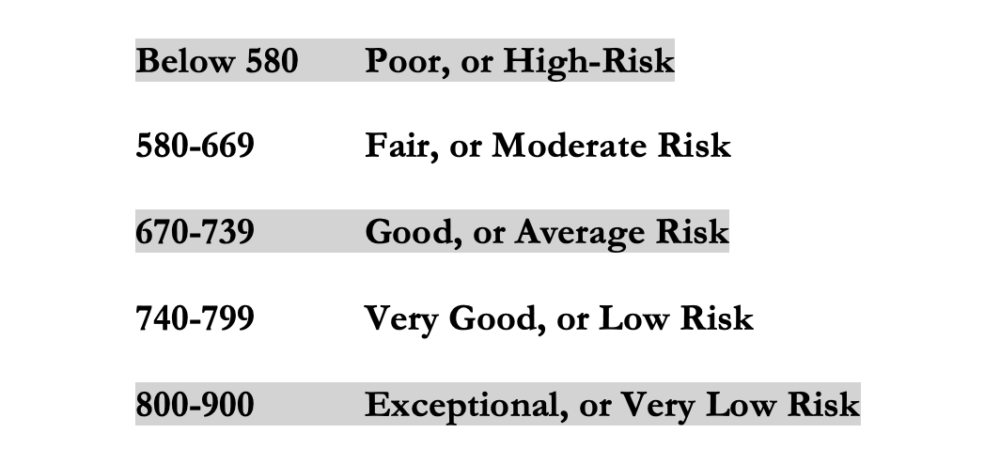
LET’S MAKE THIS PERSONAL…
WHAT IMPACTS YOUR CREDIT RATING AS A CONSUMER?
Your FICO Score will become an actual number: between 250 and 900.
The higher your Score, the lower interest rates you will pay on most loans.
The average FICO Score for Americans is just over 700.
The average in Louisiana is 677, the second lowest in the 50 U.S. states; only Mississippi has a lower average FICO Score.

Slide 55
LET’S MAKE THIS PERSONAL…
WHAT SHOULD YOU BE FOCUSED ON WITH RESPECT TO YOUR CREDIT SCORE?
If your FICO Score is below 600, there are probably 1 or 2 areas where you have significant weaknesses in your history.
Commit to correcting these weaknesses and not creating any new weaknesses.
If your FICO Score is between 600-700, there are probably 1 or 2 areas that can be improved – or where you used to have significant weaknesses.
Keep doing what you’re doing – and commit to not creating any new concerns.
If your FICO Score is over 700, keep doing what you’re doing and time will eventually get you the best score possible.

Slide 56

Isn’t this a lot like what you do with your education planning?

Slide 57
And as you begin to develop your full financial plan – seeing the trade-offs with Budgeting, Investing and Debt Management – you will begin to see how interconnected all of these aspects are.
Finance is just a matter of managing money across time.
And one thing we know about time is that our plans will change – so the better you have control of your initial financial plan, the more you will be able to adjust when life and time give you new goals.
Isn’t this a lot like what you do with your education planning?

Slide 58
Financial Wellness
A goal without a plan is just a dream.
Wealth is largely the result of habit.
The most difficult thing is the decision to act; the rest is mere tenacity.
It takes as much energy to plan as it does to wish.
You cannot escape the responsibility of tomorrow by avoiding it today.

Slide 59
Don’t wait around for other people to be happy for you.
Any happiness you get,
You’ve got to make yourself.
~ Alice Walker, poet & novelist
A goal without a plan is just a dream.
Wealth is largely the result of habit.
The most difficult thing is the decision to act; the rest is mere tenacity.
It takes as much energy to plan as it does to wish.
You cannot escape the responsibility of tomorrow by avoiding it today.

Slide 60
brian.bolton@louisiana.edu http//:business.louisiana.edu/financeispersonal

