Slide 1


Building Generation Wealth with the
UL Lafayette Reginald F. Lewis Scholars
An Investment Club for the Scholars, by the Scholars
June 17, 2024
Ruben Henderson, Brian Bolton &
the UL Lafayette Reginald F. Lewis Scholars

Slide 2
Our Mission
The University of Louisiana at Lafayette Reginald F. Lewis Scholars’ Investment Club exists:
  To learn about investment strategies and philosophies;
  To gain practical investing experience; and,
  To empower students to take greater control of their own financial futures.

Slide 3
Our Mission
Most of us will have the opportunity to participate in a company-sponsored retirement plan at some point.
Most of us can open our own Individual Retirement Account to build long-term, passive income on our own.
All of us can manage our own investments, earning long-term, passive income returns of 8-12% per year.

Slide 4
If you save or invest $5,000 per year….
With a 1% investment return, you will have a total of $325,539 after 50 years.
This includes $75,539 of passive income.

Slide 5
If you save or invest $5,000 per year….
With a 4% investment return, you will have a total of $793,869 after 50 years.
This includes $543,869 of passive income.

Slide 6
If you save or invest $5,000 per year….
With a 7% investment return, you will have a total of $2,174,930 after 50 years.
This includes $1,924,930 of passive income.

Slide 7
If you save or invest $5,000 per year….
With an 11% investment return, you will have a total of $9,261,680 after 50 years.
This includes $9,011,680 of passive income.
If you save or invest $5,000 per year….
With a 11% investment return, you will have a total of $9,261,680 after 50 years.
This includes $9,011,680 of passive income.

Slide 8
If we invest for 20 years instead of 50 years:
At 1%: $100,000 ➔ $111,196
At 4%: $100,000 ➔ $154,846
At 7%: $100,000 ➔ $219,326
At 11%: $100,000 ➔ $356,326

Slide 9
A Few Opening Morals
Begin investing as early as you can.
Get comfortable taking some risks with your investing so you can earn bigger returns.
Get comfortable playing the long game.

Slide 10
A Few Opening Morals
SAVINGS
INVESTING
OWNERSHIP
WEALTH

Slide 11
A Few Opening Morals
SAVINGS
INVESTING
OWNERSHIP
WEALTH

Slide 12
The University of Louisiana at Lafayette
Reginald F. Lewis Scholars Investment Club
I deposited $10,000 into a brokerage account with Fidelity.
The Scholars manage that money.
  They decide which companies we invest in.
  They decide which industries we focus on.
  They decide when to buy, when to sell.
  …with some fine print, but not much.

Slide 13
The University of Louisiana at Lafayette
Reginald F. Lewis Scholars Investment Club
The fine print:
  All investments should be held for at least 2 months.
  We want 8-20 different companies in our portfolio.
  We want 4+ different industries in our portfolio.
  The Scholars keep all profits.
    If the $10,000 grows to $12,000, they get $2,000.
    If the $10,000 falls to $9,000, I lose $1,000.

Slide 14
The University of Louisiana at Lafayette
Reginald F. Lewis Scholars Investment Club
The fine print:
  All investments should be held for at least 2 months.
  We want 8-20 different companies in our portfolio.
  We want 4+ different industries in our portfolio.
  The Scholars keep all profits.
    If the $10,000 grows to $12,000, they get $2,000.
    If the $10,000 falls to $9,000, I lose $1,000.

Slide 15
The University of Louisiana at Lafayette
Reginald F. Lewis Scholars Investment Club
We started in Spring 2024.
We will meet every 2-4 weeks to review our portfolio and to make investment decisions.
The Scholars talk about the portfolio, talk about the economy, ask questions about finance, and debate like crazy with each other over investments and business and the economy.
  For the most part, Ruben Henderson and Brian Bolton just sit back and watch.
At the end of each meeting, the Scholars will instruct Brian Bolton what trades to make.

Slide 16
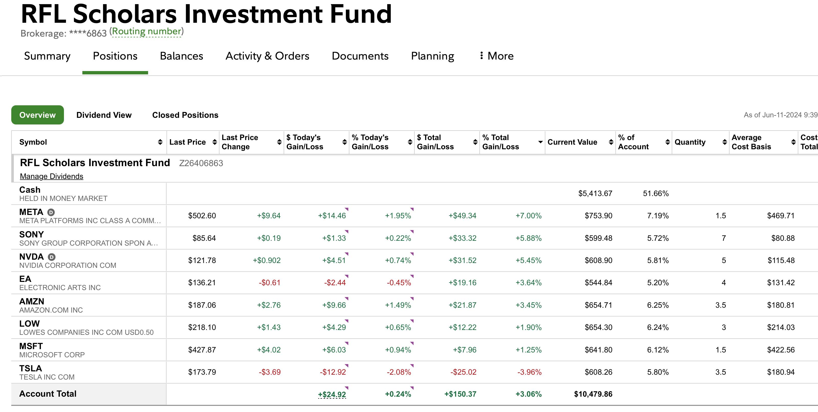

Slide 17
May 30 – First trades
Profit to date: +$150.37
Amount invested: $4,915.82
That’s a 3.06% return-on-investment in 3 weeks
  The overall stock market is up 1.48% over the same time period
That’s a 50+% annualized return on investment

Slide 18
We have $5,413.67 sitting in cash.
This is not a savings club.
This is an INVESTMENT CLUB.
We need to invest that cash…and that’s what we are here to do today

Slide 19
The University of Louisiana at Lafayette
Reginald F. Lewis Scholars Investment Club
Today’s Plan:
  Each Scholar will make 1 stock recommendation.
  The Scholars can ask questions of each other.
  When they are all done, the audience can engage and ask questions.
  Then, the Scholars will vote on their investment decisions – what are they going to buy?
  Finally, time permitting, we will go to our Fidelity account and execute the trades.

Slide 20
Caleb
Franklin
Berkshire Hathaway
JaCaleb
Smith
Berkshire Hathaway
Frank
Clavelle III
Berkshire Hathaway
Isaiah
Crawford
Berkshire Hathaway
Johnnie
Hardy
Berkshire Hathaway
Jalen
Jackson
Berkshire Hathaway
Tafari
Beard
Berkshire Hathaway
Christian
Steward
Berkshire Hathaway

Slide 21
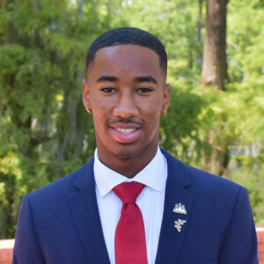
Caleb Franklin
Berkshire Hathaway

Slide 22
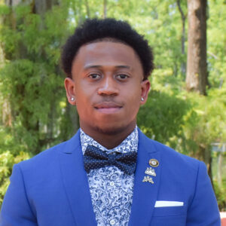
JaCaleb Smith
Berkshire Hathaway

Slide 23
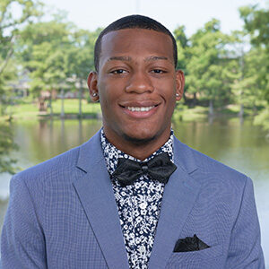
Frank Clavelle III
Berkshire Hathaway

Slide 24
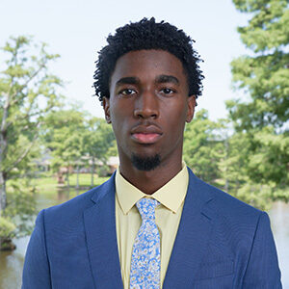
Isaiah Crawford
Berkshire Hathaway

Slide 25
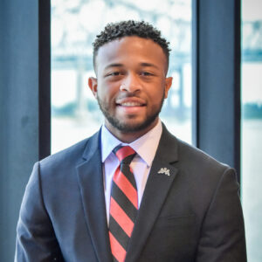
Johnnie Hardy
Berkshire Hathaway

Slide 26
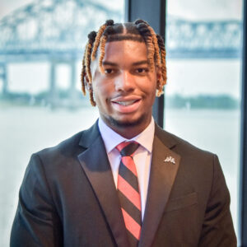
Jalen Jackson
Berkshire Hathaway

Slide 27
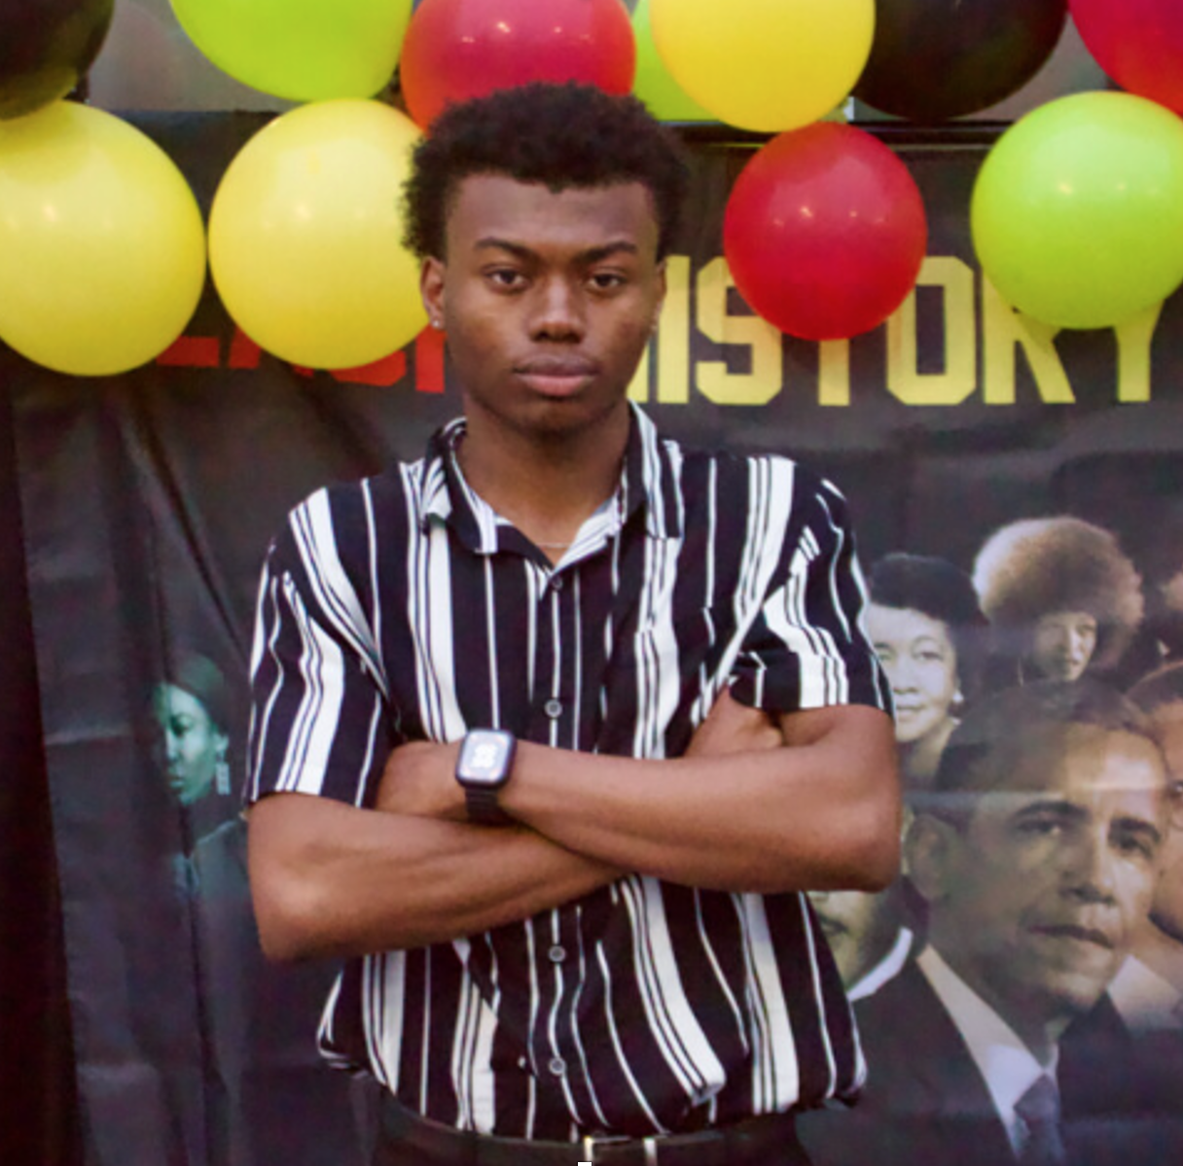
Tafari Beard
Berkshire Hathaway

Slide 28
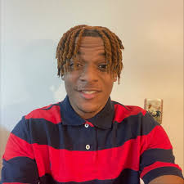
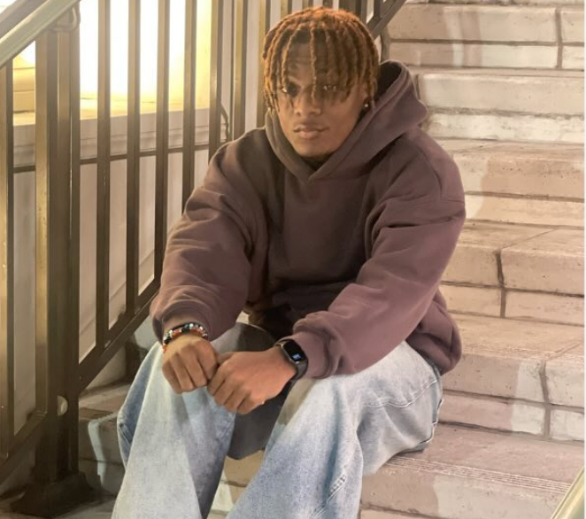
Christian Steward
Berkshire Hathaway

Slide 29
Financial Wellness
& Your Values
A goal without a plan is just a dream.
Wealth is largely the result of habit.
The most difficult thing is the decision to act; the rest is mere tenacity.
It takes as much energy to plan as it does to wish.
You cannot escape the responsibility of tomorrow by avoiding it today.

Slide 30
Don’t wait around for other people to be happy for you.
Any happiness you get,
You’ve got to make yourself.
~ Alice Walker, poet & novelist
A goal without a plan is just a dream.
Wealth is largely the result of habit.
The most difficult thing is the decision to act; the rest is mere tenacity.
It takes as much energy to plan as it does to wish.
You cannot escape the responsibility of tomorrow by avoiding it today.

Slide 31
brian.bolton@louisiana.edu http//:business.louisiana.edu/financeispersonal

