Slide 1


Entrepreneurship as a Means
to Economic Empowerment
Brought to you by the Louisiana Entrepreneurship & Economic Development Center
June 17, 2024
Jonathan Shirley, UL Lafayette LEED Center
Kevin Guillory, UL Lafayette LEED Center
Brian Bolton, UL Lafayette, Professor of Finance

Slide 2
https://business.louisiana.edu/leed
Brian Bolton
Professor of Finance brian.bolton@louisiana.edu http://business.louisiana.edu/financeispersonal
Jonathan Shirley
LEED Center Program Manager
jonathan.shirley@louisiana.edu
Kevin Guillory
LEED Center Operations Manager
kevin.guillory@louisiana.edu

Slide 3
ENTREPRENEURIAL INSPIRATION
Don’t wait around for other people to be happy for you.
Any happiness you get,
You’ve got to make yourself.
~ Alice Walker
American novelist, poet, activist

Slide 4
Entrepreneurship and economic development are processes that can be learned.
Universities are a driver in community development
Values
Operate with a growth mindset.
Head & Heart Philosophy

Slide 5

The Head and the Heart
We care as much about you as we care about your idea.
Notes:
There is no greater distance, than that of the gap between what I know in my head, and what I believe in my heart.

Slide 6


The longest journey you will ever take is the 18 inches from your head to your heart.
18 inches

Slide 7
Assets and expenses
Accounting
Breakeven point
Economics
Revenue drivers
Finance
Market share
Marketing
Provide value
Mission Statement
Finding opportunity

Slide 8
Assets and expenses
Accounting
Breakeven point
Economics
Revenue drivers
Finance
Market share
Marketing
Vision
Dreams
Provide value
Who cares?
Finding opportunity
What if?
Purpose
Why?

Slide 9
What is ENTREPRENEURSHIP?
Entrepreneurship is about solving problems.

Slide 10
What is ENTREPRENEURSHIP?
Every business has to solve a problem or make someone’s life better.
      Shoes
      Sexy Cakes – Late night food

Slide 11
What is ENTREPRENEURSHIP?
The process of creating value by bringing together a unique combination of resources to exploit an opportunity

Slide 12

Empowerment
    To create your own job
    To create jobs for others
    To create your own wealth
    To create your own sense of pride and self-worth
    To create your own identity
    To create your own contribution to the world
    To create your own ability to give back

Slide 13

Empowerment – putting people in a position to give, not to take

Slide 14
THE ENTREPRENEURIAL MINDSET
Attitude
I can affect change
There is a better way
Opportunities are
everywhere
Embrace innovation,
change & growth
Failure is learning
Optimism
Passion for what you do

Slide 15
Why talk mindset??
Time (talent development)
Born with it, genetics
Luck

Slide 16
Why talk mindset
Mindset
66%

Slide 17


Slide 18
Centering Your Creativity
Bootstrap – carried out with minimum resources of advantages.
Leverage – Using what you have to get what you need
Risk mitigation – the process of developing options and actions to enhance opportunities and reduce threats.
Financing – Obtaining money to fund a business

Slide 19

Bootstrapping
Trying to start a business using minimal external capital and resources
Key Characteristics of Bootstrapping:
  Self-Funding – Using personal finances or profits
  Frugality – Keeping expenses low
  Resourcefulness – Maximizing available resources
  Independence – Maintaining control of the business.
Bootstrapping requires:
  A strong commitment to discipline a patience.
  A willingness to take calculated risks.
  A focus on achieving long-term success

Slide 20
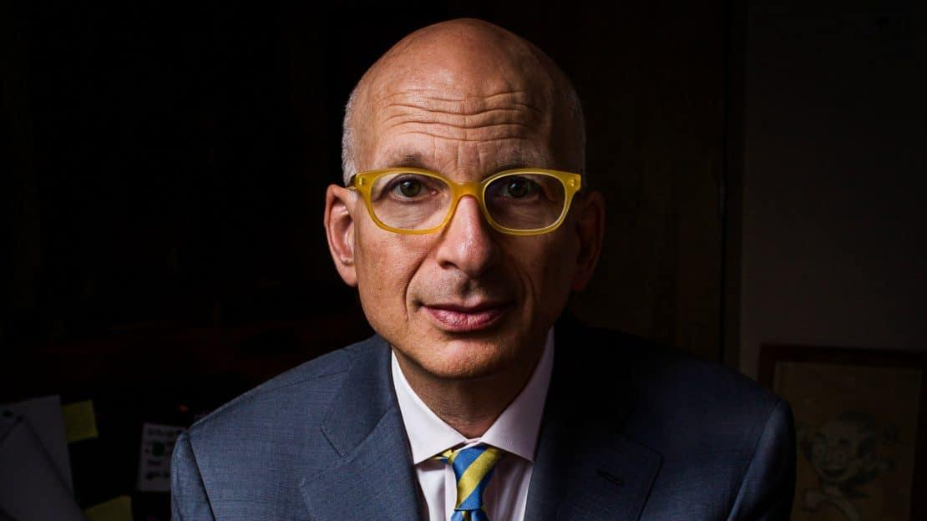
Bootstrapping
“Whatʼs a bootstrapper to do?
You have to go where the other guys canʼt. Take advantage of what you have so that you can beat the competition with what they donʼt.”
-Seth Godin
The Bootstrapper’s Bible: How to Start and Build a Business with a Great Idea and (Almost) No Money

Slide 21

Book Recommendation
“The Power of Broke is a mind-set…it is all about substance over flash. It’s about creativity over certainty. It’s about taking a shot over playing it safe…(money) will never be enough to buy all the passion, ingenuity, and determination it takes to have success over the long haul.”

Slide 22

Risk Mitigation
Willingness to pursue actions that a represent a meaningful chance of significant loss
Entrepreneurs are not high risk-takers, they are calculated risk takers.
What is calculated risk taking?
Minimize downside rather that focusing on upside

Slide 23

How the entrepreneur manages risk
Share the risk
Stage the risk – Annual Tax Bill
Isolate the risk
Lessen the risk

Slide 24
Examples of Risk Mitigation
Lessen fixed costs
Outsource
Use contract labor
Test markets/staged rollouts
Sales on commission
Hold less inventory (longer OCT)
Lock in prices with suppliers
Collaborate with competitors (e.g., on sales, purchases, technology)
Bundle products

Slide 25
Let’s create
Groups, come up with a company that solves a problem of your choosing.
You will have 2 minutes to pitch your idea
Must use the words (nouns and adjectives) that are assigned to you

Slide 26
Nouns and Adjectives
Group 1 – noodle, cat, fuzzy, purple
Group 2 – table, tiger, elegant, cold
Group 3 – banana, car, beautiful, gluten-free
Group 4 – coffee, games, allergic, spicy
Group 5 – sports, shoes, luxurious, affordable

Slide 27
ARE YOU PROVIDING VALUE?
Profit Revenue
Revenue Customers
Customers VALUE
So what value are you providing?
What pain or problem are you solving?
Are you making people’s lives better?

Slide 28
What Can You Do Tomorrow?
Go to https://geauxbiz.sos.la.gov – this is where the State registers businesses
Create an account…regardless of how close you are to starting a business.
Reserve your company name. $25 to hold a name for 120 days.
When you are ready, register your business.
  You will have to choose a legal structure for your business.
  By default, every business is a sole proprietorship. But this is risky.
  We recommend registering as an LLC, or Limited Liability Company.
    This should cost about $200…but it provides optimal protection against liability and lawsuits.
Once registered, you will receive your Articles of Incorporation – you can use this to get business bank accounts and credit cards.
You may want to get an EIN, Employee Identification Number, from the IRS (the EIN is essentially a Social Security Number for your business).

Slide 29
What Can You Do Tomorrow?
Build your team. Don’t try to do everything on your own.
  You probably want to have an attorney and a tax accountant on your team. You may want to connect with other advisors, but having an attorney and accountant on your team is essential.
Separate your personal and business lives as much as possible.
  Get separate bank accounts for the business.
  Establish a credit history for the business.
Find an accounting system you like. Quicken, Quickbooks, TaxBot, Zero, Sage, FreshBooks are all decent options. Learn it, live it, love it.
Build your business plan (or business model canvas). Tell the narrative of your business.
  Banks will want to see this. Investors will want to see this.
  View this as your roadmap or to-do list. Use it to guide both strategy and decision-making.
Go change the world.

Slide 30
https://business.louisiana.edu/leed
Brian Bolton
Professor of Finance brian.bolton@louisiana.edu http://business.louisiana.edu/financeispersonal
Jonathan Shirley
LEED Center Program Manager
jonathan.shirley@louisiana.edu
Kevin Guillory
LEED Center Operations Manager
kevin.guillory@louisiana.edu

