Slide 1
MONEY MATTERS 2023:
UL SYSTEM FINANCIAL WELLNESS SERIES
Session #1:
Adults Returning to Finish a Degree: Financial & Other Concerns
June 6, 2023

Slide 2
Brian Bolton Professor of Finance brian.bolton@louisiana.edu http://business.louisiana.edu/financeispersonal

Slide 3
Owning Your Financial Future
Adults Returning to Finish a Degree: Financial & Other Concerns
June 6, 2023 ***
Financial Planning for Graduate Students
June 7, 2023 ***
Financial & Tax Planning for International Students
June 8, 2023 ***
The Financial Aspects of Your Side- Hustle #1 – Planning, Strategies, Legal, Resources
June 20, 2023
Family Financial Planning: Making Finances Work for the Whole Family
June 23, 2023
Family Financial Planning: Sending Your Loved-Ones Off to College
June 27, 2023
Family Financial Planning: Caring for Adult Dependents
June 28, 2023
Changing Careers: The Financial & Personal Issues
July 13, 2023
Building Savings Accounts & Emergency Funds
July 14, 2023
Financial Planning for Veterans
July 18, 2023 ***
Financial Planning When Retirement is Getting Close (5-7 years out)
July 19, 2023 ***
The Financial Aspects of Your Side- Hustle #2 – Taxes, Profitability, Expansion, Success
July 25, 2023
Financial Planning for the Fun Stuff: Vacations, Home Improvements, New Vehicles
June 26, 2023
Investing 101
August 1, 2023
Navigating the Impacts of Inflation & Turbulent Economic Times
August 2, 2023
Most sessions are from 12:00-1:00pm *** Sessions on June 6, 7, 8 and July 18, 19 are from 3:00-4:00pm.

Slide 4
Happiness
Long-Term Goals
Short-Term Goals
Financial Needs
Family Needs

Slide 5
Financial Wellness
A goal without a plan is just a dream.
Wealth is largely the result of habit.
The most difficult thing is the decision to act; the rest is mere tenacity.
It takes as much energy to plan as it does to wish.
You cannot escape the responsibility of tomorrow by avoiding it today.

Slide 7
What Are Your Values, Dreams & Goals?
Completing College
Education
Career
Family
What Is Your Current Situation?
The best financial and personal investment most of us will ever make is graduating from college. It will empower and enhance everything else we want to achieve in life.
Education
Career
Family
Financial
Create a Personal Financial Plan for You:
Investing
Budgeting
Debt Management
Taxes
Insurance
Retirement
Education
Family
Business Planning
Philanthropy
Estate Planning

Slide 8
Paying for College
Financial Aid & Student Loans
How to Succeed in College
Computers & Technology
Career Planning

Slide 9
Paying for College
College may be the best investment you ever make in yourself. But it is still very expensive – in terms of money, time and energy. Make sure you do the math and understand the full cost of college.
Make a financial budget. Be realistic. Include all known and possible costs.
Make a time budget. Time management is critical. Create a regimen.
There are lots of scholarships & grants available. Talk to lots of people.
The IRS provides credits and deductions for students. Keep every receipt and find out what opportunities are available for you.

Slide 10
Paying for College
What should you consider when estimating the full cost of college? Tuition, fees, books, more fees, computer and other technology and more.
But don’t forget about other life expenses & opportunity costs: gas to get to campus, day care for your children, time-off from work, weekend hours you cannot work, parking on campus, food on campus, printing, binding, instruments, arts supplies, and other resources.
Talk to a lot of different people about the actual costs. Talk to your advisors. Talk to your faculty and the department chairs. Talk to other students.
Look around for grants, scholarships, work-study and other opportunities to get money from your school. There are more grants and scholarships available than you realize – apply for as many of them as you can. It fan be free money.
Track every penny you spend on school – including books and computers and what you pay directly to school. Some of these expenses may be tax deductible. Or you may be eligible for a federal tax credit of $2,000 or $2,500.
Check out the American Opportunity Credit and the Lifetime Learning Credit for specific details.

Slide 11
Financial Aid & Student Loans
Student loans are critical to helping many of us get through college. Shop around, be an informed customer and make sure you know what you are committing to.
Federal subsidized loans and private loans are not the same. Make sure you know which you are getting.
You generally do not have to repay your loans until after you graduate…or stop attending full-time. That’s good. But be prepared to begin making payments when the time comes.
Student loan debt is possibly the best kind of debt anyone can have. But it is still debt. Don’t let it control or ruin your future.

Slide 12
Financial Aid & Student Loans
Never think of student loan money as “free money.” Only borrow what you need.
Always know what your obligations are and have a plan to repay what you borrow.
The average student loan borrower graduates with $30,000 of debt. Current interest rates are about 5% for federal, subsidized loans (and much higher for private loans).
With a 5% interest rate, if you repay that $30,000 over 10 years, you will incur $8,850 of interest charges, making your total repayments equal to $38,850.
With a 5% interest rate, if you repay that $30,000 over 30 years, you will incur $28,550 of interest charges, making your total repayments equal to $58,550.
If you have a private loan with a 10% interest rate and you repay a $30,000 over 30 years, you will incur $95,500 of interest charges, making your total repayments equal to $65,500.
Federal student loans are loans provided by the federal government, to help you invest in yourself as a public good. This means you will probably have a lower interest rate to pay.
Private student loans are provided by private companies so they can increase profits. This means you will probably have a higher interest rate and may not have many of the other benefits of subsidized; be sure you know what your obligations are before you agree to take any money.

Slide 13
Financial Aid & Student Loans
In August 2022, the U.S. Department of Education announced a plan to forgive some student loans and to defer repayments.
Since then, this plan has been contested in Congress and in the courts. We are waiting for the U.S. Supreme Court to decide if student loan forgiveness is legal.
Financial Advice: Plan for the worst, hope for the best.
Only take out loans you need.
Contact your past and current services to learn what all this means to you individually.
Be sure to include all possible payments and expenses in all of your budget plans.

Slide 14
Jobs, Internships & Career Planning
For most students, college is a means to an end, a tool to get someplace better. Have a plan for why you are in college and where your degree is going to take you.
Begin thinking about the jobs and internships you want is now, before you even begin taking your first class again.
Getting an internship is usually the best path to getting the full-time job that you want. Start thinking about your internships early & often.
Talk to career centers, faculty and advisors to learn what jobs are available. Network with alumni and others when possible. Make finding your dream job a top priority throughout college.

Slide 15
Jobs, Internships & Career Planning
The best financial and personal investment you can make is to finish your degree.

Slide 16
Jobs, Internships & Career Planning
Make sure you know what you are going to do after college before you start college. Begin thinking about what you are going to do after college before you even begin college
While on campus or online, reach out to as many people as possible – career centers, faculty, advisors, alumni. Some people will offer only basic and foundational knowledge, while others will be able to get you an interview with a single phone call. Market yourself as much as possible.
And make sure your social media world is cleaned up – your potential employers will be checking it out.
An undergraduate degree is a pre-requisite for any graduate program. If you want a professional career – in education, in business, in architecture, in engineering, in science – you must complete your undergraduate degree first.
Do your research to know what kind of graduate degree helps you achieve your goals. For many professional careers, you may not need a graduate degree at all.

Slide 17
Computers & Information Technology
Both online and on-campus degrees rely on technology more than ever. Do not let this be the reason you struggle to get through college.
Invest in getting up to speed on technology requirements before you begin classes. Your faculty will be little help – you need to do the work.
Include all computer, software, printing and other costs in your budgeting. (And do keep all receipts because the IRS may give you some money back.)
Shop around for discounts on hardware & software. Many schools and companies give students very generous discounts while in school.

Slide 18
Computers & Information Technology
In the 2020s, colleges take it for granted that a certain amount of information technology access and proficiency is required to be a college student.
Make sure you understand the financial investment you will need to gain the access.
Make sure you understand the time investment you will need to gain the proficiency.
If you are an online student, having a reliable computer and reliable internet access is essential.
Courses are designed using the latest software technology. Faculty take it for granted that you will be proficient with this technology (and many times you will be far more proficient than the faculty).
“My computer didn’t work” or “I lost my file” will never be a valid excuse. Make sure you have adequate technology – and then make sure you have a backup plan.
If you are on-campus, you may have the same needs, your campus may have many resources that you can utilize. Find out where these resources are and if they work for you.

Slide 19
Computers & Information Technology
Doing work by hand is rarely the most effective or efficient option. Having your own computer or deciding to use the on-campus computer laboratories will be essential.
Can you succeed as a student using a smart phone as your primary technology? No, probably not.
What is a Learning Management System and why do you care? An LMS is an internet-based platform where faculty will connect with you, will provide information to you and will have you perform assignments. Get familiar with it and check it regularly.
For online classes, the LMS will be your lifeline to the course, where you will complete all videos, lectures and assignments.

Slide 20
How to Succeed in College
The best investment you can make in life is to get a college degree. Finish – and then reap the benefits.
At work, you know what you have to do to succeed, to get a raise, to avoid getting fired. Identify the same factors that will determine what you need to do to achieve your college goals.
We know that, in reality, your college work may be the 3rd or 4th priority in your life. But remember that you are being graded and evaluated against thousands of other students who only have one priority.

Slide 21
How to Succeed in College
Time management is often the most difficult aspect of college; create a system to track all of your assignments, to plan ahead, to complete everything on time.
Make sure you complete every single assignment – yes, every single one. Do not give your faculty any opportunity to make things more difficult for you.
Connect with your faculty early in the term: visit office hours, chat before or after class, send an email.
Recognize that you are not alone in this experience.
Lean on your family and friends to help with both school and non-school issues.
Connect with other students through clubs, organizations, group projects and other means.
Many other students will be in a similar situation to you – or have already been through it – and you can learn a lot from them.

Slide 22
How to Succeed in College
Focus on both the forest and the trees.
Always keep the big picture in mind and know why you’re here.
Take care of your personal and mental health first. All other success will follow.

Slide 23
Paying for College
Financial Aid & Student Loans
How to Succeed in College
Computers & Technology
Career Planning

Slide 24
Happiness
Long-Term Goals
Short-Term Goals
Financial Needs
Family Needs

Slide 25
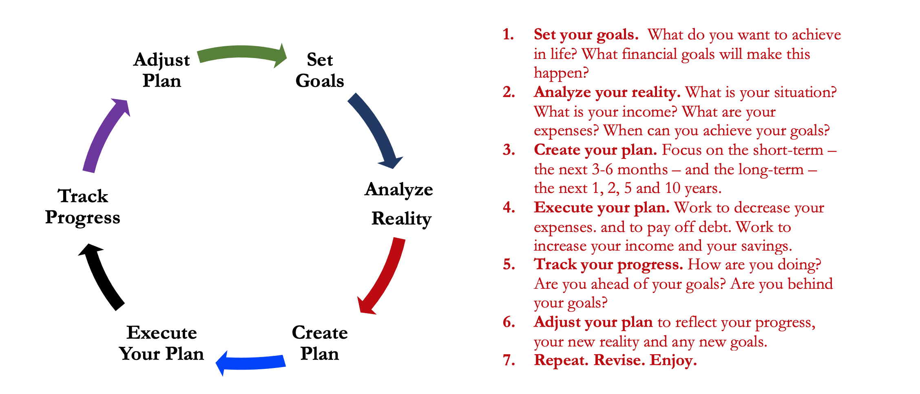
Isn’t this a lot like what you do with your education planning?

Slide 26
Financial Wellness
A goal without a plan is just a dream.
Wealth is largely the result of habit.
The most difficult thing is the decision to act; the rest is mere tenacity.
It takes as much energy to plan as it does to wish.
You cannot escape the responsibility of tomorrow by avoiding it today.

Slide 27
Don’t wait around for other people to be happy for you.
Any happiness you get,
You’ve got to make yourself.
~ Alice Walker

Slide 28
Owning Your Financial Future
Adults Returning to Finish a Degree: Financial & Other Concerns
June 6, 2023 ***
Financial Planning for Graduate Students
June 7, 2023 ***
Financial & Tax Planning for International Students
June 8, 2023 ***
The Financial Aspects of Your Side- Hustle #1 – Planning, Strategies, Legal, Resources
June 20, 2023
Family Financial Planning: Making Finances Work for the Whole Family
June 23, 2023
Family Financial Planning: Sending Your Loved-Ones Off to College
June 27, 2023
Family Financial Planning: Caring for Adult Dependents
June 28, 2023
Changing Careers: The Financial & Personal Issues
July 13, 2023
Building Savings Accounts & Emergency Funds
July 14, 2023
Financial Planning for Veterans
July 18, 2023 ***
Financial Planning When Retirement is Getting Close (5-7 years out)
July 19, 2023 ***
The Financial Aspects of Your Side- Hustle #2 – Taxes, Profitability, Expansion, Success
July 25, 2023
Financial Planning for the Fun Stuff: Vacations, Home Improvements, New Vehicles
June 26, 2023
Investing 101
August 1, 2023
Navigating the Impacts of Inflation & Turbulent Economic Times
August 2, 2023
Most sessions are from 12:00-1:00pm *** Sessions on June 6, 7, 8 and July 18, 19 are from 3:00-4:00pm.

Slide 29
Brian Bolton Professor of Finance brian.bolton@louisiana.edu http://business.louisiana.edu/financeispersonal

