Slide 1

MONEY MATTERS:
UL SYSTEM FINANCIAL WELLNESS SERIES
Session #5
Tax Planning:
For Budgeting, Investing & Retirement
July 27, 2022

Slide 2
Brian Bolton
Professor of Finance brian.bolton@louisiana.edu http://business.louisiana.edu/financeispersonal

Slide 3
Owning Your Financial Future
INVESTING GOALS, HABITS & STRATEGIES
Today, June 22
BUDGETING & DEBT MANAGEMENT
Wednesday, July 6
INVESTING FOR RETIREMENT,
EDUCATION & SPECIAL EVENTS
Wednesday, July 13

Slide 4
Owning Your Financial Future
INVESTING for INTERNATIONAL FACULTY,
STUDENTS & PROFESSIONALS
Wednesday, July 20
TAX PLANNING
(for budgeting, investing & retirement)
Wednesday, July 27
CAREER PLANNING: YOUR MONEY & YOUR FUTURE
Wednesday, August 3

Slide 5
Owning Your Financial Future
Structure of each session:
  Open question & answer session
  Brian presents specific guidance and ideas for the session’s topic
  Open question & answer session…about any topics you wish to discuss

Slide 6
Happiness
Long-Term Goals
Short-Term Goals
Financial Needs
Family Needs

Slide 7
Financial Wellness
A goal without a plan is just a dream.
Wealth is largely the result of habit.
The most difficult thing is the decision to act; the rest is mere tenacity.
It takes as much energy to plan as it does to wish.
You cannot escape the responsibility of tomorrow by avoiding it today.

Slide 8
This is exactly how most of us think about other priorities in our lives: family, career, education.
Let’s try to have the same thinking for our financial lives.
A goal without a plan is just a dream.
Wealth is largely the result of habit.
The most difficult thing is the decision to act; the rest is mere tenacity.
It takes as much energy to plan as it does to wish.
You cannot escape the responsibility of tomorrow by avoiding it today.

Slide 9
A Few Opening Morals
You cannot escape the responsibility of tomorrow by avoiding it today.

Slide 10
What Are Your Values, Dreams & Goals?
Education
Career
Family
What Is Your Current Situation?
Education
Career
Family
Financial

Slide 11
Create a Personal Financial Plan for You:
Investing
Budgeting
Debt Management
Taxes
Insurance
Retirement
Education
Family
Business Planning
Philanthropy
Estate Planning

Slide 12
What Are Your Values, Dreams & Goals?
Education
Career
Family
What Is Your Current Situation?
Education
Career
Family
Financial
Create a Personal Financial Plan for You:
Investing
Budgeting
Debt Management
Taxes
Insurance
Retirement
Education
Family
Business Planning
Philanthropy
Estate Planning

Slide 13
What Are Your Values, Dreams & Goals?
Education
Career
Family
Taxes
What Is Your Current Situation?
Tax Planning can influence all other aspect of your financial plan…in both positive and negative ways.
Education
Career
Family
Financial
Create a Personal Financial Plan for You:
Investing
Budgeting
Debt Management
Insurance
Retirement
Education
Family
Business Planning
Philanthropy
Estate Planning

Slide 14
A Few Opening Morals
SAVINGS
INVESTING
WEALTH
(and freedom, options & opportunities)

Slide 15
A Few Opening Morals
SAVINGS
Taxes Matter
INVESTING
Taxes Matter
WEALTH
(and freedom, options & opportunities)
Taxes Matter

Slide 16
A Few Opening Morals
HAVE A PLAN!
If you earn income, you owe taxes. Be proactive; play offense and not defense.
CONTROL WHAT YOU CAN CONTROL.
The U.S. Tax Code is thousands of pages long. Most humans only need to know about 10 key rules and opportunities. Know what matters to you and your situation
CREDITS & DEDUCTIONS
There are lots of beneficial credits & deductions for education and for parents that can reduce your taxes. Find yours.

Slide 17
A Few Opening Morals
TRACK ALL OF YOUR INCOME & EXPENSES
Keep receipts, keep records. If your tax return is questioned, you are guilty until you prove yourself innocent. Have evidence..
TAX OPTIMIZATION TAX MINIMIZATION
We only pay taxes on income. We do not want to overpay our taxes, but we do like income.
FIND YOUR PEACE OF MIND
Predicting the future is impossible. Nobody knows what will happen in the future. Do not stress about your decisions.

Slide 18
Overview on Income Tax Planning
For tax year 2022, you need to file your tax return – and pay any taxes – by April 15, 2022
  If you are expecting a refund, file as soon as possible. If you still owe some in taxes, file as late as possible.
  If you do not file and pay what you owe, there may be penalties.
We only owe income taxes on income (and cash)
  If you invest $1,000 and it grows to $1,500, you owe taxes on $500 only…when you sell.
  There may be years when your taxable income – your income less deductible expenses – is negative. You may be able to apply these losses to the income you make in other years.
Taxes are based on cash. If cash changes hands, there are likely taxes owed. (You do not owe taxes when your $1,000 rises to $1,500; you owes taxes if you sell at $1,500 and recognize that $500 profit.)

Slide 19
Overview on Income Tax Planning
You may need to file personal and business taxes as an entrepreneur.
  If you have a side-hustle or hobby, current tax law does not allow you to deduct any expenses…but you can offset any income with your expenses.
  If you have a legitimate side-hustle business, you may be able to merge personal and business situations to generate tax benefits (such as being able to deduct a home office or persona/business vehicle).
Most of us owe U.S. federal income taxes and state income taxes. That means we have to file a federal and state returns.
  You must file a state return for every state in which you earn income.
Get in the habit of keeping all records and tracking all income and expenses. You never know when and old textbook or child-care receipt can be used to lower your tax bill.

Slide 20
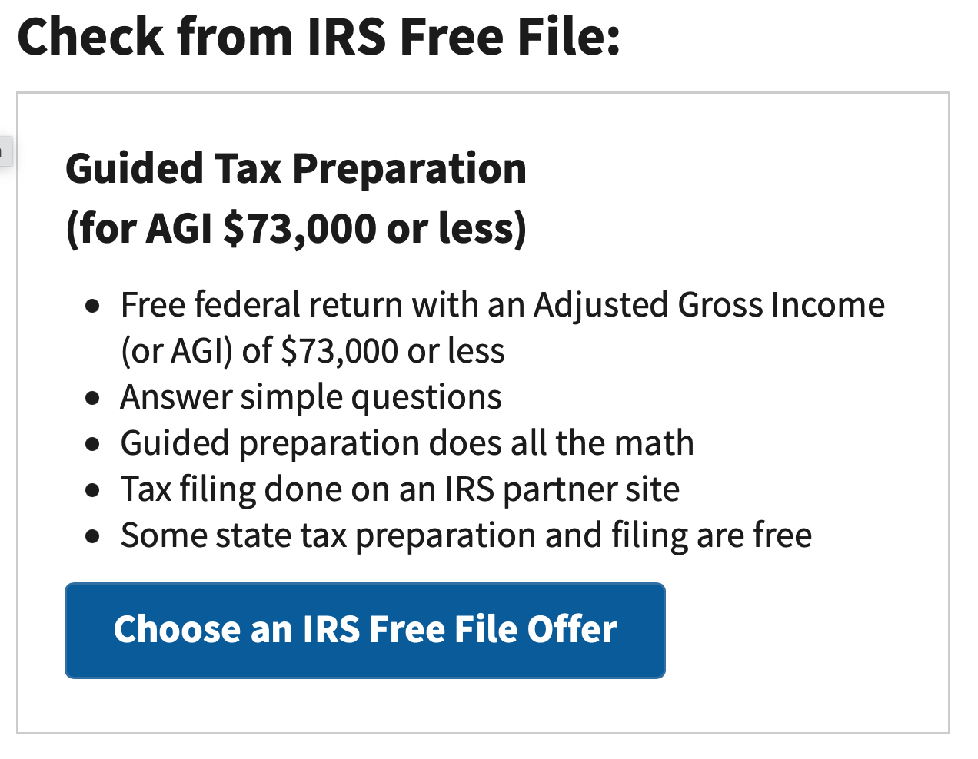
Filing Your Income Taxes for Free
This limit of $73,000 is the same regardless of whether you are filing individually or married-jointly. Sorry.
The IRS does not prepare your taxes.
Your return will be prepared by a partner firm of the IRS (HR Block, Jackson-Hewitt, Intuit…).
If you make more than $73,000, most online tax software will cost you anywhere from $30 to $100 to do both federal and state filings.
https://www.irs.gov/filing/free-file-do-your-federal-taxes-for-free

Slide 21
Do You Really Want a Tax Refund?
January $1,200
February $1,200
March $1,200
April $1,200
May $1,200
June $1,200
July $1,200
August $1,200
September $1,200
October $1,200
November $1,200
December $1,200
January $0
February $0
March $3,600
January $1,500
February $1,500
March $1,500
April $1,500
May $1,500
June $1,500
July $1,500
August $1,500
September $1,500
October $1,500
November $1,500
December $1,500
January $0
February $0
March $0
Total Income
$18,000

Slide 22
Do You Really Want a Tax Refund?
January $1,200
February $1,200
March $1,200
April $1,200
May $1,200
June $1,200
July $1,200
August $1,200
September $1,200
October $1,200
November $1,200
December $1,200
January $0
February $0
March $3,600
January $1,500
February $1,500
March $1,500
April $1,500
May $1,500
June $1,500
July $1,500
August $1,500
September $1,500
October $1,500
November $1,500
December $1,500
January $0
February $0
March $0
NO…I do not want a tax refund.
A tax refund is not a gift and it is not found money. It’s MY money.
I get the same amount of money either way.
I would rather get MY money sooner and not make an interest-free loan to the government.
The sooner I get MY money, the sooner I can invest it or use it to pay down debt.
Talk to your HR office and think about reducing your withholding so you can decrease your refund and get YOUR money sooner.
If you do get a refund, use it to invest in your future…in a retirement account or use it to pay off debt. Your future self will thank you.
Total Income
$18,000

Slide 23
Income Taxes: Deductions & Credits
What are income tax deductions & credits and why do we like them so much?
Tax Deductions
Qualifying reductions to your Taxable Income that will reduce how much Taxable Income you have…that may reduce the taxes you owe.
All filers are allowed the standard deduction ($12,550 for single, $25,100 for married).
  If your Taxable Income is less than this, you do not owe taxes.
Some deductions are “above-the-line,” reducing your Adjusted Gross Income.
  We really like these because they lower the income we receive that may allow us to receive certain credits.
  Examples: school tuition, fees, some student loan interest, some moving expenses, some health care expenses, contributions to an IRA
Other deductions, like home mortgage interest and charitable donations, can reduce your taxable income…if they are larger than the standard deduction.

Slide 24
Income Taxes: Deductions & Credits
What are income tax deductions & credits and why do we like them so much?
Tax Credits
A dollar-for-dollar reduction in taxes owed.
If you owe $2,500 in taxes for the year and find a $1,000 credit, your taxes owed will be reduced to $1,500.
We really really like tax credits.
Wait…Is a computer a “qualified higher education expense?” Can I deduct the cost of my school computer?
Maybe. It’s kind of a gray or subjective area.
If the computer is a personal asset that you use as a student for convenience and to enhance your education, then it is probably NOT a qualified education expense.
If the computer is required by the institution, if it is essential to being a student, then you may deduct it.

Slide 25
U.S. Income Taxes for International Students
Filing for income tax – FOR INTERNATIONAL STUDENTS (& maybe faculty):
It’s important to be aware that, as a nonresident student in the US, you’re legally required to file a tax return if you received US income during 2021.
And even if you didn’t work or receive income in the US, you’re still obliged to file a Form 8843 with the IRS.
  You may owe taxes on non-cash benefits you received, such as tuition forgiveness or any scholarships.
Talk to your University to see if it has a partnership to assist you.
  The University of Louisiana at Lafayette has arranged discounted access to Sprintax Tax Preparation.
  Sprintax guides you through the tax preparation process, arrange the necessary documents and check if you’re due a tax refund.
Depending on any arrangements between the U.S. and your home country, the taxes that you owe in the U.S. and at home may be different.

Slide 26
Income Taxes Are All About Income & Cash
Income taxes are generally based on when cash changes hands – if cash is exchanged for goods or services, there is a taxable transaction.
The exception is that exchanging goods for goods may be taxable, too.
When you get your paycheck, the day you get your cash is the day you owe taxes.
If you get paid on January 10 for work you performed in December, the taxable transaction occurs on January 10.
If you get $20 in tips after an evening of waiting tables, you owe taxes on that $20 as of that night.
If you get a $25 gift card for donating plasma, you owe taxes on that gift card as of the day you receive the card.
If I give you a car worth $5,000 in exchange for a computer worth $1,000, you owe taxes on the $4,000 difference on the day we trade.
Can you avoid taxes by not reporting some transactions?
Assume that the other person is reporting the transaction as a business expense. If I report the $20 in tips that I give you in tips, the IRS now knows about it. And it’s going to wonder why you haven’t reported and paid your taxes.
Even if you do not have taxes withheld from your paycheck – perhaps like with tips – you are supposed to submit estimated tax payments throughout the year.
  If you owe $10,000 in taxes for 2021, the IRS doesn’t want to wait until April 2022 to receive that $10,000 from you.
  You owe taxes to the IRS at the time you received the income, and there may be penalties if you wait too long to pay what you owe.

Slide 27
Strategies for Income Tax Planning
We have all heard of “tax loopholes.”
Loopholes are strategies for paying less in taxes based on the rules of the game.
Tax evasion is bad. It’s illegal. Tax avoidance is good. We never want to overpay.
If you are thinking of selling an asset – a car or some stock – in December, maybe wait until January to get the taxable income.
Take advantage of retirement plans that offer deferred taxation.
Set up an IRA or Roth IRA while your income is low, because you might not be able to create one when your income is high.
Try to make sure you get the company match on any defined contribution retirement plans at work (401(k) or (403(b) plans).
If you are thinking of making a charitable donation annually, maybe make larger donations every-other-year to get a larger amount of itemized deductions in one year and the standard deduction in the other year.
If you are married, do the math to determine if you should file jointly or separately. And then do the math again next year because it may be different.
If you have children and want them to attend college, try to set up a 529 Education Savings Account as soon as possible. They are very flexible, provide tax exemptions and can give lots of compound investment growth.

Slide 28
Taxes for Married Couples: Separate vs. Joint Filing
If you are married, you have a choice about whether you file your taxes as “Married Filing Jointly” or “Married Filing Separately.” Which should you do?
As with most tax questions, the answer is it depends.
Regardless of when you get married, you can choose to file under either status for the entire year.
Research shows that about half of all couples do better filing jointly and half do better filing separately.
Filing jointly is easier, but you may obtain better credits, deductions or tax rates by choosing to file separately.
In general, students and recent graduates might be better off filing “Married Filing Jointly” because it allows more education and student loan deductions.
In general, couples who both have relatively high income might be better off filing “Married Filing Separately.” It all comes down to the the math, which will be different for every couple.
  And the math will be different from year-to-year.
  You can change your status from year-to-year.

Slide 29
Taxes for Married Couples: Separate vs. Joint Filing
If you are married, you have a choice about whether you file your taxes as “Married Filing Jointly” or “Married Filing Separately.” Which should you do?
For 2021, the standard deductions were:
Married Filing Jointly: $25,100
Married Filing Separately: $12,550
If you plan to itemize deductions and file separately, both spouses CANNOT claim the same deductions.
Similarly, both spouses CANNOT claim the same credits.
  If you spend $2,000 on child-care and want to claim the child-care credit, you CANNOT both claim the full credit.
Filing as “Head of Household” is not an option for most married couples, even if that’s what you call yourself. In general, this is designed only for single parents.
  “Head of Household” status generally has better deductions and tax brackets than any other status, so do check if you might be eligible.

Slide 30
Tax Planning? Being Tax Smart With Investments
The IRS likes to incentivize us to make decisions that make the government’s life easier. Many times, these incentives help us increase our cash flow.
Imagine I have $1,000 of excess money from my paycheck at the end of the month.
If I invest this in 10 shares of Amazon through my Robinhood account, what are the tax consequences?
That $1,000 is already after tax, meaning I paid 20-30% of ordinary income tax on it.
If that $1,000 investment loses value, I do not owe any other taxes on it (and can use any losses to offset taxable gains on other investments).
If Amazon pays me a quarterly dividend on $5, that $5 is taxable, at my ordinary income rate.
  Note – Amazon is only paying me a dividend because it as excess After-Tax income, so this $5 has already been taxed and will be taxed again (and I only got the dividend because I used after-tax income to buy the stock….triple taxation).
If my investment increases from $1,000 to $1,500 and I sell after 6 months (or anything under a year), I will owe ordinary income taxes on my $500 gain.
If my investment increases from $1,000 to $1,500 and I sell after 5 years (or anything over a year), I will owe capital gain taxes on my $500 gain.

Slide 31
Tax Planning? Being Tax Smart With Investments
The IRS likes to incentivize us to make decisions that make the government’s life easier. Many times, these incentives help us increase our cash flow.
Instead, I can invest pre-tax money (maybe $1,300) into Amazon through an IRA account.
I will never owe capital gains taxes and I will only owe ordinary income taxes when I withdraw the cash after I’m 59 ½.
Or I can invest the after-tax money ($1,000) into Amazon through a Roth IRA. I will never again owe any taxes – neither capital gains nor ordinary income – no matter how much this $1,000 grows to be.
I can invest the after-tax money ($1,000) into a 529 College Savings Plan for future education use (with lots of flexibility). This investment should grow until I withdraw the money (for education purposes). I will never again owe any taxes – neither capital gains nor ordinary income – no matter how much this $1,000 grows to be.
I can defer this $1,300 pre-tax money (up to about $60,000 per year) into a 403(b) or 401(k) account.
I will never owe capital gains taxes and I will only owe ordinary income taxes when I withdraw the cash after I’m 59 ½.

Slide 32
Tax Planning? Being Tax Smart With Investments
The IRS likes to incentivize us to make decisions that make the government’s life easier. Many times, these incentives help us increase our cash flow.
The moral is: while we want to look to simplify our financial plans when possible, having multiple investment accounts that work towards different financial goals, usually makes sense because they can have very significant tax benefits.
There are other, smaller tax-preferred investment/savings options that many of us can utilize (health savings accounts, flexible spending accounts, pre-tax spending throughout your employer). There is usually some risk & reward with these – make sure you read the fine print.

Slide 33
Retirement Planning: Some Examples

Slide 34
Retirement Planning: Some Examples

Slide 35
Retirement Planning: Some Examples

Slide 36
Retirement Planning: Some Examples

Slide 37
Retirement Planning: Some Examples

Slide 38
Retirement Planning: Some Examples

Slide 39
Retirement Planning: Some Examples

Slide 40
Retirement Planning: Some Examples

Slide 41
Retirement Planning: Some Examples

Slide 42
Retirement Planning: Some Examples

Slide 43
Retirement Planning: Some Examples

Slide 44
Retirement Planning: Some Examples

Slide 45
Retirement Planning: Some Examples

Slide 46
Retirement Planning: Some Examples

Slide 47
Retirement Planning: Some Examples

Slide 48
A Few Opening Concluding Morals
TRACK ALL OF YOUR INCOME & EXPENSES
Keep receipts, keep records. If your tax return is questioned, you are guilty until you prove yourself innocent. Have evidence..
TAX OPTIMIZATION TAX MINIMIZATION
We only pay taxes on income. We do not want to overpay our taxes, but we do like income.
FIND YOUR PEACE OF MIND
Predicting the future is impossible. Nobody knows what will happen in the future. Do not stress about your decisions.
    The future will not be what we think it will be.
    Have a plan that makes sense to you today.
    Invest what you can, where you can.
      Putting money in multiple savings, investment & retirement accounts gives you flexibility and options in the future.
    Sleep well knowing you’re doing the best you can...and modify your investment strategy as your situation changes.

Slide 49
Happiness
Long-Term Goals
Short-Term Goals
Financial Needs
Family Needs

Slide 50

Isn’t this a lot like what you do with your education planning?

Slide 51
You’ve been doing this with your education for years.
You’re about to begin doing this with your career…and you will continue working through this process for the next 30 or 40 years.
Whether it’s education planning or career planning, by now we know that all of our personal decisions with have financial implications.
The more we plan ahead and integrate our decision-making process, the more control we will have over our futures…and the less money will be a source of stress and the more money will be a source of empowerment.
Isn’t this a lot like what you do with your education planning?

Slide 52
Don’t wait around for other people to be happy for you.
Any happiness you get,
You’ve got to make yourself.
~ Alice Walker, poet & novelist
A goal without a plan is just a dream.
Wealth is largely the result of habit.
The most difficult thing is the decision to act; the rest is mere tenacity.
It takes as much energy to plan as it does to wish.
You cannot escape the responsibility of tomorrow by avoiding it today.

Slide 53
Owning Your Financial Future
INVESTING GOALS, HABITS & STRATEGIES
Today, June 22
BUDGETING & DEBT MANAGEMENT
Wednesday, July 6
INVESTING FOR RETIREMENT,
EDUCATION & SPECIAL EVENTS
Wednesday, July 13

Slide 54
INVESTING for INTERNATIONAL FACULTY,
STUDENTS & PROFESSIONALS
Wednesday, July 20
TAX PLANNING
(for budgeting, investing & retirement)
Wednesday, July 27
CAREER PLANNING: YOUR MONEY & YOUR FUTURE
Wednesday, August 3

Slide 55
Brian Bolton
Professor of Finance brian.bolton@louisiana.edu http://business.louisiana.edu/financeispersonal

