Slide 1


MONEY MATTERS
2024 Fall Session #3
October 29, 2024
Money Matters: Debt, Taxes & Inflation: Navigating Life’s Financial Challenges
Manage Your Money Today
Maximize Your Money in the Future

Slide 2
Opening Quiz – Question #1
If you sold cookies out of your apartment during 2024 and made $500 from those sales, you owe taxes on that $500 of income.
TRUE
FALSE

Slide 3
Opening Quiz – Question #1
If you sold cookies out of your apartment during 2024 and made $500 from those sales, you owe taxes on that $500 of income.
TRUE
FALSE
Maybe

Slide 4
Opening Quiz – Question #2
If you sold cookies out of your apartment during 2024 and made $500 from those sales, and spent $200 making those cookies, what do you owe taxes on?
$500
$300
$200
$0

Slide 5
Opening Quiz – Question #2
If you sold cookies out of your apartment during 2024 and made $500 from those sales, and spent $200 making those cookies, what do you owe taxes on?
$500
$300
$200
$0

Slide 6
Opening Quiz – Question #3
If you sold cookies out of your apartment during 2024 and made $500 from those sales, and spent $700 making those cookies, what do you owe taxes on?
$500
$700
$0
You get a refund
for the $200 loss

Slide 7
Opening Quiz – Question #3
If you sold cookies out of your apartment during 2024 and made $500 from those sales, and spent $700 making those cookies, what do you owe taxes on?
$500
$700
$0
You get a refund
for the $200 loss

Slide 8
Opening Quiz – Question #4
If you earned $14,500 of income in 2024,
which of the following applies to you:
You owe taxes on the entire $14,500.
It depends on whether someone else claims you as a dependent.
You do not owe any taxes and you do not have to file a tax return.
You do not owe any taxes but you have to file a tax return.

Slide 9
Opening Quiz – Question #4
If you earned $14,500 of income in 2024,
which of the following applies to you:
You owe taxes on the entire $14,500.
It depends on whether someone else claims you as a dependent.
You do not owe any taxes and you do not have to file a tax return.
You do not owe any taxes but you have to file a tax return.

Slide 10
Opening Quiz – Question #5
Imagine you put $1,000 into a Roth IRA today.
Imagine this grows to become $25,000 over the next 35 years.
When you withdraw that $25,000 at age 60, what income will be taxed?
NONE
$25,000
$24,000
$1,000

Slide 11
Opening Quiz – Question #5
Imagine you put $1,000 into a Roth IRA today.
Imagine this grows to become $25,000 over the next 35 years.
When you withdraw that $25,000 at age 60, what income will be taxed?
NONE
$25,000
$24,000
$1,000

Slide 12
Opening Quiz – Question #6
If you spend $2,500 (or more) on education expenses that are required for your degree – including tuition, books, supplies, maybe a computer – you might be able to receive a $2,500 credit on your tax return.
TRUE
FALSE

Slide 13
Opening Quiz – Question #6
If you spend $2,500 (or more) on education expenses that are required for your degree – including tuition, books, supplies, maybe a computer – you might be able to receive a $2,500 credit on your tax return.
Check out the American Opportunity Tax Credit (up to $2,500) and the Lifetime Learning Credit (up to $2,000) to see if you are eligible for either credit.
Credits directly reduce the taxes you owe…which is really nice.
TRUE
FALSE

Slide 14
Opening Quiz – Question #7
If you are an international student but do not earn any income during a given year, you do NOT need to file a tax return or any return with the IRS.
TRUE
FALSE

Slide 15
Opening Quiz – Question #7
If you are an international student but do not earn any income during a given year, you do NOT need to file a tax return or any return with the IRS.
If you received any income, you have to file a tax return (Form 1040).
But, if you did not receive any income, you still need to file Form 8843 to tell the IRS that you were in the US but did not earn any income.
TRUE
FALSE

Slide 16
MONEY MATTERS SERIES: FALL 2024
SEPTEMBER 18
Managing Money, Grad School & Life: Balancing All of Your Priorities
OCTOBER 10
Investing for Your Future: Compounding Your Success
OCTOBER 29
Debt, Taxes & Inflation: Navigating Life's Financial Challenges

Slide 17

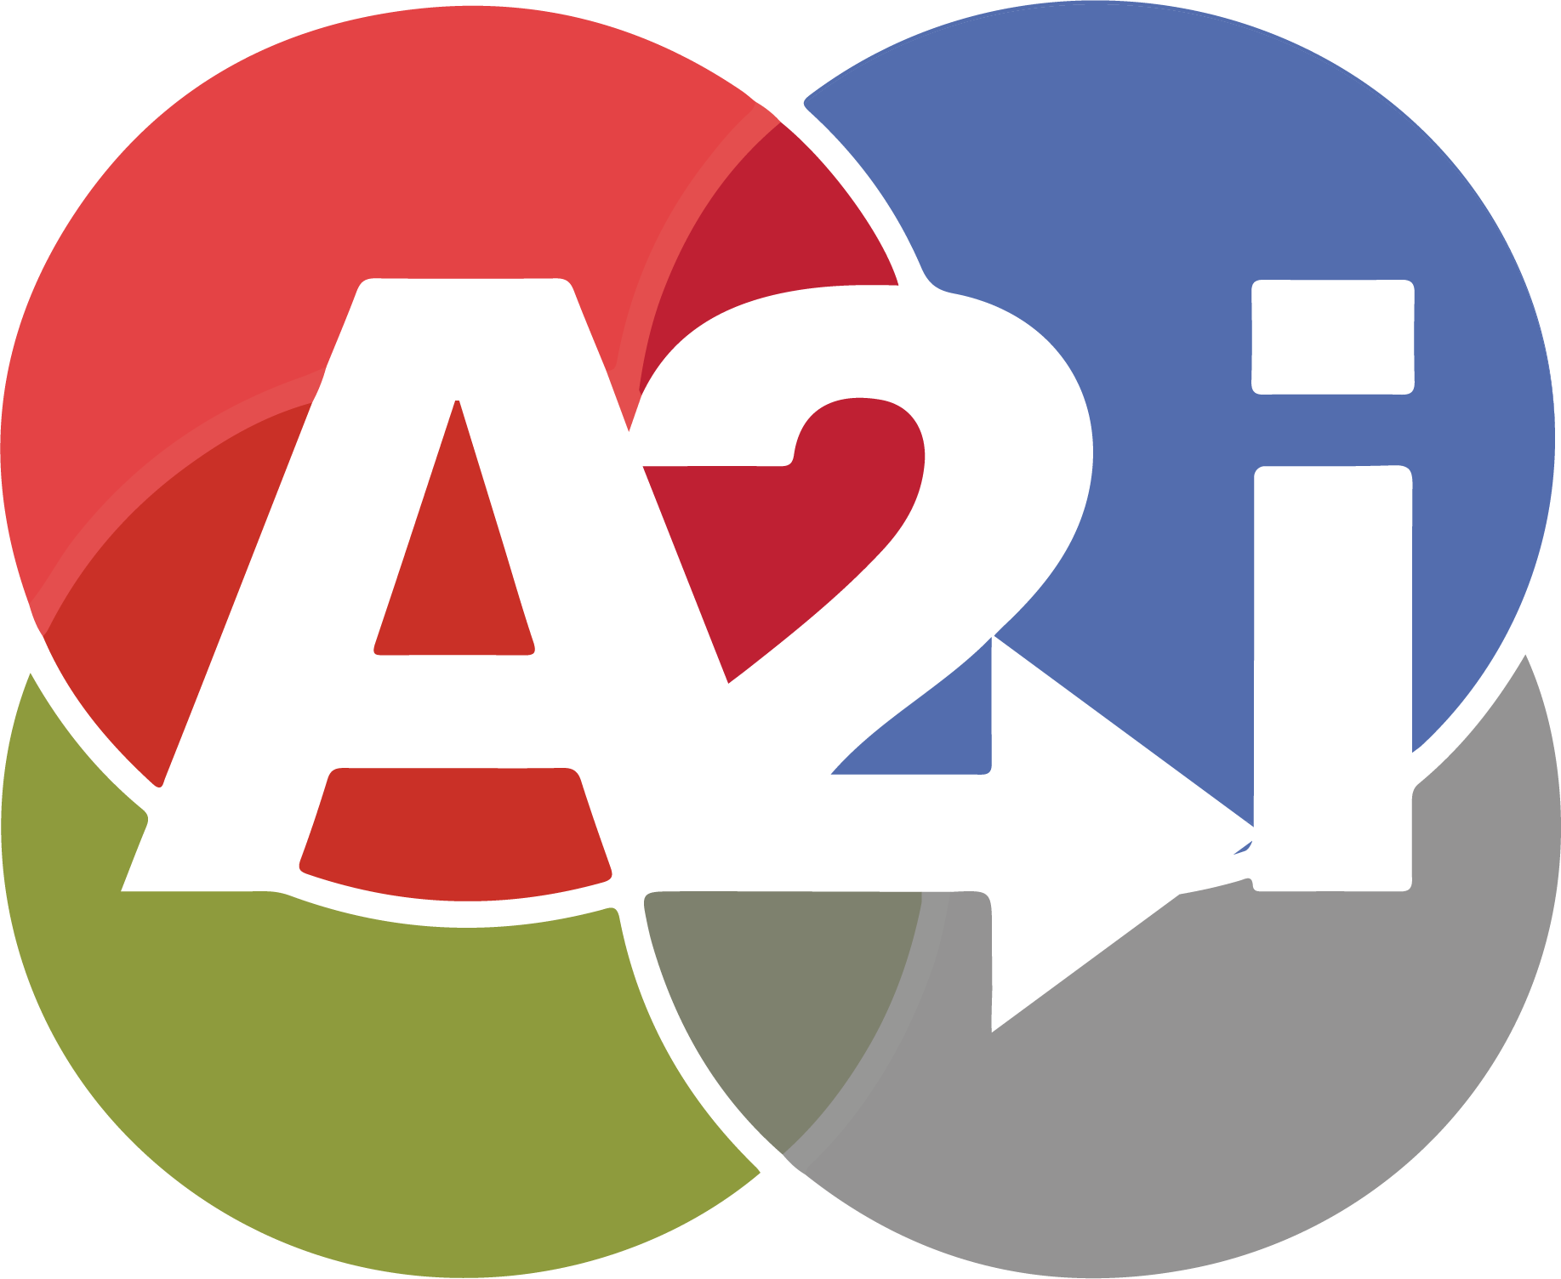
We are exciting to announce that we are now an academic partner with Accelerate to IndustryTM, a program with a bold, new approach to enhance graduate student and postdoctoral industry workforce readiness.
The A2i approach includes a range of modules that allow graduate students, postdocs, and alumni to benefit from the entire range of activities, or individual components.

Slide 18
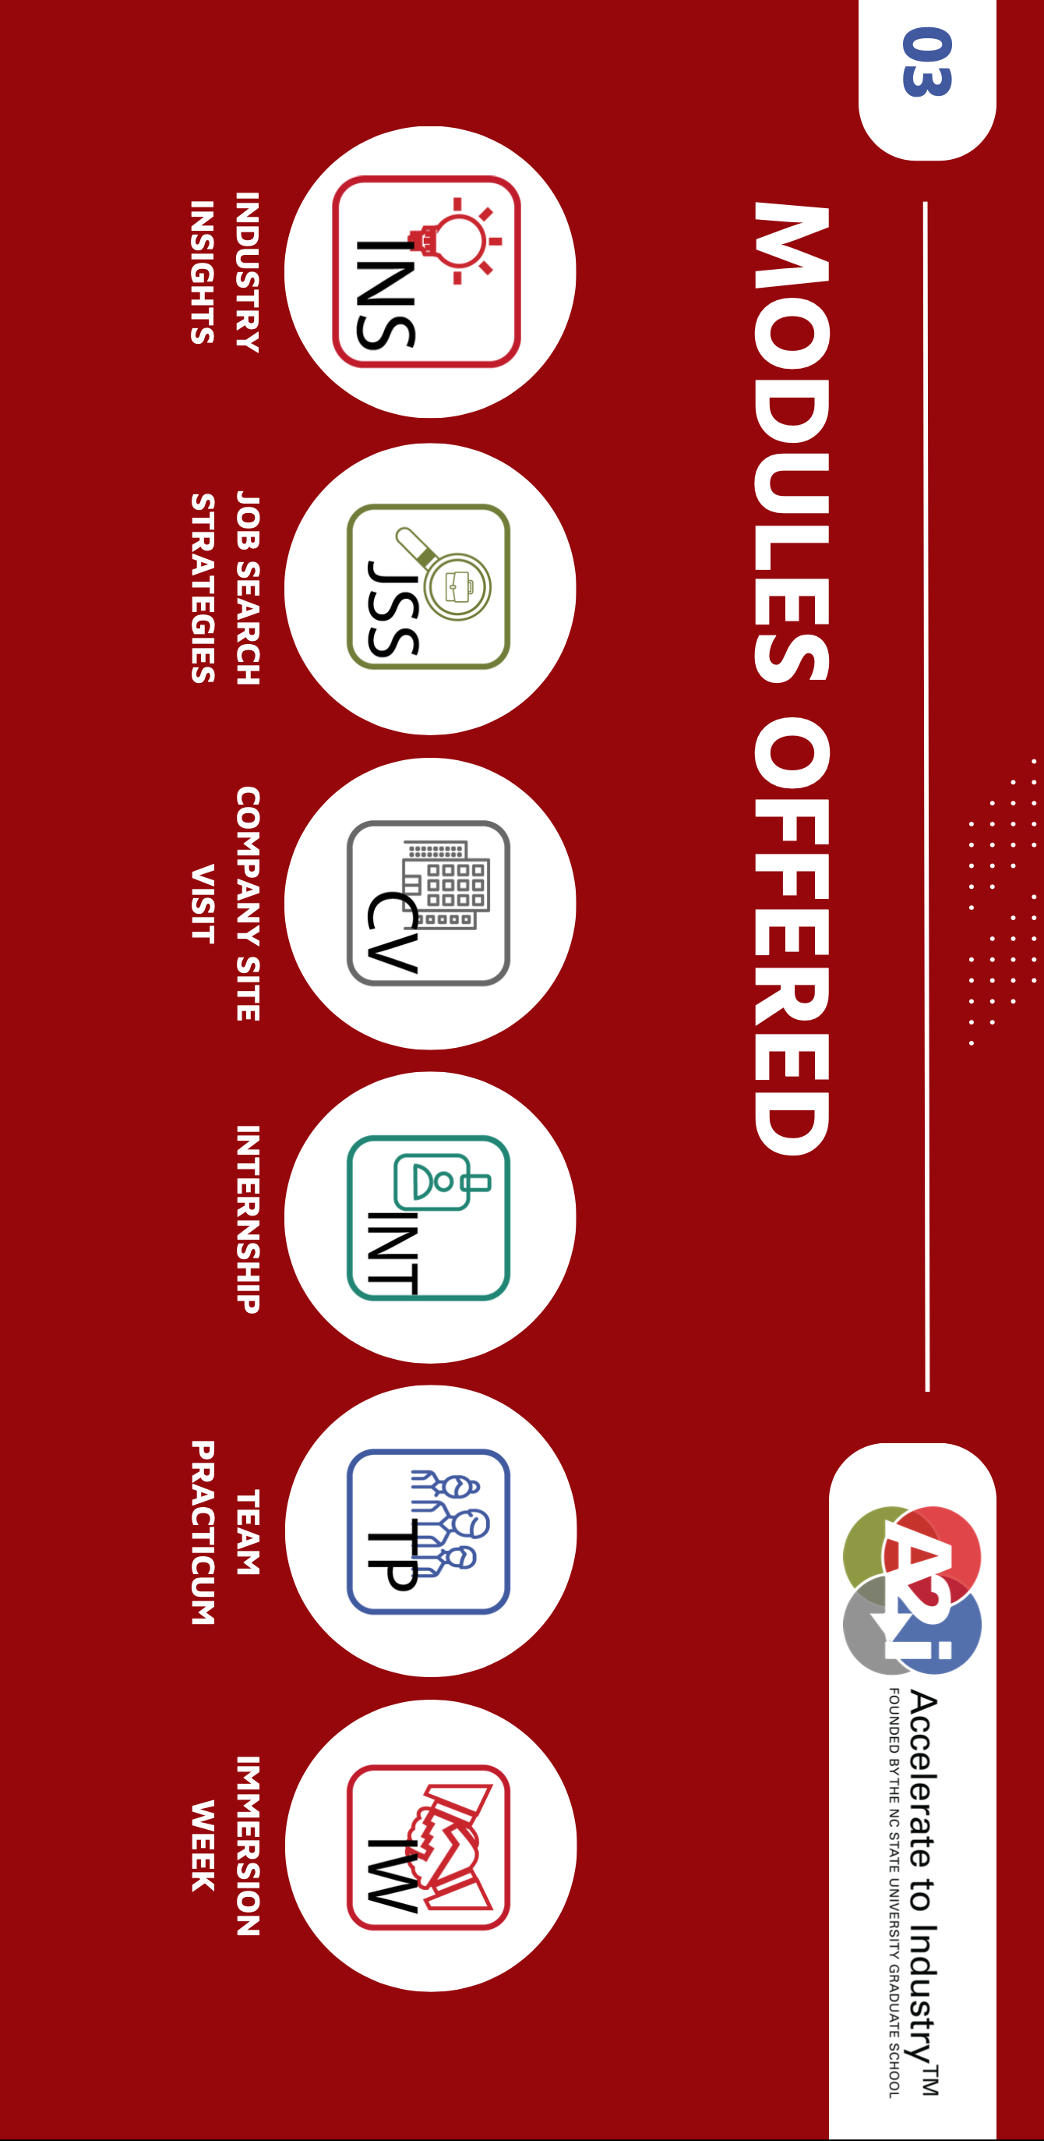

Slide 19



Slide 20
NOVEMBER 13
Thinking Like an Entrepreneur
& Exploring Alternative Career Options
This session will blend Money Matters career planning perspectives with A2i content & information.

Slide 21
Happiness
Long-Term Goals
Short-Term Goals
Financial Needs
Family Needs

Slide 22
Owning Your Financial Future
YOUR VALUES
YOUR GOALS
Education
Career
Family
FINANCIAL STRATEGIES
Investing
Income & Expense Management
Debt Management
Taxes, Insurance & Other

Slide 23
Owning Your Financial Future
YOUR VALUES
YOUR GOALS
Education
Career
Family
FINANCIAL STRATEGIES
Investing
Income & Expense Management
Debt Management
Taxes, Insurance & Other

Slide 24
Owning Your Financial Future
YOUR VALUES
YOUR GOALS
Education
Career
Family
FINANCIAL STRATEGIES
Investing
Income & Expense Management
Debt Management
Taxes, Insurance & Other
Money Matters: Debt, Taxes & Inflation: Navigating Life’s Financial Challenges

Slide 25
TODAY THE NEXT 6 MONTHS THE NEXT 12 MONTHS 2 YEARS AFTER GRADUATION 3 YEARS AFTER GRADUATION
ONCE EVERY SEMESTER:
TRACK EVERY PENNY THAT YOU SPEND & TRACK EVERY PENNY THAT YOU EARN
IN THE NEXT 3 MONTHS:
IDENTIFY WAYS TO DECREASE YOUR DISCRETIONARY SPENDING BY 25%
IN THE NEXT 6 MONTHS:
MAKE A PLAN TO MANAGE – AND PAY OFF – YOUR DEBT
IN THE NEXT 6-12 MONTHS:
OPEN MULTIPLE SAVINGS ACCOUNTS, 1 FOR EACH GOAL
IN THE NEXT 12 MONTHS, OPEN AN IRA OR ROTH IRA
WITHIN 2 YEARS OF GRADUATION:
HAVE AN “EMERGENCY FUND” ACCOUNT, WITH 3-6 MONTHS OF NON-DISCRETIONARY EXPENSES
WITHIN 3 YEARS OF GRADUATION:
ELIMINATE ALL OF YOUR BAD DEBT.

Slide 26
WHAT IS DEBT
Debt is borrowing from YOUR future.
We borrow because we want something today that we cannot afford today.
We make a promise to pay for that something in the future.
The entity we borrow from wants to make money. They are not our friends.
We have to pay them helping us get what we want today.
  At a minimum, we pay them interest on our debt.
  Depending on the type of debt, we may have to pay them much more (fees, collateral, earnings, control, etc.)

Slide 27
WHAT IS DEBT
Debt is borrowing from YOUR future.
If your debt is keeping you up at night…
If your debt is preventing you from achieving your goals…
If your debt is damaging your relationships…
…Then you may have too much debt.
(we will return to this issue later)

Slide 28
One Truism About DEBT
If you borrow $10,000,
You will have to repay $10,000.
Whatever you borrow, you will have to repay – in full, with interest – 99% of the time. Lenders do not exist to give you money.
One good exception: Student loan forgiveness.
Lots of bad exceptions: Default, bankruptcy, short sale…

Slide 29
Frequently Asked Question
Is it smart to pay off student debt as soon as you are able to?
General Answer: No, not for most people.
Student loans – if they are federally subsidized loans – are some of the BEST debt you have.
They generally have low interest rates, flexible repayment plans& the possibility of forgiveness.
HOWEVER, if you have private, unsubsidized student loans, they could be BAD debt that you want to pay off as soon as you are able.

Slide 30
Frequently Asked Question
Is it smart to pay off CREDIT CARD DEBT as soon as you are able to?
General Answer: YES. ALWAYS. FOR EVERYONE.

Slide 31
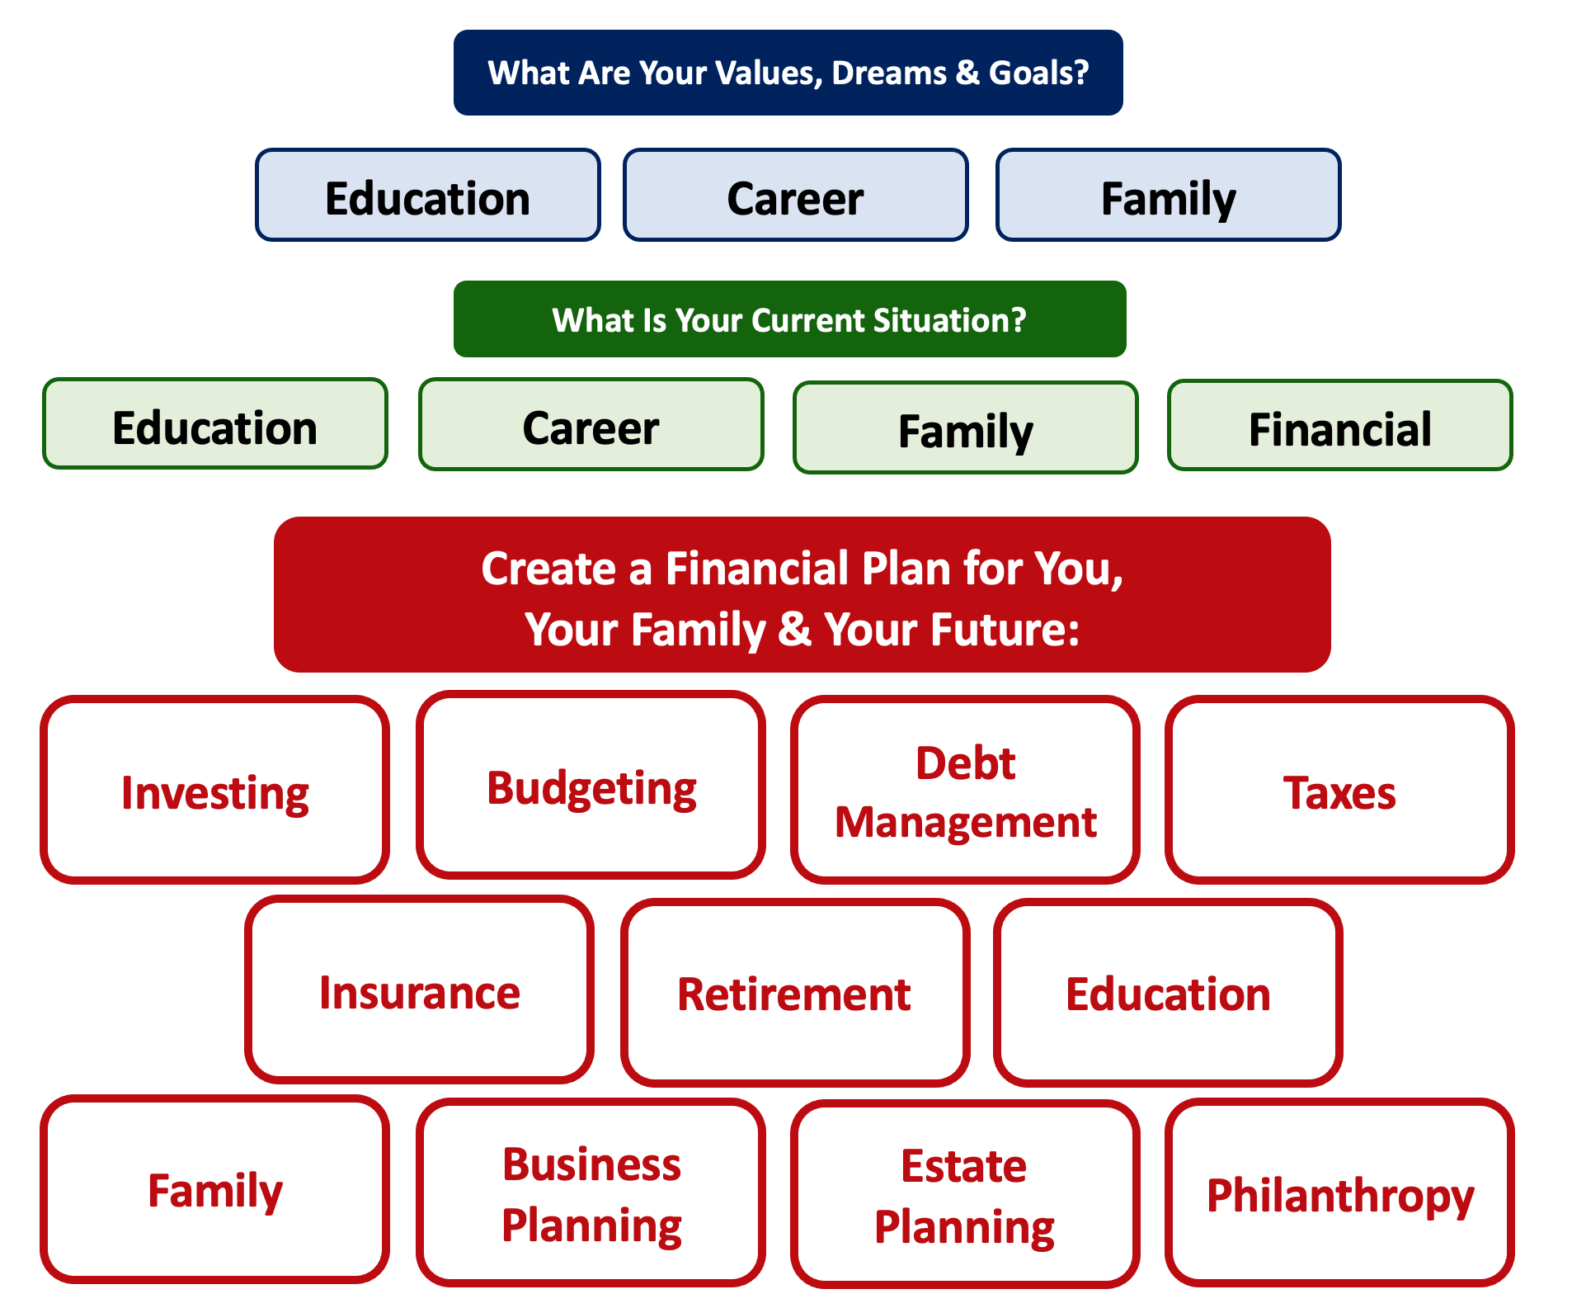
Debt is NOT a bad thing.
Debt can help us achieve our goals, depending on our current situations and what those goals are.
Debt is also called “leverage” – because it gives us the ability do things we might not be able to do otherwise.

Slide 32
Debt is NOT a bad thing.
My one primary piece of advice:
Whenever borrow money – whether it’s $20 for a Friday night pizza on your credit card or a $10,000 student loan – have a plan for paying it back.
Know why you are borrowing and where you will get the money to repay it.

Slide 33
Good Debt vs. Bad Debt
NOTE:
Using a credit card is not necessarily a bad idea.
Only racking up loads of credit card debt is a bad idea.
I regularly use 3 credit cards.
Here’s how and here’s why…

Slide 34
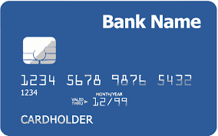
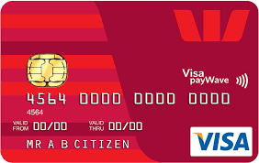
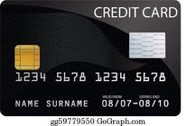
Credits Cards as Tools for Financial Planning
Card #1: Automatic bill payment of recurring monthly expenses (phone, insurance, cable, utilities)
Card #2: Living and discretionary expenses (gas, groceries, coffee, pizza, new shoes)
Card #3: Non-recurring big expenses (vacation, holidays, charity, new refrigerator)
Card #3 frequently has a $0.00 balance

Slide 35
Credits Cards as Tools for Financial Planning
WHY DO I DO THIS?
Mental Budgeting: This helps me mentally be aware of what I’m spending and why I’m spending.
  Instead of just knowing that I’m putting $1,000 on my credit cards in a month, separating the expenses across cards forces me to be aware of what I’m spending money on.
  When I review my statements and budgets at the end of each month, this gives me an easy opportunity to judge myself and to analyze my own behavior.
Card #1: Automatic bill payment of recurring monthly expenses (phone, insurance, cable, utilities)
Card #2: Living and discretionary expenses (gas, groceries, coffee, pizza, new shoes)
Card #3: Non-recurring big expenses (vacation, holidays, charity, new refrigerator)

Slide 36
Credits Cards as Tools for Financial Planning
WHY DO I DO THIS?
FREE MONEY!
  I pay off the full balance of each card each month. If I make a purchase on October 5, the cash does not leave my bank account until December 1.
    It might only be a penny or two, but earning interest during those 57 days feels kind of nice.
  Miles, cash-back and other rewards.
    Choose a card with benefits that you would be paying for anyway. And then cash in the rewards instead of paying cash in the future.
Card #1: Automatic bill payment of recurring monthly expenses (phone, insurance, cable, utilities)
Card #2: Living and discretionary expenses (gas, groceries, coffee, pizza, new shoes)
Card #3: Non-recurring big expenses (vacation, holidays, charity, new refrigerator)

Slide 37
LET’S MAKE THIS PERSONAL…
WHAT IMPACTS YOUR CREDIT RATING AS A CONSUMER?

Slide 38
LET’S MAKE THIS PERSONAL…
WHAT IMPACTS YOUR CREDIT RATING AS A CONSUMER?
35% Payment History – This is perhaps this simplest category, as it looks at how well you repay all borrowed amounts on credit cards, retail accounts, auto loans, utilities and phone bills, other installment loans and other debts. The better you are at repaying, the better your Payment History. Pay your bills on time.

Slide 39
LET’S MAKE THIS PERSONAL…
WHAT IMPACTS YOUR CREDIT RATING AS A CONSUMER?
30% Amounts Owed –The amount you owe is not simply about how much money you owe, but it’s also about how much of your available credit you use. If you have a credit card limit of $5,000 and your balance is $4,000, that’s worse than having a limit of $20,000 and a balance of $10,000. There are many trade-offs within this category and it can be confusing.
Pro-tip if you are using more than 30% of your available balance: Pay it off or down before the end of your reporting cycle and the credit agencies will never know it existed.

Slide 40
LET’S MAKE THIS PERSONAL…
WHAT IMPACTS YOUR CREDIT RATING AS A CONSUMER?
30% Amounts Owed –The amount you owe is not simply about how much money you owe, but it’s also about how much of your available credit you use. If you have a credit card limit of $5,000 and your balance is $4,000, that’s worse than having a limit of $20,000 and a balance of $10,000. There are many trade-offs within this category and it can be confusing.
Pro-tip if you are using more than 30% of your available balance: Pay it off or down before the end of your reporting cycle and the credit agencies will never know it existed.
One thing you can do tomorrow that might improve your credit score:
Ask for a credit limit increase on all of your credit cards or outstanding lines of credit.

Slide 41
LET’S MAKE THIS PERSONAL…
WHAT IMPACTS YOUR CREDIT RATING AS A CONSUMER?
15% Length of Credit History – This is also pretty simple – the longer your history of paying bills and loans, the better off you’ll be. Yes, this does bias against younger borrowers – but if your behavior in the other categories is strong, you should be okay. Be patient – you’ll build your history.

Slide 42
LET’S MAKE THIS PERSONAL…
WHAT IMPACTS YOUR CREDIT RATING AS A CONSUMER?
10% Credit Mix – Perhaps ironically, it can be better to have 5 different accounts that you repay regularly than it is to have just 2 different accounts. The greater the variety of accounts you have, the more opportunity you have to indicate that you are a low credit risk. Of course, if you have 5 accounts and you miss your payments, that will be doubly bad. Pay your bills on time and the Credit Mix will take care of itself.

Slide 43
LET’S MAKE THIS PERSONAL…
WHAT IMPACTS YOUR CREDIT RATING AS A CONSUMER?
10% New Credit – Opening a large number of new accounts in a short period of time may indicate that you are a higher risk. So, is the moral to never open new accounts? No – because then you can never indicate that you are a low risk. Be mindful of opening too many accounts in a short period of time, pay all your bills on time, and the New Credit category will not be a big issue.

Slide 44
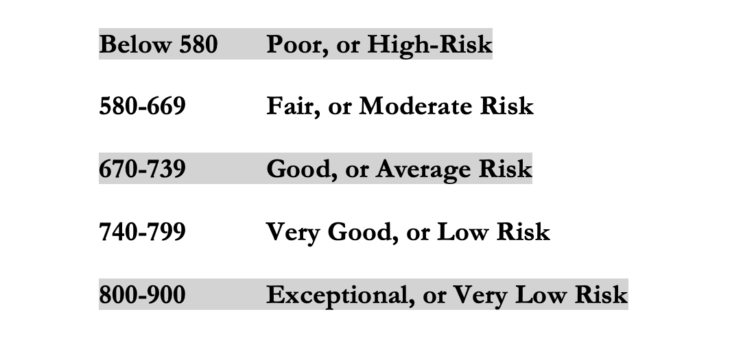
LET’S MAKE THIS PERSONAL…
WHAT IMPACTS YOUR CREDIT RATING AS A CONSUMER?
Your FICO Score will become an actual number: between 250 and 900.
The higher your Score, the lower interest rates you will pay on most loans.
The average FICO Score for Americans is just over 700.
The average in Louisiana is 677, the second lowest in the 50 U.S. states; only Mississippi has a lower average FICO Score.

Slide 45
LET’S MAKE THIS PERSONAL…
WHAT SHOULD YOU BE FOCUSED ON WITH RESPECT TO YOUR CREDIT SCORE?
If your FICO Score is below 600, there are probably 1 or 2 areas where you have significant weaknesses in your history.
Commit to correcting these weaknesses and not creating any new weaknesses.
If your FICO Score is between 600-700, there are probably 1 or 2 areas that can be improved – or where you used to have significant weaknesses.
Keep doing what you’re doing – and commit to not creating any new concerns.
If your FICO Score is over 700, keep doing what you’re doing and time will eventually get you the best score possible.

Slide 46
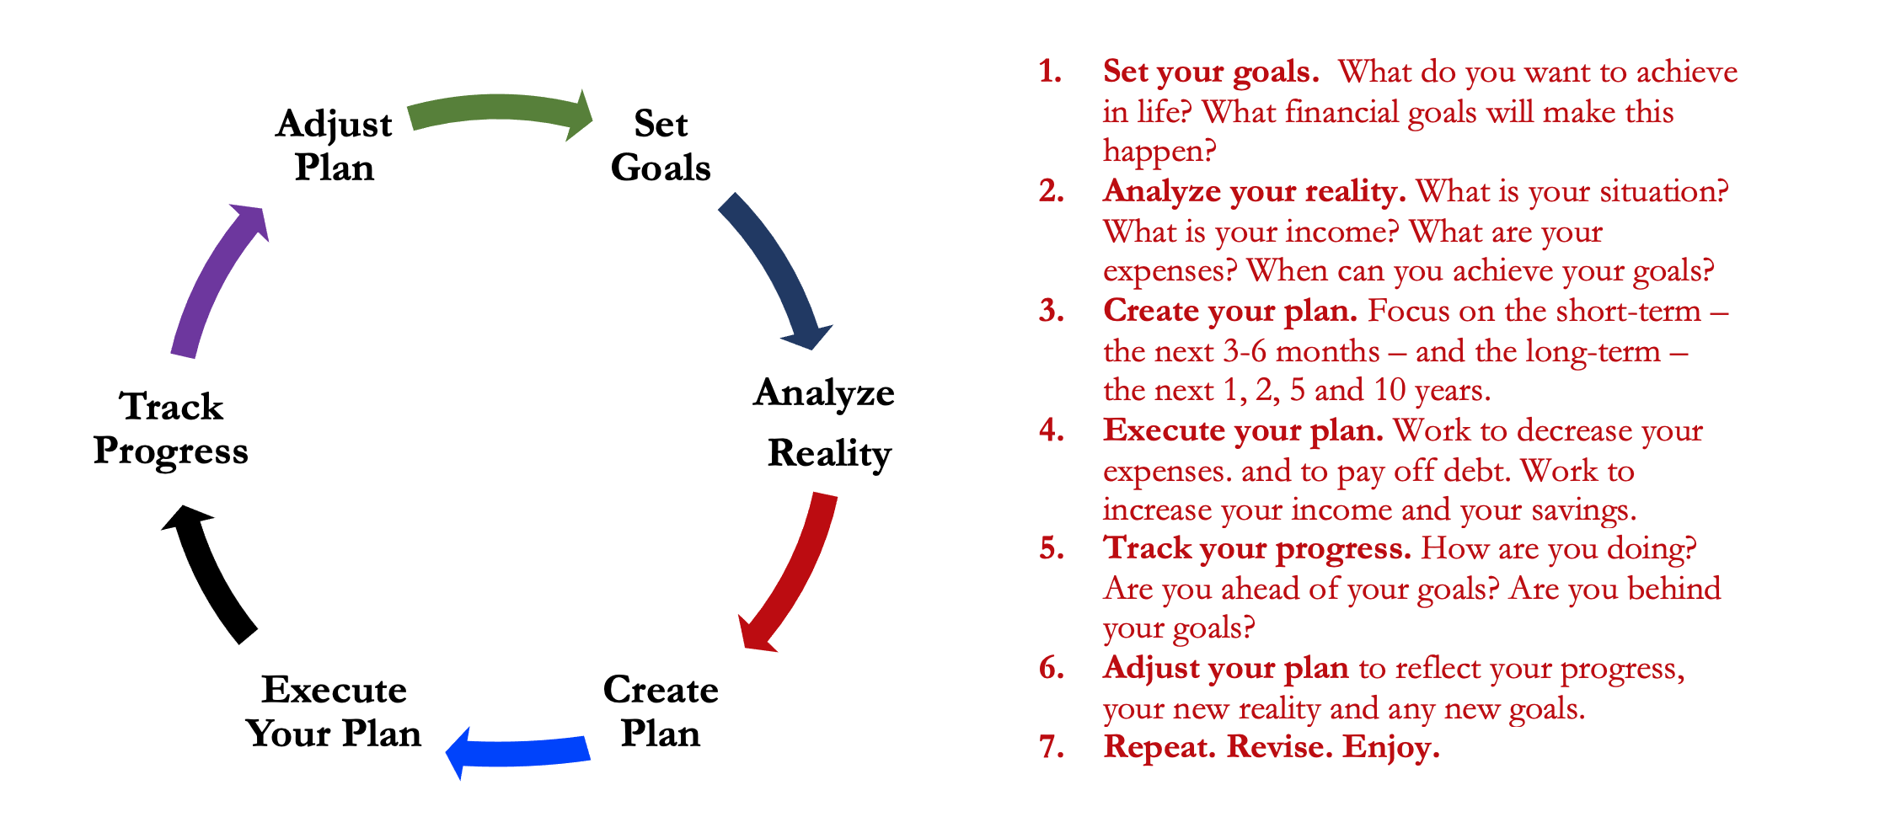
Isn’t this a lot like what you do with your education planning?

Slide 47
And as you begin to develop your full financial plan – seeing the trade-offs with Budgeting, Investing and Debt Management – you will begin to see how interconnected all of these aspects are.
Finance is just a matter of managing money across time.
And one thing we know about time is that our plans will change – so the better you have control of your initial financial plan, the more you will be able to adjust when life and time give you new goals.
Isn’t this a lot like what you do with your education planning?

Slide 48
You cannot escape the responsibility
of tomorrow by avoiding it today.

Slide 49
5 Things You Can Do To Reduce Your Taxes
Open an Individual Retirement Account or Roth IRA
  You can defer income tax and avoid capital gains tax altogether
Talk to HR and reduce your tax withholding
  If you get a refund, you are loaning your income to the government
Cluster your income so you make less than $14,600 in a year
  If possible, shift income between years to get the maximum deduction
Scan tax code and identify 3-5 deductions & credits you qualify for
  Child tax credit, education expenses (tuition, books…), student loan interest, charitable deductions, small business or hobby-related expenses
Get rid of your income

Slide 50
The 3 Legal Ways to Avoid Taxes
(Avoiding Taxes is Legal & Good; Evading Taxes is Not Legal)
RETIREMENT INVESTING
Contributing to an IRA or 401(k) can defer income tax and avoid capital gains taxes
HEALTH CARE EXPENSES
Ordinary expenses are tax deductible & contributing to an HSA o FSA avoids income and capital gain taxes
EDUCATION EXPENSES
Some ordinary expenses are tax deductible & contributing to a 529 account avoids capital gain taxes

Slide 51
4 Frequently Asked Questions – TAXES
Gross Salary & Wages
Less: Medical Expenses
Less: Student Loan Interest paid
Less: Contributions to Retirement Accounts
Adjusted Gross Income
Less: Standard Deduction or Itemized Deduction
Taxable Income
x Tax Rate .
Gross Taxes Owed
Less: Tax Credits .
Taxes Owed
“Above-the-Line” Deductions.
We like these because they reduce “Adjusted Gross Income” and you also get another deduction “below-the-line”
Standard Deduction = $14,600 for 2024
(or $29,200 for married-filing-jointly)
Everyone gets this deduction / subtraction, at least. Some will “itemize” certain deductions to get an even larger subtraction
Credits are wonderful → The reduce the taxes owed, dollar-for-dollar
But not everyone will have credits. They are for specific situations (see previous slide), but do a little homework to see if any apply to you.

Slide 52
2 More Frequently Asked Questions
Should we file taxes as Married Filing Jointly or Separately?
It depends.
It will be different for each family…and it may be different for each year.
  Both spouses are NOT allowed to take the same deductions & credits on their own returns.
  You want to be strategic and do the math to see where your combined tax liability is lowest.
  Perhaps you file separately and the higher-income spouse claims all of the deductions & credits to reduce their income the most.
  If there is a big difference in your incomes, you may be able to strategically lower your tax liability by filing individually (in theory). Look at both options and choose the better one (this year).
  A couple examples:
    The IRS allows us to have professional tax preparation if our income is less than $73,000, regardless of how you file.
    If you are working but your spouse is not, you can open an IRA for them since they cannot…but only if you file MFJ.
  “Head of Household” filing status is generally the most favorable status…but it is a legal status, it is not a description. It is generally reserved for single parents who provide >50% of dependent care.

Slide 53
2 More Frequently Asked Questions
Speaking of taxes, what are some tax benefits for families?
There are lots – each family can probably identify 3-10 benefits for them.
  The 2017 tax cuts eliminated the ability to claim a deduction for each dependent…but there are still credits and deductions available.
  The child tax credit – possibly $2,000 credit for each child.
  The dependent care credit – not exclusive to children.
  The adoption credit – can receive up to $14,000+ credit for all adoption-related expenses.
  The earned-income tax credit – available for low-income taxpayers.
  Medical expenses for having a baby may be an above-the-line deduction.
  Education credits & deductions…including the American Opportunity Tax Credit, the Lifetime Learning Credit, and deductions for student loan interest.
  As your family grows, your benefits grow…so talk to Human Resources an reduce your tax withholding.
  With all of the above, there are limitations and rules. Read the fine print.

Slide 54

How To Calculate Your Withholding
Go to the IRS calculator: https://apps.irs.gov/app/tax-withholding-estimator
This will help you determine how much Human
Resources should be taking out of your paycheck
each month.
This is ultimately up to you – but HR has a legal
obligation to the IRS to withhold estimated taxes
from your paycheck, if appropriate.
This calculator can guide you to the proper amount
of withholding – so you do not overpay taxes and
so you do not underpay and incur penalties.

Slide 55
One More Way to Possibly Avoid Taxes or to At Least Be More Efficient With Your Tax Obligations
REGISTER YOUR OWN BUSINESS IF YOU HAVE ANY CONSULTING, TUTORING, SIDE-HUSTLE OR ENTREPRENEURIAL ACTIVITIES
With your personal or family tax returns, the IRS doesn’t care about your expenses. The IRS doesn’t care how much you spend on rent, food, utilities or transportation.
You get the Standard Deduction and that’s it ($14,600 or $29,200).
With a business tax return, every business expense you incur becomes a legitimate tax deduction. You do not get a Standard Deduction, but every penny of expenses for your business will lower your taxable income.
And, there are opportunities to obtain business tax deductions when you use personal assets (like your car or home).
Note – If you do not have business income and you are recognizing business expenses for tax deduction purposes, that is fraud. Do not do that.

Slide 56
Let’s Talk About Inflation
Imagine that you are thinking about getting a new refrigerator, sometime in the next year.
The refrigerator you want costs $1,000 today.
You hear reports about inflation being really bad…say, 10%.
You fear that – if you wait a year – your $1,000 refrigerator will cost you $1,100.
So, you buy the $1,000 refrigerator today to avoid a potentially higher cost in the future.
Now, thanks to the laws of supply-and-demand, your purchase drives prices higher TODAY! That is, the fear or expectation of future inflation creates current inflation. Our fear of inflation actually makes realized inflation WORSE. This fear only corrects or moderates very slowly.

Slide 57
Brian’s Brief Explanation for Why Inflation & Interest Rates are So Dang High Right Now
COVID-19!

Slide 58
Brian’s Brief Explanation for Why Inflation & Interest Rates are So Dang High Right Now
The U.S. economy and the global economy are not speedboats.
They are enormously massive cargo freighters that take a very long time to turn.
  It took a while for inflation to become a problem following all the new 2020 money.
  And, it will take / is taking a while for higher interest rates to bring down inflation.

Slide 59
Inflation Quiz – Question #1
Which of these 4 countries currently
has the highest inflation rate?
United States
England
Germany
Argentina

Slide 60
Inflation Quiz – Question #1
Which of these 4 countries currently
has the highest inflation rate?
United States
England
Germany
Argentina

Slide 61
Inflation Quiz – Question #2
Which of these 4 countries
currently has the LOWEST inflation rate?
United States
England
Germany
Argentina

Slide 62
Inflation Quiz – Question #2
Which of these 4 countries
currently has the LOWEST inflation rate?
United States (2.4%)
England (1.7%)
Germany (1.6%)
Argentina (209%)
NOTE – The U.S.A. inflation rate is down 6% over the past year. The other 3 countries’ inflation rates are down 2-4% over the past year.

Slide 63
Brian’s Top 3 Tips for
Navigating an Uncertain Economy
Cut your expenses & Build your emergency fund.
Analyze your budget and cut your discretionary expenses by 25%. Stop dining our, shop in bulk, do potluck dinners, clean out your pantry.
Have a dedicated savings account with the equivalent of 3-6 months of your non-discretionary expenses in it.
Your budget is one of the few things you can (kind of) control in a turbulent economy. This is the perfect time to focus on essentials, behaviors & habits.

Slide 64
A Little Inflation History & Perspective
After all of the stimulus and rescue packages due to Covid-19, Inflation in the United States peaked at 9.1% annually
The Federal Reserve began aggressively increasing interest rates, which slowed down the economy and decreased inflation
Central banks around the world did the same thing (except in Argentina & Turkey)
In theory, the trade-off to fighting inflation is that it could lead to job losses and a recession.
  That has not happened – which is just about the best possible outcome for where we were in June 2022.

Slide 65
A Little Inflation History & Perspective
I think inflation is currently in a really good place.
Most economists around the world think inflation is in a really good place.
There are at least 4 caveats to this for many of us:
  Prices have increased 20%, on average, over the past 3 years. They are not coming down. They will stay at this level…and increase from here. (The rate of change has calmed down, but the level still feels high).
  Louisiana has one of the worst economies in the nation. The 2.4% inflation rate is the national average. Louisiana inflation is currently close to 3.5%
  Rent inflation is close to 5.0%. If you are renting, prices are very painful.
  Education inflation has been higher than over inflation for 30+ years. We all feel that.

Slide 66
Brian’s Top 3 Tips for
Navigating an Uncertain Economy
Cut your expenses & Build your emergency fund.
Take advantage of whatever interest rates are doing.
When they are low, refinance your mortgage, consolidate outstanding loans or credit cards (or stop using credit cards altogether). If you are close to graduating, and close to repaying student loans, learn about Income Driven Repayment or Public Service Loan Forgiveness programs.
When interest rates are high, move savings into CDs and possibly the stock market. Be proactive with your money.
    Most savings accounts are currently paying about 1.0%. If you have a little bit of savings, you can find a Certificate of Deposit that is earning 4.0% or more. That’s a huge difference.
    The stock market has earned close to 25% this year so far. That’s great. And that’s higher than inflation.
      (It lost 19% in 2022, so there will always be risk…but it may be an option if you can invest for the long run.)

Slide 67
Brian’s Top 3 Tips for
Navigating an Uncertain Economy
Cut your expenses & Build your emergency fund.
Take advantage of whatever interest rates are doing.
Finish your degree & focus on your career opportunities.
Be proactive with your career planning. Look out for #1. Inflation is a much bigger problem when you’re earning a grad student stipend than when you’re earning a full-time professional salary.
If you are not close to graduation, explore internship and part-time opportunities. If you are an international student, begin exploring CPT and OPT opportunities (Curricular Practical Training, for before graduation, and Optional Practical Training, for after graduation).

Slide 68
Brian’s Economic Predictions for 2024
Inflation has decreased…but it is still higher than most of us are used to. In June 2022, inflation was at 9.1%; it is now at 2.4%.
  My best case estimate is for it to be at 2.2% in 6 months. It will not be 8-9%.
Interest rates are decreasing. That’s good news.
  Most of us will see interest rates decrease 1-2% over the next 6 months.
  That’s good for borrowers, but bad for savers. So shop around and find rates that work best for you and what you are doing..
Wages & income have not increased as much as inflation for most of us. They may increase somewhat from here, but probably slowly.
  The exception is for income that is inflation-adjusted…like Social Security.
NOTE – Use these predictions with caution.
This is just one guy’s perspective / opinion / guess.

Slide 69
Brian’s Economic Predictions for 2024
The job market has been very strong for the past 2.5 years.
I expect that to continue…even if the growth does slow from here.
The stock market has gained 25% in 2024 – after gaining 23% in 2023 and losing 19% in 2022 (which was after gaining 25% in 2021).
  I predict (with about 35% confidence) that we will gain another 1-2% thru December.
  We may lose 5% thru December. I do not expect us to lose >10% this year.
We are not in a recession. We have not been in a recession since 2020.
We are probably not going to dip into a recession this year.
NOTE – Use these predictions with caution.
This is just one guy’s perspective / opinion / guess.

Slide 70
Brian’s Economic Predictions for 2024
All of these specific numbers will be influenced by next week’s election – but maybe not too much during the next 3-6 months.
There will be different economic paths and outcomes depending on who wins the presidential elections.
  Some of these outcomes might happen in the short-term (like, there will be a stock market reaction later next week).
  Most of these outcomes will evolve over 6-24 months (like, inflation, jobs and interest rates).
NOTE – Use these predictions with caution.
This is just one guy’s perspective / opinion / guess.

Slide 71
Brian’s Economic Predictions for 2024
Plan ahead.
Control what you can control.
NOTE – Use these predictions with caution.
This is just one guy’s perspective / opinion / guess.

Slide 72
Question From One Of You
Is a ‘soft-landing’ possible?
Is it possible for the Federal Reserve to fight inflation by raising interest rates WITHOUT triggering a recession or a whole lot of economic pain?

Slide 73
Question From One Of You
Is a ‘soft-landing’ possible?
Is it possible for the Federal Reserve to fight inflation by raising interest rates WITHOUT triggering a recession or a whole lot of economic pain?
In theory, yes, it’s possible. We have managed to get from 9.1% inflation to 2.4% inflation without big job losses, bankruptcies or other macroeconomic pain.
It’s possible that continuing to fight inflation, and trying to get inflation from 2.4% today to 2.0%, will be very difficult – and we may get some acute pain across the economy.

Slide 74
Question From One Of You
Is a ‘soft-landing’ possible?
Is it possible for the Federal Reserve to fight inflation by raising interest rates WITHOUT triggering a recession or a whole lot of economic pain?
It’s possible that continuing to fight inflation, and trying to get inflation from 2.4% today to 2.0%, will be very difficult – and we may get some acute pain across the economy.
For each of us, there may be differences between MACRO issues and MICRO issues. Macro is about the whole, Micro is about Me.

Slide 75
Financial Wellness
A goal without a plan is just a dream.
Wealth is largely the result of habit.
The most difficult thing is the decision to act; the rest is mere tenacity.
It takes as much energy to plan as it does to wish.
You cannot escape the responsibility of tomorrow by avoiding it today.

Slide 76
Don’t wait around for other people to be happy for you.
Any happiness you get,
You’ve got to make yourself.
A goal without a plan is just a dream.
Wealth is largely the result of habit.
The most difficult thing is the decision to act; the rest is mere tenacity.
It takes as much energy to plan as it does to wish.
You cannot escape the responsibility of tomorrow by avoiding it today.

Slide 77
MONEY MATTERS SERIES: FALL 2024
SEPTEMBER 18
Managing Money, Grad School & Life: Balancing All of Your Priorities
OCTOBER 10
Investing for Your Future: Compounding Your Success
OCTOBER 29
Debt, Taxes & Inflation: Navigating Life's Financial Challenges
NOVEMBER 13
Thinking Like an Entrepreneur & Exploring Alternative Career Options

Slide 78

brian.bolton@louisiana.edu http//:business.louisiana.edu/financeispersonal

Slide 79

gradschool@louisiana.edu

