Slide 1
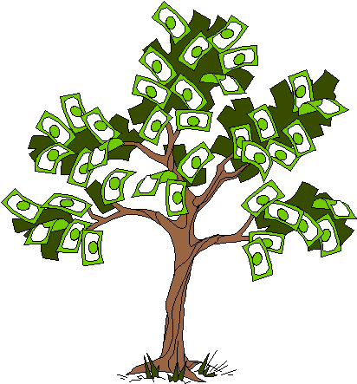

STUDENT SUPPORT SERVICES
PERSONAL FINANCIAL PLANNING
Using different financial strategies and tools
to support your personal & professional goals.
Managing Your Money Through the Holidays & New Year
Manage Your Money Today, Maximize Your Money in the Future
November 14, 2023

Slide 2
Brian Bolton
Professor of Finance brian.bolton@louisiana.edu

Slide 3
Financial Wellness
If you don’t know where you’ve come from, you can’t know where you’re going.
- Maya Angelou

Slide 4
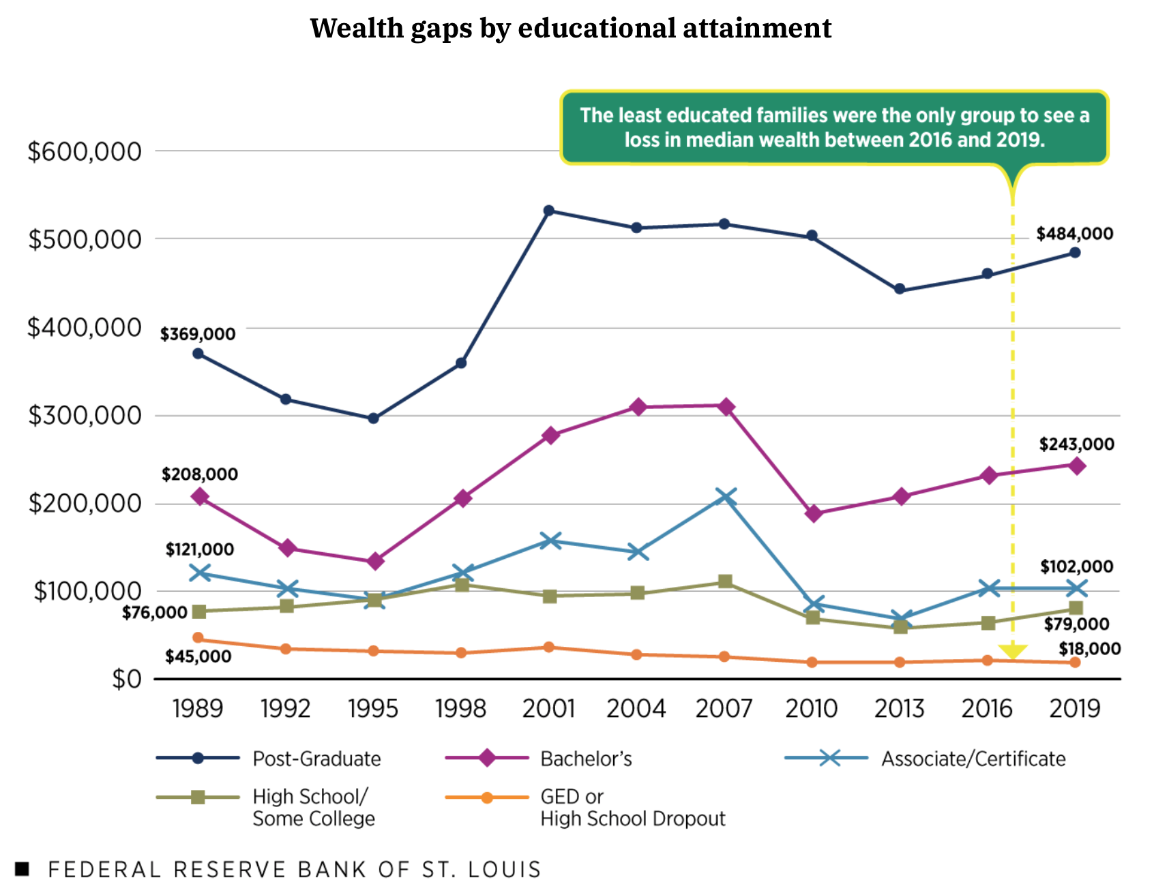
THE WEALTH GAP
IN THE
USA

Slide 5
A Few Opening Morals
Personal Finance is…personal.
It’s about you and not about anyone else.
You have to make it about you and your goals.

Slide 6
A Few Opening Morals
There is no judgment in personal finance.
There is no ego in personal finance.
There is no shame in personal finance.
It’s about you and not about anyone else.

Slide 7
A Few Opening Morals
Because personal finance is personal, it is virtually impossible for me to give you any specific advice.
However, there is one word of advice that applies to 99% of people working on their finances:
SAVE

Slide 8
A Few Opening Morals
SAVINGS
INVESTING
OWNERSHIP
WEALTH

Slide 9
Financial Wellness
Becoming an owner allows you to be the architect of your own future.
- Leigha Porter
Entrepreneur, Dancer, Choreographer, Founder of the Creole Nutcracker, PARC Village
and FIRE Expressions Conservatory, UL Lafayette grad, Northside High School grad

Slide 10
Owning Your Financial Future
What Are Your Values, Dreams & Goals?
Education
Career
Family
What Is Your Current Situation?
Education
Career
Family
Financial
Create a Personal Financial Plan for You:
Investing
Budgeting
Debt Management
Taxes
Insurance
Retirement
Education
Family
Business Planning
Estate Planning
Philanthropy

Slide 11
Financial Planning for the Holidays & New Year
5 Things Everyone Should Do:
BUDGET!
  Make shopping lists…for all types of shopping: food, gifts, fun, weekends.
  Make lists of what you ARE NOT going to buy…for all types of shopping.

Slide 12
Financial Planning for the Holidays & New Year
5 Things Everyone Should Do:
BE VERY CAREFUL ABOUT INCREASING DEBT
  Avoid increasing balances on credit card
  Maybe only use credit cards for groceries and gas and use a debt card for everything else.

Slide 13
Financial Planning for the Holidays & New Year
5 Things Everyone Should Do:
GET RID OF AT LEAST 1 SUBSCRIPTION
  Review your expenses and find any/all recurring subscriptions
  Find at least 1 to get rid of before the year end
  And make sure you do not add any that you are not going to use or get your money’s worth

Slide 14
Financial Planning for the Holidays & New Year
5 Things Everyone Should Do:
LOOK FOR DEALS…BUT ALSO BE WARY OF DEALS
  By shopping early and shopping around, you can find the best deals for what you need to buy
  But be careful – many deals will have fine print that commits you to further costs or to other constraints that are not in your best interest

Slide 15
Financial Planning for the Holidays & New Year
5 Things Everyone Should Do:
SET 5 NEW YEAR’S RESOLUTIONS THAT YOU CAN STICK WITH
  Check your credit report and credit score, open multiple savings accounts, pay yourself first with $5-$25 of every paycheck going to savings, analyze every penny you spend during 3-5 months in 2024, find a budget approach that works for you, set financial goals for the next 3-5 years, finalize your back-to-school spring 2024 budget, begin investing, pay down any high-interest debt (even before savings), do not dine out or go grocery shopping in January, maximize credit card rewards

Slide 16
Homework for You
Once a week: Make a list of the money you are
going to spend this week.
Once a month: Make a list of how your job serves
your values – or how school serves
your values over the long-term.
Once a year: Revisit your values and identify
your short- and long-term goals.

Slide 17
Owning Your Financial Future
What Are Your Values, Dreams & Goals?
Education
Career
Family
What Is Your Current Situation?
Education
Career
Family
Financial
Create a Personal Financial Plan for You:
Investing
Budgeting
Debt Management
Taxes
Insurance
Retirement
Education
Family
Business Planning
Estate Planning
Philanthropy

Slide 18
TODAY THE NEXT 6 MONTHS THE NEXT 12 MONTHS 2 YEARS AFTER GRADUATION 3 YEARS AFTER GRADUATION
ONCE EVERY SEMESTER:
TRACK EVERY PENNY THAT YOU SPEND & TRACK EVERY PENNY THAT YOU EARN
IN THE NEXT 3 MONTHS:
IDENTIFY WAYS TO DECREASE YOUR DISCRETIONARY SPENDING BY 25%
IN THE NEXT 6 MONTHS:
MAKE A PLAN TO MANAGE – AND PAY OFF – YOUR DEBT
IN THE NEXT 6-12 MONTHS:
OPEN MULTIPLE SAVINGS ACCOUNTS, 1 FOR EACH GOAL
IN THE NEXT 12 MONTHS, OPEN AN IRA OR ROTH IRA
WITHIN 2 YEARS OF GRADUATION:
HAVE AN “EMERGENCY FUND” ACCOUNT, WITH 3-6 MONTHS OF NON-DISCRETIONARY EXPENSES
WITHIN 3 YEARS OF GRADUATION:
ELIMINATE ALL OF YOUR BAD DEBT.

Slide 19
TODAY THE NEXT 6 MONTHS THE NEXT12 MONTHS 2 YEARS AFTER GRADUATION 3 YEARS AFTER GRADUATION

Slide 20
TODAY THE NEXT 6 MONTHS THE NEXT12 MONTHS 2 YEARS AFTER GRADUATION 3 YEARS AFTER GRADUATION
ONCE EVERY SEMESTER:
TRACK EVERY PENNY THAT YOU SPEND
TRACK EVERY PENNY THAT YOU EARN
CATEGORIZE YOUR SPENDING AS EITHER:
NON-DISCRETIONARY (Essential): rent, food, phone, insurance…
DISCRETIONARY (Not Essential): clothes, dining out, entertainment…
Use this as a foundation for thinking about what flexibility you have in your budget.
How can you decrease discretionary expenses by 25%?
How can you decrease non-discretionary expenses by 10%?

Slide 21
TODAY THE NEXT 6 MONTHS THE NEXT12 MONTHS 2 YEARS AFTER GRADUATION 3 YEARS AFTER GRADUATION
ONCE EVERY SEMESTER:
TRACK EVERY PENNY THAT YOU SPEND & TRACK EVERY PENNY THAT YOU EARN
IN THE NEXT 3 MONTHS:
IDENTIFY WAYS TO CUT YOUR DISCRETIONARY SPENDING BY 25%
BONUS: ALSO DECREASE YOUR NON-DISCRETIONARY SPENDING BY 10%
Can you switch insurance companies? Can you switch cell phone carriers? Can you drive less? Can you bring your lunch to school instead of buying fast food?

Slide 22
TODAY THE NEXT 6 MONTHS THE NEXT12 MONTHS 2 YEARS AFTER GRADUATION 3 YEARS AFTER GRADUATION
ONCE EVERY SEMESTER:
TRACK EVERY PENNY THAT YOU SPEND & TRACK EVERY PENNY THAT YOU EARN
IN THE NEXT 3 MONTHS:
IDENTIFY WAYS TO DECREASE YOUR DISCRETIONARY SPENDING BY 25%
IN THE NEXT 6 MONTHS:
MAKE A PLAN TO MANAGE –
AND PAY OFF – YOUR DEBT
WHICH DEBT IS YOUR WORST DEBT?
HIGH INTEREST RATE? HIGH FEES? OPPRESSIVE TERMS?
CAN YOU GET RID OF THIS DURING SCHOOL?
Which debt is more flexible?
How will you pay it off over the next 5-10 years?

Slide 23
TODAY THE NEXT 6 MONTHS THE NEXT12 MONTHS 2 YEARS AFTER GRADUATION 3 YEARS AFTER GRADUATION
ONCE EVERY SEMESTER:
TRACK EVERY PENNY THAT YOU SPEND & TRACK EVERY PENNY THAT YOU EARN
IN THE NEXT 3 MONTHS:
IDENTIFY WAYS TO DECREASE YOUR DISCRETIONARY SPENDING BY 25%
IN THE NEXT 6 MONTHS:
MAKE A PLAN TO MANAGE – AND PAY OFF – YOUR DEBT
IN THE NEXT 6-12 MONTHS:
OPEN MULTIPLE SAVINGS ACCOUNTS…ONE FOR EACH OF YOUR FINANCIAL GOALS
Maybe each account has a different time horizon.
Maybe each account has a different specific goal.
Our brains engage in “mental budgeting,” which means we mentally manage money better when it is assigned to specific purposes.

Slide 24
TODAY THE NEXT 6 MONTHS THE NEXT12 MONTHS 2 YEARS AFTER GRADUATION 3 YEARS AFTER GRADUATION
What is a useful way to use different accounts to achieve different goals?
Me? I have 5-6 bank and investing accounts.
A basic checking & transactions account. My paycheck is deposited here. And all bills are paid out of this account.
2 savings accounts…1 as my Emergency Fund for short-term crises and 1 as my saving for short-to-medium term goals, such as a new car or vacation.
An investment account. This is dedicated to long term goals, such as buying a house, children’s education or even retirement.
And 2 retirement accounts: 1 through work and 1 that I manage outside of my work retirement account.

Slide 25

TODAY THE NEXT 6 MONTHS THE NEXT12 MONTHS 2 YEARS AFTER GRADUATION 3 YEARS AFTER GRADUATION
Paycheck
Bills
$200
$100
$50
Savings Account #3:
NEW HOUSE
Savings Account #2:
NEW CAR
Emergency Fund:
3-6 Months of Discretionary Expenses
Savings Account #1:
VACATION

Slide 26
TODAY THE NEXT 6 MONTHS THE NEXT12 MONTHS 2 YEARS AFTER GRADUATION 3 YEARS AFTER GRADUATION
Paycheck
Bills
Emergency Fund:
3-6 Months of Discretionary Expenses
Short & Medium- Term Goals
(0-5 Years)
Long-Term Goals
(5+ Years)

Slide 27
TODAY THE NEXT 6 MONTHS THE NEXT12 MONTHS 2 YEARS AFTER GRADUATION 3 YEARS AFTER GRADUATION
What is a useful way to use different accounts to achieve different goals?
I have 5-6 bank and investing accounts.
Why does this work?
Research has found that humans engage in “mental budgeting.”
Imagine that you have $10,000.
You might manage (or spend) this $10,000 differently if you have it one account for “My Money” versus having $2,000 in a
checking account + $8,000 in different savings & investment accounts.

Slide 28
TODAY THE NEXT 6 MONTHS THE NEXT12 MONTHS 2 YEARS AFTER GRADUATION 3 YEARS AFTER GRADUATION
Why does this work?
Because it allows me to align different goals with different accounts.
Checking & Transaction Account
No risk,
0.0% return,
all cash
Short-to-Medium Term Goals
Some risk,
0-3% return goals,
cash + savings
Long-Term
Goals
Some Risk,
3-7% return goals,
savings + investments
Retirement
Accounts
Lots of risk,
8-12% return goals,
all investments

Slide 29
TODAY THE NEXT 6 MONTHS THE NEXT12 MONTHS 2 YEARS AFTER GRADUATION 3 YEARS AFTER GRADUATION
ONCE EVERY SEMESTER:
TRACK EVERY PENNY THAT YOU SPEND & TRACK EVERY PENNY THAT YOU EARN
IN THE NEXT 3 MONTHS:
IDENTIFY WAYS TO DECREASE YOUR DISCRETIONARY SPENDING BY 25%
IN THE NEXT 6 MONTHS:
MAKE A PLAN TO MANAGE – AND PAY OFF – YOUR DEBT
IN THE NEXT 6-12 MONTHS:
OPEN A SAVINGS ACCOUNT, ONE FOR EACH OF YOUR GOALS
IN THE NEXT 12 MONTHS:
OPEN AN IRA OR A ROTH IRA (INDIVIDUAL RETIREMENT ACCOUNT)
You can contribute $6,500 per year and invest in a wide variety of options.
You get to avoid capital gains taxes and possibly defer income taxes.
You get to benefit from compound investment returns over the long-term..and that’s one of the key hacks to building wealth.
Open a Roth IRA if your income is very low today – the tax benefits are huge.

Slide 30
TODAY THE NEXT 6 MONTHS THE NEXT12 MONTHS 2 YEARS AFTER GRADUATION 3 YEARS AFTER GRADUATION
ONCE EVERY SEMESTER:
TRACK EVERY PENNY THAT YOU SPEND & TRACK EVERY PENNY THAT YOU EARN
IN THE NEXT 3 MONTHS:
IDENTIFY WAYS TO DECREASE YOUR DISCRETIONARY SPENDING BY 25%
IN THE NEXT 6 MONTHS:
MAKE A PLAN TO MANAGE – AND PAY OFF – YOUR DEBT
IN THE NEXT 6-12 MONTHS:
OPEN A SAVINGS ACCOUNT, ONE FOR EACH OF YOUR GOALS
IN THE NEXT 12 MONTHS, OPEN AN IRA OR ROTH IRA
WITHIN 2 YEARS OF GRADUATION:
HAVE AN “EMERGENCY FUND” ACCOUNT, WITH 3-6 MONTHS OF NON-DISCRETIONARY EXPENSES IN IT
THIS IS REALLY DIFFICULT FOR ANYONE TO DO. BUT MAKE IT A PRIORITY.
Commit to paying yourself first with every paycheck. Commit to building your financial safety cushion…once you have this, then all other goals get easier and you will sleep better every night.

Slide 31
TODAY THE NEXT 6 MONTHS THE NEXT12 MONTHS 2 YEARS AFTER GRADUATION 3 YEARS AFTER GRADUATION
ONCE EVERY SEMESTER:
TRACK EVERY PENNY THAT YOU SPEND & TRACK EVERY PENNY THAT YOU EARN
IN THE NEXT 3 MONTHS:
IDENTIFY WAYS TO DECREASE YOUR DISCRETIONARY SPENDING BY 25%
IN THE NEXT 6 MONTHS:
MAKE A PLAN TO MANAGE – AND PAY OFF – YOUR DEBT
IN THE NEXT 6-12 MONTHS:
OPEN A SAVINGS ACCOUNT, ONE FOR EACH OF YOUR GOALS
IN THE NEXT 12 MONTHS, OPEN AN IRA OR ROTH IRA
ONCE EVERY SEMESTER:
TRACK EVERY PENNY THAT YOU SPEND
TRACK EVERY PENNY THAT YOU EARN
WITHIN 3 YEARS OF GRADUATION:
ELIMINATE ALL OF YOUR BAD DEBT.
EARNING 10% ON YOUR INVESTMENTS IF YOU ARE PAYING 19.99% ON A CREDIT CARD. ELIMINATING HIGH-COST AND HIGH-FEE DEBT IS THE BEST BUDGET HACK POSSIBLE.
And begin working towards executing your overall debt plan. Do not be in a hurry to pay off your good & manageable debt. Simply having control over it will give you peace of mind.

Slide 32
TODAY THE NEXT 6 MONTHS THE NEXT12 MONTHS 2 YEARS AFTER GRADUATION 3 YEARS AFTER GRADUATION
ONCE EVERY SEMESTER:
TRACK EVERY PENNY THAT YOU SPEND & TRACK EVERY PENNY THAT YOU EARN
IN THE NEXT 3 MONTHS:
IDENTIFY WAYS TO DECREASE YOUR DISCRETIONARY SPENDING BY 25%
IN THE NEXT 6 MONTHS:
MAKE A PLAN TO MANAGE – AND PAY OFF – YOUR DEBT
IN THE NEXT 6-12 MONTHS:
OPEN MULTIPLE SAVINGS ACCOUNTS, 1 FOR EACH GOAL
IN THE NEXT 12 MONTHS, OPEN AN IRA OR ROTH IRA
WITHIN 2 YEARS OF GRADUATION:
HAVE AN “EMERGENCY FUND” ACCOUNT, WITH 3-6 MONTHS OF NON-DISCRETIONARY EXPENSES
WITHIN 3 YEARS OF GRADUATION:
ELIMINATE ALL OF YOUR BAD DEBT.

Slide 33
TODAY THE NEXT 6 MONTHS THE NEXT12 MONTHS 2 YEARS AFTER GRADUATION 3 YEARS AFTER GRADUATION
ONCE EVERY SEMESTER:
TRACK EVERY PENNY THAT YOU SPEND & TRACK EVERY PENNY THAT YOU EARN
IN THE NEXT 3 MONTHS:
IDENTIFY WAYS TO DECREASE YOUR DISCRETIONARY SPENDING BY 25%
IN THE NEXT 6 MONTHS:
MAKE A PLAN TO MANAGE – AND PAY OFF – YOUR DEBT
IN THE NEXT 6-12 MONTHS:
OPEN MULTIPLE SAVINGS ACCOUNTS, 1 FOR EACH GOAL
IN THE NEXT 12 MONTHS, OPEN AN IRA OR ROTH IRA
WITHIN 2 YEARS OF GRADUATION:
HAVE AN “EMERGENCY FUND” ACCOUNT, WITH 3-6 MONTHS OF NON-DISCRETIONARY EXPENSES
WITHIN 3 YEARS OF GRADUATION:
ELIMINATE ALL OF YOUR BAD DEBT.

Slide 34
WHAT IS DEBT
Debt is borrowing from YOUR future.
We borrow because we want something today that we cannot afford today.
We make a promise to pay for that something in the future.
The entity we borrow from wants to make money. They are not our friends.
We have to pay them helping us get what we want today.
  At a minimum, we pay them interest on our debt.
  Depending on the type of debt, we may have to pay them much more (fees, collateral, earnings, control, etc.)

Slide 35
WHAT IS DEBT
Debt is borrowing from YOUR future.
If your debt is keeping you up at night…
If your debt is preventing you from achieving your goals…
If your debt is damaging your relationships…
…Then you may have too much debt.
(we will return to this issue later)

Slide 36
One Truism About DEBT
If you borrow $10,000,
You will have to repay $10,000.
Whatever you borrow, you will have to repay – in full, with interest – 99% of the time. Lenders do not exist to give you money.
One good exception: Student loan forgiveness.
Lots of bad exceptions: Default, bankruptcy, short sale…

Slide 37
Frequently Asked Question
Is it smart to pay off student debt as soon as you are able to?
General Answer: No, not for most people.
Student loans – if they are federally subsidized loans – are some of the BEST debt you have.
They generally have low interest rates, flexible repayment plans& the possibility of forgiveness.
HOWEVER, if you have private, unsubsidized student loans, they could be BAD debt that you want to pay off as soon as you are able.

Slide 38
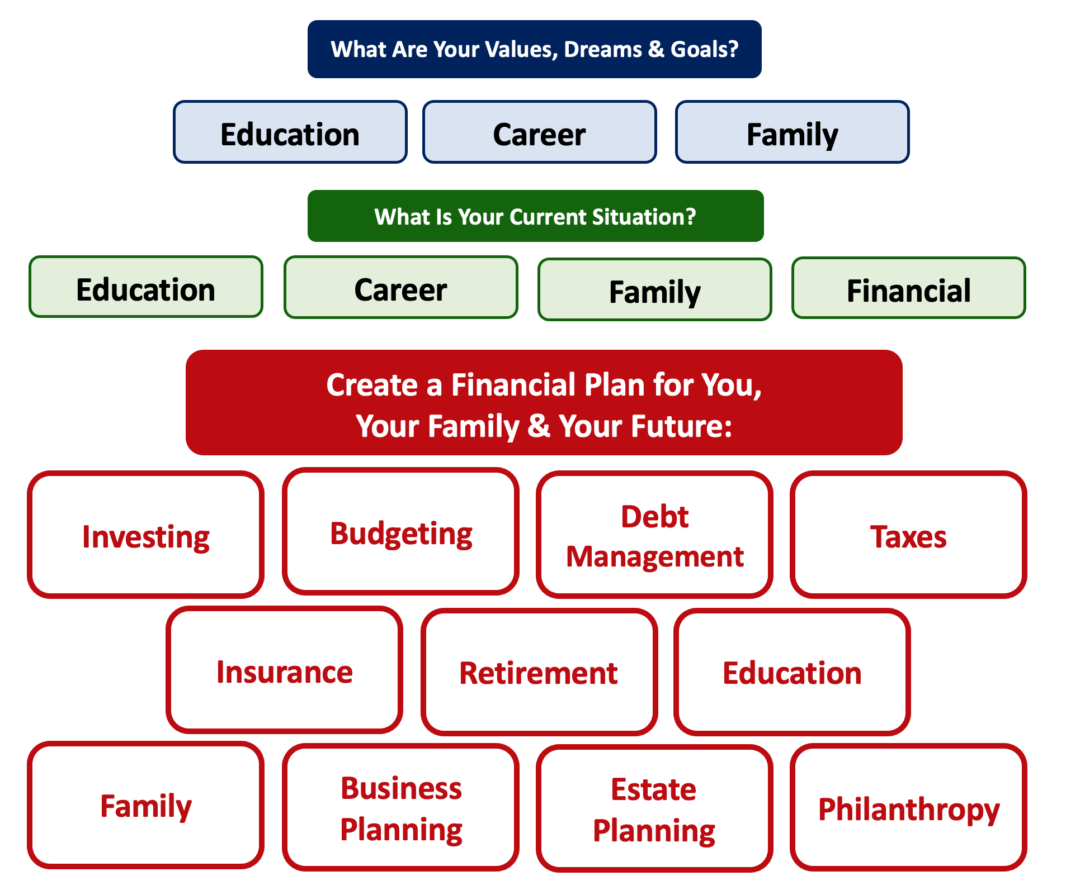
Debt is NOT a bad thing.
Debt can help us achieve our goals, depending on our current situations and what those goals are.
Debt is also called “leverage” – because it gives us the ability do things we might not be able to do otherwise.

Slide 39
Debt is NOT a bad thing.
My one primary piece of advice:
Whenever borrow money – whether it’s $20 for a Friday night pizza on your credit card or a $10,000 student loan – have a plan for paying it back.
Know why you are borrowing and where you will get the money to repay it.

Slide 40
A Little Math: Good Debt vs. Bad Debt

Slide 41
A Little Math: Good Debt vs. Bad Debt
Yes, I’ve simplified this a little. You will be making debt payments on your mortgage over those 3 years, so that would count against your equity growth. But this also means you would repay less in 3 years, which would increase your equity growth. And I have ignored taxes: both the benefits from using a mortgage and any costs due to the gains you may earn on the sale. But the idea here is to show how debt can create – or leverage – opportunities today to create value in the future.

Slide 42
A Little Math: Good Debt vs. Bad Debt
Isn’t this a lot like what you’re doing with your education?
You’re investing today – time, energy, money – in order
to create bigger and better opportunities for your future.
These opportunities may or may not be financial.
These opportunities are what will help you live your values and achieve your goals & dreams.
Yes, you do have to repay the money you borrowed. But if you are borrowing the money to achieve your dreams – dreams that you would not otherwise be able to achieve – then it’s probably a wonderful investment for you.

Slide 43




Good Debt vs. Bad Debt
High cost, both in $$$ and opportunity
Lots of uncertainty
Potential for enormous return
Perfectly aligned with values, goals & dreams
High cost, both in $ and opportunity
Lots of uncertainty
Potential for some return
Usually aligned with values, goals & dreams
Very high cost
Short-term fulfillment
No future return
Unrelated to values, goals & dreams

Slide 44
Good Debt vs. Bad Debt
$100,000 of principal
$45,435 of interest
Repaid over 20 years @ 4% interest

Slide 45
Good Debt vs. Bad Debt
$100,000 of principal
$58,389 of interest
Repaid over 20 years @ 5% interest

Slide 46
Good Debt vs. Bad Debt
$100,000 of principal
$216,030 of interest
Repaid over 20 years @ 15% interest

Slide 47
Good Debt vs. Bad Debt
Is this debt aligned with my values, goals & dreams?
How am I going to repay this debt?

Slide 48
Good Debt vs. Bad Debt
NOTE:
Using a credit card is not necessarily a bad idea.
Only racking up loads of credit card debt is a bad idea.
I regularly use 3 credit cards.
Here’s how and here’s why…

Slide 49
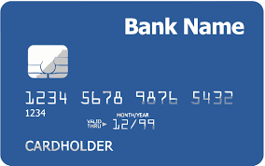
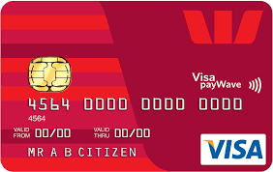
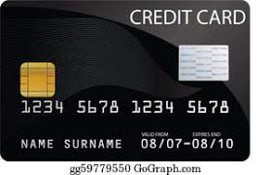
Credits Cards as Tools for Financial Planning
Card #1: Automatic bill payment of recurring monthly expenses (phone, insurance, cable, utilities)
Card #2: Living and discretionary expenses (gas, groceries, coffee, pizza, new shoes)
Card #3: Non-recurring big expenses (vacation, holidays, charity, new refrigerator)
Card #3 frequently has a $0.00 balance

Slide 50
Credits Cards as Tools for Financial Planning
WHY DO I DO THIS?
Mental Budgeting: This helps me mentally be aware of what I’m spending and why I’m spending.
  Instead of just knowing that I’m putting $1,000 on my credit cards in a month, separating the expenses across cards forces me to be aware of what I’m spending money on.
  When I review my statements and budgets at the end of each month, this gives me an easy opportunity to judge myself and to analyze my own behavior.
Card #1: Automatic bill payment of recurring monthly expenses (phone, insurance, cable, utilities)
Card #2: Living and discretionary expenses (gas, groceries, coffee, pizza, new shoes)
Card #3: Non-recurring big expenses (vacation, holidays, charity, new refrigerator)

Slide 51
Credits Cards as Tools for Financial Planning
WHY DO I DO THIS?
FREE MONEY!
  I pay off the full balance of each card each month. If I make a purchase on October 5, the cash does not leave my bank account until December 1.
    It might only be a penny or two, but earning interest during those 57 days feels kind of nice.
  Miles, cash-back and other rewards.
    Choose a card with benefits that you would be paying for anyway. And then cash in the rewards instead of paying cash in the future.
Card #1: Automatic bill payment of recurring monthly expenses (phone, insurance, cable, utilities)
Card #2: Living and discretionary expenses (gas, groceries, coffee, pizza, new shoes)
Card #3: Non-recurring big expenses (vacation, holidays, charity, new refrigerator)

Slide 52
LET’S MAKE THIS PERSONAL…
WHAT IMPACTS YOUR CREDIT RATING AS A CONSUMER?

Slide 53
LET’S MAKE THIS PERSONAL…
WHAT IMPACTS YOUR CREDIT RATING AS A CONSUMER?
35% Payment History – This is perhaps this simplest category, as it looks at how well you repay all borrowed amounts on credit cards, retail accounts, auto loans, utilities and phone bills, other installment loans and other debts. The better you are at repaying, the better your Payment History. Pay your bills on time.

Slide 54
LET’S MAKE THIS PERSONAL…
WHAT IMPACTS YOUR CREDIT RATING AS A CONSUMER?
30% Amounts Owed –The amount you owe is not simply about how much money you owe, but it’s also about how much of your available credit you use. If you have a credit card limit of $5,000 and your balance is $4,000, that’s worse than having a limit of $20,000 and a balance of $10,000. There are many trade-offs within this category and it can be confusing.
Pro-tip if you are using more than 30% of your available balance: Pay it off or down before the end of your reporting cycle and the credit agencies will never know it existed.

Slide 55
LET’S MAKE THIS PERSONAL…
WHAT IMPACTS YOUR CREDIT RATING AS A CONSUMER?
30% Amounts Owed –The amount you owe is not simply about how much money you owe, but it’s also about how much of your available credit you use. If you have a credit card limit of $5,000 and your balance is $4,000, that’s worse than having a limit of $20,000 and a balance of $10,000. There are many trade-offs within this category and it can be confusing.
Pro-tip if you are using more than 30% of your available balance: Pay it off or down before the end of your reporting cycle and the credit agencies will never know it existed.
One thing you can do tomorrow that might improve your credit score:
Ask for a credit limit increase on all of your credit cards or outstanding lines of credit.

Slide 56
LET’S MAKE THIS PERSONAL…
WHAT IMPACTS YOUR CREDIT RATING AS A CONSUMER?
15% Length of Credit History – This is also pretty simple – the longer your history of paying bills and loans, the better off you’ll be. Yes, this does bias against younger borrowers – but if your behavior in the other categories is strong, you should be okay. Be patient – you’ll build your history.

Slide 57
LET’S MAKE THIS PERSONAL…
WHAT IMPACTS YOUR CREDIT RATING AS A CONSUMER?
10% Credit Mix – Perhaps ironically, it can be better to have 5 different accounts that you repay regularly than it is to have just 2 different accounts. The greater the variety of accounts you have, the more opportunity you have to indicate that you are a low credit risk. Of course, if you have 5 accounts and you miss your payments, that will be doubly bad. Pay your bills on time and the Credit Mix will take care of itself.

Slide 58
LET’S MAKE THIS PERSONAL…
WHAT IMPACTS YOUR CREDIT RATING AS A CONSUMER?
10% New Credit – Opening a large number of new accounts in a short period of time may indicate that you are a higher risk. So, is the moral to never open new accounts? No – because then you can never indicate that you are a low risk. Be mindful of opening too many accounts in a short period of time, pay all your bills on time, and the New Credit category will not be a big issue.

Slide 59
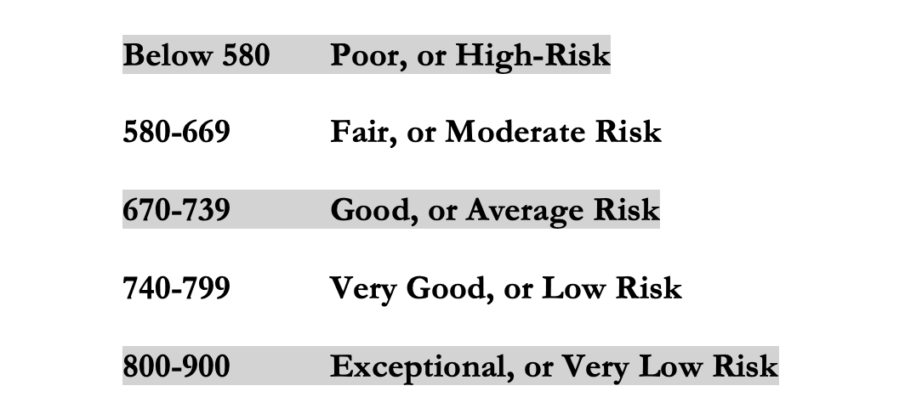
LET’S MAKE THIS PERSONAL…
WHAT IMPACTS YOUR CREDIT RATING AS A CONSUMER?
Your FICO Score will become an actual number: between 250 and 900.
The higher your Score, the lower interest rates you will pay on most loans.
The average FICO Score for Americans is just over 700.
The average in Louisiana is 677, the second lowest in the 50 U.S. states; only Mississippi has a lower average FICO Score.

Slide 60
LET’S MAKE THIS PERSONAL…
WHAT SHOULD YOU BE FOCUSED ON WITH RESPECT TO YOUR CREDIT SCORE?
If your FICO Score is below 600, there are probably 1 or 2 areas where you have significant weaknesses in your history.
Commit to correcting these weaknesses and not creating any new weaknesses.
If your FICO Score is between 600-700, there are probably 1 or 2 areas that can be improved – or where you used to have significant weaknesses.
Keep doing what you’re doing – and commit to not creating any new concerns.
If your FICO Score is over 700, keep doing what you’re doing and time will eventually get you the best score possible.

Slide 61
TODAY THE NEXT 6 MONTHS THE NEXT12 MONTHS 2 YEARS AFTER GRADUATION 3 YEARS AFTER GRADUATION
ONCE EVERY SEMESTER:
TRACK EVERY PENNY THAT YOU SPEND & TRACK EVERY PENNY THAT YOU EARN
IN THE NEXT 3 MONTHS:
IDENTIFY WAYS TO DECREASE YOUR DISCRETIONARY SPENDING BY 25%
IN THE NEXT 6 MONTHS:
MAKE A PLAN TO MANAGE – AND PAY OFF – YOUR DEBT
IN THE NEXT 6-12 MONTHS:
OPEN MULTIPLE SAVINGS ACCOUNTS, 1 FOR EACH GOAL
IN THE NEXT 12 MONTHS, OPEN AN IRA OR ROTH IRA
WITHIN 2 YEARS OF GRADUATION:
HAVE AN “EMERGENCY FUND” ACCOUNT, WITH 3-6 MONTHS OF NON-DISCRETIONARY EXPENSES
WITHIN 3 YEARS OF GRADUATION:
ELIMINATE ALL OF YOUR BAD DEBT.

Slide 62
TODAY THE NEXT 6 MONTHS THE NEXT12 MONTHS 2 YEARS AFTER GRADUATION 3 YEARS AFTER GRADUATION
ONCE EVERY SEMESTER:
TRACK EVERY PENNY THAT YOU SPEND & TRACK EVERY PENNY THAT YOU EARN
IN THE NEXT 3 MONTHS:
IDENTIFY WAYS TO DECREASE YOUR DISCRETIONARY SPENDING BY 25%
IN THE NEXT 6 MONTHS:
MAKE A PLAN TO MANAGE – AND PAY OFF – YOUR DEBT
IN THE NEXT 6-12 MONTHS:
OPEN MULTIPLE SAVINGS ACCOUNTS, 1 FOR EACH GOAL
IN THE NEXT 12 MONTHS, OPEN AN IRA OR ROTH IRA
WITHIN 2 YEARS OF GRADUATION:
HAVE AN “EMERGENCY FUND” ACCOUNT, WITH 3-6 MONTHS OF NON-DISCRETIONARY EXPENSES
WITHIN 3 YEARS OF GRADUATION:
ELIMINATE ALL OF YOUR BAD DEBT.

Slide 63
Opening a Roth IRA – Why Do It?
Conceptually, the earlier we begin saving for retirement, the more we will benefit from compound interest when we get to retirement age.
  If you invest $6,000 per year from age 25 to age 60, you would have $1,300,000 in your account at age 60 (assuming a 9% annual return).
  If you wait 10 years and invest $6,000 per year from age 35 to age 60, you would have $500,000 in your account at age 60 (assuming a 9% annual return).

Slide 64
Planning for Retirement – Why do it NOW?
Conceptually, the earlier we begin saving for retirement, the more we will benefit from compound interest when we get to retirement age.
  If you invest $6,000 per year from age 25 to age 60, you would have $1,300,000 in your account at age 60 (assuming a 9% annual return).
  If you wait 10 years and invest $6,000 per year from age 35 to age 60, you would have $500,000 in your account at age 60 (assuming a 9% annual return).

Slide 65
Planning for Retirement – How to do it?
A taxable-brokerage account (with Robinhood, Fidelity or some other brokerage)
    You contribute/invest after-tax cash flow (what is leftover from your paycheck)
    Your investments should grow over time
    You pay income taxes today, before investing, and then capital gains when you withdraw the money in the future
    This is the most flexible…but has the fewest tax benefits
A company-sponsored retirement plan: 401(k) or 403(b), in most cases.
    Your employer may match some of your contributions (= “free money”)
    Your investments should grow over time
    You will pay income taxes when you withdraw the money in retirement, only
    You never pay capital gains taxes on the growth – that’s good

Slide 66
Planning for Retirement – How to do it?
An IRA – Individual Retirement Account, designed for people without a company sponsored retirement plan
    Available through Robinhood, Fidelity or most other brokerages
    You contribute/invest PRE-TAX cash flow today
    Your investments should grow over time
    You pay income taxes in retirement
A Roth IRA
    Available through Robinhood, Fidelity or most other brokerages
    You contribute/invest AFTER-TAX cash flow today
    Your investments should grow over time
    You pay income taxes today, but never again
    Roth IRAs are ideal for people with relatively low income today,
    who expect their income to increase in the future

Slide 67
Opening a Roth IRA – The Fine Print
But what is an IRA? Why the Roth IRA?
  An IRA is an Individual Retirement Account.
  You are allowed to contribute $6,500 per year
  An IRA has tax advantages to a regular brokerage account, in that it allows you avoid capital gains taxes
    With a Roth IRA, you use after-tax money to invest today. The money should grow over time, but then when you with withdraw the money in retirement, you do NOT pay income taxes
    With a traditional IRA, you get a tax-deduction today for the amount that you invest. So you do not pay taxes today on that amount of income. But then you will pay income taxes when you withdraw the money in retirement.
    The key decision is based on whether you think your tax rate will be higher today or in the future.
    This is why we recommend a Roth IRA to graduate students: Your income tax rate is probably lower today than it will be in the future, so you want to pay taxes today and avoid taxes in the future. The Roth lets you do this.
  The bad news is that the money you put into an IRA cannot be withdrawn, unless you pay a 10% penalty, until you turn 59 ½ years old
  There is more fine print that we are skipping over here and some minor exceptions to this overview, but this should cover most of you and most situations.

Slide 68
Opening a Roth IRA – A Checklist
  Research – and pick – a brokerage or financial institution to use.
      Functionally & legally, as far as managing your account and investments, they are going to be similar.
      However, the user interfaces will be different…including how you use the account and resources available. That’s the decision – which interface do you like best.
      And, some brokerages may not offer certain types of accounts.
      Robinhood, Fidelity, Charles Schwab, JP Morgan Chase, Bank of America, TD Ameritrade and many others are all good.
  Establish and open your Roth IRA account.
      This will require your Social Security number and other personal information, but not too much. It should take 5-10 minutes.
  Fund your Roth IRA account.
      Link a bank account to your Roth IRA to allow online transfers. It may take 1-2 weeks initially to get the money transferred as the Roth IRA account verifies your bank accounts.
      Your brokerage may allow wire transfers for a fee, but the initial transfer may still take 1-2 weeks
      You may be able to upload an electronic copy of a personal check to deposit funds into your Roth IRA account.
      You may be able to go old school and visit a branch of your brokerage to do everything in person.
  Begin investing and saving for your retirement.

Slide 69
The Magic of Compound Returns

Slide 70
The Magic of Compound Returns

Slide 71
The Magic of Compound Returns
Quiz Question on Compound Returns:
Under which of the following scenarios will you have more money saved when you turn 65?
Investing $100 per month from age 25-35 (and then nothing from 35-65)
With an 8% return, you will have $185,000 accumulated at 65.
Investing $100 per month from age 35-65 (but nothing from 25-35)
With an 8% return, you will have $150,000 accumulated at 65.
Note: If the returns on your investments are less than 6%, (B) will lead to greater wealth.
There’s a similar but different problem on page 37 of your handbook.

Slide 72
The Magic of Compound Returns
Quiz Question on Compound Returns:
Under which of the following scenarios will you have more money saved when you turn 65?
Investing $100 per month from age 25-35 (and then nothing from 35-65)
With an 8% return, you will have $185,000 accumulated at 65.
Investing $100 per month from age 35-65 (but nothing from 25-35)
With an 8% return, you will have $150,000 accumulated at 65.
Note: If the returns on your investments are less than 6%, (B) will lead to greater wealth.
There’s a similar but different problem on page 37 of your handbook.

Slide 73
Review: A Few Rules About INVESTING
Investing lets COMPOUND INTEREST be your friend.
  With compound interest, your interest earns interest.
  Without actively making decisions, your money can grow exponentially.
  Yes, there is risk – the exponential growth rate could be negative.
  Such risk is greatest if you ‘invest’ over very short periods of time.
  Historically, over the past 100+ years, if you invest for 5+ years, you have benefited from positive exponential growth.
  The average return of a common stock over the past 100 years is 10%.
    The word ’average’ is very important here. But, the good news, we can all achieve ‘average’ returns relatively easily (though they may not be 10% in the future)

Slide 74
Review: A Few Rules About INVESTING
Investing lets COMPOUND INTEREST be your friend.
  With compound interest, your interest earns interest.
  Without actively making decisions, your money can grow exponentially.
  Yes, there is risk – the exponential growth rate could be negative.
  Such risk is greatest if you ‘invest’ over very short periods of time.
  Historically, over the past 100+ years, if you invest for 5+ years, you have benefited from positive exponential growth.
  The average return of a common stock over the past 100 years is 10%.
    The word ’average’ is very important here. But, the good news, we can all achieve ‘average’ returns relatively easily (though they may not be 10% in the future)
Not to be too esoteric or philosophical…
But compound interest doesn’t just apply to investing.
Compound interest applies to all aspects of college life:
Time Management
Mental Health
Health Management
Writing Skills
Relationships
And…Of course, Money Management

Slide 75
Values, Financial Wellness & Resilience
Budgeting & Debt Management
Resetting your financial plan
Tax planning
Graduate School…Is it in your future?
Revisiting your family, personal & career goals

Slide 76
Budgeting & Debt Management
Budgeting – The one truth is that you can only spend money that you have or earn…unless you borrow.
  Find a budget approach that works for you.
  Don’t outsource all of your budgeting to apps, websites or your bank. Do it yourself. Internalize the numbers.
  Set boundaries and rules – make willpower natural.
  Set goals and challenges – make saving a game.
  Align your spending with your values and what you care about most.

Slide 77
Budgeting & Debt Management
Debt Management – When you borrow, you are saying that your present needs are so great that you are willing to endure some pain or sacrifice in the future to satisfy those needs (and almost all students do this).
  Whenever you borrow – whether it’s student loans or credit card debt – make a plan for how you’re going to repay that debt.
  Interest: the premium you pay to use someone else’s money.
    Find loans with low rates, no fees or penalties & a short repayment term.
  Once a year, talk to a bank or lender about consolidating your debt.
  Live a life that is not controlled by debt. This starts with your values, your behavior & your budgeting. Always have a plan to get rid of your debt.

Slide 78
Financial Wellness & Resilience
Resetting your financial plan
  Revisit your values and identify your short- and long-term goals
  Analyze your insurance, phone, subscription and other expenses
  What kind of job are you looking for?
  Start a money journal – note your behaviors, feelings and emotions related to how you spend money
  Share your financial goals with your family

Slide 79
Financial Wellness & Resilience
Tax planning
  Make sure your employer is withholding the right amount.
    Less withholding = More cash in your pocket
  Do you want to make any charitable donations before year-end (or wait until January)?
  Should you recognize any investment gains or losses before year-end?
  Do you know all of the deductions and credits that you are eligible for?
  Did you receive a tax refund this year? Do you really want a tax refund each year?
  Are you married or close to getting married? Do a little research to understand how this is going to affect your tax situation.

Slide 80
Financial Wellness & Resilience
Graduate School…Is it in your future?
  For some careers, graduate school degrees are required.
    But not for all.
    Do your research on whether or not it is essential for you to get a graduate degree.
    Do your research on whether you need to go to grad school NOW or if you can wait.
  In selecting a graduate school, focus on both the short-term and long-term benefits…because this is probably the only graduate degree you will ever have
    Some schools may entice you with generous scholarships or work-study benefits. That’s great…so long as the value of the degree is also great.
      The cliché that “you get what you pay for” certainly applies here.
    Make sure the school – or faculty – can get you the job you want.
      Otherwise, you’re just wasting 1-5 additional years of your life.

Slide 81
Financial Wellness & Resilience
Revisiting your family, personal & career goals
  What do you want to achieve over the next 1-2 years?
  What do you want to achieve over the next 3-5 years?
  What do you want to achieve over the next 10 years?
  As you revisit your goals, be sure to communicate with your family and anyone else affected by your goals.

Slide 82

Isn’t this a lot like what you do with your education planning?

Slide 83
Some Parting Words
Nothing in finance is free. Do not think some institution is giving you a super deal just because they like you. There will be costs.
Investment companies work really hard to get your money. They hire psychologists to figure out how to get you addicted to your products. Your money pays for their commercials, buildings, fancy cars and vacation homes.
I check my bank, savings & investment accounts daily. I do not make changes daily (or even monthly). I just don’t want any surprises.

Slide 84
Some Parting Words
If you ever invest based on personal relationships, be prepared for losses.
Nobody – NOBODY – can predict the future. And investing is all about predicting the future. Be careful about thinking you can predict the future. Make sure your investments align with your goals.
Be your own boss. Take control of your money and your investments. Nobody else is going to do it for you. Own your financial future.

Slide 85
Financial Wellness
Don’t wait around for other people to be happy for you.
Any happiness you get,
You’ve got to make yourself.
~ Alice Walker, poet & novelist

Slide 86
Brian Bolton
Professor of Finance brian.bolton@louisiana.edu

