Slide 1
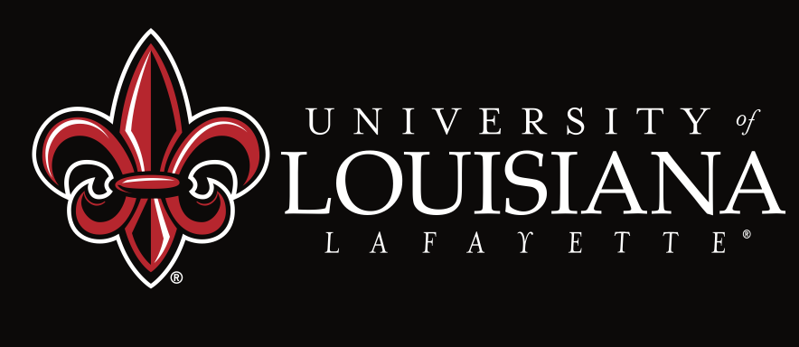
STUDENT SUPPORT SERVICES
FINANCIAL WELLNESS SERIES 2024
Session #5:
Planning to Pay Off Your Student Loans
April 17, 2024

Slide 2
Brian Bolton Professor of Finance brian.bolton@louisiana.edu http://business.louisiana.edu/financeispersonal

Slide 3
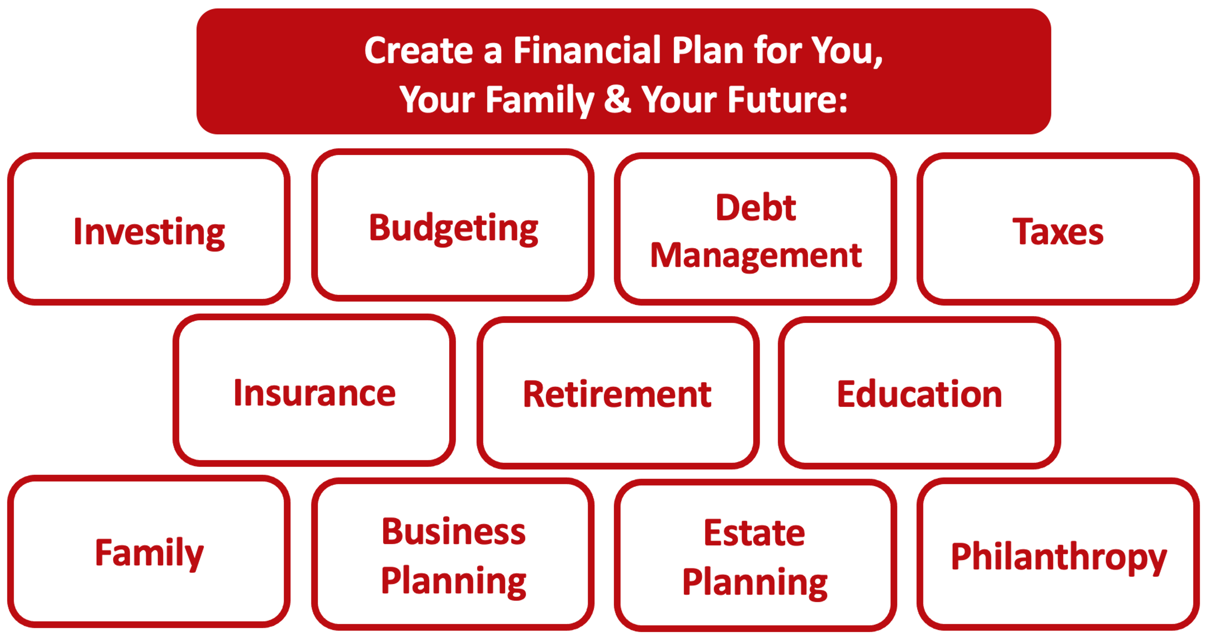

Slide 4
Owning Your Financial Future
YOUR VALUES
YOUR GOALS
Education
Career
Family
FINANCIAL STRATEGIES
Investing
Income & Expense Management
Debt Management
Taxes, Insurance & Other

Slide 5
Owning Your Financial Future
YOUR VALUES
YOUR GOALS
Education
Career
Family
FINANCIAL STRATEGIES
Investing
Income & Expense Management
Debt Management
Taxes, Insurance & Other

Slide 6
Owning Your Financial Future
YOUR VALUES
YOUR GOALS
Education
Career
Family
FINANCIAL STRATEGIES
Investing
Income & Expense Management
Debt Management
Taxes, Insurance & Other

Slide 7
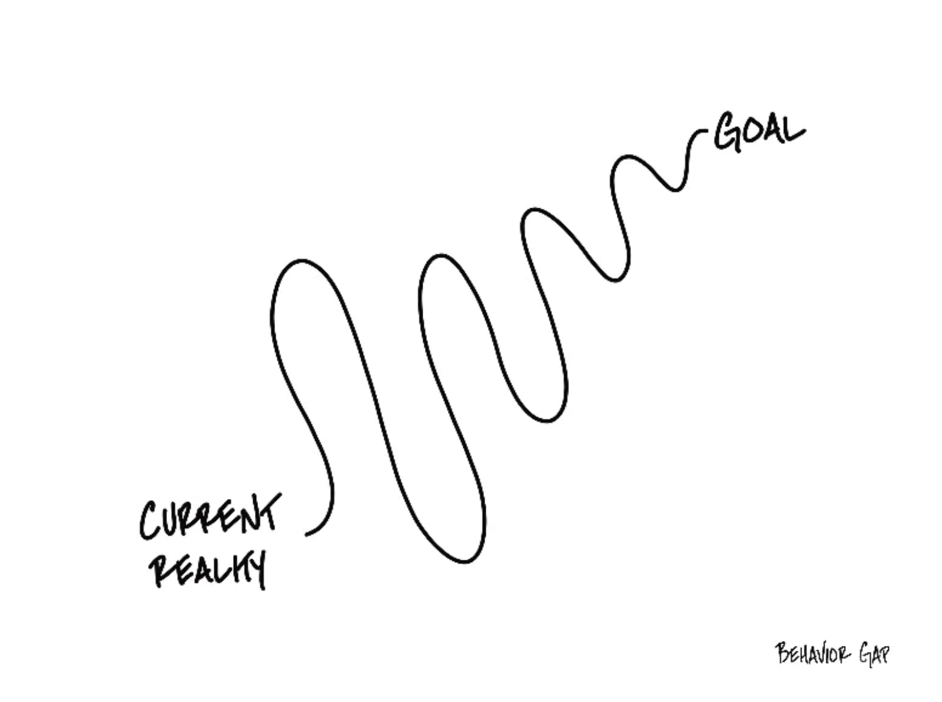

Slide 8
TODAY THE NEXT 6 MONTHS THE NEXT 12 MONTHS 2 YEARS AFTER GRADUATION 3 YEARS AFTER GRADUATION
ONCE EVERY SEMESTER:
TRACK EVERY PENNY THAT YOU SPEND & TRACK EVERY PENNY THAT YOU EARN
IN THE NEXT 3 MONTHS:
IDENTIFY WAYS TO DECREASE YOUR DISCRETIONARY SPENDING BY 25%
IN THE NEXT 6 MONTHS:
MAKE A PLAN TO MANAGE – AND PAY OFF – YOUR DEBT
IN THE NEXT 6-12 MONTHS:
OPEN MULTIPLE SAVINGS ACCOUNTS, 1 FOR EACH GOAL
IN THE NEXT 12 MONTHS, OPEN AN IRA OR ROTH IRA
WITHIN 2 YEARS OF GRADUATION:
HAVE AN “EMERGENCY FUND” ACCOUNT, WITH 3-6 MONTHS OF NON-DISCRETIONARY EXPENSES
WITHIN 3 YEARS OF GRADUATION:
ELIMINATE ALL OF YOUR BAD DEBT.

Slide 9
School & Education
Money
Family

Slide 10
A Few Opening Morals
Personal Finance is…personal.
It’s about you and not about anyone else.
You have to make it about you and your goals.

Slide 11
A Few Opening Morals
There is no judgment in personal finance.
There is no ego in personal finance.
There is no shame in personal finance.
It’s about you and not about anyone else.

Slide 12
WHAT IS HAPPENING WITH STUDENT LOAN DEBT?
THERE’S
GOOD NEWS
THERE’S
BAD NEWS

Slide 13
STUDENT LOAN DEBT UPDATE
THE GOOD NEWS
Some student loans are being forgiven….for a variety of reasons.
There is no longer a national plan for $10,000 or $20,000 of relief, but the Department of Education is relieving loans on a more specific basis
If your lender engaged in fraud, if your university went out of business, if your university misled you…you might receive forgiveness at some point in the future.
The Department of Education has continued to expand student loan repayment and forgiveness options – you may or may not be part of this expansion.
Expanded opportunities for INCOME DRIVEN REPAYMENT
Expanded opportunities for PUBLIC SERVICE LOAN FORGIVENESS

Slide 14
STUDENT LOAN DEBT UPDATE
THE BAD NEWS
There is no longer a national plan for $10,000 or $20,000 of relief
Payments resumed – after a 3.5 year break – in October 2023 for graduates and others whose loans required payments
For federally subsidized loans, you do not have to repay and interest does not accrue until 6 months after you are no longer a student – that probably applies to most of you
Interest rates have increased and may stay elevated for months or years
If you have a private loan – NOT through FAFSA or studentaid.gov – you do not benefit from federal relief or forgiveness programs
This includes if you moved a federal loan to a private lenders, probably

Slide 15
STUDENT LOAN DEBT UPDATE
What YOU Should Do Today
Go to studentaid.gov to understand the status of your loans
Get to know your loan servicer….this is the bank or company where you send (or will send in the future) your monthly loan payments
Explore the requirements for Public Service Loan Forgiveness, the most generous loan forgiveness program offered
If you work in education, for non-profits, government and other public service, your full loan might be forgiven after 10 years of on-time payments

Slide 16
STUDENT LOAN DEBT UPDATE
What YOU Should Do Today
Go to studentaid.gov to understand the status of your loans
Explore the options within Income Driven Repayment….a repayment plan that allows you to make repayments based on your income (which can be great while your income is relatively low)
Making 20-25 years of payments on-time should lead to forgiveness
Public service loan forgiveness is a special kind of Income Driven Repayment – if you start working in education, and then switch to private industry, you can switch your repayment plan from PSLF to IDR
Make all required payments on-time!

Slide 17
Frequently Asked Question #1
Ideally how much of your income should you expect to go into paying off various loans (car, house, school, etc.)?
There are 2 ways to address this:
From a lender’s perspective.
From your own, personal perspective.

Slide 18
Frequently Asked Question #1
Ideally how much of your income should you expect to go into paying off various loans (car, house, school, etc.)?
The lender’s perspective:
28% of your gross income should go to housing payments (at most) (including rent, mortgage, taxes, insurance…but not maintenance or utilities)
36% of your gross income should go to all debt payments (at most)
(including housing, credit cards, student loans, auto loans…)

Slide 19
Frequently Asked Question #1
Ideally how much of your income should you expect to go into paying off various loans (car, house, school, etc.)?
28% of your gross income should go to housing payments (at most) (including rent, mortgage, taxes, insurance…but not maintenance or utilities)
36% of your gross income should go to all debt payments (at most)
(including housing, credit cards, student loans, auto loans…)
Be very careful: These ratios are based on payments, not borrowed amounts or loan balances. Lenders may encourage you to extend your loan repayment term, which may lower your monthly or annual payment….but doing this will usually increase the total amount that you have to repay over the life of the loan.

Slide 20
Frequently Asked Question #1
Ideally how much of your income should you expect to go into paying off various loans (car, house, school, etc.)?
These ratios are based on payments, not borrowed amounts or loan balances. Lenders may encourage you to extend your loan repayment term, which may lower your monthly or annual payment….but doing this will usually increase the total amount that you have to repay over the life of the loan.
You generally want to repay your debt as soon as possible.
Longer term = More interest paid = More cash out of your pocket
The biggest exception is student loan debt…where rates are generally the lowest, some interest can be tax deductible, and you have maximum flexibility in repayment plans (and, if you are on track for public service forgiveness, you need to make 10 years of payments).

Slide 21
Frequently Asked Question #1
Ideally how much of your income should you expect to go into paying off various loans (car, house, school, etc.)?
From a personal perspective, it will all depend on your other goals and investments and your specific situation.
If you buy a home, you will increase your debt.
If you have children, you may increase your debt as you save for their education or incur other expenses.
You can offset this by having a lower auto loan or reducing your student loans.
Always, always, always pay off your credit card balances as soon as you are able.

Slide 22
Frequently Asked Question #1
Ideally how much of your income should you expect to go into paying off various loans (car, house, school, etc.)?
From a personal perspective, it will all depend on your other goals and investments and your specific situation.
If your debt payments are over 40% of your income, make a plan to change this and to get your payments lower.
This will help your credit score, it will help you access more debt in the future, it will free up income to invest in your other goals…and it will help you sleep at night.

Slide 23
Frequently Asked Question #2
How does Income-Driven Repayment of student loans work?
There are several income-based payment plans, so these responses will be generic.
You choose 1 of 4 repayment plans
You make monthly payments based on your discretionary income.
Historically, payments ranged from 10-20% of your income.
The new policies reduces this to 5% of your income. That’s good.
You have flexibility if you lose your job or move to a lower paying job.
If you make payments for 20-25 years, your loan will be forgiven. (20 years for UG debt, 25 years for GR debt)
Income-Driven Repayment is generally required if you are going to eventually seek public service loan forgiveness (after 10 years of working in public service and making on-time payments).

Slide 24
Frequently Asked Question #2
Income Driven Repayment (IDR) itself is not new.
IDR allows borrowers to repay federal student loan debt based on what their income is, ostensibly to allow students who go into lower-paying careers more flexibility in how they repay their student loans.
Instead of making monthly payments based on some set formula – like a car loan or a mortgage – the monthly payment amounts are based on borrower annual income.
You still owe the entire amount, but IDR adjusts both the monthly payments and the loan term, as appropriate.
Public Service Loan Forgiveness is a special kind of IDR. Many people in academia will be in both programs and take advantage of PSLF if they qualify.
The new adjustments to Income-Driven Repayment will substantially reduce future monthly payments for lower- and middle-income borrowers.

Slide 25
Frequently Asked Question #2
The new adjustments to Income-Driven Repayment will substantially reduce future monthly payments for lower- and middle-income borrowers.
Require borrowers to pay no more than 5% of their discretionary income monthly on undergraduate loans.
This is down from the 10-20% available under the previous income-driven repayment plan.
Raises the amount of income that is considered non-discretionary income and therefore is protected from repayment, guaranteeing that no borrower earning under 225% of the federal poverty level will have to make a monthly payment.
Forgive loan balances after 10 years of payments, instead of 20 years, for borrowers with loan balances of $12,000 or less.
Cover the borrower's unpaid monthly interest, so that unlike other existing income-driven repayment plans, no borrower's loan balance will grow as long as they make their monthly payments—even when that monthly payment is $0 because their income is low.

Slide 26
Frequently Asked Question #2
Why should you consider Income Driven Repayment as an option?
It does give you some flexibility in how much of your debt you repay each month, affording you the ability to choose careers based on reasons unrelated to how much student loan debt you owe.
You can still decide to pay more than what is required, thereby reducing your loan balance and potentially retiring your debt sooner.
If you make on-time payments for 20 years through IDR, your entire remaining balance of UNDERGRADUATE debt may be completely forgiven. If you make on-time payments for 25 years through IDR, your entire remaining balance of GRADUATE debt may be completely forgiven. (Note: If your loan balance is less than $12,000, the 20 years might be reduced to 10 years.)

Slide 27
Frequently Asked Question #2
The proposed adjustments to Income-Driven Repayment will substantially reduce future monthly payments for lower- and middle-income borrowers.
Require borrowers to pay no more than 5% of their discretionary income monthly on undergraduate loans.
This is down from the 10% available under the most recent income-driven repayment plan.
Raise the amount of income that is considered non-discretionary income and therefore is protected from repayment, guaranteeing that no borrower earning under 225% of the federal poverty level will have to make a monthly payment.
Forgive loan balances after 10 years of payments, instead of 20 years, for borrowers with loan balances of $12,000 or less.
Cover the borrower's unpaid monthly interest, so that unlike other existing income-driven repayment plans, no borrower's loan balance will grow as long as they make their monthly payments—even when that monthly payment is $0 because their income is low.
These proposed changes to Income-Driven Repayment is different from the Public Service Loan Forgiveness information on the previous slides.
These proposed changes are only for undergraduate loans (no changes for graduate loans).
These proposed changes are designed to encourage more borrowers to pursue Income-Driven Repayment…because more people will benefit from IDR.
You may not need to do anything now…beyond considering whether you should use IDR when it is time to repay your student loans.

Slide 28
Frequently Asked Question #3
What are my options for repaying my student loan debt? Specifically, how does Public Service Loan Forgiveness work?
There are lots of repayment plans, but they generally fit into 3 types:
Set monthly payment, with a plan to repay in full over some period.
Income-Driven Repayment, with payments based on your salary.
Public Service Loan Forgiveness, which can include a payment plan based on either (1) or (2), but can offer to forgive your remaining loan balance after you work in a public service job (and make payments) for 10 years.

Slide 29
Frequently Asked Question #3
The proposed adjustments to Income-Driven Repayment will substantially reduce future monthly payments for lower- and middle-income borrowers.
Require borrowers to pay no more than 5% of their discretionary income monthly on undergraduate loans.
This is down from the 10% available under the most recent income-driven repayment plan.
Raise the amount of income that is considered non-discretionary income and therefore is protected from repayment, guaranteeing that no borrower earning under 225% of the federal poverty level will have to make a monthly payment.
Forgive loan balances after 10 years of payments, instead of 20 years, for borrowers with loan balances of $12,000 or less.
Cover the borrower's unpaid monthly interest, so that unlike other existing income-driven repayment plans, no borrower's loan balance will grow as long as they make their monthly payments—even when that monthly payment is $0 because their income is low.
These proposed changes to Income-Driven Repayment is different from Public Service Loan Forgiveness.
These proposed changes are only for undergraduate loans (no changes for graduate loans).
These proposed changes are designed to encourage more borrowers to pursue Income-Driven Repayment…because more people will benefit from IDR.
You may not need to do anything now…beyond considering whether you should use IDR when it is time to repay your student loans.

Slide 30
Frequently Asked Question #3
Borrowers who are employed by non-profits, the military, or federal, state, Tribal, or local government may be eligible to have all of their student loans forgiven through the Public Service Loan Forgiveness (PSLF) program.
This is the most generous repayment (or forgiveness) plan offered by the Department of Education. As such, it can also be the most restrictive.
Simply put…if you make your scheduled payments for 10 years, and have spent those 10 years working in public service, your loan balance will be forgiven.
If your loan balance is significantly high (say, over $100,000), choosing a career that allows the possibility of PSLF might be the value-maximizing financial planning decision.
The salary you get might be lower than in an industry job. But, the possible debt forgiveness might more than make up for that lower salary over time.

Slide 31
Frequently Asked Question #4
What is the new SAVE Plan – Saving on Valuable Education – and what does it mean for me?
The SAVE Plan is another version of IDR, Income Driven Repayment.
Monthly payments are based on your monthly discretionary income.
Discretionary Income = Adjusted Gross Income – (225% x Federal Poverty Guideline)
If your income is less than $32,800, your monthly payment will be $0.00.
The lower payment does NOT increase interest accrual.
If the math shows you owe $50 in interest, but the above says you owe $30, the $20 difference is forgiven.
Separates repayments plans for married couples (filing taxes separately keeps student loan repayment plans separate for each partner).

Slide 32
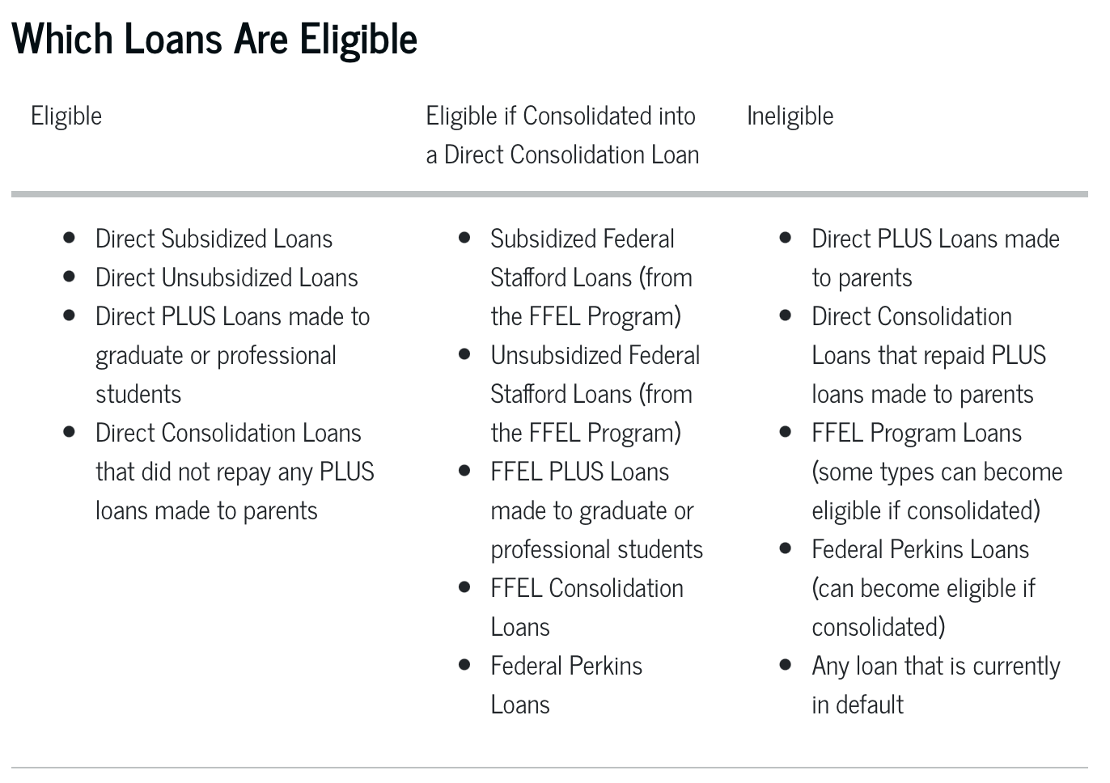
Frequently Asked Question #4

Slide 33
Frequently Asked Question #4
What is the new SAVE Plan – Saving on Valuable Education – and what does it mean for me?
If your loan is in default, you may be eligible for the Fresh Start Initiative, which will help you get your loan back in good standing.
This is important to consider while you are a current student – as it will allow you to become an eligible borrower again.

Slide 34
Frequently Asked Question #5
Is it smart to pay off student debt as soon as you are able to?
General Answer: No, not for most people.
I have 30k in savings and 16k in student debt, mostly subsidized and low-interest (2-4%). I've been trying to figure out if it would be smarter to pay off my loans entirely before I leave school and start accruing interest or if it'd be better to save/invest my savings and pay off the debt over time.
If I were you, I would not be in a hurry to repay the $16k of student debt.

Slide 35
Frequently Asked Question #5
I have 30k in savings and 16k in student debt, mostly subsidized and low-interest (2-4%). I've been trying to figure out if it would be smarter to pay off my loans entirely before I leave school and start accruing interest or if it'd be better to save/invest my savings and pay off the debt over time.
If I were you, I would not be in a hurry to repay the $16k of student debt.
Yes, you could pay off the debt with your savings.
But is there something else you could be using the savings for?
Buying a new house?
Building up a retirement account?
Setting money aside for kids?
Do you have other debt to repay?
Does having the debt cause you stress?

Slide 36
Frequently Asked Question #5
I have 30k in savings and 16k in student debt, mostly subsidized and low-interest (2-4%). I've been trying to figure out if it would be smarter to pay off my loans entirely before I leave school and start accruing interest or if it'd be better to save/invest my savings and pay off the debt over time.
Do you have any other debt to repay?
As a general rule, student loan debt should be the last debt you pay off.
Your interest rate is very low - lower than you’ll get on just about any other loan.
You generally have the most flexibility with repayment.
If you quit or lose your job next year, after paying off your student loan debt, that money is gone and you may now have to borrow at a much higher rate.
But if that $16k is still in savings, you can use it as necessary next year.

Slide 37
Frequently Asked Question #5
I have 30k in savings and 16k in student debt, mostly subsidized and low-interest (2-4%). I've been trying to figure out if it would be smarter to pay off my loans entirely before I leave school and start accruing interest or if it'd be better to save/invest my savings and pay off the debt over time.
What else could you be doing with the $16k of savings?
If you are only going to earn 0.25% on your savings, and you don’t have anything else to do with it, maybe pay off the 2-4% student loans at 2-4%.
The S&P 500 Index has averaged 12.1% annual return over the past 100 years. What if you invest $10,000 into an S&P 500 Fund and use the growth in that to pay off your student loan over time?
Note – This is just an example, not a recommendation. There is no guarantee of getting this return, certainly not every single year. There are other investments you could make that might have less risk and uncertainty (or more risk and uncertainty).

Slide 38
Frequently Asked Question #5
I have 30k in savings and 16k in student debt, mostly subsidized and low-interest (2-4%). I've been trying to figure out if it would be smarter to pay off my loans entirely before I leave school and start accruing interest or if it'd be better to save/invest my savings and pay off the debt over time.
Only YOU can decide what best aligns with:
Your short-term and long-term goals.
Your mental health. What helps you sleep better at night.
I finished my MBA in a similar situation. I had about the same debt but less in savings. I paid close to the minimum payments for the first 1-2 years after graduation. Then, as my income became more comfortable and my plans become more clear, I was able to make larger one-time payments.
I ended up paying off the debt 4.5 years after graduation. Even then, it wasn’t a financial decision; it was an “I’m ready to get rid of this and stop having to think about this decision.”

Slide 39
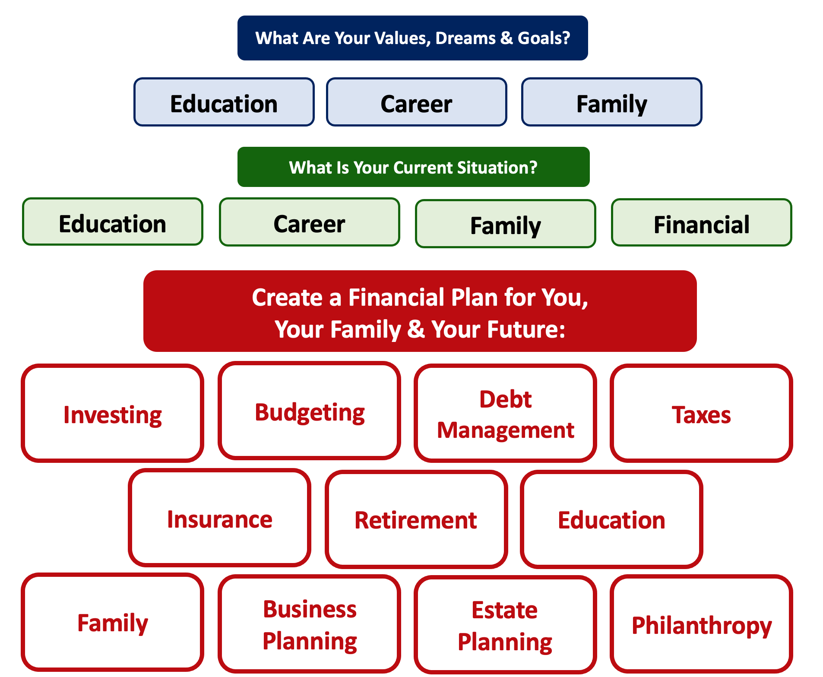

Slide 40
Debt is NOT a bad thing.
Debt can help us achieve our goals, depending on our current situations and what those goals are.
Debt is also called “leverage” – because it gives us the ability do things we might not be able to do otherwise.

Slide 41
Debt is NOT a bad thing.
My one primary piece of advice:
Whenever borrow money – whether it’s $20 for a Friday night pizza on your credit card or a $10,000 student loan – have a plan for paying it back.
Know why you are borrowing and where you will get the money to repay it.

Slide 42
INDULGENCE is good.
IMPULSE is bad.

Slide 43
Long-Term Investment Planning
YOUR VALUES
YOUR GOALS
FINANCIAL STRATEGIES
INVESTMENT STRATEGIES
Identify Your Risk Tolerance
Identify Your Time Horizons
Select Investments
Monitor & Modify Investments

Slide 44
Long-Term Investment Planning
FINANCIAL STRATEGIES
EDUCATION STRATEGIES
INVESTMENT STRATEGIES
GRAD SCHOOL STRATEGIES
Identify Your Risk Tolerance
Identify Your Risk Tolerance
Identify Your Time Horizons
Identify Your Time Horizons
Select Investments
Select Your Field, Program, Specialization, Thesis
Monitor & Modify Investments
Monitor & Modify Your Progress & Plan

Slide 45
Long-Term Investment Planning
FINANCIAL GOALS
YOU,
as college students, are better wired and equipped to make long-term plans – education, career, financial & otherwise – than 99% of humanity.
Be confident. Be intentional.
Be diligent.
Be awesome.
EDUCATION GOALS
INVESTMENT STRATEGIES
EDUCATION STRATEGIES
Identify Your Risk Tolerance & Priorities
Identify Your Risk Tolerance & Priorities
Identify Your Time Horizons
Identify Your Time Horizons
Select Investments
Select Your Field, Program, Specialization, Thesis
Monitor & Modify Investments
Monitor & Modify Your Progress & Plan

Slide 46
TODAY THE NEXT 6 MONTHS THE NEXT 12 MONTHS 2 YEARS AFTER GRADUATION 3 YEARS AFTER GRADUATION
ONCE EVERY SEMESTER:
TRACK EVERY PENNY THAT YOU SPEND & TRACK EVERY PENNY THAT YOU EARN
IN THE NEXT 3 MONTHS:
IDENTIFY WAYS TO DECREASE YOUR DISCRETIONARY SPENDING BY 25%
IN THE NEXT 6 MONTHS:
MAKE A PLAN TO MANAGE – AND PAY OFF – YOUR DEBT
IN THE NEXT 6-12 MONTHS:
OPEN MULTIPLE SAVINGS ACCOUNTS, 1 FOR EACH GOAL
IN THE NEXT 12 MONTHS, OPEN AN IRA OR ROTH IRA
WITHIN 2 YEARS OF GRADUATION:
HAVE AN “EMERGENCY FUND” ACCOUNT, WITH 3-6 MONTHS OF NON-DISCRETIONARY EXPENSES
WITHIN 3 YEARS OF GRADUATION:
ELIMINATE ALL OF YOUR BAD DEBT.

Slide 47
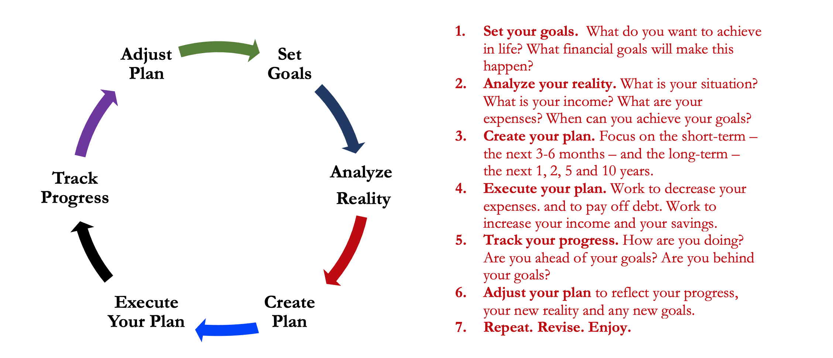
Isn’t this a lot like what you do with your education planning?

Slide 48
Some Parting Words
Nothing in finance is free. Do not think some institution is giving you a super deal just because they like you. There will be costs.
Investment companies work really hard to get your money. They hire psychologists to figure out how to get you addicted to your products. Your money pays for their commercials, buildings, fancy cars and vacation homes.
I check my bank, savings & investment accounts daily. I do not make changes daily (or even monthly). I just don’t want any surprises.

Slide 49
Some Parting Words
Earning interest is good….Paying interest is bad. Control you debt so your debt doesn’t end up controlling your life.
Nobody – NOBODY – can predict the future. And investing is all about predicting the future. Be careful about thinking you can predict the future. Make sure your investments align with your goals.
Be your own boss. Take control of your money and your investments. Nobody else is going to do it for you. Own your financial future.

Slide 50
Financial Wellness
A goal without a plan is just a dream.
Wealth is largely the result of habit.
The most difficult thing is the decision to act; the rest is mere tenacity.
It takes as much energy to plan as it does to wish.
You cannot escape the responsibility of tomorrow by avoiding it today.

Slide 51
Don’t wait around for other people to be happy for you.
Any happiness you get,
You’ve got to make yourself.
~ Alice Walker, poet & novelist
A goal without a plan is just a dream.
Wealth is largely the result of habit.
The most difficult thing is the decision to act; the rest is mere tenacity.
It takes as much energy to plan as it does to wish.
You cannot escape the responsibility of tomorrow by avoiding it today.

Slide 52
brian.bolton@louisiana.edu http//:business.louisiana.edu/financeispersonal

