Slide 1


PERSONAL FINANCIAL PLANNING
Using different financial strategies and tools
to support your personal & professional goals.
VISIONARY VENTURES
INVEST IN TOMORROW
November 20, 2024

Slide 2
Brian Bolton
Professor of Finance brian.bolton@louisiana.edu https://business.louisiana.edu/financeispersonal

Slide 3
Challenge #1
For 3 months a year – once in the fall, once in the spring, once in the summer – track every penny you spend. Prepare a complete budget of your expenses to look in the mirror to determine what your spending habits and behaviors are.
• Identify discretionary vs. non-discretionary cash flows.
• Identify investments vs. expenses.
• Identify personal vs. business expenses.

Slide 4
Challenge #2
Open a Roth IRA (Individual Retirement Account) or a taxable brokerage account to begin investing for your future.
A Roth IRA – or any retirement plan – has some restrictions and is designed for the long-term, but comes with tax deferral and possibly tax avoidance options.
A taxable brokerage account has more flexibility, but does not have tax benefits.
When it comes to investing, TIME is your best friend. The earlier you begin investing, the sooner your investments begin working for your and your future.
There are dozens of investment platforms available, and the investing options are virtually identical across platforms, so which one you use is a personal decision. Robinhood and Fidelity are two of the most popular, but any will serve your purposes.

Slide 5
Challenge #3
Begin building your personal – and possibly business – debt profile.
Check your credit score regularly and check your credit report annually. Make sure that the information in your account and affecting your debt profile is accurate.
Get at least 1 credit card as soon as possible. Think about having 2 or 3 credit cards. Only use them as you would use a debit card or cash…but the credit features (a) can give you rewards or benefits or cash, and (b) help your credit score.
Getting a credit card is easier while you are young…so begin as quickly as possible.
When looking at credit cards, they are all very similar. Which is best depends on you. But I would look at 3 things: (1) do not pay an annual fee, (2) lower interest rate (not just any introductory rates, but the regular rates), and (3) what reward benefits are being offered.

Slide 6
Challenge #4
Most of you will have a formal or informal business at some point in your life. Getting that business legal and professional as soon as possible will make your life much easier and better.
You owe income tax on all income you earn, whether as an individual or as a business. But you only owe tax on NET business income, after expenses are deducted, which is nice.
Keep track of all personal and business expenses – and know which expenses you can claim as business expenses to reduce your overall taxable income. Yes, this is legal.
Go to https://geauxbiz.sos.la.gov to begin your business ownership journey. You can spend $25 to reserve your company name or you can spend $100 to $200 to legally establish your business in the state. When asked which legal structure you want, if in doubt, choose LLC – or Limited Liability Company – as it has the best legal liability protection and flexibility.
Even if your ‘business’ is just a small side hustle, the sooner you make it legal and professional, the more flexibility and less legal liability you might have in the future. Do it.

Slide 7
Challenge #5
Strategic planning…
Complete the thought exercises in this deck and in your handout once a year, to think about your current and desired future financial goals and plans.
This plan is the first – and most important step – towards turning your goals into a plan and into reality.

Slide 8
A Thought Exercise
What is your dream life when you are 30?
What is your dream life when you are 50?

Slide 9
Owning Your Financial Future
What Are Your Values, Dreams & Goals?
Education
Career
Family
What Is Your Current Situation?
Education
Career
Family
Financial
Create a Personal Financial Plan for You:
Investing
Budgeting
Debt Management
Taxes
Insurance
Retirement
Education
Family
Business Planning
Estate Planning
Philanthropy

Slide 10
I believe that your college degree is the best investment you can ever make.
But it is very expensive – in terms of money, time, energy and opportunity costs.
Take a minute to think about all of the costs involved in getting your degree…

Slide 11
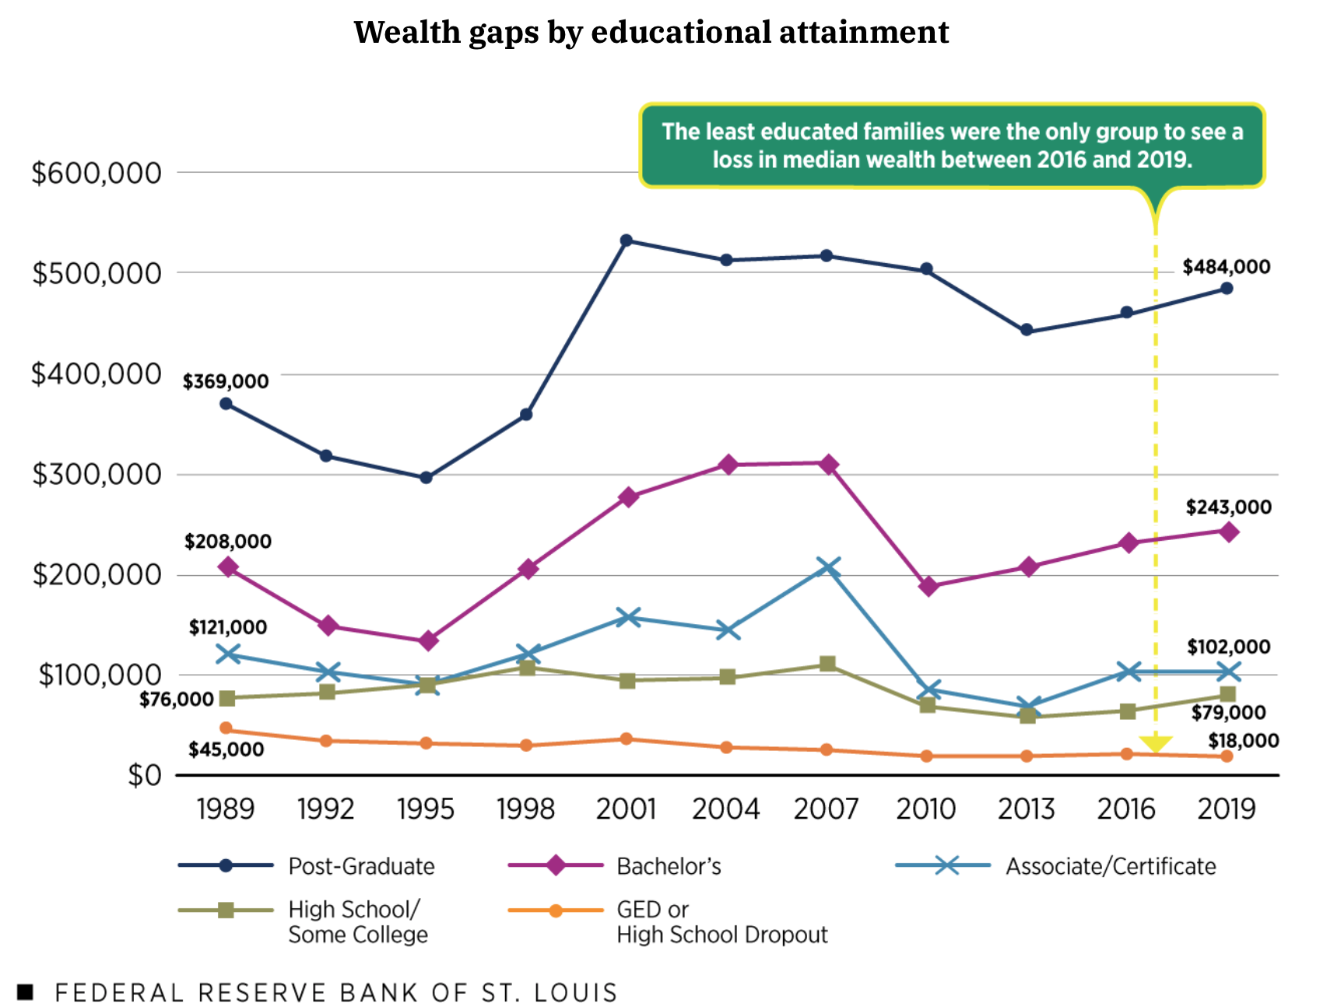
THE WEALTH GAP
IN THE
USA

Slide 12
A Few Opening Morals
Personal Finance is…personal.
It’s about you and not about anyone else.
You have to make it about you and your goals.

Slide 13
A Few Opening Morals
There is no judgment in personal finance.
There is no ego in personal finance.
There is no shame in personal finance.
It’s about you and not about anyone else.

Slide 14
A Few Opening Morals
Because personal finance is personal, it is virtually impossible for me to give you any specific advice.
However, there is one word of advice that applies to 99% of people working on their finances:
SAVE

Slide 15
A Few Opening Morals
SAVINGS
INVESTING
OWNERSHIP
WEALTH

Slide 16
If you save or invest $5,000 per year….
With a 1% investment return, you will have a total of $325,539 after 50 years.
This includes $75,539 of passive income.

Slide 17
If you save or invest $5,000 per year….
With a 4% investment return, you will have a total of $793,869 after 50 years.
This includes $543,869 of passive income.

Slide 18
If you save or invest $5,000 per year….
With a 7% investment return, you will have a total of $2,174,930 after 50 years.
This includes $1,924,930 of passive income.

Slide 19
If you save or invest $5,000 per year….
With an 11% investment return, you will have a total of $9,261,680 after 50 years.
This includes $9,011,680 of passive income.
If you save or invest $5,000 per year….
With a 11% investment return, you will have a total of $9,261,680 after 50 years.
This includes $9,011,680 of passive income.

Slide 20
If we invest for 20 years instead of 50 years:
At 1%: $100,000 ➔ $111,196
At 4%: $100,000 ➔ $154,846
At 7%: $100,000 ➔ $219,326
At 11%: $100,000 ➔ $356,326

Slide 21
A Few Opening Morals
Begin investing as early as you can.
Get comfortable taking some risks with your investing so you can earn bigger returns.
Get comfortable playing the long game.

Slide 22
A Few Opening Morals
SAVINGS
INVESTING
OWNERSHIP
WEALTH

Slide 23
A Few Opening Morals
SAVINGS
INVESTING
OWNERSHIP
WEALTH

Slide 24
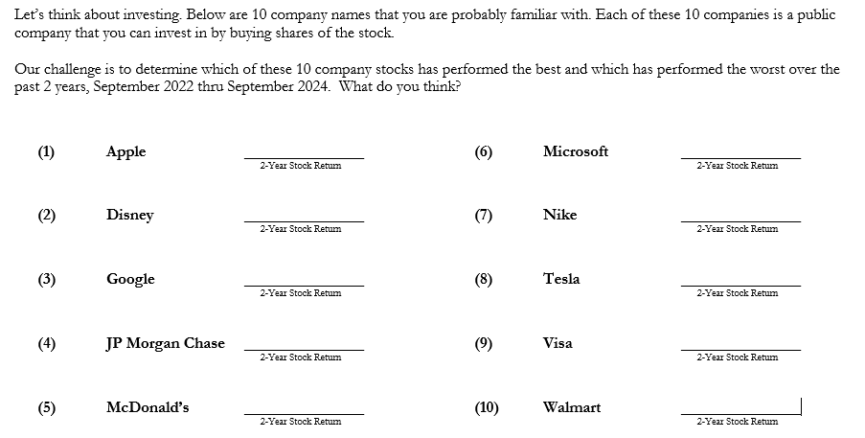
Which of These 10 Companies Has Been the Best / Worst Over the Past 2 Years?
(the average company has had a return of 45% over the past 2 years)
Which of These 12 Companies Has Been
the Best / Worst Over the Past 2 Years?

Slide 25
Which of These 10 Companies Has Been the Best / Worst Over the Past 2 Years?
(the average company has had a return of 45% over the past 2 years)

Slide 26
November 2022 thru November 2024

Slide 27
Owning Your Financial Future
What Are Your Values, Dreams & Goals?
Education
Career
Family
What Is Your Current Situation?
Education
Career
Family
Financial
Create a Personal Financial Plan for You:
Investing
Budgeting
Debt Management
Taxes
Insurance
Retirement
Education
Family
Business Planning
Estate Planning
Philanthropy

Slide 28
Financial Wellness
If you don’t know where you’ve come from, you can’t know where you’re going.
- Maya Angelou

Slide 29
A Few Opening Morals
Finance is the art of trading money – or stuff – across time
Finance is the art of making investments…of devoting time/energy/money to something today, with the hope of getting back something bigger and better in the future.
That’s what you are doing with your education…spending time/energy/money for these few year, hoping it sets you up for enormous success and happiness in the future.

Slide 30
A Thought Exercise
What is your dream life when you are 30?
What is your dream life when you are 50?

Slide 31
Financial Wellness
A goal without a plan
Is just a dream.
~ Antoine de Saint-Exupéry

Slide 32
Financial Wellness
Becoming an owner allows you to be the architect of your own future.
- Leigha Porter
Entrepreneur, Dancer, Choreographer, Founder of the Creole Nutcracker, PARC Village
and FIRE Expressions Conservatory, UL Lafayette grad, Northside High School grad

Slide 33
Owning Your Financial Future
YOUR VALUES
YOUR GOALS
Education
Career
Family
FINANCIAL STRATEGIES
Investing
Income & Expense Management
Debt Management
Taxes, Insurance & Other

Slide 34
Owning Your Financial Future
YOUR VALUES
YOUR GOALS
Education
Career
Family
FINANCIAL STRATEGIES
Investing
Income & Expense Management
Debt Management
Taxes, Insurance & Other

Slide 35
Owning Your Financial Future
YOUR VALUES
YOUR GOALS
Education
Career
Family
FINANCIAL STRATEGIES
Investing
Income & Expense Management
Debt Management
Taxes, Insurance & Other

Slide 36
Let’s Take a Quick Quiz
Please define the following word:
VALUES
Now define this word:
VALUE
THESE ARE THE SAME WORDS!

Slide 37
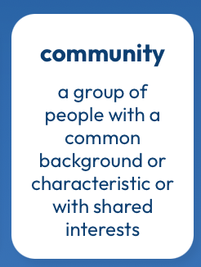
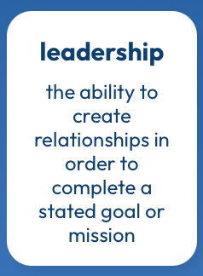



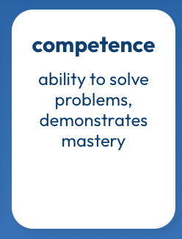
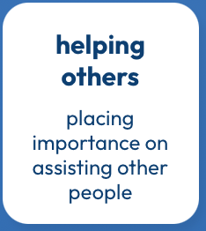

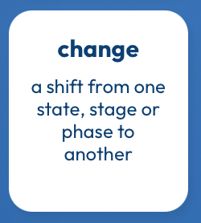


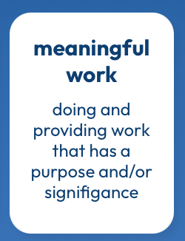

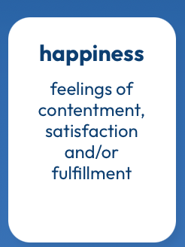
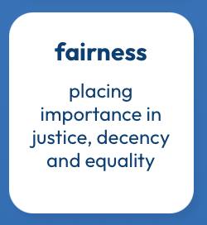
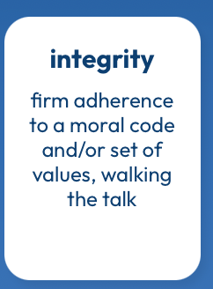
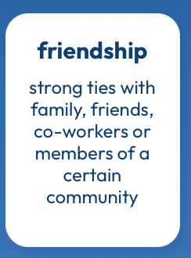
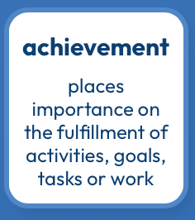
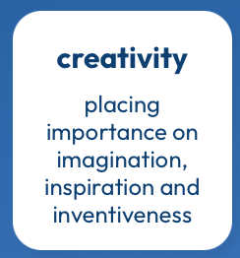


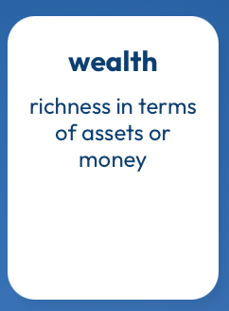
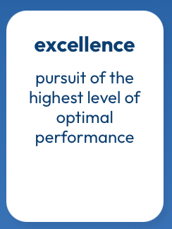

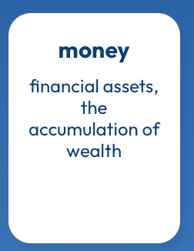
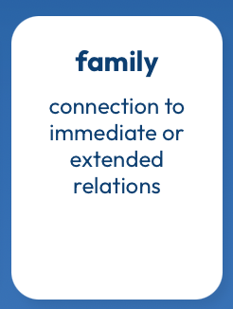
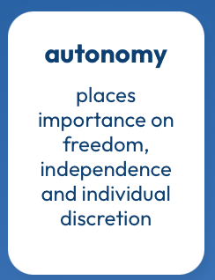
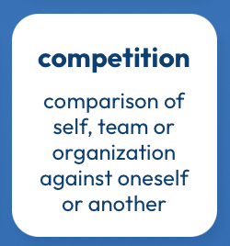

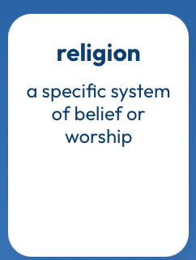
What Are Your Values?
https://www.think2perform.com/values#start

Slide 38
What Are MY Values?
What values are part of my DNA?
What Am I Looking For in MY LIFE?
What Am I Looking For in A JOB?
https://www.think2perform.com/values#start

Slide 39
What Are MY Values?
What values are part of my DNA?
https://www.think2perform.com/values#start

Slide 40
What Are MY Values?
What Am I Looking For in MY LIFE?
https://www.think2perform.com/values#start

Slide 41
What Are MY Values?
What Am I Looking For in A JOB?
https://www.think2perform.com/values#start

Slide 42
What Am I Looking For in A JOB?
These are the values that give my work energy and purpose.
I need to find a job, a career, projects, programs, activities or hobbies that give me the opportunity to embrace with and connect with these values.
https://www.think2perform.com/values#start

Slide 43
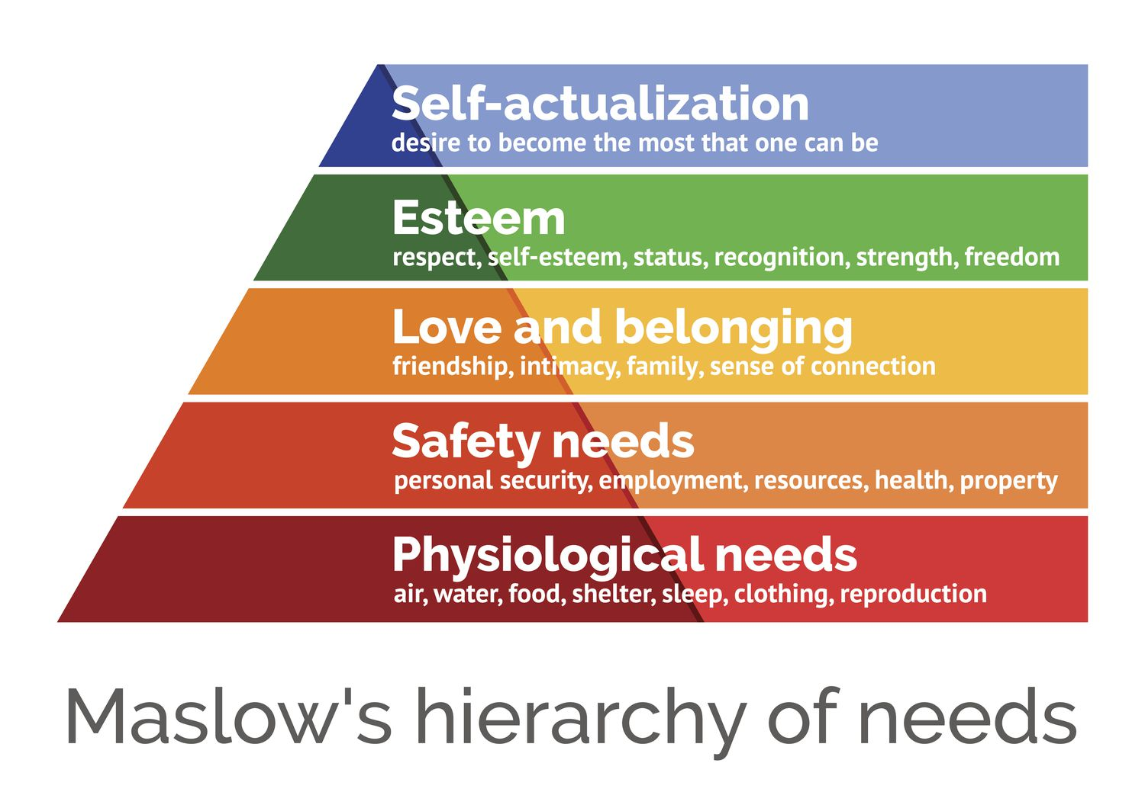
https://www.think2perform.com/values#start

Slide 44
Some Homework for You
Make a list of the 5-10 most important criteria you are looking for in a job or career.
Rank these criteria.
Connect these criteria to your long-term and
short-term goals. Connect these criteria to your values.

Slide 45
More Homework for You
Once a week: Make a list of the money you are
going to spend this week.
Once a month: Make a list of how your job serves
your values – or how school serves
your values over the long-term.
Once a year: Revisit your values and identify
your short- and long-term goals.

Slide 46
Values, Financial Wellness & Resilience
Budgeting & Debt Management
Resetting your financial plan
Tax planning
Summer Work, Holiday spending & New Year’s Resolutions
Revisiting your family, personal & career goals

Slide 47
Budgeting & Debt Management
Budgeting – The one truth is that you can only spend money that you have or earn…unless you borrow.
  Find a budget approach that works for you.
  Don’t outsource all of your budgeting to apps, websites or your bank. Do it yourself. Internalize the numbers.
  Set boundaries and rules – make willpower natural.
  Set goals and challenges – make saving a game.
  Align your spending with your values and what you care about most.

Slide 48
Budgeting & Debt Management
Debt Management – When you borrow, you are saying that your present needs are so great that you are willing to endure some pain or sacrifice in the future to satisfy those needs (and almost all students do this).
  Whenever you borrow – whether it’s student loans or credit card debt – make a plan for how you’re going to repay that debt.
  Interest: the premium you pay to use someone else’s money.
    Find loans with low rates, no fees or penalties & a short repayment term.
  Once a year, talk to a bank or lender about consolidating your debt.
  Live a life that is not controlled by debt. This starts with your values, your behavior & your budgeting. Always have a plan to get rid of your debt.

Slide 49
Financial Wellness & Resilience
Resetting your financial plan
  Revisit your values and identify your short- and long-term goals
  Analyze your insurance, phone, subscription and other expenses
  Should you look for a new job?
  Start a money journal – note your behaviors, feelings and emotions related to how you spend money
  Share your financial goals with your family

Slide 50
TODAY THE NEXT 6 MONTHS THE NEXT 12 MONTHS 2 YEARS AFTER GRADUATION 3 YEARS AFTER GRADUATION
ONCE EVERY SEMESTER:
TRACK EVERY PENNY THAT YOU SPEND & TRACK EVERY PENNY THAT YOU EARN
IN THE NEXT 3 MONTHS:
IDENTIFY WAYS TO DECREASE YOUR DISCRETIONARY SPENDING BY 25%
IN THE NEXT 6 MONTHS:
MAKE A PLAN TO MANAGE – AND PAY OFF – YOUR DEBT
IN THE NEXT 6-12 MONTHS:
OPEN MULTIPLE SAVINGS ACCOUNTS, 1 FOR EACH GOAL
IN THE NEXT 12 MONTHS, OPEN AN IRA OR ROTH IRA
WITHIN 2 YEARS OF GRADUATION:
HAVE AN “EMERGENCY FUND” ACCOUNT, WITH 3-6 MONTHS OF NON-DISCRETIONARY EXPENSES
WITHIN 3 YEARS OF GRADUATION:
ELIMINATE ALL OF YOUR BAD DEBT.

Slide 51
Financial Wellness & Resilience
Tax planning
  Do you want to make any charitable donations before year-end (or wait until January)?
  Should you recognize any investment gains or losses before year-end?
  Do you know all of the deductions and credits that you are eligible for?
  Did you receive a tax refund this year? Do you really want a tax refund each year?

Slide 52
Financial Wellness & Resilience
Summer Work
  If you’re earning money this summer, make a plan for how that money is going to help you achieve your future goals.
    Yes, it’s okay to enjoy some of that money during this summer…but maybe don’t enjoy ALL of it.
  If you’re not earning money this summer, this is a great time to develop budgeting habits that will serve you in the long-term.
  When do you transition from a job that pays well (but doesn’t align with your career goals) (like bartending) to an internship or lower-paying job (that does align with your career goals)?
    Only you can decide that…but you probably will have to decide at some point.

Slide 53
Financial Wellness & Resilience
Holiday spending
  Set a budget & make lots of lists
  Make a list of what you are going to buy
  Make a list of what you are NOT going to buy
  Have open conversations about money with your family
New Year’s Resolutions
  Create specific financial goals (For example…Eliminate 3 subscriptions this year)
  Create generic financial goals (For example…Improve my credit score)
  Think about how financial resolutions relate to other resolutions
    If you want to exercise, travel or read more, what will it cost?

Slide 54
Financial Wellness & Resilience
Revisiting your family, personal & career goals
  What do you want to achieve over the next 1-2 years?
  What do you want to achieve over the next 3-5 years?
  What do you want to achieve over the next 10 years?
  As you revisit your goals, be sure to communicate with your family and anyone else affected by your goals.

Slide 55
Owning Your Financial Future
What Are Your Values, Dreams & Goals?
Education
Career
Family
What Is Your Current Situation?
Education
Career
Family
Financial
Create a Personal Financial Plan for You:
Investing
Budgeting
Debt Management
Taxes
Insurance
Retirement
Education
Family
Business Planning
Estate Planning
Philanthropy

Slide 56
What Do You Want to Talk About?
Budgeting & Income Management
Debt, Credit Scores, Student Loans, Credit Cards
Investing
Or, we can do a conversational quiz about investing and some other stuff

Slide 57
Opening Quiz – Question #1
If you had invested $1,000 in the S&P 500 at the beginning of 2021
(3+ years years ago), how much would that $1,000 be worth today?
A. $775
B. $1,000
C. $1,581
D. $4,043

Slide 58
Opening Quiz – Question #1
If you had invested $1,000 in the S&P 500 at the beginning of 2021
(3+ years years ago), how much would that $1,000 be worth today?
A. $775
B. $1,000
$1,581
(that’s a 13.2% annual return)
D. $4,043

Slide 59
Opening Quiz – Question #2
If you had invested $1,000 in the S&P 500 at the beginning of 2014
(10+ years ago), how much would that $1,000 be worth today?
A. $775
B. $1,000
C. $1,581
D. $4,043

Slide 60
Opening Quiz – Question #2
If you had invested $1,000 in the S&P 500 at the beginning of 2014
(10+ years ago), how much would that $1,000 be worth today?
A. $775
B. $1,000
C. $1,581
D. $4,043
(that’s a 13.9% annual return)

Slide 61
Opening Quiz – Question #3
Which of these 4 countries currently
has the lowest inflation rate?
United States
England
Germany
Mexico

Slide 62
Opening Quiz – Question #3
Which of these 4 countries currently
has the lowest inflation rate?
United States
England
Germany
Mexico

Slide 63
Opening Quiz – Question #4
Which of these 4 countries
currently has the HIGHEST inflation rate?
United States
England
Germany
Mexico

Slide 64
Opening Quiz – Question #4
Which of these 4 countries
currently has the HIGHEST inflation rate?
United States (2.5%)
England (2.2%)
Germany (1.9%)
Mexico (5.0%)

Slide 65
Opening Quiz – Question #5
If you sold cookies out of your apartment during 2024, received
made $500 from those sales, and spent $200 making those cookies,
what do you owe taxes on?
$500
$300
$200
$0

Slide 66
Opening Quiz – Question #5
If you sold cookies out of your apartment during 2024, received
made $500 from those sales, and spent $200 making those cookies,
what do you owe taxes on?
$500
$300
$200
$0

Slide 67
Opening Quiz – Question #6
If you sold cookies out of your apartment during 2024, received
made $500 from those sales, and spent $700 making those cookies,
what do you owe taxes on?
$500
$700
$0
You get a refund
for the $200 loss

Slide 68
Opening Quiz – Question #6
If you sold cookies out of your apartment during 2024, received
made $500 from those sales, and spent $700 making those cookies,
what do you owe taxes on?
$500
$700
$0
You get a refund
for the $200 loss

Slide 69
Opening Quiz – Question #7
If you earned $14,500 of income in 2024,
which of the following applies to you:
You owe taxes on the entire $14,500.
It depends on whether someone else claims you as a dependent.
You do not owe any taxes and you do not have to file a tax return.
You do not owe any taxes but you have to file a tax return.

Slide 70
Opening Quiz – Question #7
If you earned $14,500 of income in 2024,
which of the following applies to you:
You owe taxes on the entire $14,500.
It depends on whether someone else claims you as a dependent.
You do not owe any taxes and you do not have to file a tax return.
You do not owe any taxes but you have to file a tax return.

Slide 71
Opening Quiz – Question #8 – Last One
If I had invested $1,000 into the S&P 500, the overall U.S. stock market, on the day that I was born, how much would that be worth today?
A. $1,000
B. $22,257
C. $60,371
C. $95,035

Slide 72
Opening Quiz – Question #8 – Last One
If I had invested $1,000 into the S&P 500, the overall U.S. stock market, on the day that I was born, how much would that be worth today?
A. $1,000
B. $22,257
$60,371
That’s an annual return of just over 10% per year.
C. $95,035

Slide 73
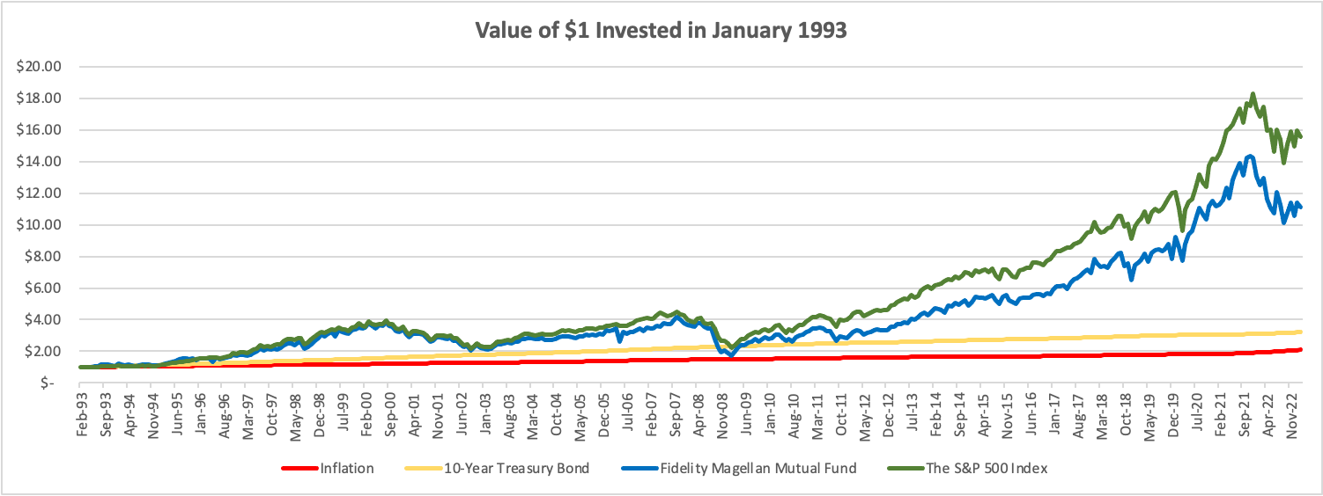
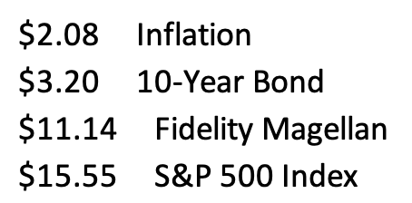

Slide 74
Owning Your Financial Future
Question #1
What are you going to be doing in 2030?
Will you be in graduate school? If so, what are you studying?
Are you working? If so, what is your job?
Where do you live? Who do you live with?
How do you spend your free time?

Slide 75
Owning Your Financial Future
Question #2
What are the 3 most expensive things you plan on buying in the next 10 years.
For now, exclude your undergraduate education.
But if you’re planning on graduate school, do include that.
Or maybe it’s a house, a car, a vacation, a baby, a new pair of shoes. Anything.

Slide 76
Owning Your Financial Future
Question #2
What are the 3 most expensive things you plan on buying in the next 10 years.
We do these thought exercises to begin thinking about how we might make it happen. Yes, we are just making things up in our responses – but that’s where planning begins.
For most of us, owing our financial futures begins with identifying our goals and designing a plan to achieve those goals.

Slide 77
Owning Your Financial Future
Question #3
What are your financial goals?
  What financial goals do you want to achieve in the next 3 months?
  What financial goals do you want to achieve in the next 12 months?
  What financial goals do you want to achieve in the next 3 years?

Slide 78
Financial Planning for the Year
5 Things Everyone Should Do:
BUDGET!
  Make shopping lists…for all types of shopping: food, gifts, fun, weekends.
  Make lists of what you ARE NOT going to buy…for all types of shopping.

Slide 79
Financial Planning for the Year
5 Things Everyone Should Do:
BE VERY CAREFUL ABOUT INCREASING DEBT
  Avoid increasing balances on credit card
  Maybe only use credit cards for groceries and gas and use a debt card for everything else.

Slide 80
Financial Planning for the Year
5 Things Everyone Should Do:
GET RID OF AT LEAST 1 SUBSCRIPTION
  Review your expenses and find any/all recurring subscriptions
  Find at least 1 to get rid of before the year end
  And make sure you do not add any that you are not going to use or get your money’s worth

Slide 81
Financial Planning for the Year
5 Things Everyone Should Do:
LOOK FOR DEALS…BUT ALSO BE WARY OF DEALS
  By shopping early and shopping around, you can find the best deals for what you need to buy
  But be careful – many deals will have fine print that commits you to further costs or to other constraints that are not in your best interest

Slide 82
Financial Planning for the Year
5 Things Everyone Should Do:
SET 5 FINANCIAL RESOLUTIONS THAT YOU CAN STICK WITH
  Check your credit report and credit score, open multiple savings accounts, pay yourself first with $5-$25 of every paycheck going to savings, analyze every penny you spend during 3-5 months in 2024, find a budget approach that works for you, set financial goals for the next 3-5 years, finalize your back-to-school spring 2024 budget, begin investing, pay down any high-interest debt (even before savings), do not dine out or go grocery shopping in January, maximize credit card rewards

Slide 83
Some Homework for You
Think about why you are in college.
Make a list of the 5-10 most important criteria you are looking for in a job or career.
Connect these criteria to your long-term and
short-term goals. Connect these criteria to your values.
(And if you don’t know what your values are, take 30 minutes to identify them and commit to them.)

Slide 84
More Homework for You
Once a week: Make a list of the money you are
going to spend this week.
Once a month: Make a list of how college – and your
future job – serves your values over the
long-term.
Once a year: Revisit your values and identify
your short- and long-term goals.

Slide 85
Owning Your Financial Future
YOUR VALUES
YOUR GOALS
Education
Career
Family
FINANCIAL STRATEGIES
Investing
Income & Expense Management
Debt Management
Taxes, Insurance & Other

Slide 86
One Rule About BUDGETING
Budgeting is philosophically very easy but practically very difficult because there is just one basic rule that applies to Budgeting:
Spend less than you earn.
Of course, this is much easier said than done…Especially for students with limited income and fixed expenses.
If you spend more than you earn, you have to make up the difference somehow - student loans, credit cards, savings.
  And this borrowing will set your goals back when it comes time to repay this borrowing. You are borrowing from your future.

Slide 87
How Do You Succeed at Budgeting
Be intentional. Know what you’re spending. Know what your income is.
Look in the mirror. Analyze yourself.
  This can be painful. You may see some habits you do not like. But recognizing those habits is the first step to correcting them.
Think both short-term and long-term.
  At its core, budgeting is about balancing monthly income and expenses.
  But, be sure to connect your income and expenses to your long-term goals.
When I was in college and in grad school, my priority was my degree. I ate more Top Ramen than any human should ever eat (including every night for a month, as part of a bet). To me, this was a choice and a habit that was critical to fulfilling my goal – my degree.

Slide 88
How Do You Succeed at Budgeting
I do not want all of my life to
be controlled by a budget.
I simply want my budget to be functional.
~ Quote from one of your student colleagues this summer

Slide 89
How Do You Succeed at Budgeting
I simply want my budget to be functional.
You want a budget to be a guide, not a rulebook.
You want a budget that is designed for you and nobody else.
You want to identify what is most important to you.
  Yes, you may have to change behavior and make sacrifices – so make sure you are only sacrificing those expenses or parts of your financial life that are least important to you.

Slide 90
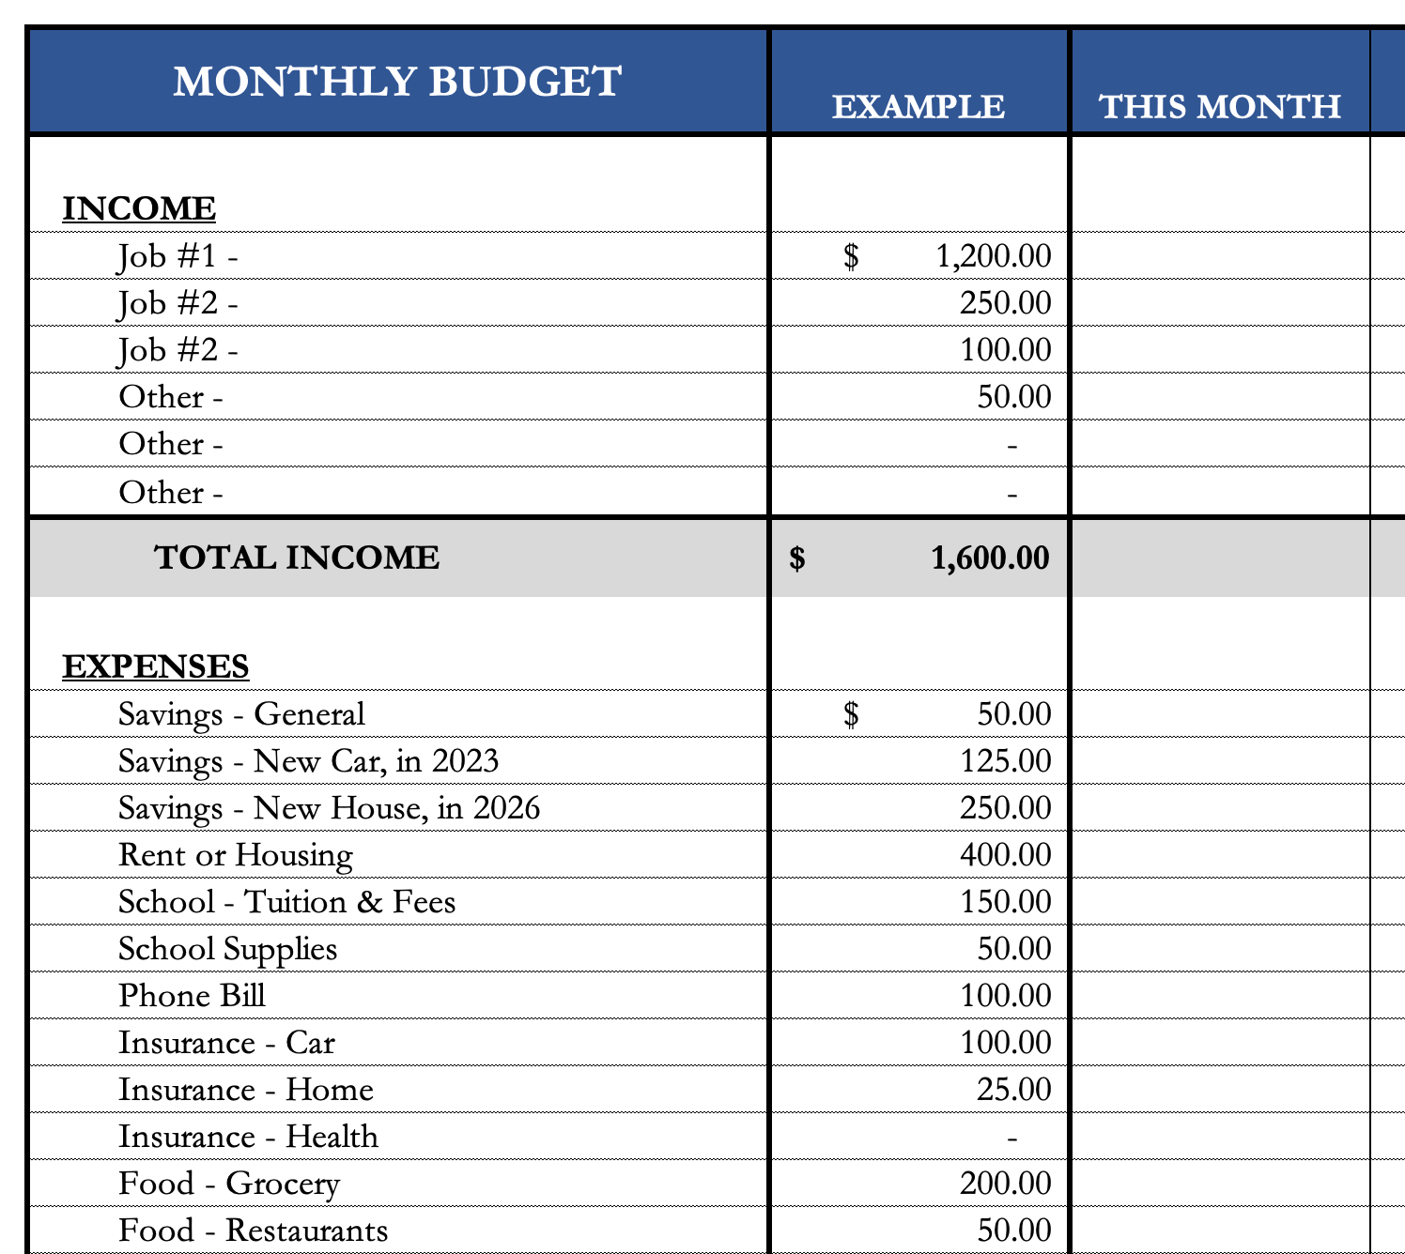
How Do You Succeed at Budgeting
I simply want my budget to be functional.
You want a budget to be a guide, not a rulebook.
You want a budget that is designed for you and nobody else.
You want to identify what is most important to you.
  Yes, you may have to change behavior and make sacrifices – so make sure you are only sacrificing those expenses or parts of your financial life that are least important to you.
These budgeting templates are in the handbook on pages 24-25.
You can download them from the MCOBA website, search for “Personal Financial Planning.”
Or you can email me and I will send them to you.

Slide 91
Owning Your Financial Future
Turn to the 4th page of your handout.
There are 42 suggestions for ways to save money.
How many of these could you do over the next 3 months?
Are there any other ideas you have that should be on this list?

Slide 92
Owning Your Financial Future
How many of these could you do over the next 3 months?
Move to a better bank account
Give up your television
Give up a subscription
Sign up for free customer loyalty programs
Always make a shopping list
Stop eating out
Shop at a thrift store
Shop at a yard sale
Stop buying new video games
Cut your coffee purchases in half
Drink more water
Avoid convenience stores
Avoid fast food
Avoid alcohol
Quit smoking
Buy food and staples in bulk
Make a gift for friend or family member
No online purchases
Cancel unused memberships
Share your dreams with a close friend
Shop for new car insurance
Spend your free time volunteering
Avoid the mall
Only walk to places within 1 mile
Cancel magazine subscriptions
Eat breakfast
Eat leftovers
Bring your lunch to work or school
Only go to free entertainment events
Take public transportation
Carpool
Pack food for road trips
Eliminate cell phone services
Eliminate cable services
Spend 10 hours a week at the library
Learn about employee offers at work
Only drive within 3 MPH of the speed limit
Drive a different route to work
Eat less meat
Use coupons
Exercise more
Pay bills online through your bank

Slide 93
Owning Your Financial Future
How many of these could you do over the next 3 months?
Move to a better bank account
Give up your television
Give up a subscription
Sign up for free customer loyalty programs
Always make a shopping list
Stop eating out
Shop at a thrift store
Shop at a yard sale
Stop buying new video games
Cut your coffee purchases in half
Drink more water
Avoid convenience stores
Avoid fast food
Avoid alcohol
Quit smoking
Buy food and staples in bulk
Make a gift for friend or family member
No online purchases
Cancel unused memberships
Share your dreams with a close friend
Shop for new car insurance
Spend your free time volunteering
Avoid the mall
Only walk to places within 1 mile
Cancel magazine subscriptions
Eat breakfast
Eat leftovers
Bring your lunch to work or school
Only go to free entertainment events
Take public transportation
Carpool
Pack food for road trips
Eliminate cell phone services
Eliminate cable services
Spend 10 hours a week at the library
Learn about employee offers at work
Only drive within 3 MPH of the speed limit
Drive a different route to work
Eat less meat
Use coupons
Exercise more
Pay bills online through your bank
Focus on habits, not just dollars.
While you’re in college, many of these ideas may not help you – such as eating leftovers.
But if you develop the mindset now, the benefits will grow and compound and lead to real dollar savings (or income) when you are on your own and paying for your own meals.

Slide 94
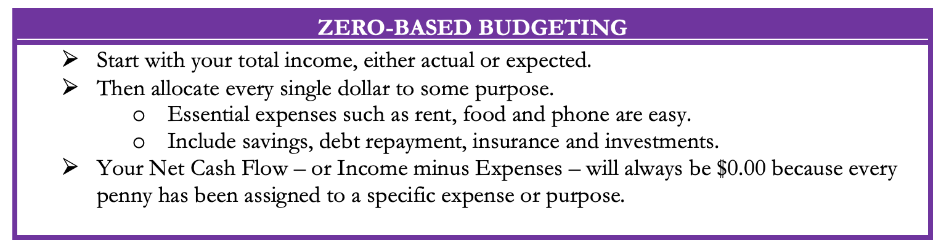
Five Budgeting Models

Slide 95
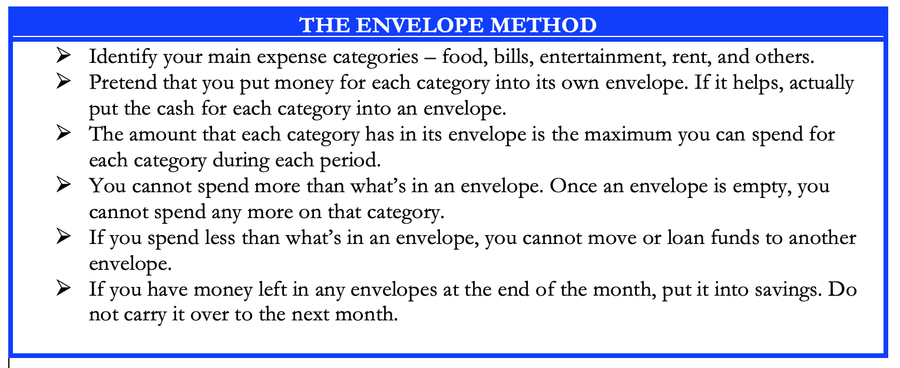
Five Budgeting Models

Slide 96
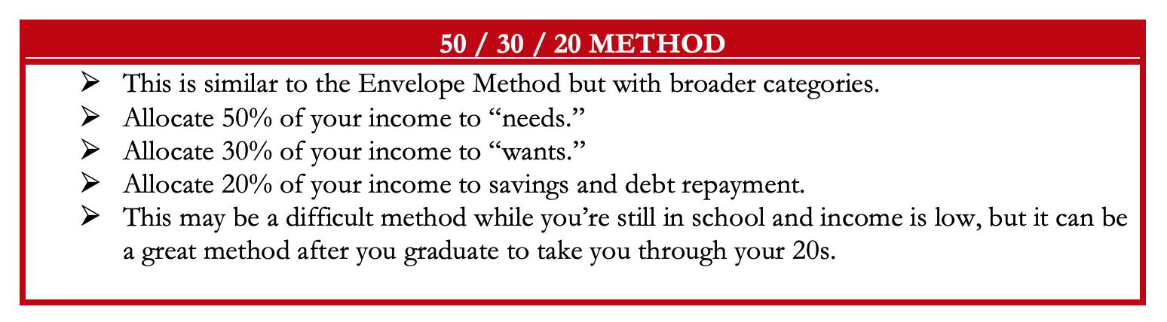
Five Budgeting Models

Slide 97
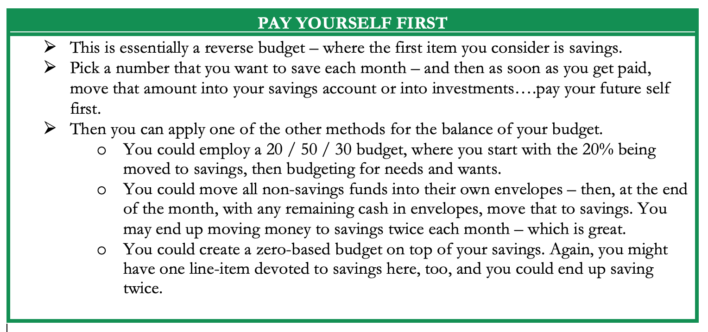
Five Budgeting Models

Slide 98
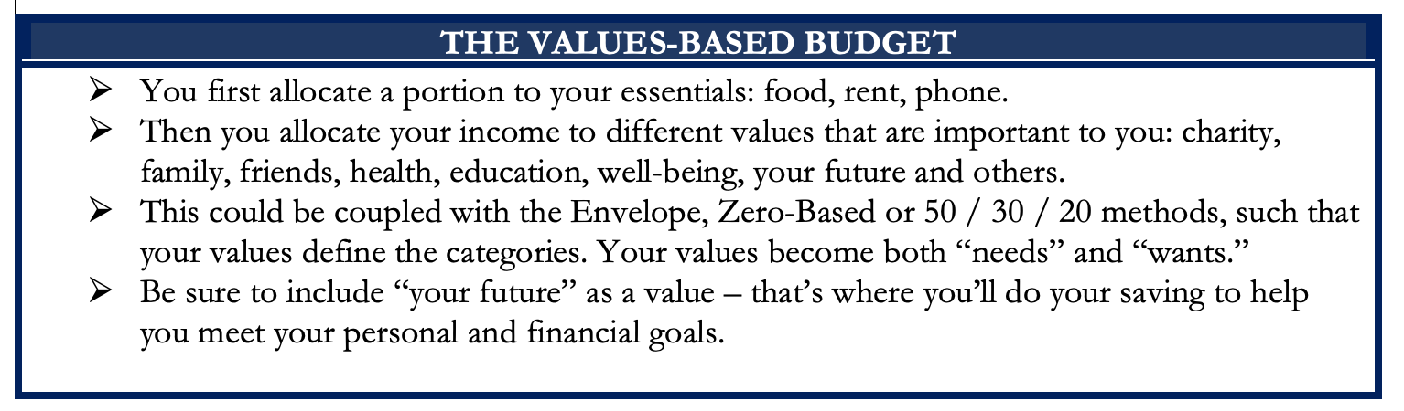
Five Budgeting Models

Slide 99
Five Budgeting Models
Which Budget Model is Best For You?
Only you can answer that.
Budgeting is more of a mental game than a financial process.
You need to select the approach that:
Gives you the least stress and the most confidence;
Best aligns with your short- and long-term goals.
In practice, most people combine different models to best suit
what they are most comfortable with.
(I personally pay myself first and then use a zero-based approach)
(And then, if I can, I pay myself last, too)

Slide 100
Developing A Budgeting Mindset
Budgeting is more of a mental game than a financial process.
Think of budgeting as part of a long-term financial plan.
Think of budgeting in the same way you think of studying, writing or working in the laboratory.
Recognize your own behavior, habits, priorities and goals. Only you know what is best for you.
Choose the budgeting approach that works best for you…and for you only.

Slide 101
Developing A Budgeting Mindset
If you have a spouse, partner, family or others who are affected by your budgeting decisions….
….Talk to them. Make budgeting a team effort.
Research on personal finance shows that couples feel more empowered and develop a closer, stronger relationship when they share financial goals, decisions and strategies with each other.
Your pets may be affected by your budgeting decisions. But you don’t have to communicate with them. They don’t want to be bothered with budgeting decisions. They have other priorities.

Slide 102
Developing A Budgeting Mindset
Some exercises to help you develop a budgeting mindset.
Track all of your income and expenses – every penny – over an extended period of time (say, 1-2 months).
Write down the last 15 things you spent money on.
Write down the next 15 things you want to spend money on.
Identify your 10 biggest expenses over the past 12 months.
Predict every dollar of income you will earn over the next 12 months.
Predict what your income will be for each of the next 5 years.

Slide 103
Developing A Budgeting Mindset
Some exercises to help you develop a budgeting mindset.
Track all of your income and expenses – every penny – over an extended period of time (say, 1-2 months).
Write down the last 15 things you spent money on.
Write down the next 15 things you want to spend money on.
Identify your 10 biggest expenses over the past 12 months.
Predict every dollar of income you will earn over the next 12 months.
Predict what your income will be for each of the next 5 years.
What is the purpose of this self-analysis?
To ensure that your spending is aligned with your income.
To ensure that your spending and income are part of your plan.
To ensure your budget is driven by wants & needs, and not driven by impulses.
To be intentional.

Slide 104
Developing A Budgeting Mindset
Some actions that may help you better control your spending:
Wait 24 hours before making any purchase over a certain dollar amount
  For me, it’s $100. I don’t make any purchase of more than $100 without thinking about it for 24 hours
  (except groceries).
Don’t make any purchases on certain days or after a certain time
  For me it’s 9:00pm. I do not spend any money after 9:00pm. Ever.
Only use cash…because studies have found that spending cash causes us more pain than the abstraction of a credit card or debit card
  It’s also why casinos use similarly abstract poker chips…because we don’t feel pain when we lose them.
Take 10 minutes every Sunday to write down what you’re allowed to spend in this week.

Slide 105
Developing A Budgeting Mindset
Some actions that may help you better control your spending:
Wait 24 hours before making any purchase over a certain dollar amount
  For me, it’s $100. I don’t make any purchase of more than $100 without thinking about it for 24 hours
  (except groceries).
Don’t make any purchases on certain days or after a certain time
  For me it’s 9:00pm. I do not spend any money after 9:00pm. Ever.
Only use cash…because studies have found that spending cash causes us more pain than the abstraction of a credit card or debit card
  It’s also why casinos use similarly abstract poker chips…because we don’t feel pain when we lose them.
Take 10 minutes every Sunday to write down what you’re allowed to spend in this week.
And then reward yourself.
Turn this into a game.
If you predict you will spend $200 this week, and you only spend $150, reward yourself with half the difference.
Take $25 for happy hour or a night out.
Put the other $25 into savings or investing.

Slide 106
Values, Financial Wellness & Resilience
Budgeting & Debt Management
Resetting your financial plan
Tax planning
Summer Work, Holiday spending & New Year’s Resolutions
Revisiting your family, personal & career goals

Slide 107
Budgeting & Debt Management
Budgeting – The one truth is that you can only spend money that you have or earn…unless you borrow.
  Find a budget approach that works for you.
  Don’t outsource all of your budgeting to apps, websites or your bank. Do it yourself. Internalize the numbers.
  Set boundaries and rules – make willpower natural.
  Set goals and challenges – make saving a game.
  Align your spending with your values and what you care about most.

Slide 108
Budgeting & Debt Management
Debt Management – When you borrow, you are saying that your present needs are so great that you are willing to endure some pain or sacrifice in the future to satisfy those needs (and almost all students do this).
  Whenever you borrow – whether it’s student loans or credit card debt – make a plan for how you’re going to repay that debt.
  Interest: the premium you pay to use someone else’s money.
    Find loans with low rates, no fees or penalties & a short repayment term.
  Once a year, talk to a bank or lender about consolidating your debt.
  Live a life that is not controlled by debt. This starts with your values, your behavior & your budgeting. Always have a plan to get rid of your debt.

Slide 109
WHAT IS DEBT
Debt is borrowing from YOUR future.
We borrow because we want something today that we cannot afford today.
We make a promise to pay for that something in the future.
The entity we borrow from wants to make money. They are not our friends.
We have to pay them helping us get what we want today.
  At a minimum, we pay them interest on our debt.
  Depending on the type of debt, we may have to pay them much more (fees, collateral, earnings, control, etc.)

Slide 110
WHAT IS DEBT
Debt is borrowing from YOUR future.
If your debt is keeping you up at night…
If your debt is preventing you from achieving your goals…
If your debt is damaging your relationships…
…Then you may have too much debt.
(we will return to this issue later)

Slide 111
One Truism About DEBT
If you borrow $10,000,
You will have to repay $10,000.
Whatever you borrow, you will have to repay – in full, with interest – 99% of the time. Lenders do not exist to give you money.
One good exception: Student loan forgiveness.
Lots of bad exceptions: Default, bankruptcy, short sale…

Slide 112
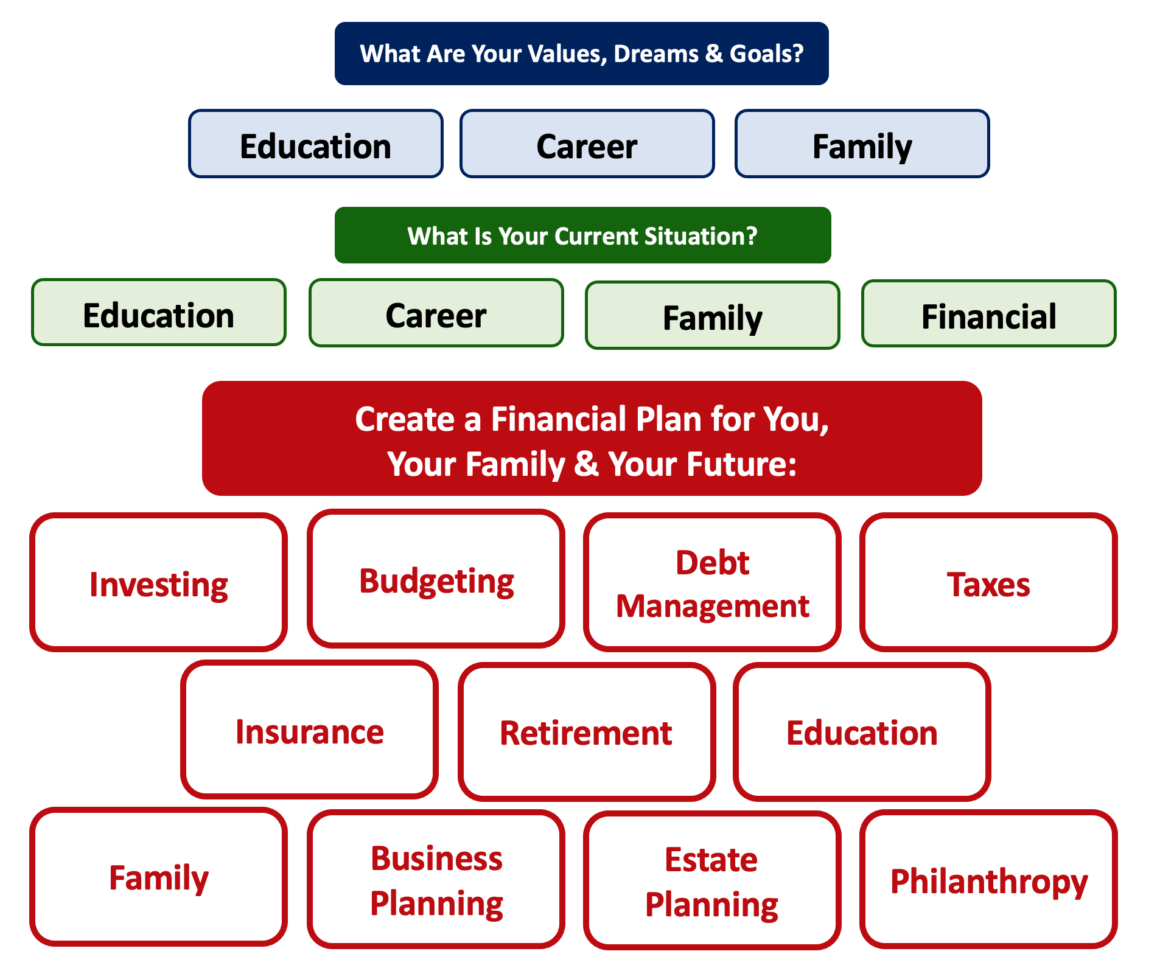
Debt is NOT a bad thing.
Debt can help us achieve our goals, depending on our current situations and what those goals are.
Debt is also called “leverage” – because it gives us the ability do things we might not be able to do otherwise.

Slide 113
Debt is NOT a bad thing.
My one primary piece of advice:
Whenever borrow money – whether it’s $20 for a Friday night pizza on your credit card or a $10,000 student loan – have a plan for paying it back.
Know why you are borrowing and where you will get the money to repay it.

Slide 114




Good Debt vs. Bad Debt
Is this debt aligned with my values, goals & dreams?
How am I going to repay this debt?

Slide 115
Good Debt vs. Bad Debt
NOTE:
Using a credit card is not necessarily a bad idea.
Only racking up loads of credit card debt is a bad idea.
I regularly use 3 credit cards.
Here’s how and here’s why…

Slide 116
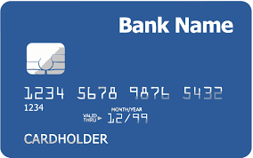
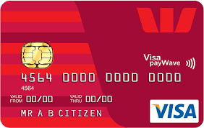
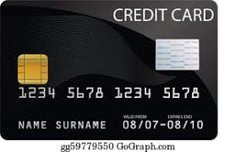
Credits Cards as Tools for Financial Planning
Card #1: Automatic bill payment of recurring monthly expenses (phone, insurance, cable, utilities)
Card #2: Living and discretionary expenses (gas, groceries, coffee, pizza, new shoes)
Card #3: Non-recurring big expenses (vacation, holidays, charity, new refrigerator)
Card #3 frequently has a $0.00 balance

Slide 117
LET’S MAKE THIS PERSONAL…
WHAT IMPACTS YOUR CREDIT RATING AS A CONSUMER?

Slide 118
LET’S MAKE THIS PERSONAL…
WHAT IMPACTS YOUR CREDIT RATING AS A CONSUMER?
35% Payment History – This is perhaps this simplest category, as it looks at how well you repay all borrowed amounts on credit cards, retail accounts, auto loans, utilities and phone bills, other installment loans and other debts. The better you are at repaying, the better your Payment History. Pay your bills on time.

Slide 119
LET’S MAKE THIS PERSONAL…
WHAT IMPACTS YOUR CREDIT RATING AS A CONSUMER?
30% Amounts Owed –The amount you owe is not simply about how much money you owe, but it’s also about how much of your available credit you use. If you have a credit card limit of $5,000 and your balance is $4,000, that’s worse than having a limit of $20,000 and a balance of $10,000. There are many trade-offs within this category and it can be confusing.
Pro-tip if you are using more than 30% of your available balance: Pay it off or down before the end of your reporting cycle and the credit agencies will never know it existed.

Slide 120
LET’S MAKE THIS PERSONAL…
WHAT IMPACTS YOUR CREDIT RATING AS A CONSUMER?
30% Amounts Owed –The amount you owe is not simply about how much money you owe, but it’s also about how much of your available credit you use. If you have a credit card limit of $5,000 and your balance is $4,000, that’s worse than having a limit of $20,000 and a balance of $10,000. There are many trade-offs within this category and it can be confusing.
Pro-tip if you are using more than 30% of your available balance: Pay it off or down before the end of your reporting cycle and the credit agencies will never know it existed.
One thing you can do tomorrow that might improve your credit score:
Ask for a credit limit increase on all of your credit cards or outstanding lines of credit.

Slide 121
LET’S MAKE THIS PERSONAL…
WHAT IMPACTS YOUR CREDIT RATING AS A CONSUMER?
15% Length of Credit History – This is also pretty simple – the longer your history of paying bills and loans, the better off you’ll be. Yes, this does bias against younger borrowers – but if your behavior in the other categories is strong, you should be okay. Be patient – you’ll build your history.

Slide 122
LET’S MAKE THIS PERSONAL…
WHAT IMPACTS YOUR CREDIT RATING AS A CONSUMER?
10% Credit Mix – Perhaps ironically, it can be better to have 5 different accounts that you repay regularly than it is to have just 2 different accounts. The greater the variety of accounts you have, the more opportunity you have to indicate that you are a low credit risk. Of course, if you have 5 accounts and you miss your payments, that will be doubly bad. Pay your bills on time and the Credit Mix will take care of itself.

Slide 123
LET’S MAKE THIS PERSONAL…
WHAT IMPACTS YOUR CREDIT RATING AS A CONSUMER?
10% New Credit – Opening a large number of new accounts in a short period of time may indicate that you are a higher risk. So, is the moral to never open new accounts? No – because then you can never indicate that you are a low risk. Be mindful of opening too many accounts in a short period of time, pay all your bills on time, and the New Credit category will not be a big issue.

Slide 124
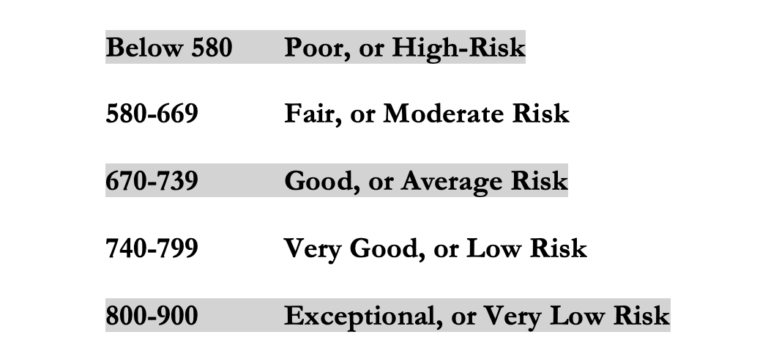
LET’S MAKE THIS PERSONAL…
WHAT IMPACTS YOUR CREDIT RATING AS A CONSUMER?
Your FICO Score will become an actual number: between 250 and 900.
The higher your Score, the lower interest rates you will pay on most loans.
The average FICO Score for Americans is just over 700.
The average in Louisiana is 677, the second lowest in the 50 U.S. states; only Mississippi has a lower average FICO Score.

Slide 125
LET’S MAKE THIS PERSONAL…
WHAT SHOULD YOU BE FOCUSED ON WITH RESPECT TO YOUR CREDIT SCORE?
If your FICO Score is below 600, there are probably 1 or 2 areas where you have significant weaknesses in your history.
Commit to correcting these weaknesses and not creating any new weaknesses.
If your FICO Score is between 600-700, there are probably 1 or 2 areas that can be improved – or where you used to have significant weaknesses.
Keep doing what you’re doing – and commit to not creating any new concerns.
If your FICO Score is over 700, keep doing what you’re doing and time will eventually get you the best score possible.

Slide 126
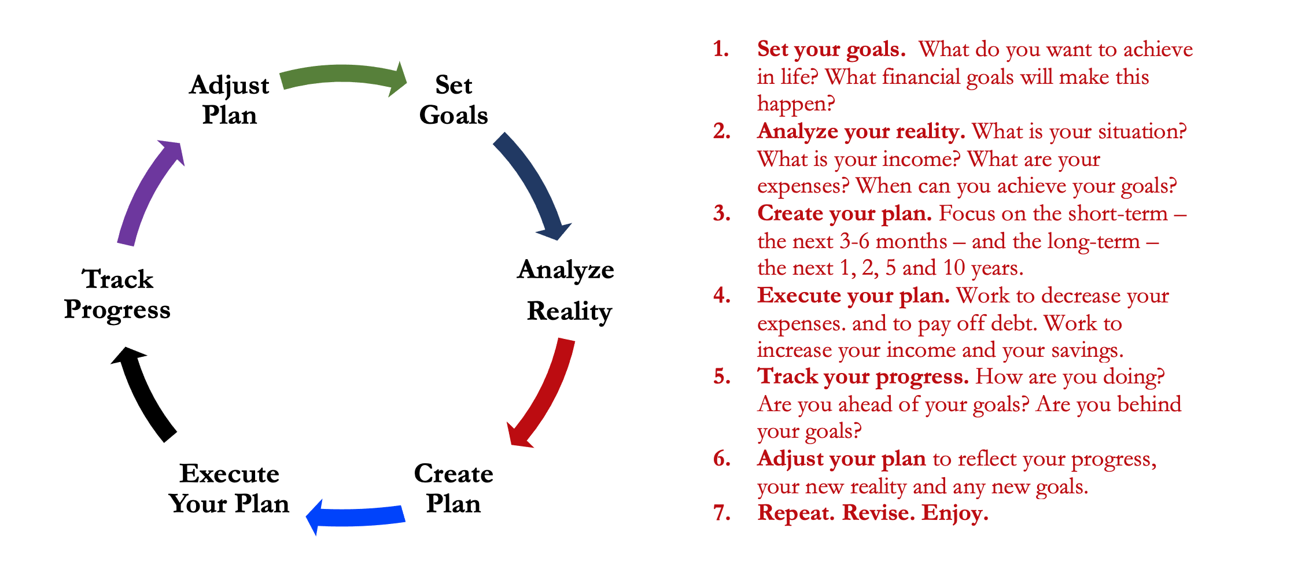
Isn’t this a lot like what you do with your education planning?

Slide 127
Financial Wellness & Resilience
Resetting your financial plan
  Revisit your values and identify your short- and long-term goals
  Analyze your insurance, phone, subscription and other expenses
  Should you look for a new job?
  Start a money journal – note your behaviors, feelings and emotions related to how you spend money
  Share your financial goals with your family

Slide 128
TODAY THE NEXT 6 MONTHS THE NEXT 12 MONTHS 2 YEARS AFTER GRADUATION 3 YEARS AFTER GRADUATION
ONCE EVERY SEMESTER:
TRACK EVERY PENNY THAT YOU SPEND & TRACK EVERY PENNY THAT YOU EARN
IN THE NEXT 3 MONTHS:
IDENTIFY WAYS TO DECREASE YOUR DISCRETIONARY SPENDING BY 25%
IN THE NEXT 6 MONTHS:
MAKE A PLAN TO MANAGE – AND PAY OFF – YOUR DEBT
IN THE NEXT 6-12 MONTHS:
OPEN MULTIPLE SAVINGS ACCOUNTS, 1 FOR EACH GOAL
IN THE NEXT 12 MONTHS, OPEN AN IRA OR ROTH IRA
WITHIN 2 YEARS OF GRADUATION:
HAVE AN “EMERGENCY FUND” ACCOUNT, WITH 3-6 MONTHS OF NON-DISCRETIONARY EXPENSES
WITHIN 3 YEARS OF GRADUATION:
ELIMINATE ALL OF YOUR BAD DEBT.

Slide 129
Financial Wellness & Resilience
Tax planning
  Do you want to make any charitable donations before year-end (or wait until January)?
  Should you recognize any investment gains or losses before year-end?
  Do you know all of the deductions and credits that you are eligible for?
  Did you receive a tax refund this year? Do you really want a tax refund each year?

Slide 130
Financial Wellness & Resilience
Summer Work
  If you’re earning money this summer, make a plan for how that money is going to help you achieve your future goals.
    Yes, it’s okay to enjoy some of that money during this summer…but maybe don’t enjoy ALL of it.
  If you’re not earning money this summer, this is a great time to develop budgeting habits that will serve you in the long-term.
  When do you transition from a job that pays well (but doesn’t align with your career goals) (like bartending) to an internship or lower-paying job (that does align with your career goals)?
    Only you can decide that…but you probably will have to decide at some point.

Slide 131
Financial Wellness & Resilience
Holiday spending
  Set a budget & make lots of lists
  Make a list of what you are going to buy
  Make a list of what you are NOT going to buy
  Have open conversations about money with your family
New Year’s Resolutions
  Create specific financial goals (For example…Eliminate 3 subscriptions this year)
  Create generic financial goals (For example…Improve my credit score)
  Think about how financial resolutions relate to other resolutions
    If you want to exercise, travel or read more, what will it cost?

Slide 132
Financial Wellness & Resilience
Revisiting your family, personal & career goals
  What do you want to achieve over the next 1-2 years?
  What do you want to achieve over the next 3-5 years?
  What do you want to achieve over the next 10 years?
  As you revisit your goals, be sure to communicate with your family and anyone else affected by your goals.

Slide 133
Long-Term Investment Planning
YOUR VALUES
YOUR GOALS
FINANCIAL STRATEGIES
INVESTMENT STRATEGIES
Identify Your Risk Tolerance
Identify Your Time Horizons
Select Investments
Monitor & Modify Investments

Slide 134
Long-Term Investment Planning
FINANCIAL STRATEGIES
INVESTMENT STRATEGIES
Identify Your Risk Tolerance
Identify Your Time Horizons
Select Investments
Monitor & Modify Investments

Slide 135
Long-Term Investment Planning
FINANCIAL GOALS
EDUCATION GOALS
INVESTMENT STRATEGIES
EDUCATION STRATEGIES
Identify Your Risk Tolerance & Priorities
Identify Your Risk Tolerance & Priorities
Identify Your Time Horizons
Identify Your Time Horizons
Select Investments
Select Your Field, Program, Specialization, Thesis
Monitor & Modify Investments
Monitor & Modify Your Progress & Plan

Slide 136
Isn’t this a lot like what you do with your education planning?

Slide 137
Long-Term Investment Planning
FINANCIAL GOALS
YOU,
as college students, are better wired and equipped to make long-term plans – education, career, financial & otherwise – than 99% of humanity.
Be confident.
Be intentional.
Be diligent.
Be awesome.
EDUCATION GOALS
INVESTMENT STRATEGIES
EDUCATION STRATEGIES
Identify Your Risk Tolerance & Priorities
Identify Your Risk Tolerance & Priorities
Identify Your Time Horizons
Identify Your Time Horizons
Select Investments
Select Your Field, Program, Specialization, Thesis
Monitor & Modify Investments
Monitor & Modify Your Progress & Plan

Slide 138
Owning Your Financial Future
YOUR VALUES
YOUR GOALS
Education
Career
Family
FINANCIAL STRATEGIES
Investing
Income & Expense Management
Debt Management
Taxes, Insurance & Other

Slide 139
What is INVESTING?
Investing is saving for the future.
We typically think of investing as long-term – anywhere from 1 or 2 years all the way through retirement.
Saving vs. Investing
  Saving can be short-term, Investing is typically long-term.
  Saving is passive, Investing is dedicated…it could be relatively passive or extremely active.
    Passive: Mutual funds. Extremely Active: Owning an apartment complex.
  Saving is typically very low risk, Investing generally has more risk.
  Saving provides low returns on investment (currently about 0.0%)
  Inflation is risky…You can lose 100% or realize huge positive returns.

Slide 140
What Is Your Investing Goal?
Take a few seconds to ask yourself:
Why Are You Investing?
What are your investing goals?
To buy a house?
To buy a car?
To pay off debt?
To retire?

Slide 141
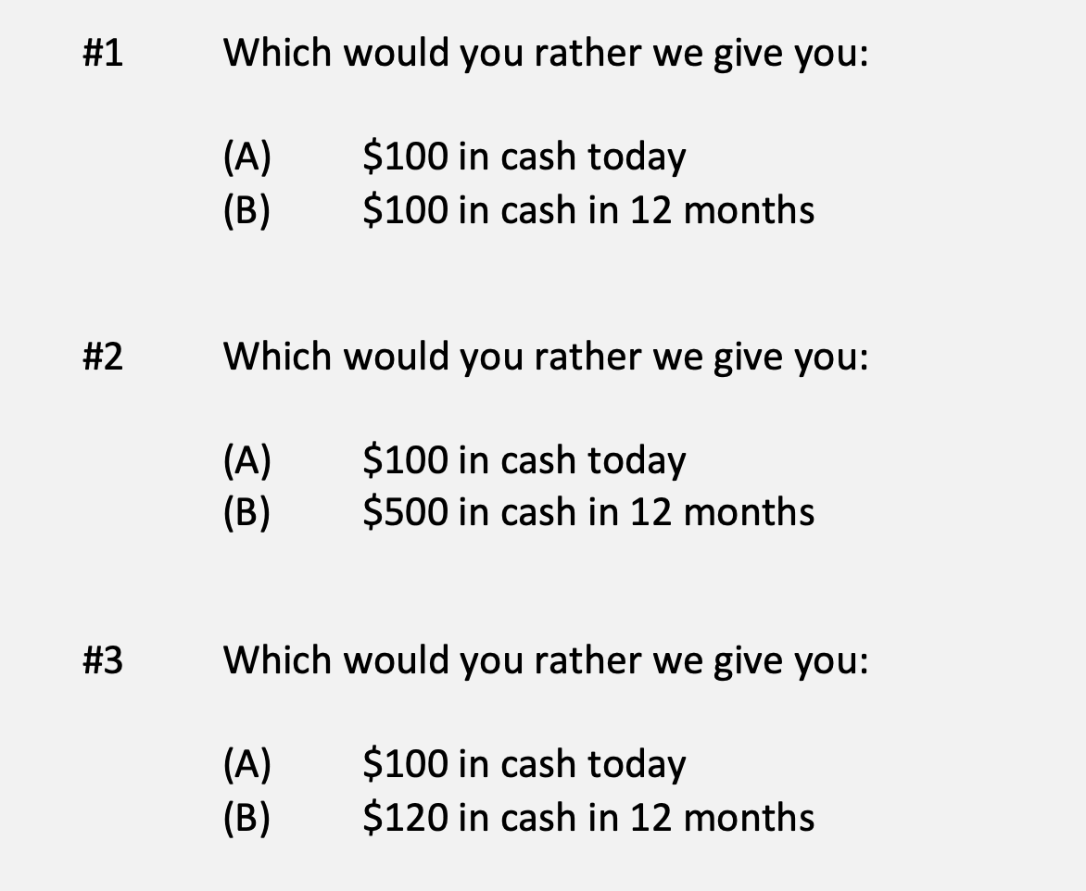
A Few Rules About INVESTING
Investing is about Trade-Offs. Using money today to get (hopefully more) money in the future:

Slide 142
A Few Rules About INVESTING
Risk matters. Know your risk tolerance.
Goals matter. Be intentional about what you are saving for.
  Maybe create 3-5 different investment accounts for different goals.
  This is what I do – I’ll show you why in a bit.
Transaction costs matter. You can pay a lot of fees for not much benefit or service. Be careful.
Experts rarely have tips or secrets. Investing is about predicting the future, and none of us can predict the future (perfectly). Be careful.
  If there really were sure-things or get-rich-quick schemes, the experts would be using them themselves, not sharing them with you.
Communicate with your family. Achieving goals is a family affair.

Slide 143
A Few Rules About INVESTING
Investing lets COMPOUND INTEREST be your friend.
  With compound interest, your interest earns interest.
  Without actively making decisions, your money can grow exponentially.
  Yes, there is risk – the exponential growth rate could be negative.
  Such risk is greatest if you ‘invest’ over very short periods of time.
  Historically, over the past 100+ years, if you invest for 5+ years, you have benefited from positive exponential growth.
  The average return of a common stock over the past 100 years is 10%.
    The word ’average’ is very important here. But, the good news, we can all achieve ‘average’ returns relatively easily (though they may not be 10% in the future)

Slide 144
A Few Rules About INVESTING
Investing lets COMPOUND INTEREST be your friend.
  Invest $100 at 10% interest or growth:
  Year 1: $100 x (1 + 10%) = $110
  Year 2: $110 x (1 + 10%) = $121
  $100 x (1 + 10%)² = $121
  Year 1: $10 of interest
  Year 2: $10 of interest on your original $100
  + $1 of interest on year 1 interest

Slide 145
Timing Matters
We could tell similar stories about ups-and-downs for Bitcoin, Tesla, Dogecoin, AMC, Viacom and many other investments
It is very, very, very, very, very, very, very, very, very, very, difficult to consistently have perfect timing when making investments
  People who research this phenomenon for a living will tell you it’s impossible
Do you think you’re unique and that you will be able to consistently time the market so you gain from the up moves and never lose from the down moves?

Slide 146
Expertise Matters
Take a minute to think about the following question:
What do YOU do better than 99.9% of humanity?
Think about what you’re studying. Think about what you’ve been working on for years. Think about what you know that I do not know.
I’ve probably only spent 1-2 hours studying what you have dedicated your life to studying and becoming an expert in.
  Could I do your job as well as you do it?

Slide 147
Expertise Matters
Of course, I couldn’t do your job as well as you.
Now connect this logic to investing: there are many professionals who have dedicated their lives to making investments. They are good.
  Yes, there are many amateurs involved in trading stocks – but they (usually) account for a very minor portion of the total money invested.
Remind yourself of this old gambling maxim:
When you are sitting at the poker or gambling table, take a look around and see if you can figure out who the sucker is. If you cannot identify who the sucker is, then the sucker is probably you.

Slide 148
Isn’t this a lot like what you do with your education planning?

Slide 149
Determining Your Risk Tolerance
High Risk Attitude
I want to summer in Paris and winter in Hawaii
Medium-High Risk Attitude
I will work through normal retirement age, but I want my spouse to retire early - and we want to visit Paris & Hawaii
Medium-Low Risk Attitude
I want my children to have a college education
Low Risk Attitude
I want food on the table and a roof over my head

Slide 150
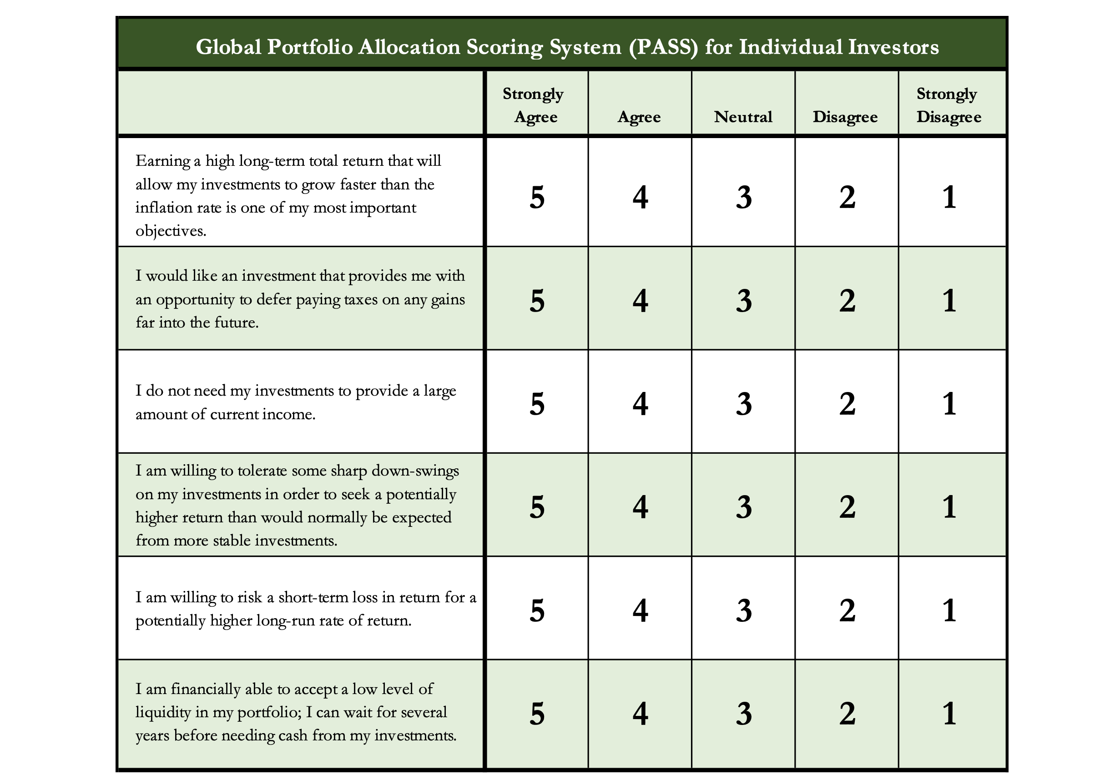
Determining Your Risk Tolerance

Slide 151
Comparing Different Investments

Slide 152
Comparing Different Investments

Slide 153
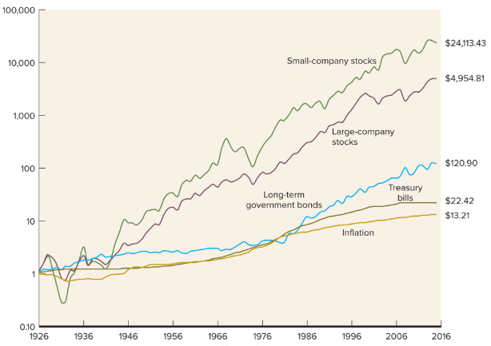
Comparing Different Investments

Slide 154
The Magic of Compound Returns

Slide 155
Owning Your Financial Future
What Are Your Values, Dreams & Goals?
Education
Career
Family
What Is Your Current Situation?
Education
Career
Family
Financial
Create a Personal Financial Plan for You:
Investing
Budgeting
Debt Management
Taxes
Insurance
Retirement
Education
Family
Business Planning
Estate Planning
Philanthropy

Slide 156
Isn’t this a lot like what you do with your education planning?

Slide 157
Long-Term Investment Planning
FINANCIAL GOALS
YOU,
as college students, are better wired and equipped to make long-term plans – education, career, financial & otherwise – than 99% of humanity.
Be confident.
Be intentional.
Be diligent.
Be awesome.
EDUCATION GOALS
INVESTMENT STRATEGIES
EDUCATION STRATEGIES
Identify Your Risk Tolerance & Priorities
Identify Your Risk Tolerance & Priorities
Identify Your Time Horizons
Identify Your Time Horizons
Select Investments
Select Your Field, Program, Specialization, Thesis
Monitor & Modify Investments
Monitor & Modify Your Progress & Plan

Slide 158
Owning Your Financial Future
YOUR VALUES
YOUR GOALS
Education
Career
Family
FINANCIAL STRATEGIES
Investing
Income & Expense Management
Debt Management
Taxes, Insurance & Other

Slide 159
What is INVESTING?
Investing is saving for the future.
We typically think of investing as long-term – anywhere from 1 or 2 years all the way through retirement.
Saving vs. Investing
  Saving can be short-term, Investing is typically long-term.
  Saving is passive, Investing is dedicated…it could be relatively passive or extremely active.
    Passive: Mutual funds. Extremely Active: Owning an apartment complex.
  Saving is typically very low risk, Investing generally has more risk.
  Saving provides low returns on investment (currently about 0.0%)
  Inflation is risky…You can lose 100% or realize huge positive returns.

Slide 160
What Is Your Investing Goal?
Take a few seconds to ask yourself:
Why Are You Investing?
What are your investing goals?
To buy a house?
To buy a car?
To pay off debt?
To retire?

Slide 161
A Few Rules About INVESTING
Investing is about Trade-Offs. Using money today to get (hopefully more) money in the future:

Slide 162
A Few Rules About INVESTING
Risk matters. Know your risk tolerance.
Goals matter. Be intentional about what you are saving for.
  Maybe create 3-5 different investment accounts for different goals.
  This is what I do – I’ll show you why in a bit.
Transaction costs matter. You can pay a lot of fees for not much benefit or service. Be careful.
Experts rarely have tips or secrets. Investing is about predicting the future, and none of us can predict the future (perfectly). Be careful.
  If there really were sure-things or get-rich-quick schemes, the experts would be using them themselves, not sharing them with you.
Communicate with your family. Achieving goals is a family affair.

Slide 163
A Few Rules About INVESTING
Investing lets COMPOUND INTEREST be your friend.
  With compound interest, your interest earns interest.
  Without actively making decisions, your money can grow exponentially.
  Yes, there is risk – the exponential growth rate could be negative.
  Such risk is greatest if you ‘invest’ over very short periods of time.
  Historically, over the past 100+ years, if you invest for 5+ years, you have benefited from positive exponential growth.
  The average return of a common stock over the past 100 years is 10%.
    The word ’average’ is very important here. But, the good news, we can all achieve ‘average’ returns relatively easily (though they may not be 10% in the future)

Slide 164
A Few Rules About INVESTING
Investing lets COMPOUND INTEREST be your friend.
  Invest $100 at 10% interest or growth:
  Year 1: $100 x (1 + 10%) = $110
  Year 2: $110 x (1 + 10%) = $121
  $100 x (1 + 10%)² = $121
  Year 1: $10 of interest
  Year 2: $10 of interest on your original $100
  + $1 of interest on year 1 interest

Slide 165
Timing Matters
We could tell similar stories about ups-and-downs for Bitcoin, Tesla, Dogecoin, AMC, Viacom and many other investments
It is very, very, very, very, very, very, very, very, very, very, difficult to consistently have perfect timing when making investments
  People who research this phenomenon for a living will tell you it’s impossible
Do you think you’re unique and that you will be able to consistently time the market so you gain from the up moves and never lose from the down moves?

Slide 166
Expertise Matters
Take a minute to think about the following question:
What do YOU do better than 99.9% of humanity?
Think about what you’re studying. Think about what you’ve been working on for years. Think about what you know that I do not know.
I’ve probably only spent 1-2 hours studying what you have dedicated your life to studying and becoming an expert in.
  Could I do your job as well as you do it?

Slide 167
Expertise Matters
Of course, I couldn’t do your job as well as you.
Now connect this logic to investing: there are many professionals who have dedicated their lives to making investments. They are good.
  Yes, there are many amateurs involved in trading stocks – but they (usually) account for a very minor portion of the total money invested.
Remind yourself of this old gambling maxim:
When you are sitting at the poker or gambling table, take a look around and see if you can figure out who the sucker is. If you cannot identify who the sucker is, then the sucker is probably you.

Slide 168
Isn’t this a lot like what you do with your education planning?

Slide 169
Determining Your Risk Tolerance
High Risk Attitude
I want to summer in Paris and winter in Hawaii
Medium-High Risk Attitude
I will work through normal retirement age, but I want my spouse to retire early - and we want to visit Paris & Hawaii
Medium-Low Risk Attitude
I want my children to have a college education
Low Risk Attitude
I want food on the table and a roof over my head

Slide 170
Determining Your Risk Tolerance

Slide 171
Comparing Different Investments

Slide 172
Comparing Different Investments

Slide 173
Comparing Different Investments

Slide 174
The Magic of Compound Returns

Slide 175
The Magic of Compound Returns

Slide 176
The Magic of Compound Returns
Quiz Question on Compound Returns:
Under which of the following scenarios will you have more money saved when you turn 65?
Investing $100 per month from age 25-35 (and then nothing from 35-65)
With an 8% return, you will have $185,000 accumulated at 65.
Investing $100 per month from age 35-65 (but nothing from 25-35)
With an 8% return, you will have $150,000 accumulated at 65.
Note: If the returns on your investments are less than 6%, (B) will lead to greater wealth.
There’s a similar but different problem on page 37 of your handbook.

Slide 177
The Magic of Compound Returns
Quiz Question on Compound Returns:
Under which of the following scenarios will you have more money saved when you turn 65?
Investing $100 per month from age 25-35 (and then nothing from 35-65)
With an 8% return, you will have $185,000 accumulated at 65.
Investing $100 per month from age 35-65 (but nothing from 25-35)
With an 8% return, you will have $150,000 accumulated at 65.
Note: If the returns on your investments are less than 6%, (B) will lead to greater wealth.
There’s a similar but different problem on page 37 of your handbook.

Slide 178
Review: A Few Rules About INVESTING
Investing lets COMPOUND INTEREST be your friend.
  With compound interest, your interest earns interest.
  Without actively making decisions, your money can grow exponentially.
  Yes, there is risk – the exponential growth rate could be negative.
  Such risk is greatest if you ‘invest’ over very short periods of time.
  Historically, over the past 100+ years, if you invest for 5+ years, you have benefited from positive exponential growth.
  The average return of a common stock over the past 100 years is 10%.
    The word ’average’ is very important here. But, the good news, we can all achieve ‘average’ returns relatively easily (though they may not be 10% in the future)

Slide 179
Review: A Few Rules About INVESTING
Investing lets COMPOUND INTEREST be your friend.
  With compound interest, your interest earns interest.
  Without actively making decisions, your money can grow exponentially.
  Yes, there is risk – the exponential growth rate could be negative.
  Such risk is greatest if you ‘invest’ over very short periods of time.
  Historically, over the past 100+ years, if you invest for 5+ years, you have benefited from positive exponential growth.
  The average return of a common stock over the past 100 years is 10%.
    The word ’average’ is very important here. But, the good news, we can all achieve ‘average’ returns relatively easily (though they may not be 10% in the future)
Not to be too esoteric or philosophical…
But compound interest doesn’t just apply to investing.
Compound interest applies to all aspects of college life:
Time Management
Mental Health
Health Management
Writing Skills
Relationships
And…Of course, Money Management

Slide 180
Investing – Some Perspective
I am biased because I am a finance professor. I study investing and I teach investing. My perspective on risk may be meaningless to you.
Do not take my advice on what level of risk you should take. Be thoughtful, be prudent.
Avoid doing things that you know are stupid and that you know will cause you stress.
But don’t be afraid of taking risks just because they scare you. You have already taken many, many risks in your life. Taking informed and measured risks will continue to open many doors and opportunities for you – in both your personal and financial lives.

Slide 181
A Few Opening Morals
SAVINGS
INVESTING
OWNERSHIP
WEALTH

Slide 182
Common Questions about Investing & Saving
How can I save when my income is so low as a student?
My problem isn’t budgeting but it’s having too little income.
Your short-term priorities while in grad school need to be your education, your family and your mental health.
Maybe saving cannot be a priority for you while you’re in school.
The goal is to develop habits and a mindset that will prepare you to maximize the benefits of saving when your income allows you to do so. Be patient. The benefits of good habits will grow exponentially.

Slide 183
Common Questions about Investing & Saving
How can I save when my income is so low as a student?
My problem isn’t budgeting but it’s having too little income.
And think of ways to generate more money: gigs, internships, tutor, lab assistant, freelance positions, blogger, podcasts, consulting
  Create new jobs for yourself: maybe sell your skills in social media marketing
  to a company you want to work for, regardless of your program
A lot of the advice we think of in budgeting is about “reducing expenses.”
And that’s because we generally have more control over our expenses than we do over our income, at least in the short-term. Do what you can.
  And, decreasing expenses can feel like an increase income. Same same.

Slide 184
Common Questions about Investing & Saving
How much of my income should I be saving each month?
Only you can answer this. Nobody can answer it for you.
It depends on:
  What your goals are, both short- and medium-term.
  What your immediate expenses are.
I frequently advise students to save $25 of every paycheck as soon as they receive each paycheck. Save or set aside as much as you can.
  When I was getting my Master degree, I had no income. I was living off a little savings and a lot of debt. But I intentionally saved $10 to $25 on the first day of each month…simply to develop the habit.
  In school, the habit is more important than the amount.

Slide 185
Common Questions about Investing & Saving
How much of my income should I be saving each month?
My challenge to you:
Take $10 of every paycheck and move it into a savings account.
If you can save more, do it.
But at a minimum, save $10 of every paycheck to develop the habit.
My advanced challenge to you:
Take half of what you save each month and invest it in the stock market.

Slide 186
Common Questions about Investing & Saving
How do I save for a big purchase – house, car, etc…?
Stary by asking yourself a few questions:
  How much do I need to save?
  When am I going to make this purchase?
  Is this essential or discretionary? (A refrigerator or car vs. a vacation)
These questions will help identify timing and priority.
  Knowing timing & priority will help determine how you save.
    Do you use a bank savings account or do you have time to invest in the stock market?

Slide 187
Common Questions about Investing & Saving
How do I save for a big purchase – house, car, etc…?
I would explicitly allocate some of my monthly
savings to this purchase.
  I have already penciled in my holiday gift purchases –
  even though I won’t make them for 2 months.
We will talk about my 5 buckets for saving-
investing in a few slides.
If it’s a really big purchase (e.g. house), you
could even set up a dedicated saving or
investing account just for that purchase.

Slide 188
Common Questions about Investing & Saving
How do I save for a big purchase – house, car, etc…?
I would explicitly allocate some of my monthly
savings to this purchase.
  I have already penciled in my holiday gift purchases –
  even though I won’t make them for 2 months.
We will talk about my 5 buckets for saving-
investing in a few slides.
If it’s a really big purchase (e.g. house), you
could even set up a dedicated saving or
investing account just for that purchase.
These budgeting templates are in the handbook on pages 24-25.
You can download them from the MCOBA website, search for “Personal Financial Planning.”
Or you can email me and I will send them to you.

Slide 189
Common Questions about Investing & Saving
How much of my income should I be investing each month?
Again, only you can answer this. Nobody can answer this for you.
Your goals, values and resources are unique to you…and only you.
You may read reports about how much you should have saved by a certain age or whatever.
  It’s okay to read those, but be sure to put them into your own perspective.
  Those articles do not know what your goals are, do not know that you are in graduate school and do not know what your future plans are.
  It is important to have a plan – but it is critical that that plan is unique to you and your situation.

Slide 190
Common Questions about Investing & Saving
What is a useful way to use different accounts to achieve different goals?
Me? I have 4-5 bank and investing accounts.
A basic checking & transactions account. My paycheck is deposited here. And all bills are paid out of this account.
A savings account. This is dedicated to short-to-medium term goals, such as paying down debt or paying for a vacation.
An investment account. This is dedicated to long term goals, such as buying a house, children’s education or even retirement.
And 2 retirement accounts: 1 through work and 1 that I manage outside of my work retirement account.

Slide 191

Common Questions about Investing & Saving
Contribution from ULL
Paycheck
Work Retirement Plan
Bills
Transfer from Savings
Independent Retirement Plan
Short & Medium- Term Goals (0-5 Years)
Long-Term Goals
(5+ Years)

Slide 192
Common Questions about Investing & Saving
What is a useful way to use different accounts to achieve different goals?
I have 4-5 bank and investing accounts.
Why does this work?
Research has found that humans engage in “mental budgeting.”
Imagine that you have $10,000.
You might manage (or spend) this $10,000 differently if you have it one account for “My Money” versus having $2,000 in a
checking account + $8,000 in different savings & investment accounts.

Slide 193
Common Questions about Investing & Saving
Why does this work?
Because it allows me to align different goals with different accounts.
Checking & Transaction Account
No risk,
0.0% return,
all cash
Short-to-Medium Term Goals
Some risk,
0-3% return goals,
cash + savings
Long-Term
Goals
Some Risk,
3-7% return goals,
savings + investments
Retirement
Accounts
Lots of risk,
8-12% return goals,
all investments

Slide 194
Isn’t this a lot like what you do with your education planning?

Slide 195
Some Parting Words
Nothing in finance is free. Do not think some institution is giving you a super deal just because they like you. There will be costs.
Investment companies work really hard to get your money. They hire psychologists to figure out how to get you addicted to your products. Your money pays for their commercials, buildings, fancy cars and vacation homes.
I check my bank, savings & investment accounts daily. I do not make changes daily (or even monthly). I just don’t want any surprises.

Slide 196
Some Parting Words
If you ever invest based on personal relationships, be prepared for losses.
Nobody – NOBODY – can predict the future. And investing is all about predicting the future. Be careful about thinking you can predict the future. Make sure your investments align with your goals.
Be your own boss. Take control of your money and your investments. Nobody else is going to do it for you. Own your financial future.

Slide 197
Brian Bolton
Professor of Finance brian.bolton@louisiana.edu

